Slide 1
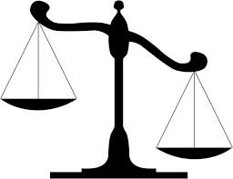
WALT: What best explains why women won the vote?
1872 <-> 1918
WSPU
NUWSS

Slide 2
WALT: What best explains why women won the vote?
4 | Remembered and Described the reasons why women won the vote. Described some of the main causes for women winning the vote.
5 | Started to explain the reasons why women won the vote. Explained in your conclusion why one cause was in your opinion more important than the others.
6 | Explained in depth the reasons for women winning the vote. Started to analyse the events in the story of the women's suffrage Reached a supported conclusion explaining your choice of the most important causes using some knowledge and understanding.
7 | Explained the reasons for the women winning the vote consistently Fully analysed the events leading to women winning the vote and linked this analysis to your argument and conclusion. Reached an evaluated and supported conclusion to the question supported by clear and consistent argument, analysis and evidence.

Slide 3
Causes
At the time, the Suffragettes caused a lot of anger and it has been argued that they lost support for the cause. Certainly, women had not been given the vote by 1914, even after a lot of Suffragette violence. However, some historians argue that, although they could not be seen to give in to Suffragette violence, politicians could not face a return to Suffragette violence after the war, and that is why they gave women the vote.
Some historians argue that the long-term persuasion of the Suffragists won the vote. In 1916, Lloyd George, who supported women's suffrage, replaced Asquith as prime minister, and many pro-suffrage MPs who had been young men before 1914 now held influential places in the government. So the women won by patient persuasion, after all.

Slide 4
Writing Frame
In my opinion, the most important reason why women won the vote was…
This was a very important reason because …
Another reason why the was …
This was also very important because …
There were several other reasons why the Women won the vote including;
Probably the least important reason why was
This is less important because
In conclusion the women won the vote because … I believe this because…

Slide 5
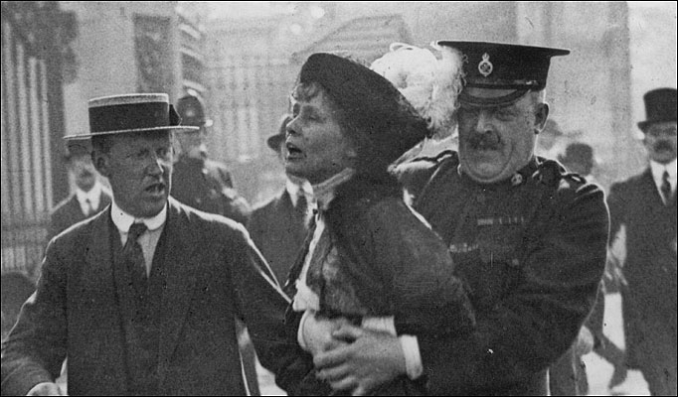

Slide 6
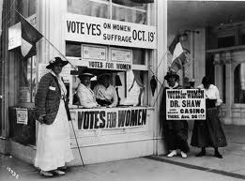

Slide 7
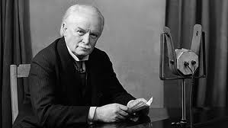

Slide 8
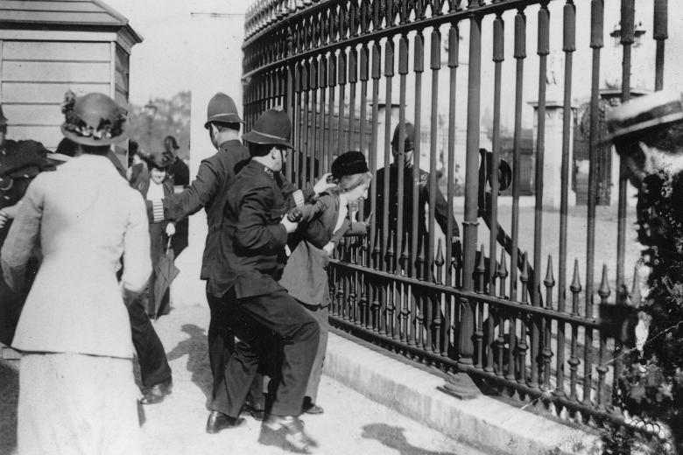

Slide 9
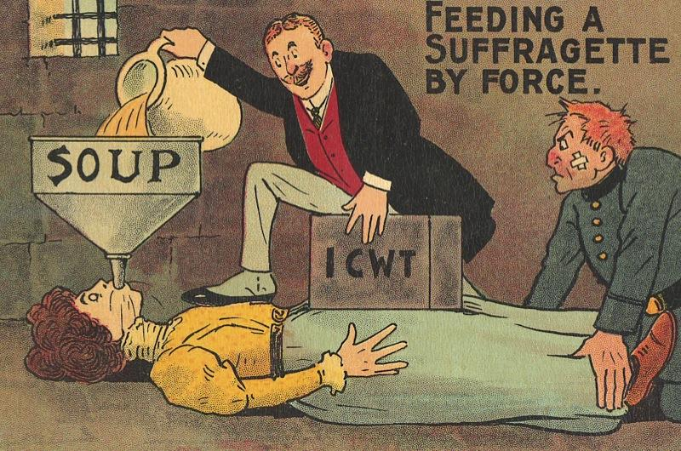

Slide 10
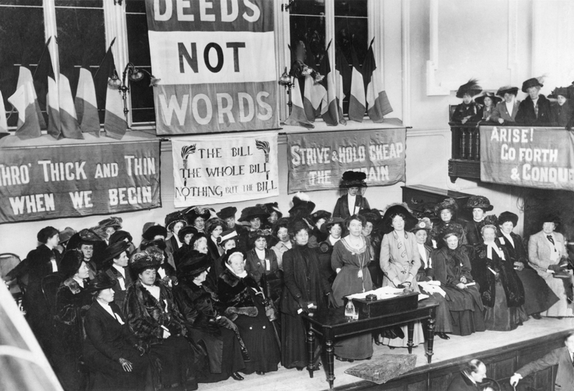

Slide 11
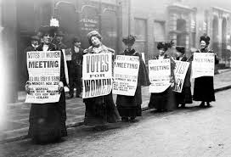
Source A – Importance of Sylvia Pankhurst
In June 1914, she famously took a delegation of working class women to lobby Prime Minister Asquith who did not think that working class women were intelligent enough to have the vote. This proved to Asquith that working class women were intelligent enough to vote.
Source B – Importance of the NUWSS
The NUWSS was established in 1897 by Millicent Fawcett and its members were known as Suffragists. The NUWSS hoped to persuade politicians to give them the right to vote and undertook a peaceful campaign. Some of their tactics included petitions, distributing leaflets and organised meetings.
They were the first organised group of women to begin campaigning for female suffrage. They were responsible for persuading a number of MPs to back their cause. Fawcett believed that if the organisation was seen to be intelligent, polite and law-abiding then women would prove themselves responsible enough to participate fully in politics.
Source C – Millicent Fawcett (NUWSS) talking about the importance of the WSPU.
“In my opinion, far from having injured the movement, they have done more during the last 12 months to bring it within the region of practical politics than we have been able to accomplish”.
Source D – Historian on the Suffragettes
“After November 1911 the position is much more doubtful. Militancy was becoming more extreme and strong antagonism was being aroused. The public could hardly be expected to approve of arson.”
Source E – Image of Suffragists campaigning in 1900.

