Slide 1
RALLY TABLE –
How do we know they are Rich (Upper Class) or Poor (Working Class)?
WALT:
Why were people angry in the 1800’s…

Slide 2
WALT: WHY were people angry in the 1800’s….
WILFS:
4 – Describe the conditions of the working class (Poor) in 1800…
5 – Explain why the working class (Poor) wanted change in 1800…
6 – Compare the views on the vote of Working Class (poor) and Upper Class (Rich)

Slide 3
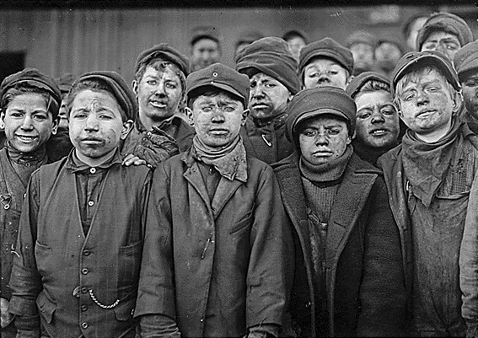
Working class or upper class ?

Slide 4
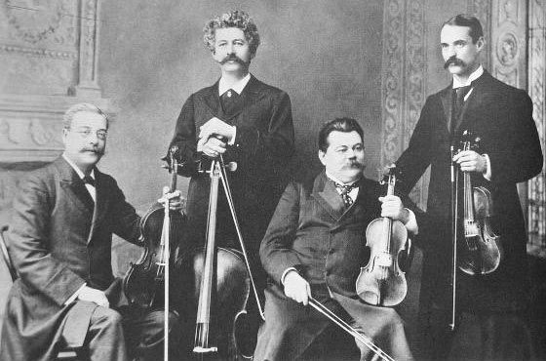
Working class or upper class ?

Slide 5
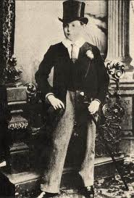
Working class or upper class ?

Slide 6
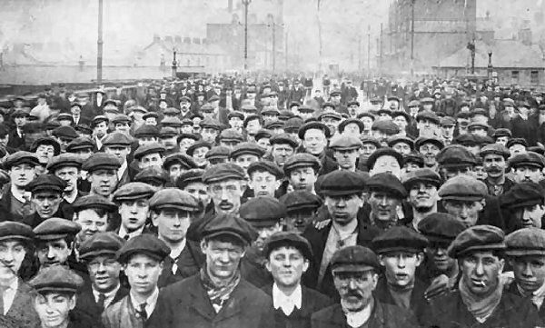
Working class or upper class ?

Slide 7
Why did working class people want the vote in 1800 !? – l4 TASK!
Why did Working Class people want the vote in 1800 … ?
Sorting activity
Sort the problems of the working class into three piles.
ECONOMIC (MONEY) PROBLEMS
SOCIAL (LIVING) PROBLEMS
POLITICAL PROBLEMS
Extension – Write a sentence explaining why they are poor (Working Class) were unhappy..
The working class are unhappy because…
L5

Slide 8
How do you bring about change
You are a working class person.
Make a quick list of what changes would you demand from Parliament and your MP…
THEY ARE THE ONLY PEOPLE THAT CAN SOLVE YOUR PROBLEMS…
THE VOTE

Slide 9
Label the quotes
Label the Quotes – Are they from a Working Class person … Or an Upper Class person…
Remember the Upper Class (Rich) have the vote …
Your Task is to write a newspaper report from the time.
L4 – Describe the conditions of the working class people in 1800…
L5 – Explain why the working class people wanted the Vote in 1800…
Compare the views of the Working Class and Upper Class in 1800
L6

Slide 10
Assess your efforts
Swap Articles with the person sitting OPPOSITE you.
How have they done…
Have they achieved a Level 4, 5 or a 6?
How could they do better?
4 – Describe the conditions of the working class (Poor) in 1800…
5 – Explain why the working class (Poor) wanted change in 1800…
6 – Compare the views on the vote of Working Class (poor) and Upper Class (Rich)

