Slide 1
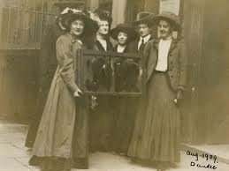
WALT: Decide why the campaign became more violent after 1910?
What’s different / what is the same with these tactics.

Slide 2
WALT: Decide why the campaign became more violent after 1910?
WILFS.
5 – Explain what the suffragettes did.
6 – Compare several sources as evidence of the changes.
7 – Evaluate the Governments Reaction to the tactics.

Slide 3
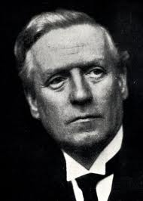
Herbert Henry Asquith

Slide 4
1910
November 1910 was a turning point in the campaign. The Prime Minister promised to change the law so that women had the right to vote.
18 November 1910, 300 women went to Parliament to protest. They were beaten up by police who had been ordered by the government to frighten and humiliate the women. One woman died…
From 1910 the suffragette campaign became more MILITANT. Hundreds would risk a prison sentence.
Street lamps were broken.
Thirteen pictures were hacked in the Manchester Art Gallery.
Houses were set on fire.
Bombs were placed near the Bank of England.

Slide 5
Task – Teach each other.
You now have 3 minutes to become an expert in explaining how the campaign became more violent.
You will need to summarise what your event was in order to teach the rest of your table.
Each person will talk at a time and will have 2m to teach their table.
Must include information and evidence (A quote, a phrase).
Q. Did the suffragettes act on impulse?
Q. Did the suffragettes think carefully about their actions before taking them?

Slide 6
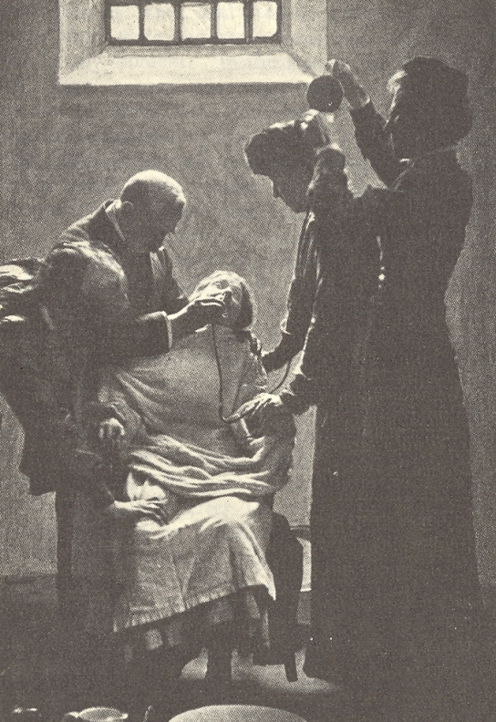
Publicity.
Come up with two captions for this photograph.
One from a suffragette
One from a member of the government opposed to them.
IE: This photo show’s an heroic sister protesting for vote. She is being violently force fed…
IE: This photo show’s a women near death who has had her lived saved by the gallant medical staff.
Forceful, Militant, Warriors, Brave, Sympathy, Righteous, Torture
Peaceful, Necessary, Extreme, Life Saving,

Slide 7
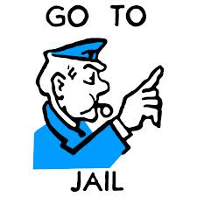
Discuss & List
How would the Government react to the suffragettes increased militancy? This led to more publicity.
Sensible suggestions.
Extreme suggestions.

Slide 8
Question.
Governments banned suffragettes meetings.
Women were not allowed to enter public galleries unless accompanied by a responsible man.
Longer prison sentences.
Forced the Newspapers to portray them negatively.
Force Fed and released those on Hunger Strikes.
How effective do you think the Government’s reactions to the Suffragettes’ campaign. Would it have led to more militancy or less?

Slide 9
Promenade
How did the campaign become more violent after 1910?
What was the Government’s reaction to the increased militancy?

Slide 10
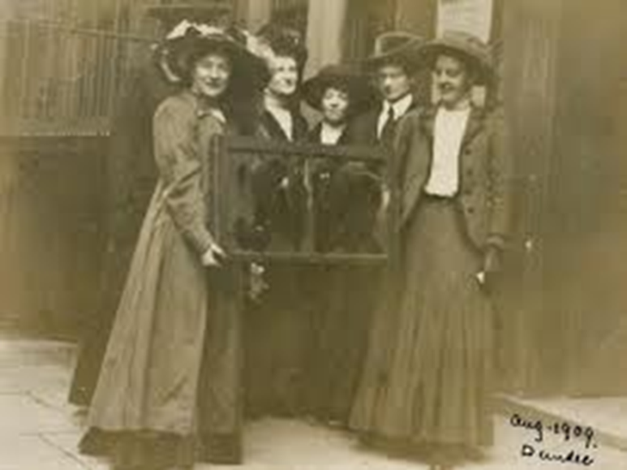
Source A – Window Smashing
“ From 1911 the suffragettes set out on massive window smashing raids. Many of the shops in the West end of London were attacked. On 1 March 1912 Emmeline Pankhurst and others smashed windows in 10 Downing street, the home of the Prime Minister, and on the same day 150 shops were attacked. One elderly woman gave this as her reasons fro becoming more violent: ‘I’ve read everything a great deal has been written, and a great deal has bee said and it’s no good. Something has to be done! I just want to go out into the street and smash, and smash, and smash everything.”

Slide 11
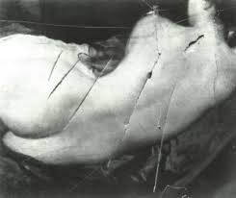
Source B – Picture Slashing
Mary Richardson felt that men valued objects more than they valued giving women the vote. ‘A paining came to mind. Yes, yes, the Venus in the National Gallery. AS the day approached I grew nervous. The hours of hesitation were brought unexpectedly to an end by an announcement in the evening newspaper. “Mrs Pankhurst taken from a meeting in Glasgow.” I went out to spend my last shillings on an axe.’ Mary Richardson slashed the paining seven times.

Slide 12
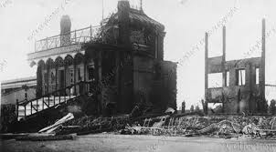
Source C - Arson
“Several Racecourse stands were set on fire. The suffragettes made sure there were no people or animals in these properties. Police often found suffragette leaflets and posters at the scene but rarely managed to arrest a suffragette. Many acts of arson took place in 1913 in protest about Emmeline Pankhurst being arrested.”

Slide 13
Source D – Hunger Strikes
“Because of the increased violence there were many suffragettes in prison. To win sympathy, suffragette prisoners began a mass hunger strike in June 1912”
A woman on a hunger strike would be forcibly fed. The woman would be held down and a tube pushed up her nose. This was extremely painful.

Slide 14
Homework
This will all be on Core and WatHistory.
Write an introduction for the essay…
Write a conclusion based on a comparison of the Suffragettes and Suffragists.
You can write a whole essay if you want to go above and beyond…
There will be information and writing frames to accompany this homework. You will be writing part of an essay.

