Slide 1
WALT: How was the vote won?
RALLY TABLE WHAT YOU ALREADY KNOW ABOUT THE VOTE ?
Elections?
How often?
Who can vote?
Age?
Gender?
Who do you vote for?
Why do you vote?
How do you vote?
What did you come up with, one at time, hands up. Add to your table.

Slide 2
WALT: How was the vote won?
L4 – Describe the voting process…
L5 – Compare 1800 to modern day ?
L6 – Explain what was wrong with the vote in 1800?

Slide 3
Key words
This term will be covering how the vote for all Men & Women came about. This is known as Universal Suffrage, it took until 1929 for MEN & WOMEN (over 21) to get the vote. How did this come about?
TODAYS KEY WORDS – Write these down, come up with your own definitions at the end of the lesson.
Elections -
Votes -
Democracy -

Slide 4
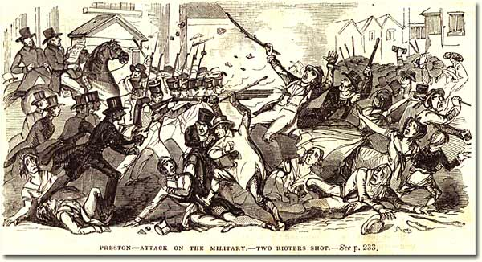
How was the vote won ?

Slide 5
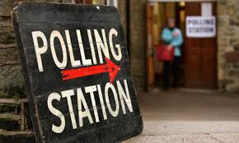
POLLING STATION

Slide 6
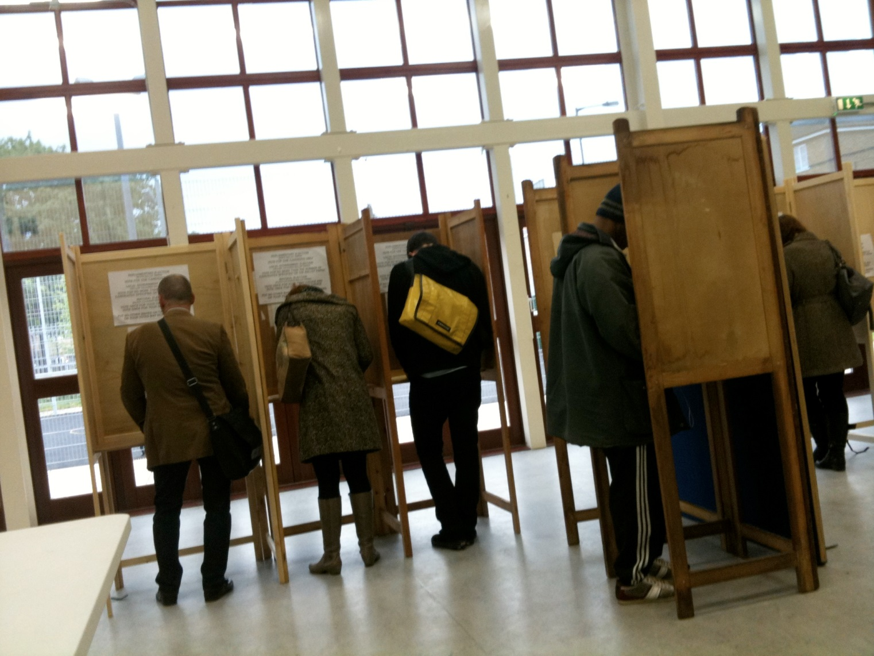
CAST YOUR VOTE

Slide 7
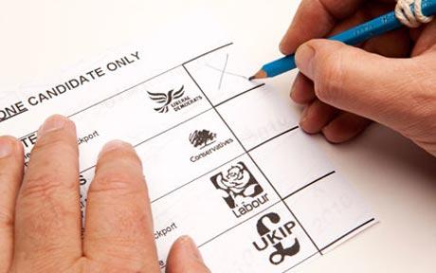
VOTE

Slide 8
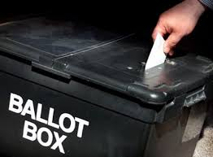
BALLOT BOX

Slide 9
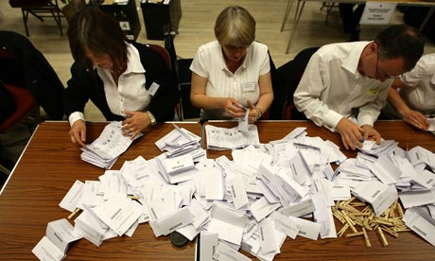
COUNT

Slide 10
An Election
Elections are held every 5 years in the United Kingdom.
What is an Election? – An ORGANISED CHOICE by VOTE for a political office
Now cast your vote, in private. This is known as a BALLOT. Fold the paper in two and drop it into the Box.
Write up your own definition, while we count the votes.
WHO WILL BE HEAD TEACHER | MARK WITH AN (X)
Mr Murphy
Mr Watkins
???

Slide 11
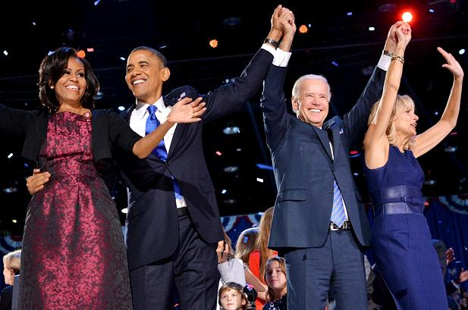
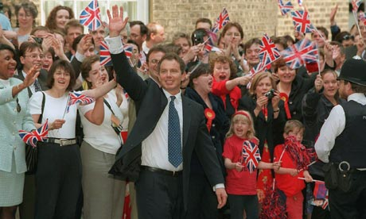
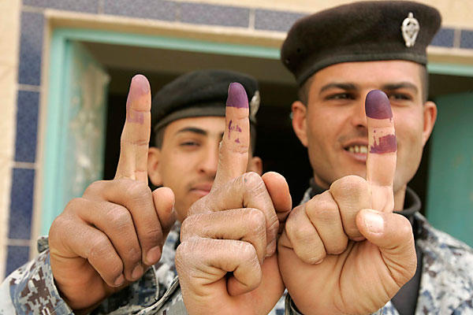
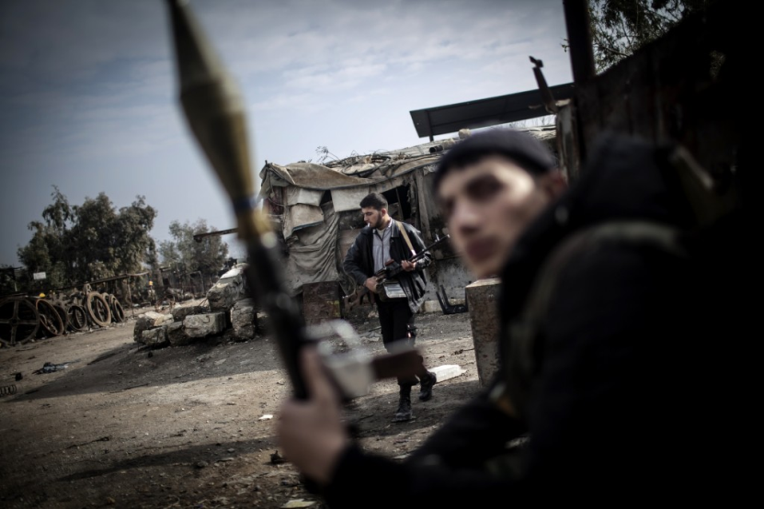
WHATS THIS ?

Slide 12
1800’s
Unfortunately none of us in the room would have been able to vote in 1800.
Politics in 1800 | Politics today | Changed or stayed the same?
Nobody under 21 could vote. | Everyone over 18 can vote.
Women could not vote. | Everyone can vote.
Voting was not in secret. | Voting is done in secret.
General elections were held at least every seven years. | General elections are held at least every five years.
Constituencies were different sizes. | There are 651 constituencies of nearly equal size.
Some constituencies sent 2 MPs to Parliament. | Each constituency sends one MP to Parliament.
MPs were not paid a salary. | MPs are paid a salary.

Slide 13
1800 Vote
In 1800, nobody under 21 could vote. Fewer than 5% of the population had this political right.
Most of the new cities and towns had no MP to represent them.
Voting was open. There was no secret ballot, so it was possible to pay a voter to vote. Sometimes voters were frightened into voting for a particular candidate.
The country was divided into constituencies made up of counties and boroughs. The seats were unevenly distributed. There were some boroughs where nobody lived or where there were only a few voters. These were called rotten boroughs.
In many constituencies, there was only one candidate for voters to choose from.
MPs in Parliament were not paid a salary, so they had to have enough money to support themselves.
Parliament was made up of the House of Commons and the House of Lords. The king chose the Prime Minister, but increasingly the Prime Minister and his Cabinet made the decisions of government.
Elections were held at least once every seven years.
No women were allowed to vote.

Slide 14
TASK
Write down 5 changes to elections and the vote that have occurred between 1800 and today ?
OR Answer the following in detail.
“How have elections changed between 1800 and modern day?”
L4 – Describe the voting process…
L5 – Compare 1800 to modern day ?
L6 – Explain what was wrong with the vote in 1800?
EXTENSION QUESTION: Why are elections important?

Slide 15
Task
Discuss for 30 seconds with your shoulder partner the definitions for the following – Write them down.
Elections -
Votes -
Democracy -

