Slide 1
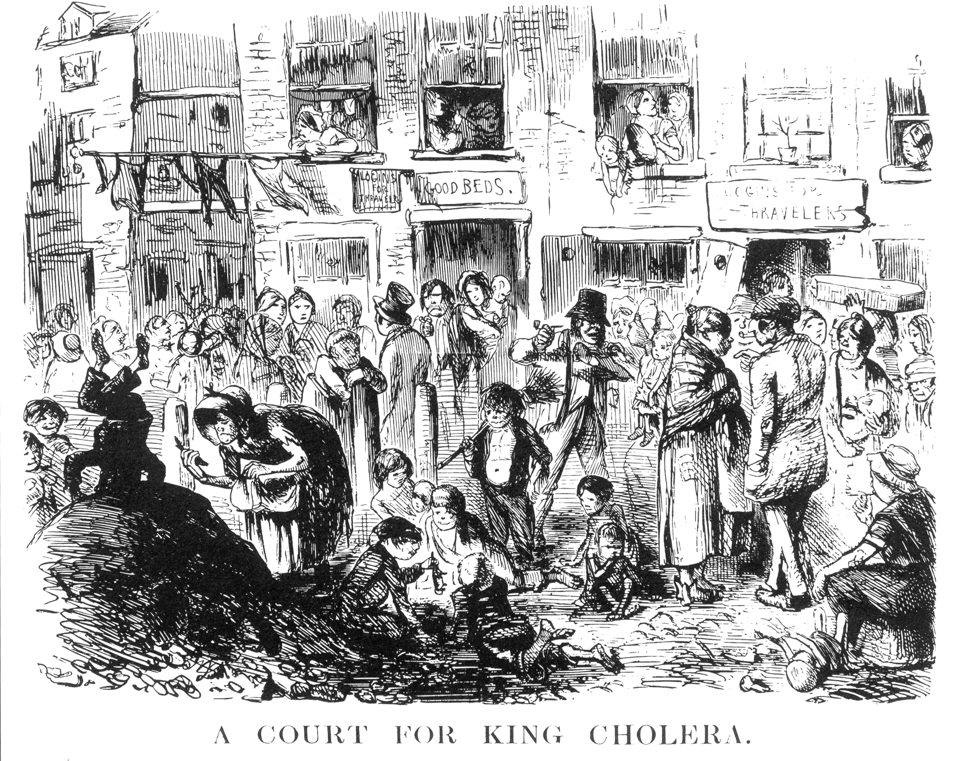
What did People think caused disease at the start of the 19th Century?

Slide 2
WALT: WHO WAS ROBERT KOCH
What did People think caused disease at the start of the 19th Century?
Miasma – Bad air, poisonous fumes were given off …
Contagion – Being close to someone who had a disease…
God – People still saw disease as a punishment from God
Spontaneous Generation – Decay creates germs…

Slide 3
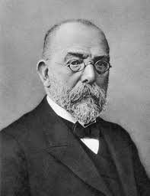
WALT: WHO WAS ROBERT KOCH ?
WILFS:
C – Describe Robert Koch contribution.
B – What factors combined to help Robert Koch
A – Evaluate Robert Koch’s significance.

Slide 4
WALT: Who was Robert koch
How important was Louis Pasteur & Edward Jenner to developing medical understand of the causes and cures of disease.
RALLY TABLE – What you know about Pasteur and Jenner.
EXT: How could Robert Koch develop & build upon the work of Jenner and Pasteur?

Slide 5
Find the Information
Online Treasure Hunt.
Download the worksheet from WatHistory. I have given you the Greatest achievements of Pasteur and Jenner. Use the clues below to find Koch’s achievements… Open up a new tab and WatHistory to help. The information is on different pages.
1. I’m the virgin Queen of England…
2. CLUE >> I’m not the Top Tunnel or the Lower Channel
3. Willy the first..
4. Wirtschaft – Google me…
5. ZzzzzzZzzzzZzzzz
6. Stephenson, Tull, Arkwright, Marx – Key Figures of what?
COPY AND PASTE THE KEY INFORMATION

Slide 6
In your own words…
What contribution did Robert Koch make to medicine?
Use the information sheet to answer the Question above.
Post your answer onto the Year 10 Blog...
Use the PPT found here to assist you…
http://www.educationforum.co.uk/kochlesson.htm

Slide 7
task
On the sticker provided… Write a summary of Koch’s contribution.
Pass it to another student and get them to stick it in their books...
YOU ARE RESPONSIBLE FOR THEIR LEARNING?

