Slide 1
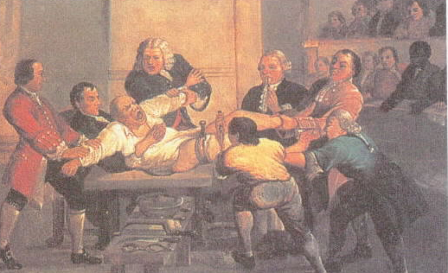
TASK – Surgery.
With your Study Buddy.
Discuss what is going on in this image.
When was it painted?
What does it show?
How would he feel?
Why is Pain a problem in Surgery?

Slide 2
WALT – What were the anaesthetics breakthroughs in the 19th Century ?
WILFS:
C – Describe the breakthroughs in Anaesthetics during the 19th Century.
B – Explain the benefits and negatives of each Anaesthetic …
A – Evaluate which and why it was the most important.

Slide 3
Ether.
1842: Crawford W Long (America) used ether as an anaesthetic while operating on a neck tumour (but did not publish details of his operation).
Ether is a colourless liquid which causes unconsciousness.
Ether began being used as a medical treatment in 1794, and had a reputation as a recreational drug in the 1800s.
From the 1840s ‘ether frolics’ involved the inhalation of ether at parties, which were often held by medical students. The use of ether specifically as an anaesthetic in dental and surgical procedures began in the 1840s.
Its history was marked by bitter quarrels over who had first begun to use it this way. The Boston dentist William Morton was particularly active in attempting to patent its use.
Ether drinking was common was particularly popular in Ireland, where the Catholic Church promoted abstinence from alcohol.
.
The British government had worked hard to prevent the illegal distillation of alcohol, but ether was a legal substitute. Like alcohol, it was sold in pubs. It was also available from shops, and groups of women would hold ether parties in their houses.

Slide 4
Nitrous Oxide.
1845: Horace Wells (America) tried unsuccessfully to demonstrate that laughing gas would allow him to extract a tooth painlessly.
In 1799 nitrous oxide was first used by Sir Humphry Davy.
It was not used for surgery as its effects were unreliable, but in the early 1800s it became popular with dentists who used it to prevent pain during extraction.
It was also used as a recreational drug at parties - often by doctors.
Quite often… It didn’t work.

Slide 5
Ether.
1846: Dr JC Warren (America) removed a tumour from the neck of Gilbert Abbott using ether.
The first gas anaesthetic to be used in Western surgery was ether.
William Morton, a Boston dentist, demonstrated its usefulness in an 1846 operation.
It rendered the patient unconscious, allowing surgeons to perform more complicated surgery.
Unfortunately ether was flammable and irritated the lungs, so a replacement was sought.

Slide 6
Ether.
1846: Robert Liston (Britain) removed a leg using ether - 'this Yankee dodge'.

Slide 7
Chloroform.
1847: James Simpson (Britain) discovered chloroform.
Chloroform is a colourless liquid.
Inhaling vapours from chloroform can cause dizziness, sleepiness and unconsciousness.
It was first used as an anaesthetic by the Edinburgh obstetrician James Young Simpson, experimenting on himself and some friends. He quickly realised its value for reducing the pain of childbirth.
There was some resistance to this use of anaesthesia from within the Church, which insisted the pain of childbirth was ordained by God. However, when Queen Victoria allowed John Snow to use chloroform for the birth of two of her children, in 1853 and 1857, it became a popular choice for the next 50 years.
While chloroform was certainly viewed as an important innovation for anaesthetics in surgery and childbirth, it also gained a rather more sinister reputation, becoming associated with abductions, murders, rapes and robbery. Even the medical profession was not immune from accusations of the misuse of chloroform - doctors were accused of molesting female patients who were under its influence.

Slide 8
Cocaine.
1884: Carl Koller (Germany) discovered that cocaine is a local anaesthetic.

Slide 9
TASK
TASK – With your Study Buddy. Download the Worksheet from
WatHistory.weebly.com
Complete an evaluation form for each breakthrough.

