Slide 1
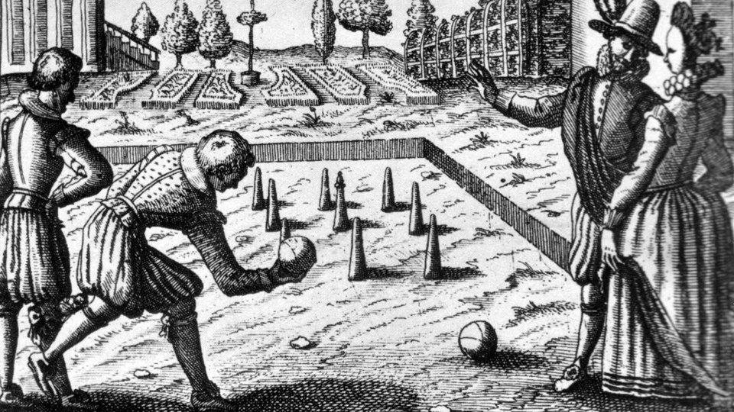
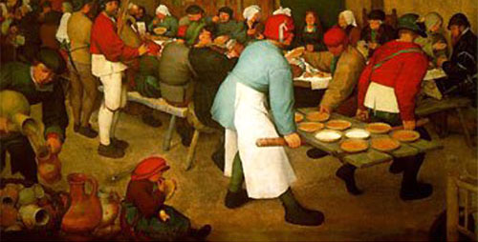
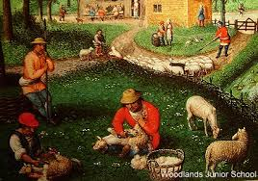
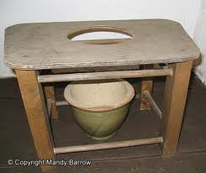
What was life like in Tudor England
What do you think Tudor life was like?
RALLY TABLE YOUR ANSWERS
Walt:

Slide 2
What was life like in Tudor England
WILFS
L4 – Describe life in Tudor England.
L5 – Explain what life was like?
L6 – Compare the differences between Rich & Poor!

Slide 3
Tudor Life
Daily Life
Poverty
Punishment and Torture
Education
Sport and Pastimes
Food
Medicine and Health

Slide 4
Tudor Life
In groups you will be given one information sheet that is about one aspect of Tudor life.
In your group design a poster containing all the information on the sheet using as many pictures, numbers and symbols as you want BUT only 5 written words!
Your information sheet will then be taken off you.
You will then have to present your information to the class.
Everyone will be take notes about what you are teaching them.

Slide 5
Tudor Life
Daily Life, Poverty, Punishment and Torture, Education, Sport and Pastimes, Food, Medicine and Health
Write a diary entry. Who are you, what do you do?
Compare to lives of Rich/Poor?
You must write about ALL aspects of life.

Slide 6
Find the Fiction
Create a Find the Fiction for another table.
Write two correct statements about Tudor Life & one incorrect statement.
Move around the room and test each other. See if you catch people out.
At School, Tudors had often had to speak in Latin.
At School, Tudors were taught Greek.
At School, Tudors were taught Spanish.

Slide 7
Homework.
Write a FactFile or Biography of Elizabeth the First.
What were some of her & the UK’s achievements during her reign.
Homework will be on WatHistory & Core

