Slide 1
Starter – What happened in the Gunpowder plot.
Discuss your homework for two minutes.
Complete the Cartoon of events
I will be collecting your homework as you work.

Slide 2
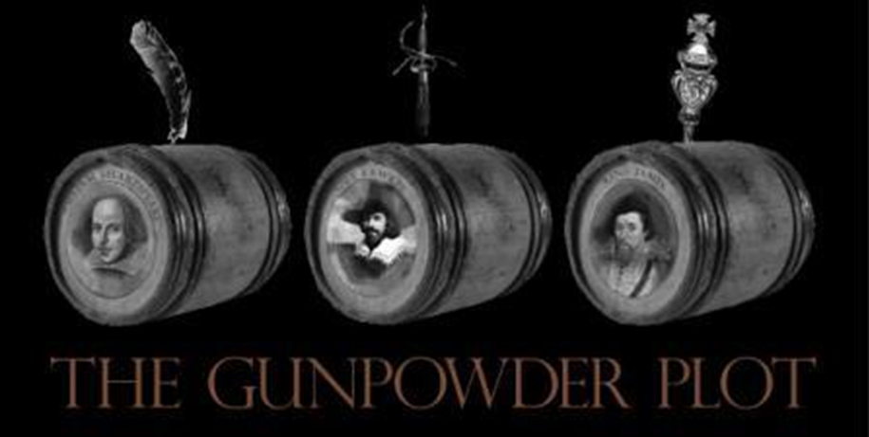
WALT: Were the Plotters framed?
WILFS
4 – You can select sources to write a structured answer.
5 – You can identify the Source most useful to answer the Question.
6 –You can use sources to support a conclusion.

Slide 3
Can you think of any possible motive (reasons) for Historians to question the Gunpowder Plot.

Slide 4
Examine the evidence – Conspiracy?
Step one
Find evidence that the plotters were framed
Find the evidence that the plotters were guilty
Step two
Find a motive for the Gunpowder plotters to be framed
Was there a motive for the Catholics to plan the Gunpowder plot?
Step three
Can we trust the evidence?
Step four
Time to make up your mind, were the plotters framed?

Slide 5
Conspiracy ?
YES Move to the side of the room.
NO

Slide 6
Writing frame - Were the Plotters Framed?
Guy Fawkes and the plotters were Guilty of trying to kill the king because he was caught handed under the House of Parliament with 36 Barrels of gunpowder. They also ………………….
( add some more reasons)
On the other hand there were a number of suspicious circumstances surrounding the plot such as Percey being allowed to hire a cellar under the House of Parliament when he was known to the King and Cecil as being dangerous. It is also suspicious that ……………………………
To conclude I think that……………………………………………………………………
Because……………………………………………………………………………….

Slide 7
Tweet
Tweet about what you have learned about the Gunpowder Plot and whether you think it was a conspiracy or not.
#Conspiracy

