Slide 1
Move around the room with your Key Word Cards.
When I call out a number you will need to make a group of that number.
You will then need to …
Read out your Key Word …
Create a sentence using all of your Key Words.

Slide 2
Q-Q-T
WALT: What happened at Peterloo?
Quiz-Quiz-Trade the Questions…
Ask another Student your Question
Wait for answer.
COACH don’t TELL the answer.
Let them ask you their Question.

Slide 3
WALT: What happened at Peterloo?
4: Describe the events of Peterloo.
5: Explain the importance of Peterloo.
6: Evaluate the importance of Peterloo to the Chartists.

Slide 4
Write down as many things that you can see in the Cartoon coming up.
You will have 60 seconds to write down as many things that you can see in the picture.
Think of the following Questions…
What do you think they are doing?
What do they want?

Slide 5
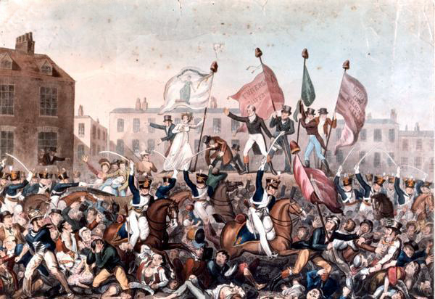

Slide 6
What did you come up.
House
Swords
Horses
Death
Flags
People

Slide 7
PETERLOO
MANCHESTER, 1819
50,000 people arrived to hear Henry Hunt make a speech calling for reform (change) of Parliament.
Government sent the army to prevent any riots
When Hunt began to speak the army tried to arrest him.
They attacked anyone who got in their way.
11 people were killed…400 injured.

Slide 8
Read the Peterloo section on the Handout.
Summarize in 5 words the event of Peterloo.
50,000… PROTEST…REFORM…ARMY…DEATH

Slide 9
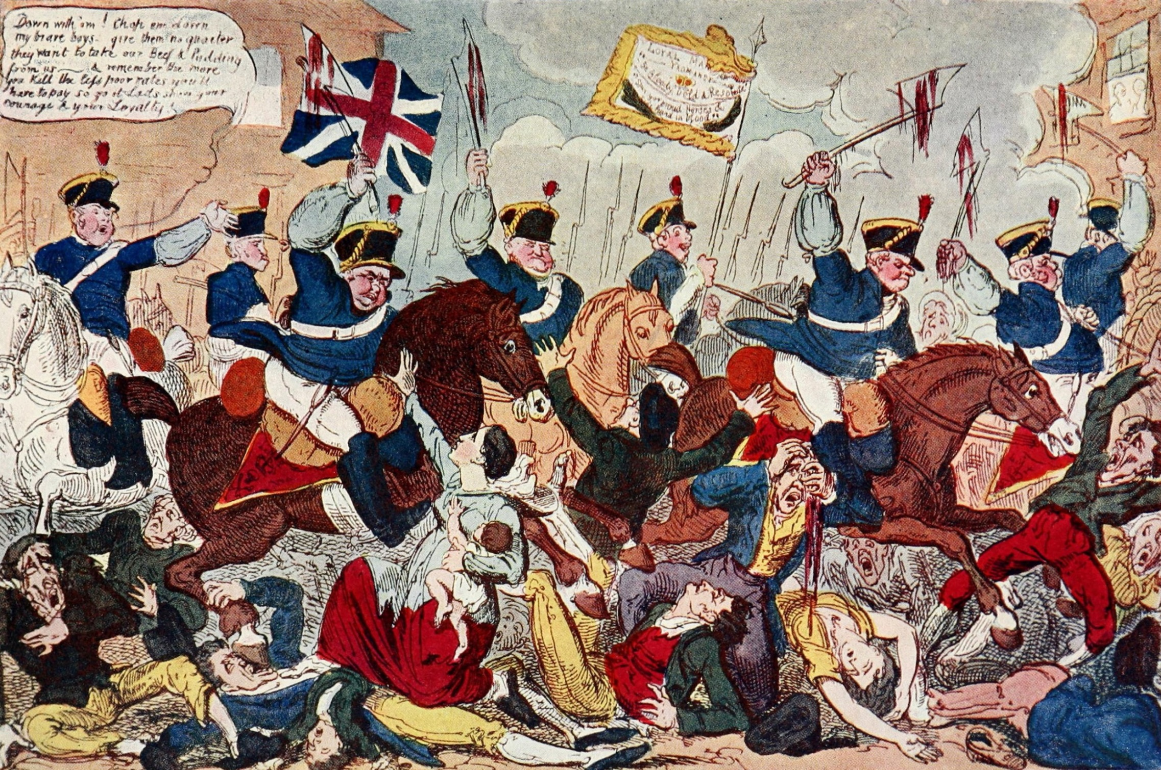
Cartoon from a Working Class paper at the time – 1819 … Remember CAPD
Context … Author … Purpose … Date … What are the potential limitations of this source?

Slide 10
How useful is this source? What are its limitations?
Think Pair Share
Why would you bring a child to a protest ? What was the mother thinking??
CONTEXT // AUTHOR // PURPOSE // DATE

Slide 11
TASK:
Use the worksheet…
You are a journalist for the Tory Landowners Associated Press reporting the Peterloo massacre.
Describe what you have seen…
This was not a peaceful protest. This was working class people trying to overthrow the Government…
EXT: Write a response from the working class…
5: Explain the importance of Peterloo.
6: Evaluate the importance of Peterloo to the Working Class

Slide 12
Create a Sticker
Summarise what you have learnt today. Stick the Sticker in someone else's book.
You are responsible for their learning.

