Slide 1
Nazism and the Churches
WALT: How successful were the nazis in their attempt to control the Christian church?

Slide 2
WILFS
E) = Describe the German Churches before 1933.
D) = Describe & Explain the ideological tensions between Nazism and Christianity.
C&B) = Describe & Explain the Nazis attempts to control both the RC Church and the Protestant Churches in Germany. Why did they want control? (B)
A) = Can evaluate the success/failure.

Slide 3
Churches Before 1933
Catholic
Members: 22m (32% of Pop); concentrated in west and south.
Powerful institution with range of bodies (e.g Youth organisations, Schools, Charities).
The Catholic Z and BVP parties together regularly received about one-fifth of the votes in the Weimar elections.
Protestant
Members: over 40m (58% of Pop).
Mainly Lutheran (Evangelical) and Calvinist.
Organised separately in 28 state-based churches.
Youth Organisations had 0.7 million members.

Slide 4
Previous Exam Q’s
12 - Explain why the Nazi government made a Concordat with the Catholic Church in July 1933.
12 - Explain why the Nazi rise to power in 1933 caused problems for the German Churches.
24 - Explain why the Nazi rise to power in 1933 caused problems for the German Churches.
24 - ‘Nazi attempts to control the German Churches had limited success in the years 1933 to 1945.’
Explain why you agree or disagree with this view.

Slide 5
Why did the Churches Support the Nazis
To many Christians, Weimar Germany seemed to be very immoral – The Nazis appealed as they supported the family and old fashioned moral standards.
Hitler tried to win over Christians by expressing his support for the Church in his speeches.
Nazis were opposed to Communism and as Communists wanted to destroy Christianity the Churches saw Nazis as a good thing.

Slide 6
CATHOLIC CHURCH
Strong in the South – Especially in the Nazi Home State of Bavaria – They supported the Nazis … at first.
Formidable opponent – International.
- In 1933 Hitler signed the Concordat with the Pope which said the Church would be left alone by the Nazis provided the Church stayed out of politics.
- They soon realised the Nazis would not leave them alone.
- Catholics had a well organised Youth organisation. Many parents preferred to send their children to the Catholic Youth.
- In 1937 the Catholic Youth was made illegal.

Slide 7
Catholic Church
The Concordat – Got the Catholics to accept the destruction of their Political Parties in return for freedom of worship and independence of Catholic Institutions, Schools and Youth Clubs
Convenient for both sides. The Catholic bishops were concerned to safeguard the position of the Church under the Nazis. For Hitler it gave him international recognition and the ‘the permanent exclusion of the clergy from Party Politics.
Temporary Legitimacy and respectability.

Slide 8
Catholic schools
Catholic schools were not subjected to the level of propaganda faced by children in state schools – Nazis thought this would lead people to oppose them.
At first these schools were made to remove Christian symbols from Classrooms.
Schools were taken out of Church Control – The Pope protested to Hitler.

Slide 9
Catholic priests
As many as 1/3 of all priests were punished by the Nazis
At least 400 were put in a special block at Dachau Concentration Camp.
Rarely did Catholic leaders protest publicly as they would be severely punished.
Nobody protested about the attacks on Kristallnacht…

Slide 10
The protestant churches
The Protestant Churches were divided about support – Some supported and some opposed.
Not as organised as the Catholic Church – More independent. No real Central organisation.
Nazi’s got better election results in Protestant areas, worse in Catholic.
Bishop Meiser supported the Nazis and said “We thank you Lord, for every success which through Your Grace, you have granted to Hitler for the good of the people”.

Slide 11
German evangelical church
28 regional churches or Landeskirchen that included the three major theological traditions that had emerged from the Reformation.
Lutheran, Reformed and United.
Historically the German Evangelical Church viewed itself as one of the pillars of German culture and society, with a theologically grounded tradition of loyalty to the state.
The Bekennende Kirche—the "Confessing Church"—emerged in opposition to the “German Christians.

Slide 12
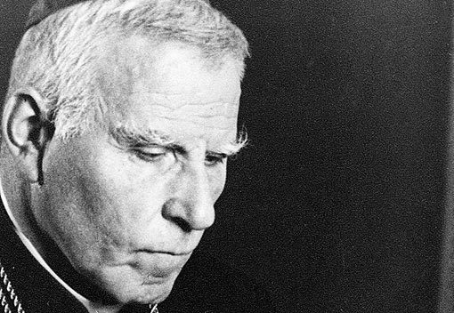
Cardinal galen
In 1941 Catholic Cardinal Galen openly criticised the Nazis for killing mentally ill people.
He ended the war in Sachsenhausen Concentration camp.

Slide 13
Key church Organisations during the third reich
Could they gain control of Christianity ?
Was it a success?

Slide 14
The reich church
The Reich Church was a new umbrella organisation of the Protestant Churches, set up as a means of co-ordination religion.
Within it, the German Christians developed as a powerful movement. Hitler hoped they would dominate the Reich Church. However, the attempt to create a unified, state controlled Church caused a reaction and the Confessional Church broke away.

Slide 15
Confessional church
In 1934 the Confessional Church broke away from the Reich Church. It was not based on opposition to Nazism as such, but it was concerned to defend the Protestant Church against state interference and the false theology of the German Christians.
Opposed to Hitler
One of the leaders, Dietrich Bonhoeffer, tried to lead organised resistance against the Nazis – He was even in contact with the Allies – He was murdered by the Gestapo
It had about 5,000 clergy.

Slide 16
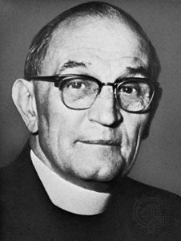
Pastor Niemoller
First they came for the communists, and I didn't speak out because I wasn't a communist.
Then they came for the socialists, and I didn't speak out because I wasn't a socialist.
Then they came for the trade unionists, and I didn't speak out because I wasn't a trade unionist.
Then they came for the Jews,
And I didn’t speak out because I wasn’t a Jew.
Then they came for me, and there was no one left to speak for me.

Slide 17
German Christians
German Christians wanted to restructure the whole of Protestantism into a new, racially based brand of Christianity. They described themselves as the ‘SA of the Church’, of a new people’s Church.
They adopted Nazi style uniforms and salutes; they had a slogan: ‘The swastika on our breasts and the cross in our hearts.’ In November 1933 they called for the cleansing of the gospels of un-German elements, especially ‘the scapegoat and inferiority theology of Rabbi Paul’.

Slide 18
German Faith Movement
Whereas the German Christians wanted to Nazify Christianity, the Faith Movement went further and wanted to replace Christianity and adopt pagan rituals: for example the SS held marriages in runic carved rooms. It remained a small sect, but illustrate what the Nazis might have done if they had won the Second World War.
“Jesus was a cowardly Jewish lout who had certain adventures during his years of indiscretion. He uprooted his disciples from blood and soil … At the very end he insulted the majesty of death in an obscene manner.” – From the Journal of the Faith Movement, 1937.

Slide 19
Success or Failure.

