Slide 1

Nazi Germany 1919-39 Key topics 1-2 revision
I can understand the chronology of Germany 1919-39
I can evaluate my performance on an 8 and 16 mark question
The exam will consist of 6 questions in 1hr 15mins. The questions will test:
1a. Inference from a source (4)
1b. Describe question (6)
1c. Explain effects question (8)
1d. Explain why question (8)
2a or b. Explain how question (8)
3a or b. Cause or effect essay (16 + 4 SPAG)
Starter: Rate your confidence on answering 8 and 16 mark questions:
8 mark
16 mark

Slide 2
I can understand the chronology of Germany 1919-39
I can evaluate my performance on an 8 and 16 mark question
Get into groups of 5.
You need to use the list on p76-77 to find the events for your group.
Use the textbook to answer the questions for your events.
We will then have experts explaining the events to the other groups.
Group 1 | Group 2 | Group 3 | Group 4
11 November 1918 Armistice signed January 1919 Spartacists uprisings August 1919 New constitution drawn up | Sturmabteilung (SA) created French occupy the Ruhr November 1923 Rentenmark issued | April 1924 Dawes Plan agreed October 1925 Locarno Pact signed Schutzstaffel (SS) set up | August 1928 Kellogg-Briand Pact signed March 1932 Hitler stood for election as President 1932 Bruning removed as Chancellor

Slide 3

Explain the…(8 marks)
On your sheet you will find a list of 8 mark questions.
RAG each question.
Pick the question you are least confident on.
Use the pages in the textbook to plan your answer NO FULL SENTENCES
Point:
Evidence:
Explain:
Point:
Evidence:
Explain:
NOTE: What type of 8 mark question are you doing?
Now shut the textbook and use your notes to answer the question in timed conditions.

Slide 4
Explain the…(8 marks)
For all 8 mark questions you need 2 PEE paragraphs specifically answering the questions.
However for 6-8 marks they slightly differ:
Type of 8 mark question | A) Explanation of consequence | B) Explanation of causation | C) Change within a historical context (pick one from two)
6-8 marks | The student explains one or more consequence supported by selected knowledge. 6 marks for one explained statement 7-8 marks for two or more explained statements 8 marks for answers which show links between statements | The student explains one or more consequence supported by selected knowledge. 6 marks for one cause linked to outcome 7-8 marks for two or more causes linked to outcome 8 marks for answers which prioritise causes or demonstrate how they combine to produce the outcome | Developed explanation of change. An explanation of one or more changes, supported by selected knowledge. 6-7 marks for one explained change. 7-8 marks for two or more explained changes. 8 marks for answers which prioritise changes or show links between them.

Slide 5
A - Explanation of consequence (8 marks)
Level | Mark | Description
1 | 1-2 | Simple or generalised statements of consequence(s). 1 mark for one simple statement. 2 marks for two or more simple statements.
2 | 3-5 | Developed statements of cause / consequence(s). The student supports the statement with relevant contextual knowledge. 3-4 marks for one developed statement. 4-5 marks for two or more developed statements.
3 | 6-8 | Developed explanation of cause / consequence(s). The student explains one or more consequence supported by selected knowledge. 6 marks for one explained statement 7-8 marks for two or more explained statements 8 marks for answers which show links between statements

Slide 6
B - explanation of causation (8 marks)
Level | Mark | Description
1 | 1-2 | Simple or generalised statements of consequence(s). 1 mark for one simple statement. 2 marks for two or more simple statements.
2 | 3-5 | Developed statements of cause / consequence(s). The student supports the statement with relevant contextual knowledge. 3-4 marks for one developed statement. 4-5 marks for two or more developed statements.
3 | 6-8 | Developed explanation of cause / consequence(s). The student explains one or more consequence supported by selected knowledge. 6 marks for one cause linked to outcome 7-8 marks for two or more causes linked to outcome 8 marks for answers which prioritise causes or demonstrate how they combine to produce the outcome

Slide 7
C - change within a historical context (8 marks)
Level | Mark | Description
1 | 1-2 | Simple statements of change 1 mark for one simple statement 2 marks for two or more simple statements
2 | 3-5 | Developed statement(s) of change supported with relevant knowledge 3-4 marks for one development statement 4-5 marks for two or more developed statements
3 | 6-8 | Developed explanation of change. An explanation of one or more changes, supported by selected knowledge. 6-7 marks for one explained change. 7-8 marks for two or more explained changes. 8 marks for answers which prioritise changes or show links between them.

Slide 8
Analysis of causation (16 marks) + SPaG (4 marks)
Was the Great Depression the main reason why the Nazi Party grew between 1929 and 1932?
You may include the following in your answer:
The Great Depression
Nazi Propaganda
You may also include information of your own.
Model first point as a class
P - Great Depression E – E – L - | P – E – E – L - | P - E – E – L -
Most important:
More important than…and….because…
Task: Use pages 37-39 to complete your notes in a PEEL structure. NO FULL SENTENCES

Slide 9
Analysis of causation (16 marks) + SPaG (4 marks)
Level | Mark | Description
1 | 1-3 | Simple or generalised statements of causation. agree or disagree without development write on the stimulus points or other causes without specific detail.
2 | 4-7 | Developed statements which agree and/or disagree with the question. These answers provide detail, but do not explain the causes. 4–5 marks for developing one cause. 5–6 marks for developing two causes. 6–7 marks for developing three causes.
3 | 8-12 | Developed explanation of causation, agreeing and/or disagreeing with the question. 8–9 marks for one cause explained. 9–10 marks for two causes explained. 11–12 marks for three or more causes explained. Maximum 10 marks for answers that do not explain a cause beyond those prompted by the stimulus material, for example the use of censorship or persecution of the churches.
4 | 13-16 | Prioritises causes or sees link between them. This considers the relationship between a range of causes. (This level can be achieved only if the response has explained at least three causes and has made explicit comparisons of the relative importance of two of them in coming to a judgement.) 15–16 marks for judgement of the relative importance of more than two causes or for an answer which shows the interrelationship between three causes in coming to a judgement for an answer which shows the interrelationship between three causes in coming to a judgement.

Slide 10
Nazi Germany 1919-39 Key topics 1-2 revision
I can understand the chronology of Germany 1919-39
I can evaluate my performance on an 8 and 16 mark question
The exam will consist of 6 questions in 1hr 15mins. The questions will test:
1a. Inference from a source (4)
1b. Describe question (6)
1c. Explain effects question (8)
1d. Explain why question (8)
2a or b. Explain how question (8)
3a or b. Cause or effect essay (16 + 4 SPAG)
Plenary: Now rate your confidence on answering 8 and 16 mark questions:
8 mark
16 mark

Slide 11
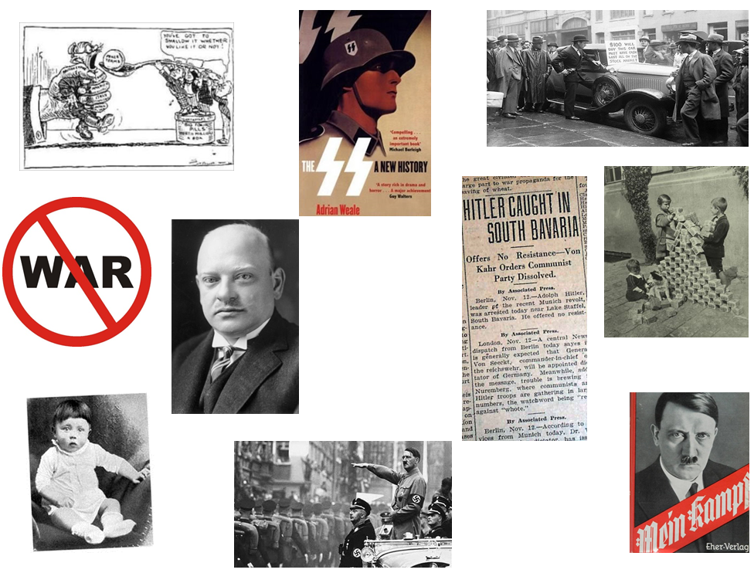
Nazi Germany 1919-39 Key topics 1-2 revision
Task: Look at the pictures in front of you.
Write a brief description underneath each of them about what event you think this picture shows.
Write the year you think it happened in.

Slide 12

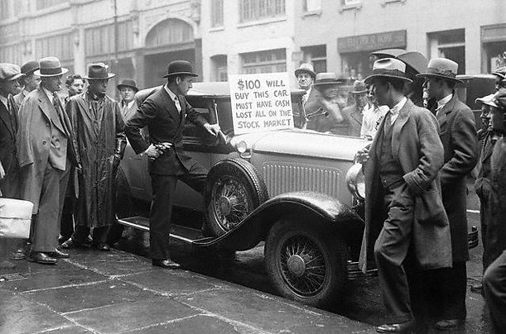
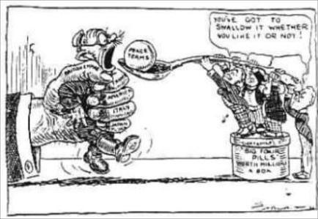
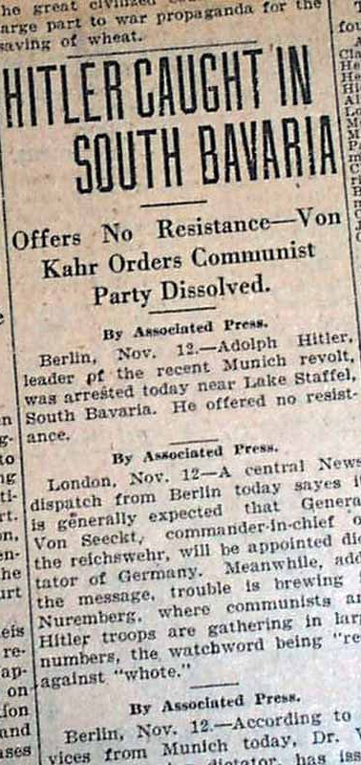
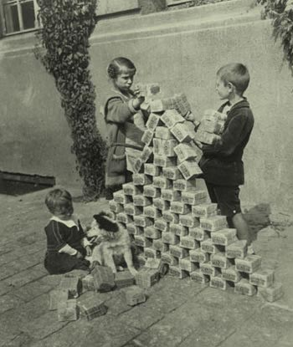

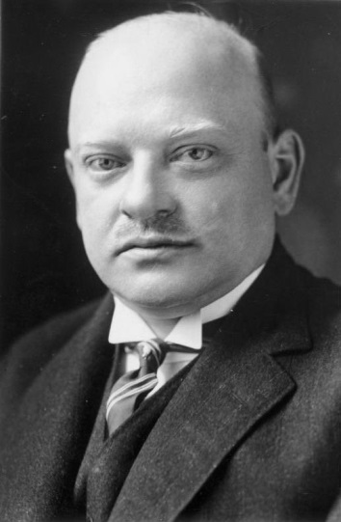
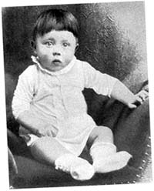

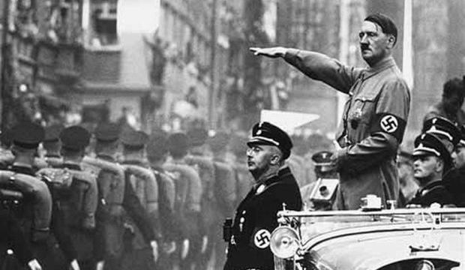

Slide 13
Wall Street Crash 1929
Treaty of Versailles 1919
SS formed 1925
Hyperinflation 1923
Kellogg Briand Pact 1925
Gustav Stresemann appointed Chancellor in 1923
Munich Putsch 1923
Hitler born 1889
Hitler becomes Chancellor 30th January 1933
Mein Kampf first published 1925

