Slide 1
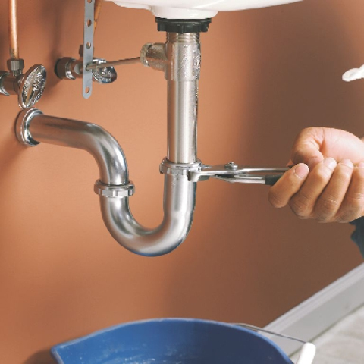
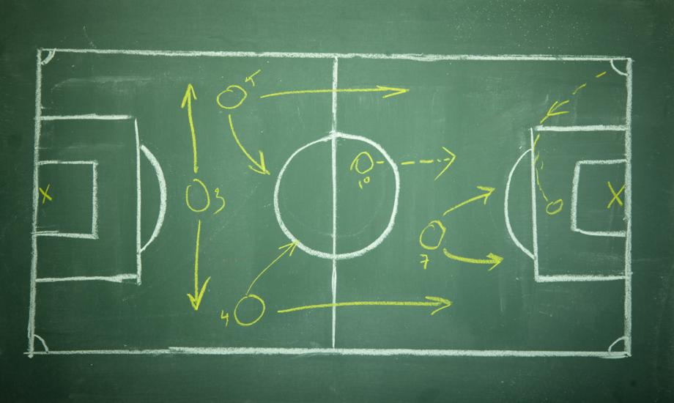
How might the following images relate to the Rise of Hitler and the Nazis?

Slide 2
WALT: How did Hitler and the Nazis come to power in 1933?
WILFS
Identify some valid reasons (E) ....
List accurate causes (D) ......
Explain linkage between causes (C)....
Evaluate causes and come to a conclusion (A)

Slide 3
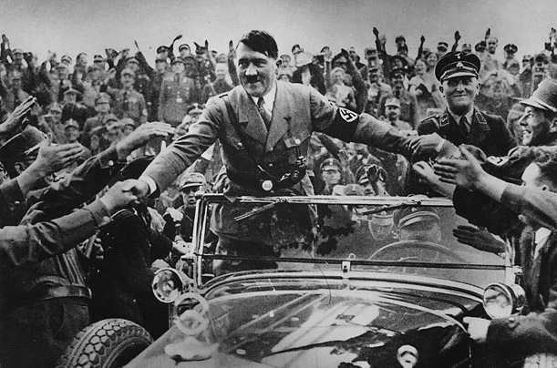
If the answer is this image what could the question be?

Slide 4
Exam Style Questions…
How important was the use of legislation in the Nazi consolidation of power by the end of 1933?
‘Hitler established a dictatorship by August 1934 by legal means.’ Explain why you agree or disagree with this view.

Slide 5
RAG your knowledge.
KNOWLEDGE
Hitler’s Rise to power How did Hitler come to power (narrative of events)? Why did Hitler come to power (Causes)? What did the Nazis believe in (ideology)? How important was ‘terror’ in the Nazi seizure of power? How important were ‘legal means’ in the Nazi seizure of power? How important was ‘propaganda’ in the Nazi seizure of power? How did Hitler go from Chancellor to Fuhrer? How important was policy and legal changes in the Nazi consolidation of power?

Slide 6
Question -
“What would have happened if the Reichstag Fire had never occurred?”
Write an alternative History. Would Hitler have gained power?

Slide 7
Revision tool.
Topic
Rise to Power
Everything that you know already.
Information that you are missing / Questions you need answering

Slide 8
Diamond nine
Come up with as many causes for Hitler’s Rise to Power in 1933.
Use Education Forum and PPT if you need help.

Slide 9
Timeline
1928 | vast increase in Nazi power in German parliament (Reichstag) Nazi Party membership reaches 60 000 members
1930 | Germans 1930 elect Nazis making them the 2nd largest political party in Germany
1932 | Hitler ran for President and won 30% of the vote, forcing the eventual victor, Paul von Hindenburg, into a runoff election. A political deal was made to make Hitler chancellor in exchange for his political support.
1933 | JANUARY 30 - Hitler appointed Chancellor (Prime Minister) of Germany by President Hindenburg FEBRUARY 27 - a week before the election, the Reichstag burns. Hitler blames it on the Communists. Hitler granted emergency powers Nazi party only had a small majority in the Reichstag (parliament), but arrests his opponents, has another vote to and gains the power to re-write Germany’s constitution MARCH 23 - Hitler passes the Enabling Act (power to make own laws, abolish political parties, and open concentration camps), establishing himself as dictator APRIL 1 – Nazi boycott of Jewish owned shops; first concentration camps open JULY 14 – Nazi party declared only party in Germany OCTOBER 14 – Germany resigns from League of Nations
1934 | JUNE 30-“Night of the Long Knives” AUGUST 2- President Hindenberg dies AUGUST 19 - Hitler names himself Furher (dictator) of Germany

Slide 10
Answer the following Question on the forum
How important was the use of Legislation in the Nazi consolidation of power by the end of 1933?

