Slide 1
Source A: From a speech by the Prime Minister, Stanley Baldwin, to the House of Commons, 15 October 1936.
In the opinion of the government, marches such as that which started at Jarrow, can do no good to the causes for which they are undertaken. They are liable to cause unnecessary hardship to those taking part in them. Government ministers have, therefore, decided
that encouragement cannot be given to marches, whatever their purpose, and ministers cannot agree to meet any representatives of the marchers from Jarrow.
Source D: A photograph taken near the start of the Jarrow March, 5 October 1936. Ellen Wilkinson, the MP for Jarrow, is shown towards the front of the march.
Jarrow March
Jarrow was particularly badly hit by the Depression of the 1930s. By 1935, 73% of the working population were out of work. The people of Jarrow decided to fight back and organised a march to London where they would present a petition demanding the right to work. Some historians believe the Jarrow Crusade was a great success and achieved much for the unemployed. Other historians
suggest it brought little in the way of improvement.
Source B: From a British newspaper reporter who witnessed the landings on D-Day.
During the last fifteen years, Jarrow has passed through a period of depression without parallel in the town’s history. Its shipyard is closed. Its steelworks have been denied the right to re-open. Where formerly 8,000 people were employed, only 100 men are now employed on a temporary scheme. The town cannot be left rundown. Therefore your petitioners humbly pray that His Majesty’s Government should realise the urgent need that work should be found without delay.
Q1. Give two things you can infer from Source A about the response of the Government? (6)
Q2. What was the purpose of Source B (8)
Q3 Use Source C and your own knowledge to explain why there was a march to London in 1936? (10)
Q4. How reliable are Source D and E as evidence of the effects of unemployment in Britain in the 1930s? Explain your answer, using Source D and E and your own knowledge. (10)
Q5. Source F suggests that the March was successful.
How far do you agree with this interpretation? Use your own knowledge and other sources to explain your answer.
Source E: From an article written by a journalist during the Jarrow March. It was published in a national newspaper which supported the march.
There can be no doubt that, as a protest, the march is a great success. I met up with the march this morning on the road to Ripon. Two hundred people were marching with banners, harmonicas and drums. The march was going strong. The marchers had with them two doctors, a barber, a group of pressmen and a Labrador dog mascot. The Mayor of Jarrow has been with the march for most of the time so far. The march is an example of community spirit probably without parallel anywhere else in the country..
Source C: From an interview with Paddy Scullion in the 1950s. Scullion was a Jarrow Councillor and one of the organisers of the Jarrow March.
We were more or less crusaders for all the distressed areas of the country, not just Jarrow. There were other distressed towns as well as Jarrow. We showed poverty to the people who didn’t know poverty existed and didn’t know what it meant. We thought we’d show our protests to the House of Commons and demand the right to work, which is a God-given right..
6 – Hypothesis Question. Source F suggests that…
1 – Argument FOR Sources ……. support the view that …… as…. (sources) In addition… (add own knowledge) This evidence is further strengthened/weakened by the reliability of… 2 – Argument AGAINST (using sources and own knowledge) However, sources ……. weakly support the view that …… as…. (sources) In addition… (add own knowledge) This evidence is further strengthened/weakened by the reliability of… 3 – Overall I strongly/partially/weakly agree with the interpretation because….
Source F: From a history of the modern world, published in 2001.
The Jarrow marchers captured the imagination of the country. People in the prosperous south began to understand the plight of those living in the depressed areas. The men returned home as heroes. The government, however, refused to let them present the
petition and the marchers failed to get work for the town. Furthermore, some marchers discovered that their ‘Dole’ had been stopped as they had not been available for work while on the march.
Notes:
http://www.bbc.co.uk/guides/zgs34j6

Slide 2
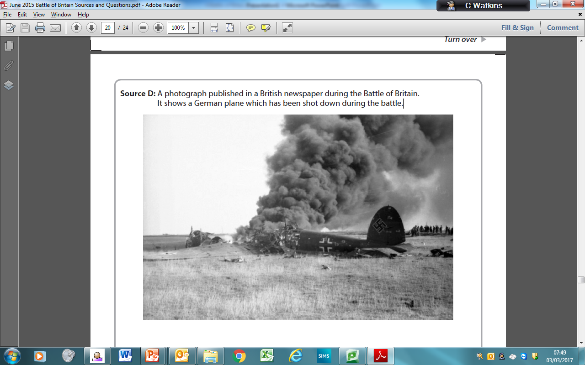
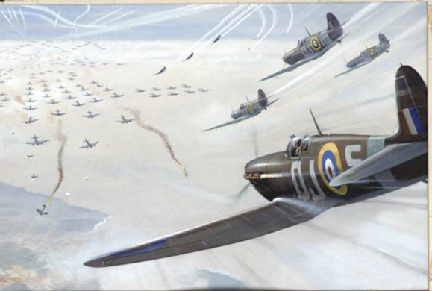
Study Sources A, E and F and use your own knowledge. Spelling, punctuation and grammar will be assessed in this question.
Source F suggests that the reason for the German defeat in the Battle of Britain was the weaknesses of the Luftwaffe.
How far do you agree with this interpretation? Use your own knowledge, Sources A, E and F and any other sources you find helpful to explain your answer.
Source A: From the memoirs of a pilot in the Luftwaffe (German air force), published in 2004, about the Battle of Britain.
The pilots in our squadron did not have much experience. In just two months, our numbers fell from 36 pilots to four. By early September, we were losing to the RAF. We really wasted our fighter planes. We didn’t have enough fighter planes to begin with. We also used them in the wrong way by flying slowly over England in very close escort to the bombers. Of course, the Spitfires could change direction easily and, when close to the bombers, that was important.
Source D: A photograph published in a British newspaper during the Battle of Britain. It shows a German plane which has been shot down during the battle.
Battle of Britain
Following the evacuation of the BEF from Dunkirk, Hitler ordered the preparation for the invasion of GB – Codenamed Operation Sea lion.
Britain had naval superiority. Hitler would need to win the battle of the air.
Luftwaffe had a clear advantage. 1,300 bombers, 1,200 fights. RAF had 600.
Luftwaffe blockaded British shipping.
Luftwaffe attacked Britain's fighter command ground installations and major cities.
British forced were well prepared. Radar was an advantage. Most advanced in the world. Gave early notice of an attack.
Spitfire plan was arguably the best fighter in the world but short supply.
June 1940 – Hitler attacks shipping, ports, airfields.
2nd August – Goering issued the Adlertag (Eagle Day) directive to attack air power and to open the way to invade. Began on the 8th August, 1,500 aircraft a day and directed them against airfields and radar stations. By late August, Germans had lost 600, RAF only 260. RAF was rapidly losing fighters and pilots, radar was damaged.
September – British retaliated by bombing Berlin, Hitler redirected his attack against cities.. Much needed breather. Blitz against London intensified.
Mid September – Battle of Britain won. Air superiority had been secured. Built more planes than could be shot down.
Source B: A painting of a scene from the Battle of Britain with the title Diving Squadron of Spitfires. It was painted in 1942 by an artist who was working for the Ministry of Information.
Source E: From an interview given in 2007 by a former RAF officer. He is talking about events on 15 September 1940, during the Battle of Britain. The interview was for The Battle of Britain Historical Society website.
Radar meant we were ready for the Luftwaffe. My RAF squadron moved towards about 20 unescorted German bombers which were coming in towards London. It
was going to be a nice party because other squadrons of Hurricanes and Spitfires also joined in. We gained a little height on the German bombers and were able to dive on them from the right. Our first attack broke them up very nicely. The bomber I attacked soon had white smoke streaming behind it.
Source F: From a modern world history textbook, published in 1996.
The successful outcome of the Battle of Britain was due to the weaknesses of the Luftwaffe. The commander of the Luftwaffe, Goering, had little understanding of tactics and underestimated the strength of the RAF. Hitler and Goering also made the mistake on 7 September 1940 of switching their attacks from RAF fighter bases to London. On the other hand, the RAF had several advantages. It was led by Air Chief Marshall Dowding who was a great supporter of radar. The British also made effective use of their fighter planes, the Hurricane and the Spitfire, which were a good match for the German Messerschmitt 109.
6 – Hypothesis Question. Source F suggests that…
1 – Argument FOR Sources ……. support the view that …… as…. (sources) In addition… (add own knowledge) This evidence is further strengthened/weakened by the reliability of… 2 – Argument AGAINST (using sources and own knowledge) However, sources ……. weakly support the view that …… as…. (sources) In addition… (add own knowledge) This evidence is further strengthened/weakened by the reliability of… 3 – Overall I strongly/partially/weakly agree with the interpretation because….
Source C: From orders given by the German leader Adolf Hitler, 1 August 1940.
I want to establish the necessary conditions for the final conquest of Britain. I order the Luftwaffe to use all the forces at its command to defeat the RAF in the shortest time possible. The primary targets should be British planes, their airfields and supply organisations. The Luftwaffe should also attack factories making aeroplanes and anti-aircraft equipment.
Notes:
http://www.bbc.co.uk/guides/zgs34j6

Slide 3
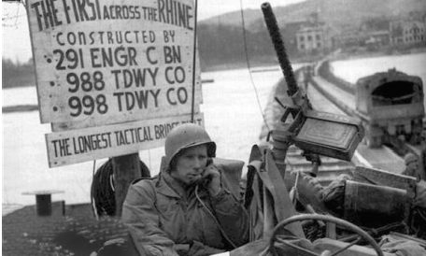
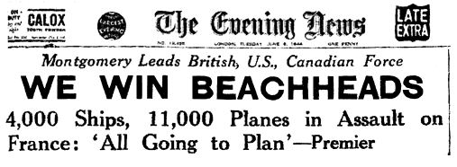
Source A: From a US army report about the landings on Omaha Beach on D-Day.
As the landing craft reached the beach they faced heavy shelling, machine gun fire and rifle fire. It came from the pill-boxes and cliffs above the beach. Men were hit as they came down the ramps of the landing craft and as they struggled through the defences towards land. Many others were killed by mines. Several craft were sunk by shelling and mines. The enemy now started shelling the beaches, which were full of US soldiers.
Source E: An official US photograph showing the first soldiers crossing the Rhine, March 1945. The notice board refers to the soldiers in the engineering corps who constructed ‘the longest tactical bridge built’.
D-Day
In June 1944 Allied forces successfully landed on the beaches of Normandy in France. In the months that followed, they liberated France, Belgium and Holland, crossed the Rhine and advanced on Berlin. Germany surrendered in early May 1945. Some historians argue that D-Day was the main reason for the German defeat. Some believe it was other factors, such as the Allied advance after the landings and the events on the Russian front.
Q1. Give two things you can infer from Source A
Q2. What was the purpose of Source B
Q3. Use Source C and your own knowledge to explain the success of the D-Day landings.
Q4. How reliable are Sources D and F as evidence of the advance towards Berlin in 1945?
Q5. Source F suggests that the reason for the German defeat was the success of the D-Day landings.
How far do you agree with this interpretation? Use your own knowledge, Sources A, E and F and any other sources you find helpful to explain your answer.
Source B: British newspaper headlines for D-Day, 6 June 1944.
Source F: From a diary written by William Shirer and published in 1945. Shirer was a US journalist who had lived in Nazi Germany until 1941. He accompanied the Allied advance after D-Day.
March 2nd
US troops have reached the Rhine.
March 8th
The first army is across the Rhine. We got across at Remagen on the railway bridge – a few minutes before the Germans had planned to blow it up.
April 2nd
War reporters are saying today that there will be no more big battles in the West. The Germans are finished.
April 22nd
The Russians are within 3 miles of the heart of Berlin. The city is in flames.
May 1st
Adolf Hitler is dead. The news came from German radio.
Study Sources A, E and F and use your own knowledge. Spelling, punctuation and grammar will be assessed in this question.
Source F suggests that the reason for the German defeat was the success of the D-Day landings.
How far do you agree with this interpretation? Use your own knowledge, Sources A, E and F and any other sources you find helpful to explain your answer.
Source C: From a British newspaper reporter who witnessed the landings on D-Day.
I was in a bomber aircraft above the landings for the first few minutes. From what I could see there was nothing stopping the attacking soldiers from getting to the shore. The Germans had been taken by surprise. There seemed little resistance. Wave after wave of Allied troops reached the shore almost unopposed. Everything seemed to be going according to plan.
6 – Hypothesis Question. Source F suggests that…
1 – Argument FOR Sources ……. support the view that …… as…. (sources) In addition… (add own knowledge) This evidence is further strengthened/weakened by the reliability of… 2 – Argument AGAINST (using sources and own knowledge) However, sources ……. weakly support the view that …… as…. (sources) In addition… (add own knowledge) This evidence is further strengthened/weakened by the reliability of… 3 – Overall I strongly/partially/weakly agree with the interpretation because….
Source D: From a modern world history textbook, 2001.
In December 1944, the Germans launched one last attack on the Americans in the Ardennes. The Battle of the Bulge was Hitler’s last gamble and it failed. This forced the Germans to retreat once more. They had used up their final reserves of troops and tanks. German troops everywhere were overstretched and on the retreat. The Russians continued to close in from the east, while German troops were retreating from Italy.
Notes:
http://www.bbc.co.uk/guides/zgs34j6

Slide 4


Source A: An extract from the diary of a 30-year-old woman, August 1941. She lived in London during the Second World War.
We think and talk about food all the time. Not because we are hungry, but because our meals are expensive and difficult to come by because of rationing. How bored I am with vegetable pie, tinned meats and boiled potatoes. What wouldn’t I give for orange juice, steak and onions, chocolate or apples and cream! I haven’t seen an egg for months in London, but many other parts of the country seem to have a reasonable supply.
Source D: A photograph published in a British newspaper in 1942. It shows firefighters working in their allotments in the centre of London.
Rationing
The government had been making plans since 1936 to deal with possible food shortages during a war. In the early months of the Second World War, food rationing was
introduced and the ‘Dig for Victory’ campaign began. The campaign asked every man and woman in Britain to grow vegetables in gardens and allotments. Some historians believe that these government measures to deal with food shortages were successful. Others suggest that they were not.
Questions
Q1. Give two things you can infer from Source A about rationing?
Q2. What was the purpose of Source B ?
Q3. Use Source C and your own knowledge to explain the success of rationing?
Q4. How reliable are Sources D and E as evidence of the success of the War Effort?
Q5. Source F suggests that the some people did not suffer the same hardship due to rationing.
How far do you agree with this interpretation? Use your own knowledge, Sources A, E and F and any other sources you find helpful to explain your answer.
Source B: A photograph published in a British newspaper in 1941. It shows a shop assistant arranging tins of meat newly arrived from the USA.
Source E: From a radio broadcast by the Ministry of Agriculture in 1944.
We can justly congratulate ourselves in what we have achieved so far in our ‘Dig for Victory’ campaign. But we must on no account relax our efforts. The war is not yet won. Even if the war were to end sooner than we expect, the food situation might not become easier. It might actually become more difficult. There would be an urgent need to feed the starving people of Europe. Carry on therefore with your good work. Do not rest on your spades!
Source F: From a modern world history textbook, published in 1996.
Despite the hardships caused by rationing, the people of Britain were healthier than before the war. They had a more balanced diet, even if it was rather boring. The
‘Dig for Victory’ campaign led to twice the number of allotments by 1943. However, the effects of rationing and shortages were different in different areas and even for different families. Very large families with a large number of ration books did not suffer from shortages in the same way as smaller families. Meat and vegetables were much easier to come by in the countryside.
6 – Hypothesis Question. Source F suggests that…
1 – Argument FOR Sources ……. support the view that …… as…. (sources) In addition… (add own knowledge) This evidence is further strengthened/weakened by the reliability of… 2 – Argument AGAINST (using sources and own knowledge) However, sources ……. weakly support the view that …… as…. (sources) In addition… (add own knowledge) This evidence is further strengthened/weakened by the reliability of… 3 – Overall I strongly/partially/weakly agree with the interpretation because….
Source C: From an interview in 2005 with a woman about her childhood memories of living in a village during the Second World War.
Rationing did not affect us very much, except for occasional tasteless tinned meats. We were better off for food than some people, especially those living in cities. We had a large vegetable garden and orchard and a plentiful supply of apples, pears and plums and we collected blackberries by the basketful. We also kept chickens and had lots of eggs. My father worked for a landowner and usually got rabbits, pigeons and sometimes pheasants. I also remember we ate lots of stinging nettle tops for vegetables.
Notes:
http://www.bbc.co.uk/guides/zgs34j6

Slide 5
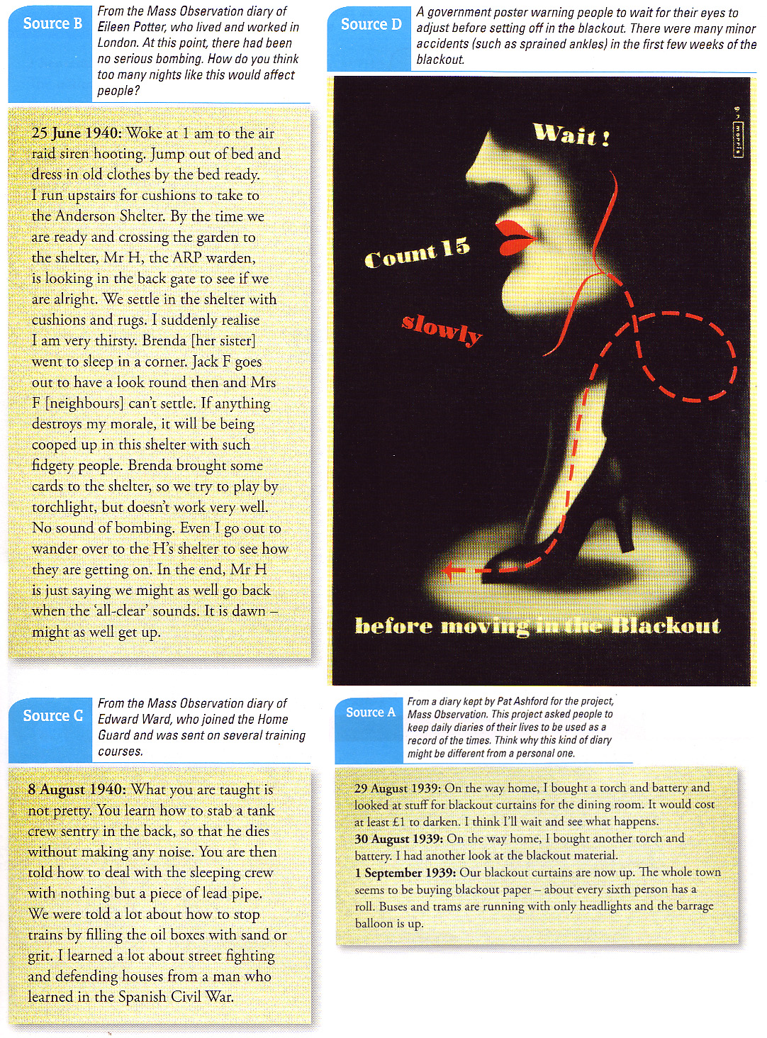
Source A: Mass Observation. This project asked people to keep daily diaries of their lives to be used a record of the times. Why might this be different from a personal one?
29 August 1939: On the way home, I bought a torch and batter and looked at stuff for blackout curtains for the dining room. It would cost at least £1 to darken. I think I’ll wait and see what happens.
30 August 1939: On the way home, I bought another torch battery. I had another look at the blackout material.
1 September 1939: Our blackout curtains are now up. The whole town seems to be buying blackout paper – about every sixth person has a roll. Buses and trams are running with only headlights and the barrage balloon is up.
Source C: From the Mass Observation diary of Edward Ward, who joined the Home Guard and was sent on several training courses.
8 August 1940: What you are taught is not pretty. You learn how to stab a tank crew sentry in the back, so that he dies without making any noise. You are then told how to deal with the sleeping crew with nothing but a piece of lead pipe. We were told a lot about how to stop trains by filling the oil boxes with sand or grit. I learned a lot about street fighting and defending houses from a man who learned in the Spanish Civil War.
How did the Government prepare.
Between 1938 and 1939, the government thought of all the possible dangers and difficulties the Home Front would face during war, and started to take precautions. People were needed on the home front to help with all sorts of things. They were encouraged to plant vegetables on any spare land they had to supplement the rationing, but people were also recruited into a variety of essential positions such as Air Raid Wardens and the Home Guard. People were also encouraged to think about their safety, and the government spent a great deal of time educating people on what to do in situations such as an air raid, or a gas attack, as well as providing information on how to make rations stretch further and how to keep yourself healthy. In addition, children near to the bombing targets were evacuated to the countryside.
Source D: A government poster warning people to wait for their eyes to adjust before setting off in the blackout. There were many major accidents (such as sprained ankles) in the first few weeks of the black out.
Source B: Eileen Potter, who lived and worked in London. At this point, there had been no serious bombing. How do you think too many nights like this would affect people?
25 June 1940: Woke at 1 am to the air raid siren hooting. Jump out of bed and dress in old clothes by the bed ready. I run upstairs for cushions to take to the Anderson Shelter. By the time we are ready and crossing the garden to the shelter, Mr H, the ARP warden is looking in the back gate to see if we are alright. We settle in the shelter with cushions and rugs. I suddenly realise I am very thirsty. Brenda [her sister] went to sleep in a corner. Jack F goes out to have a look round then and Mrs F [neighbours] can’t settle. If anything destroys my morale, it will be being cooped up in this shelter with such fidgety people. Brenda brought some cards to the shelter, so we try to play by torchlight, but doesn’t work very well. No sound of bombing. Even I go out to wander over to the H’s shelter to see how they are getting on. In the end, Mr H is just saying we might as well go back when the ‘all-clear’ sounds. It is dawn – might as well get up.
Source F: An ‘interview’ with a Londoner during in 1940 published in a national newspaper. This later turned out to be a piece of propaganda.
All in all it hasn’t disrupted my life. Our kids moved to the countryside and received an excellent education. They write to us weekly. My husband has joint the home guard to do his bit for King and country. He is drilled daily and comes home exhausted but say’s he is well prepared should we be attacked. We’ve had to use the air raid shelter, but it is so well organised it is hardly an issue. We make do.
Q1. Give two things you can infer from Source A about the reaction of the British.
Q2. What was the purpose of Source B?
Q3. Use Source C and your own knowledge to explain the success of the Home Guard.
Q4. How reliable are Sources D and E as evidence of the government response to war?
Q5. Source F suggests that Government preparation was successful.
How far do you agree with this interpretation? Use your own knowledge, Sources A, E and F and any other sources you find helpful to explain your answer.
Source E: From a modern History Textbook.
The government expected the war to disrupt and threaten the lives of civilians left at home. This happened in a variety of different ways, from cutting down railings to be melted down and used in munitions factories, to rationing and evacuation plans. Over 3.5 million children were evacuated during WW2. However, less than half of children in Urban areas were moved. Less than the 80% expected. The government refused to spend the necessary money.
Notes:
http://www.bbc.co.uk/guides/zgs34j6

Slide 6
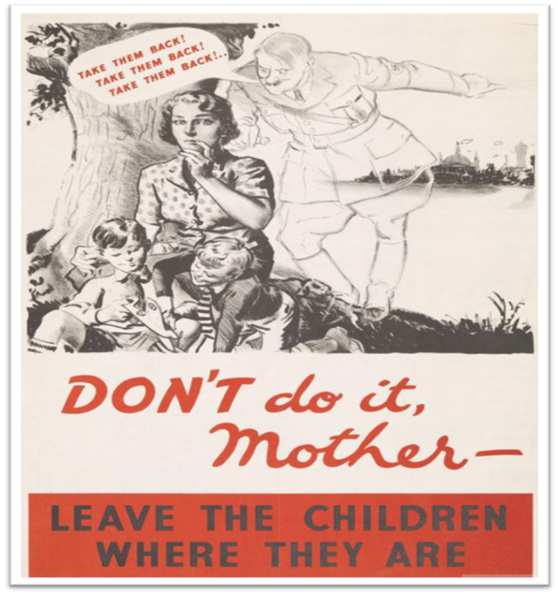
Source A: From the memoirs of a schoolchild, published in 1989, about evacuation.
I was at primary school when war broke out, in Nottingham. As a small child I can remember the evacuees coming. We were horrible to them. It's one of my most shameful memories, how nasty we were. We didn't want them to come, and we all ranged up on them in the playground. We were all in a big circle and the poor evacuees were herded together in the middle, and we were glaring at them and saying, "You made us squash up in our classrooms, you've done this, you're done that." I can remember them now, looking frightened to death. They were poor little East-Enders, they weren't tough at all, they were poor little thin, puny things. They used to be very quiet, and they only used to talk to themselves. We weren't friendly with them at all, we were very much apart, we just ignored them.
Evacuation
Source D: From a newspaper article, published in 1939.
The great scheme of evacuating some three million children and mother of infants under five years of age from what are regarded as vulnerable areas to less vulnerable areas came into operation on Friday. By yesterday the evacuation was practically complete. Everything proceeded “according to plan” and the whole scheme went through with such smooth precision as to call for the highest admiration for the enthusiasm and efficiency of all those taking part. The various reception committees threw themselves into the work with whole-hearted enthusiasm and the smooth way in which the children were detrained and conveyed to their destinations by buses to the rural areas and by private motor cars in the borough is worthy of the highest praise.
The Government Evacuation Scheme was developed during summer 1938 by the Anderson Committee and implemented by the Ministry of Health. The country was divided into zones, classified as either "evacuation", "neutral", or "reception", with priority evacuees being moved from the major urban centres and billeted on the available private housing in more rural areas
Source F: D Taylor, Mastering Economic & Social History (1988). David Taylor is a modern Historian.
Many children, parents and teachers were evacuated when war was declared. The evacuees were received at reception centres and then placed with local families. Arrangements, however, did not always go smoothly. Unfortunately many evacuees could not settle in the countryside. The country people were shocked at the obvious poverty and deprivation of the town children, not to mention their bad manners. There were reports of children 'fouling' gardens, hair crawling with lice, and bed wetting.
Source B: A government poster published in 1939.
Source E: From a diary of a seventeen year old girl from London, written during World War Two.
I was an evacuee for six weeks. The main problem between evacuees and hosts seems to me to be the difficulty of adapting one to the other. A few of the hosts treated their evacuees, mainly girls, as guests, or as they would their own children. But the majority treated the girls as unpaid maids. A good deal of publicity has been given to the hosts burdened with dirty, verminous evacuees, but none or very little to cases where well brought up, middle class girls and boys have been billeted in poor, dirty homes, where they have little to eat and none of the facilities they are used to. At least half of the 250 girls evacuated with the school are billeted in tiny, dirty houses where they have to do any housework that is done. Being billeted in such houses has a very bad effect on the younger girls of an impressionable age, and they grow slack in their care of their personal cleanliness and manners.
1. Study Source A.
What can you learn from Source A about the experiences of evacuees during the Second World War? (6 marks)
2. Study Source B and use your own knowledge.
What was the purpose of this representation? (8 marks)
Use details of the poster and your own knowledge to explain your answer.
3. Study Source C and use your own knowledge.
Use Source C and your own knowledge to explain why children were evacuated during the Second World War. (10 marks)
4. Study Sources D and E and use your own knowledge.
How reliable are Sources D and E as evidence of evacuation during the Second World War? (10 marks)
Explain your answer, using Sources D and E and your own knowledge.
5. Study Sources A, D and F and use your own knowledge.
Spelling, punctuation and grammar will be assessed in this question. Source F suggests that evacuation was a negative experience for all.
How far do you agree with this interpretation? Use your own knowledge, Sources A, D and F and any other sources you find helpful to explain your answer. (16 marks + 3 SPAG)
Source C: From a government leaflet entitled Evacuation: Why and How? Published in July 1939.
One of the first measures we can take to prevent this is the removal of the children from the more dangerous areas. The Government have accordingly made plans for the removal from what are called "evacuable" areas to safer places called "reception" areas, of school children, children below school age if accompanied by their mothers or other responsible persons, and expectant mothers and blind persons. The scheme is entirely a voluntary one, but clearly the children will be much safer and happier away from the big cities where the dangers will be greatest. There is room in the safer areas for these children; householders have volunteered to provide it. They have offered homes where the children will be made welcome. The children will have their schoolteachers and other helpers with them and their schooling will be continued.
Notes:
http://www.bbc.co.uk/guides/zgs34j6

Slide 7
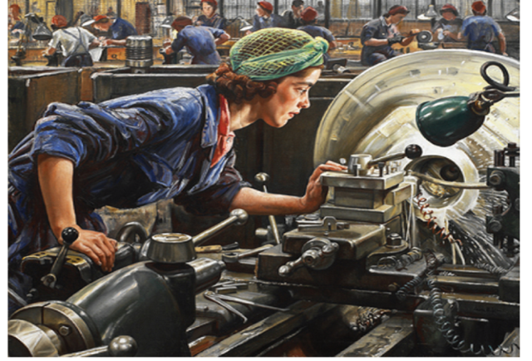
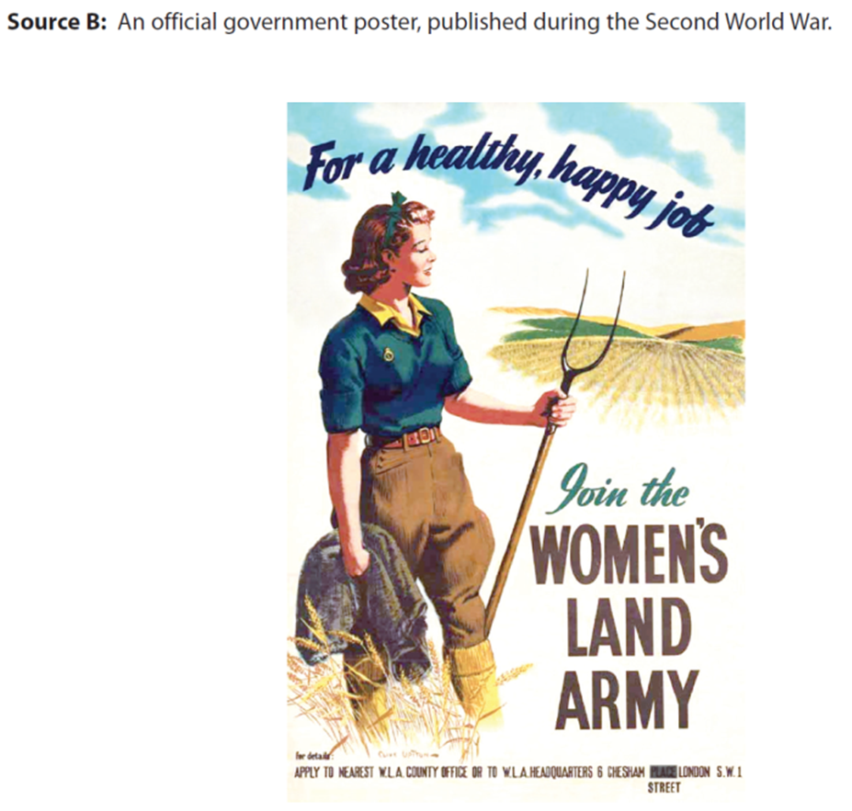
Source A: From an interview in 2007 with Joyce Watts for the online Wartime Memories Project. She describes her experiences as a land girl during the Second World War.
I had to get up at 4.30 in the morning to milk the cows. In the winter my hands became war and it was very painful when I milked the cows. I came from London and our house had all the modern conveniences. On this farm I had a candle for a light in my bedroom, the loo was outside and the water was obtained from a pump. Despite all this, I must say, I had plenty to eat and the farmer’s wife was a good cook. The Land Army days were some of the best years of my life. I still have fond memories of the good times that I had.
Source D: From a newspaper article, published in 1939.
Women in World War Two
Women played a vital part in this country’s success in World War Two. But, as with World War One, women at the end of World War Two, found that the advances they had made were greatly reduced when the soldiers returned from fighting abroad. Women were called on to help on the land and the Women’s Land Army (WLA) was re-formed in July 1939. Their work was vital as so many men were being called up.
The government tried to make out that the work of the WLA was glamorous and adverts showed it as this. In fact, the work was hard and young women usually worked in isolated communities. Many lived in years old farm workers cottages without running water, electricity or gas.
During the Blitz on London women in voluntary organisations did a very important job. The Women’s Voluntary Service provided fire fighters with tea and refreshments when the clear-up took place after a bombing raid. The WVS had one million members by 1943.
Many women decided that they would work in a factory. They worked in all manner of production ranging from making ammunition to uniforms to aeroplanes. The hours they worked were long and some women had to move to where the factories were. Those who moved away were paid more.
Source B: A government poster published in 1939.
Source E: From an interview given in 1999 by a woman who worked in a factory during the Second World War. She gave the interview for Bombers and Mash a history book about the home front during the Second World War.
Working in factories was not fun. To be shut in for hours on end without even a window to see daylight was grim. The noise was horrendous and at night when you shut your eyes to sleep all the noise would start again in your head. Night shifts were the worst. The work was very tedious. I think boredom was our worst enemy. The toilets were revolting and the canteen facilities were poor.
1. Study Source A.
What can you learn from Source A about the experiences of evacuees during the Second World War? (6 marks)
2. Study Source B and use your own knowledge.
What was the purpose of this representation? (8 marks)
Use details of the poster and your own knowledge to explain your answer.
3. Study Source C and use your own knowledge.
Use Source C and your own knowledge to explain why children were evacuated during the Second World War. (10 marks)
4. Study Sources D and E and use your own knowledge.
How reliable are Sources D and E as evidence of evacuation during the Second World War? (10 marks)
Explain your answer, using Sources D and E and your own knowledge.
5. Study Sources A, D and F and use your own knowledge.
Source F suggests that evacuation was a negative experience for all.
How far do you agree with this interpretation? Use your own knowledge, Sources A, D and F and any other sources you find helpful to explain your answer. (16 marks + 3 SPAG)
Source F: From a history of the Second World War published in 1998.
Many women were pleased to be involved in useful work which helped the war effort. They were earning much more than before the war. However, the attitude of some male workers was not welcoming because they were afraid that unskilled women would start doing skilled, male workers jobs. In fact, many of the jobs done by women, even if identical to those done by men, were simply renamed so that women could be paid at a lower rate.
Source C: Interview from a women in 1990 about her work in the WLA.
I worked 12 hours a day on a large farm in Lincolnshire. The work was hard and tedious and we received no training. Wages were £1.40 a week but we had to pay £1 for our lodgings. At another farm, we expected to be trained in tractor driving but we were made to do odd jobs, including kitchen work for the farmer’s wife. The farmer gave us no training and refused to pay us any wages.
Notes:
http://www.bbc.co.uk/guides/zgs34j6

Slide 8
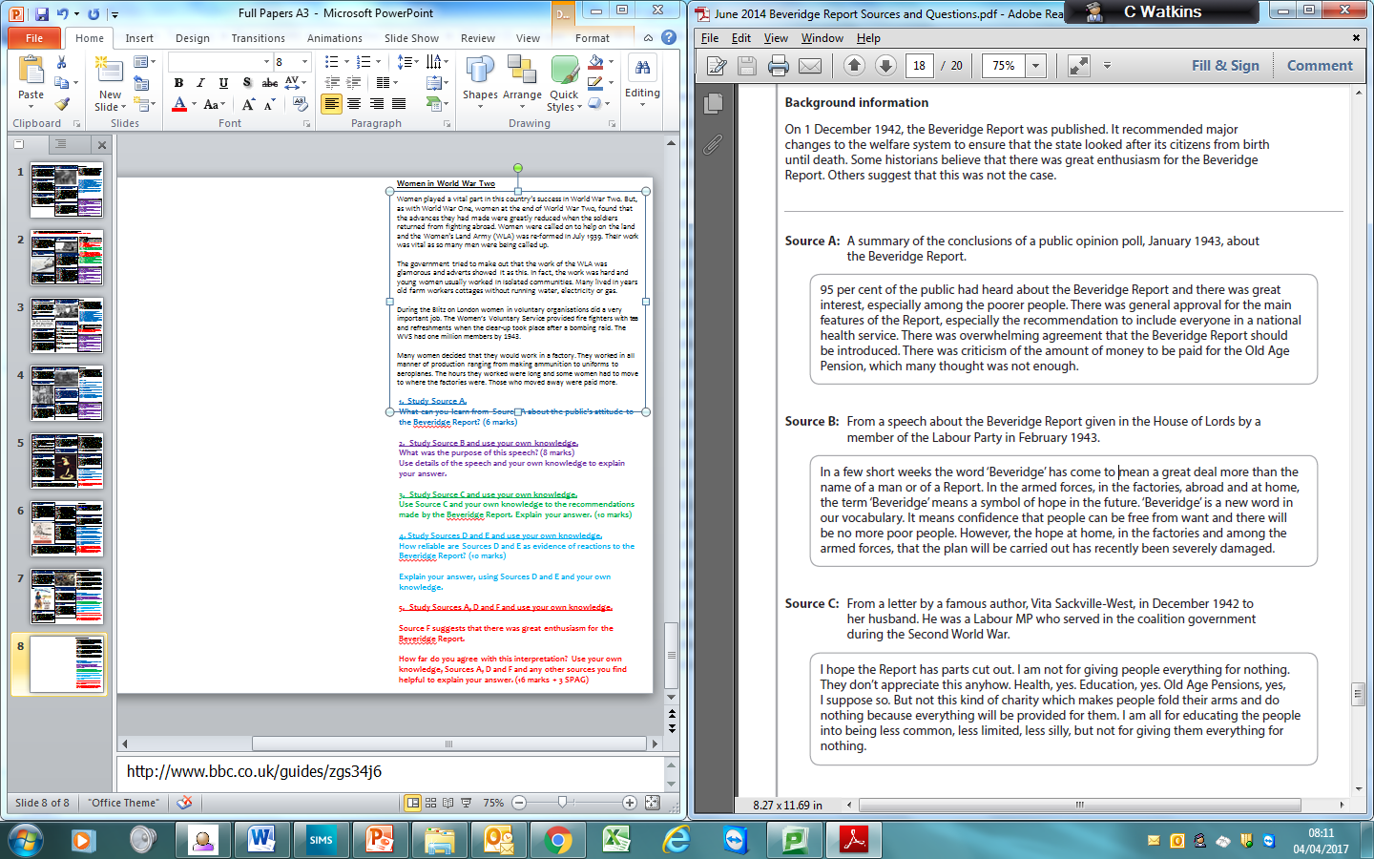
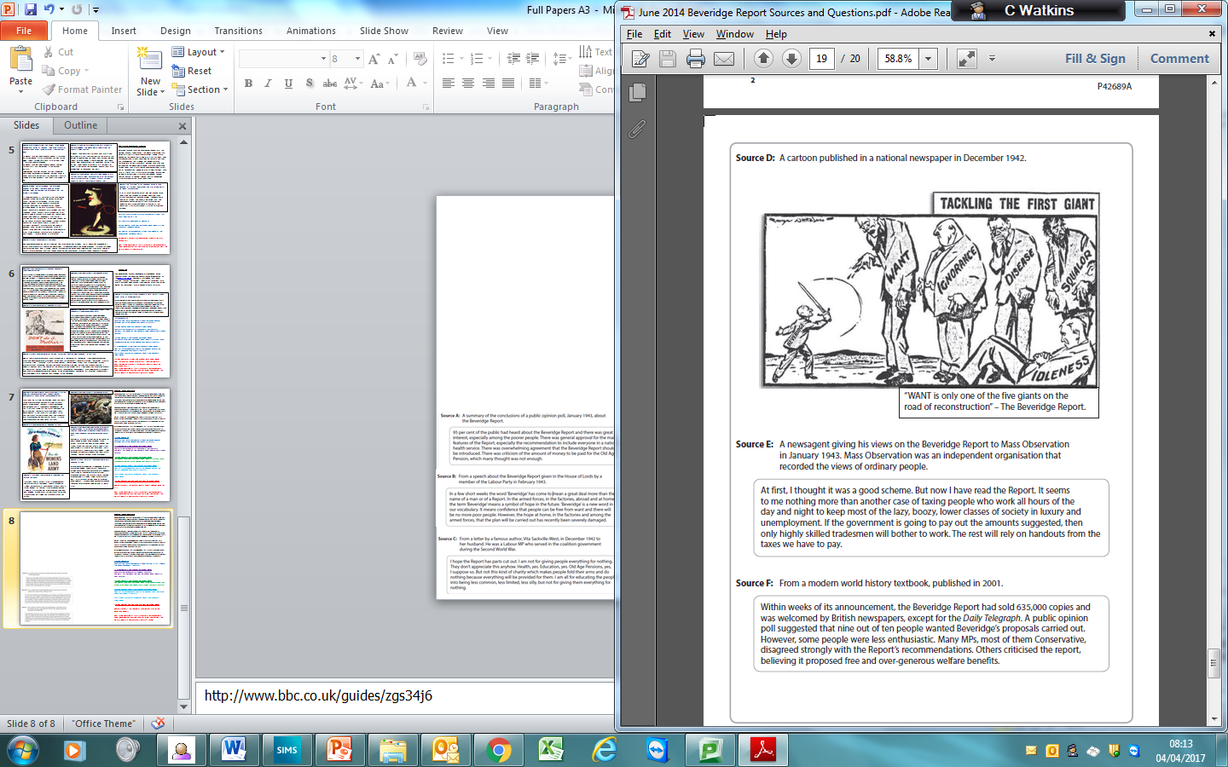
1. Study Source A.
What can you learn from Source A about the public's attitude to the Beveridge Report? (6 marks)
2. Study Source B and use your own knowledge.
What was the purpose of this speech? (8 marks)
Use details of the speech and your own knowledge to explain your answer.
3. Study Source C and use your own knowledge.
Use Source C and your own knowledge to the recommendations made by the Beveridge Report. Explain your answer. (10 marks)
4. Study Sources D and E and use your own knowledge.
How reliable are Sources D and E as evidence of reactions to the Beveridge Report? (10 marks)
Explain your answer, using Sources D and E and your own knowledge.
5. Study Sources A, D and F and use your own knowledge.
Source F suggests that there was great enthusiasm for the Beveridge Report.
How far do you agree with this interpretation? Use your own knowledge, Sources A, D and F and any other sources you find helpful to explain your answer. (16 marks + 3 SPAG)
Notes:
http://www.bbc.co.uk/guides/zgs34j6

Slide 9
Question 2: PURPOSE (8 marks)
1 – The purpose of the source is to convince the peers in the House of Lords and British Public to support the suggestions made in the Beveridge Report of 1942. The purpose was to ensure that the House of Lords were aware of the British Publics support across the country and that this desire was potentially being breached.
2 – To achieve it’s purpose the representation emphasises that the report had become a 'symbol of hope' for the working class and 'is a new word in our vocabulary'. That the British public had dropped the support of the laissez faire approach adopted in the 1930's in favour of government action. The fact that Winston Churchill and the Conservative government were slow and even hesitant to pass the legislation shows the was desired
3 – Moreover at this time the National Government were passing some of the laws that would solve the Giants. The Report had proved popular as it has sold 70,000 copies.
Mark | Description
1-2 | comment about the message of the source without support comment about the source context but relevance to message / purpose not explained
3-5 | comment about purpose of representation, linked to details in the content max 5 marks for identifying purpose using detail from content AND own knowledge
6-8 | purpose of the representation explained using supporting details max 6 marks if no own knowledge used

