Slide 1
SILENT STARTER
In your books. Draw a Spider Diagram.
How do the Government help those who need it?
Do other people help?
Un - Jumble the words for clues.
EXT : Would these have existed in Tudor Times ?

Slide 2
WALT: How did Elizabeth deal with the poor!
L4: Describe how Elizabeth dealt with the Poor.
L5: Explain how her solutions dealt with the Poor.
L6: Evaluate how successful Elizabeth was.

Slide 3
Swap Diagrams with another person on the TABLE
Would these have existed in the Elizabethan period?
Add to the diagram
EXAMPLE
Church – Henry VIII dissolved the Monasteries between 1536 & 1539.

Slide 4
Causes of Tudor poverty
About two in every five people in Tudor England lived on the edge of poverty. It did not take much to push them under.
During the 16th century prices went up. This inflation made it hard for some people to afford to live.
Inflation – when prises rise and money buys less

Slide 5
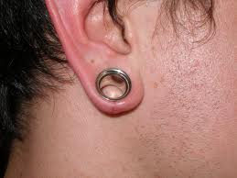
How did the Tudors deal with the Poor…
Task: What was wrong with the laws?
Laws to prevent begging
Problem with the law
HARSH
Sort the cards out into 2 piles: FAIR and HARSH – Rank them
Draw a small image to represent the law.
Write the problem IN YOUR OWN WORDS
Explain why the law is fair or harsh
I think that Law 1 is HARSH / FAIR because ___
FAIR
Notes:
Create table in exercise books. Decide which laws are harsh and which are fair, then draw the law and glue in next to the law

Slide 6
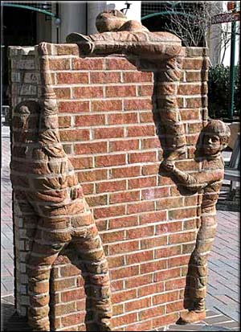
Wall of Truth: Prepare to explain yourself!
The laws designed to prevent begging were sensible.
If you agree
If you disagree

Slide 7
Poor Laws
Laws called poor laws were passed by parliament between 1531 and 1601.
These gave help to the sick and old (‘the impotent poor’) and paupers wanting to find work

Slide 8
5 Minutes
Find the information from sheets stuck to the wall. – You could work in pairs or groups or on your own. DO NOT SHOUT
Who were the Idle Poor?
How did the Poor Law help them?
Who were the Deserving Poor?
How did the Poor Law and Parishes help them?

Slide 9
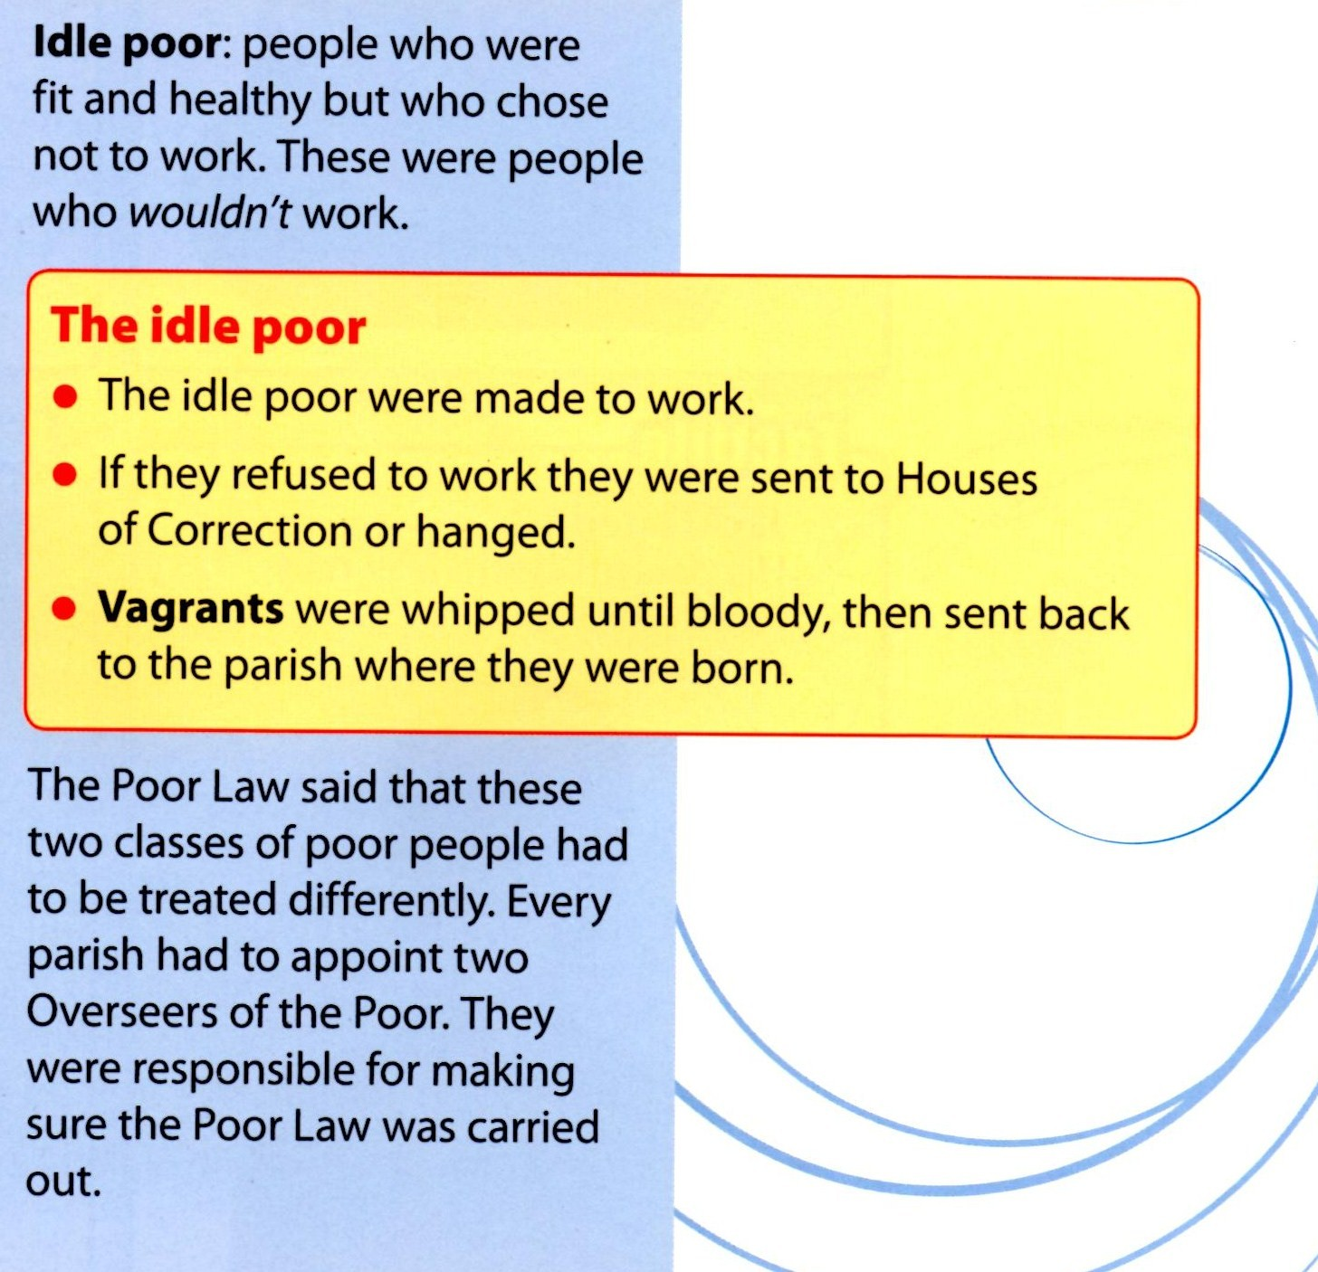

Slide 11
TASK
Imagine you are one of the deserving poor. Write a sentence or two describing how you feel about this new act.
Imagine you are a rich person. Write a paragraph describing how you feel about this new act. What are the advantages and disadvantages for you?

Slide 12
Summarise the Lesson.
Fill up the Sticker with words, images, numbers symbols.
Stick them at the end of your work.

