Slide 1
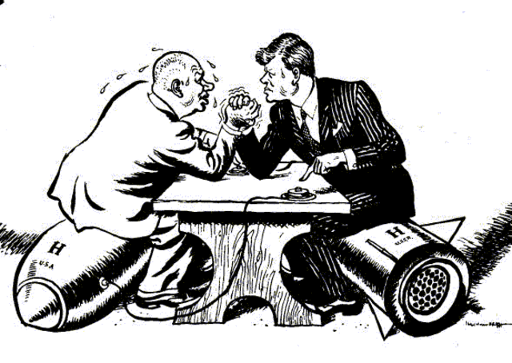
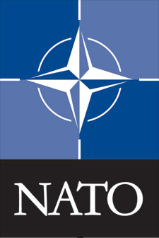
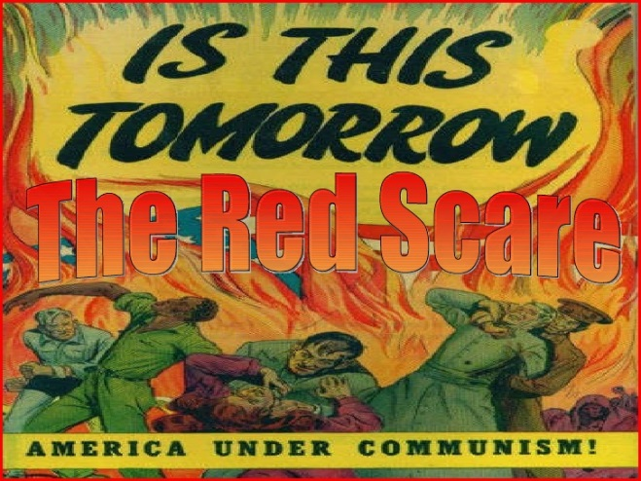
Key topic 1 – How did the Cold War develop? 1945-53 | Feature: Reasons for the Cold War
The “Cold War” was not a “hot” war because American and Soviet soldiers never faced each other in battle.
Both sides knew that a real “WW3”, a nuclear war, would be unwinnable.
However the Cold War had many characteristics of an actual war:
Arms race (when countries compete to have the most effective armed forces)
Alliances (a formal agreement between countries)
Propaganda (information designed to win support)

Slide 2
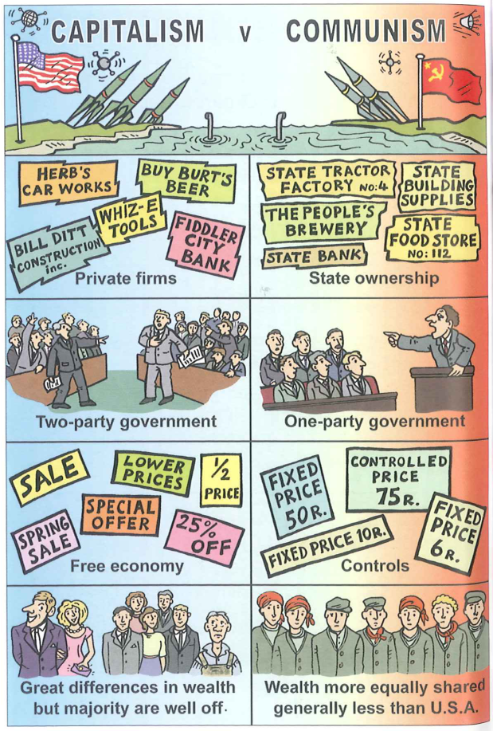
Ideological differences
Key topic 1 – How did the Cold War develop? 1945-53 | Feature: Ideological differences
During WW2 America and the USSR worked together as members of the Grand Alliance.
However after the defeat of Nazi Germany, the alliance became increasingly uneasy. This was due to ideological differences.
The leaders each wanted the other to recognize that there were countries which fell within their “sphere of influence” (countries which are influenced by a larger country)

Slide 3
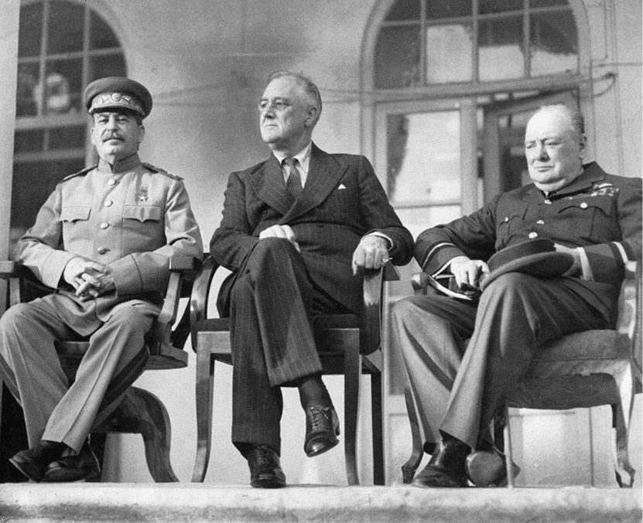
Key topic 1 – How did the Cold War develop? 1945-53 | Feature: Teheran, Yalta and Potsdam Conferences
Conference/date | Present | Context | Agreed | Disagreements
Teheran November/ December 1943 | Churchill (UK) Stalin (USSR) Roosevelt (USA) | Stalin was annoyed that UK and USA had delayed opening a second front. | USA/UK would open a second front against Nazi Germany. USSR would declare war on Japan after Germany was defeated. | Churchill wanted to invade the Balkans – Roosevelt sided with Stalin against Churchill.

Slide 4
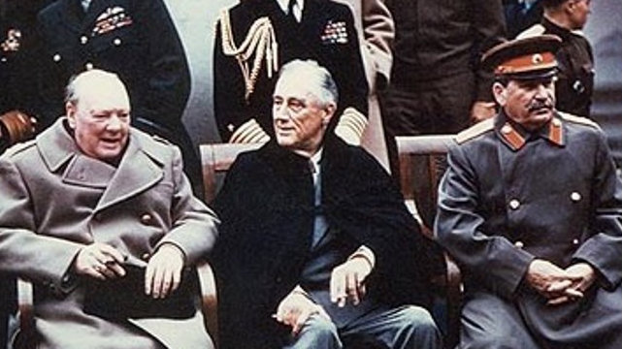
Key topic 1 – How did the Cold War develop? 1945-53 | Feature: Teheran, Yalta and Potsdam Conferences
Conference/date | Present | Context | Agreed | Disagreements
Yalta (February 1945) | Churchill (UK) Stalin (USSR) Roosevelt (USA) | Germany was not yet defeated – but it was clear the Allies would win. | Germany would be reduced in size, demilitarized and forced to pay reparations. United Nations set up and USSR invited to join. USSR to allow free elections in Eastern European countries. USSR promised to join the war against Japan when Germany was defeated | UK and USA did not want Poland to become communist. Stalin desperately wanted Poland as a buffer between the USSR and the West.

Slide 5
Key topic 1 – How did the Cold War develop? 1945-53 | Feature: Teheran, Yalta and Potsdam Conferences
Conference/date | Present | Context | Agreed | Disagreements
Potsdam (July and August 1945) | Churchill/ Atlee (UK) Stalin (USSR) Truman (USA) | Roosevelt had died April 1945. The new American President, Harry S. Truman, did not trust Stalin. Clement Atlee replaced Churchill half way through the conference. Germany had been defeated so the Big Three no longer had a common enemy | Ban the Nazi Party and prosecute surviving Nazis as war criminals. Divide Germany and Berlin into 4 zones of occupation. | USSR wanted Germany to pay heavy reparations but USA wanted Germany rebuilt. Truman kept the atomic bomb a secret from Stalin. Stalin went back on his word on Poland and set up a communist government.

Slide 6
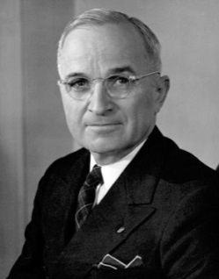
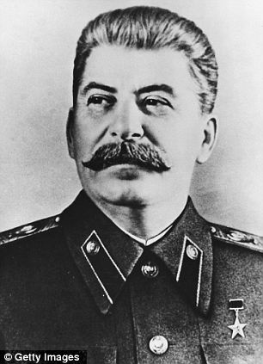
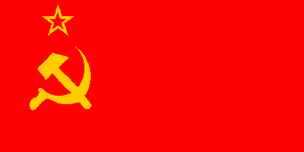
Key topic 1 – How did the Cold War develop? 1945-53 | Feature: The attitudes of Stalin and Truman
The Russians only understand one language - how many armies have you got? I'm tired of babying the Soviets.
Harry S Truman, 1945
Truman | Stalin
Believed that Communism was evil. | Believed that capitalism was evil.
Had the atomic bomb - but was scared of Russia's conventional army. | Had the biggest army in the world - but was angry that Truman had not warned that he was going to drop the atomic bomb.
Angry about the Nazi-Soviet Pact that was a major factor in starting the Second World War. | Believed that America and Britain had delayed opening the second front (attacking France) to let Germany and Russia destroy each other on the eastern front.
Wanted Germany to recover as a trading partner | Russia wanted to weaken Germany and create a buffer zone of friendly states around Russia.

Slide 7
Key topic 1 – How did the Cold War develop? 1945-53 | Feature: The attitudes of Stalin and Truman
The Russians only understand one language - how many armies have you got? I'm tired of babying the Soviets.
Harry S Truman, 1945
Truman and Stalin were concerned about the breakdown of the Great Alliance and the threat of a new war. They both asked for top secret reports rom their embassies about their opponents:
The Long Telegram (1946)
Kennan, US Ambassador to Moscow, reported:
Stalin had given a speech calling for the destruction of capitalism
There could be no peace with the USSR while it was opposing capitalism.
The USSR was building up its military power
The USA should seek to contain communism.
Novikov’s Telegram (1946)
Novikov, USSR ambassador to Washington D.C, reported:
America desired to dominate the world
Following Roosevelt's death, the American government was no longer interested in co-operation with the USSR
The American public was being prepared for war with the USSR

Slide 8
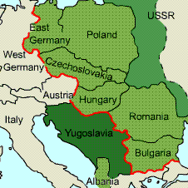
Soviet Expansion in Eastern Europe
Key topic 1 – How did the Cold War develop? 1945-53 | Feature: Soviet expansion in Eastern Europe
A satellite state is a country that is officially independent, but is in reality controlled by another country. Between 1947 and 1949, the USSR turned most of the countries in Eastern Europe into satellite states.
At Yalta and Potsdam, the USSR agreed to free elections. However, most of the countries did not choose communism. Therefore they rigged elections, got rid of opposition parties and made each country a single party state.
The USSR kept control by:
controlling the army
setting up a secret police force
arresting their opponents.
By 1949, all the governments of Eastern Europe, except Yugoslavia, were hard line Stalinist regimes.

Slide 9
Soviet Expansion in Eastern Europe
Key topic 1 – How did the Cold War develop? 1945-53 | Feature: Soviet expansion in Eastern Europe
Czechoslovakia – 1948
A coalition government was set up and led by the non-Communist Benes. However, the Communists' leader Gottwald made sure they controlled the radio, the army and the police. Gottwald became prime minister and set up a secret police force. Non-Communists were arrested. In 1948, Communist workers went on strike, the non-Communist minister Masaryk committed suicide and Gottwald took over the government.
Poland – 1947
Stalin invited 16 non-Communist leaders to Moscow and arrested them. Thousands of non-Communists were arrested, and the Communists won the 1947 election.
East Germany – 1945
This was Soviet zone of Germany. In 1949, they set up a Communist-controlled state called the German Democratic Republic.
Romania – 1947
In the 1945 elections, a Communist-led coalition was elected to power. The Communists gradually took over and in 1947 they abolished the monarchy.
Hungary – 1947
The non-communists won the 1945 elections with Zoltan Tildy as president. However, the Communists' leader, Rakosi, took control of the secret police, and executed and arrested his opponents. Tildy was forced to resign. By 1948, Rakosi had complete control of Hungary.
Bulgaria – 1945
In the 1945 elections, a Communist-led coalition was elected, but the Communists executed the non-Communists.
Albania – 1945.
The Communists immediately took power.
Notes:
Just go over Hungary and Czechoslovakia as will come up later

Slide 10
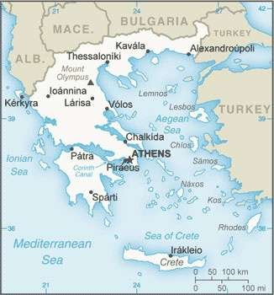
Key topic 1 – How did the Cold War develop? 1945-53 | Feature: Allied response to USSR
In 1947 the British army were fighting in Greece to prevent Communist rebels taking over.
America was becoming increasingly alarmed by the growth of Soviet power. So, when the British told Truman they could no longer afford to keep their soldiers in Greece, Truman stepped in to take over.
General George Marshall came up with a plan to help Europe recover from the war using $17 billion of American money - this became known as the Marshall Plan.
In order to qualify for American money, European countries had to agree to trade freely with America.
In 1947 President Truman said that America would send troops and economic resources to help governments that were threatened by communists. This became known as the Truman Doctrine
Stalin forbade the Cominform countries to apply for Marshall Aid. He set up Comecon in 1948 as the communist alternative to the Marshall Plan.

Slide 11
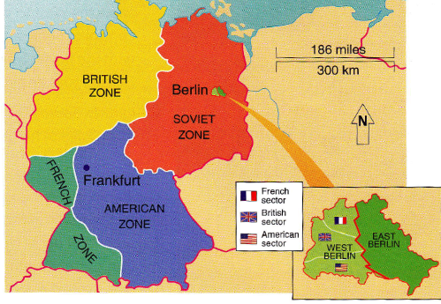
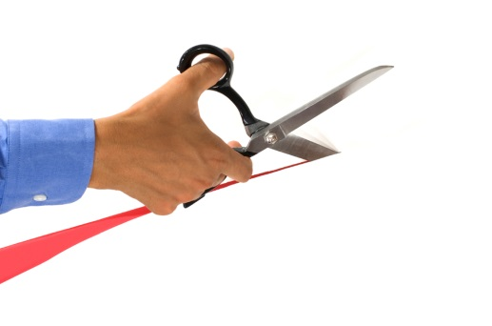
Key topic 1 – How did the Cold War develop? 1945-53 | Feature: Causes of the Berlin Blockade 1948-49
At Yalta in 1945 Germany was split it into 4 zones to be controlled by Britain, France, America and the USSR.
The capital, Berlin, was in the Soviet zone so it too was split into 4 zones.
In 1947 the British and American zones of Germany united and became known as “Bizonia”.
In June 1948, Britain, France and America united their zones into a new country, West Germany.
On 23 June 1948, they introduced a new currency called the Deutschmark, which they said would help trade.
Map above showing how Germany was divided in 1945
The next day, Stalin cut off all rail and road links to west Berlin - the Berlin Blockade

Slide 12
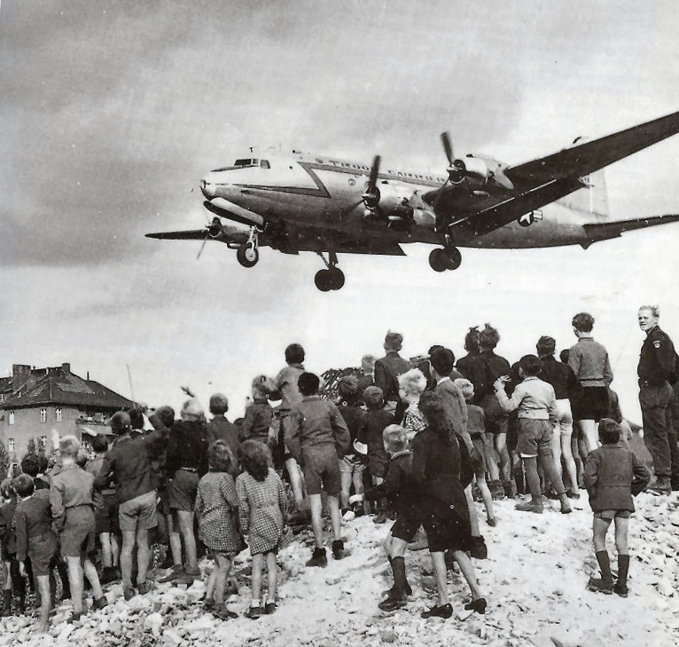
Key topic 1 – How did the Cold War develop? 1945-53 | Feature: Events of the Berlin Blockade 1948-49
The west saw this as an attempt to starve Berlin into surrender, so they decided to supply west Berlin by air.
The Berlin Blockade lasted 318 days. During this time, 275,000 planes transported 1.5 million tons of supplies and a plane landed every three minutes at Berlin's Templehof airport. This was known as the “Berlin Airlift”.
On 12 May 1949, Stalin abandoned the blockade.
In September 1949, West Germany (officially called the Federal Republic of Germany) was formed. In October, East Germany (German Democratic Republic) was formed.

Slide 13
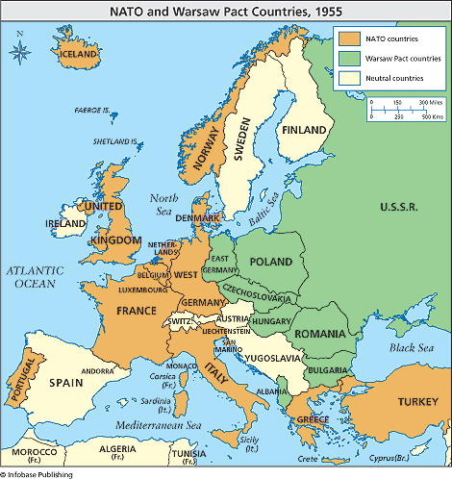
The formation of NATO and the Warsaw Pact
Key topic 1 – How did the Cold War develop? 1945-53 | Feature: NATO and the Warsaw Pact
The Berlin Blockade was the first military confrontation of the Cold War. It raised the possibility of war in Europe. Both sides arranged themselves in to two alliances and agreed that if any of their members came under attack, all members would come to their defence.
NATO (North Atlantic Treaty Organization)
Formed 1949
Warsaw Pact
Formed 1955

Slide 14
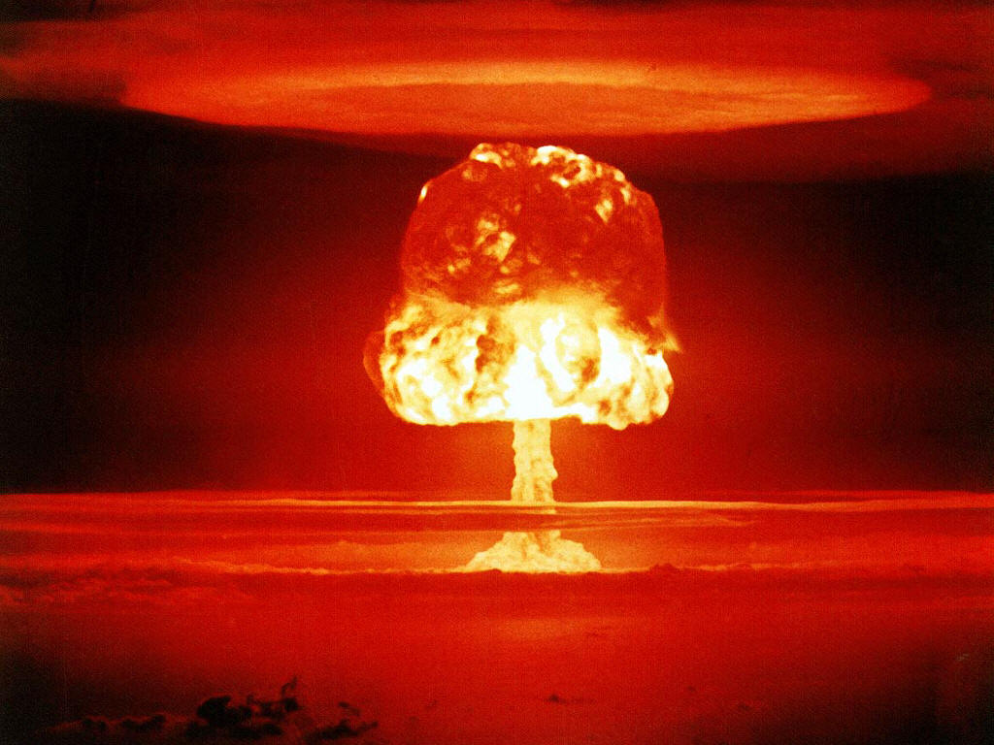
Key topic 1 – How did the Cold War develop? 1945-53 | Feature: The Arms Race 1945-55
Arms race (when countries compete to have the most effective armed forces)
In 1945, the USA became the first country to develop and use an atomic bomb.
By 1949 the USSR had caught up.
By 1953 both countries had hydrogen bombs.
The arms race prevented a war in Europe as Soviet leaders feared an American nuclear retaliation if they attacked, resulting in the deaths of millions.
Castle Romeo detonation, March 27 1954. Romeo was a hydrogen bomb and the third largest nuclear test carried out by the United States.

Slide 15
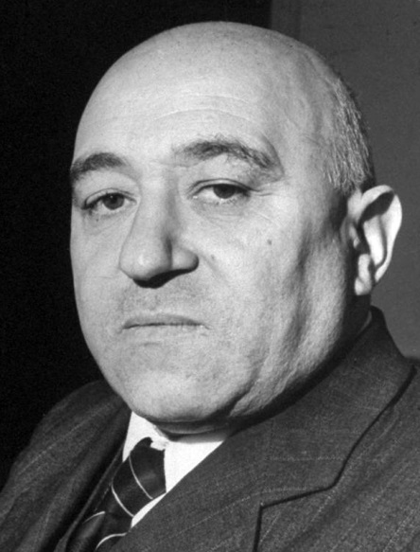
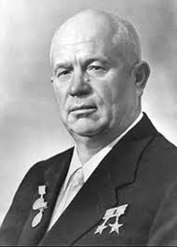
Causes of the Hungarian Revolution
Key topic 1 – How did the Cold War develop? 1945-53 | Feature: Causes of the Hungarian Revolution
Hungary had been controlled by Russia since 1945. Many Hungarians were angry because:
Hungarian land was redistributed to other Eastern European countries.
Hungarian coal, oil and wheat were shipped to Russia while Hungarians starved.
Communists executed popular political leaders and their supporters.
Matyas Rakosi, Hungary’s dictator from 1949 to1956, described himself as “Stalin's best pupil”. He imprisoned 287,000 people and was responsible for more than 2,000 deaths.
Matyas Rakosi
The death of Stalin in 1953 brought people in many Eastern European countries the hope of freedom and change. Khrushchev’s “secret speech” in 1956 criticised Stalin and set out a more liberal approach called “de-stalinisation”. This encouraged many Hungarians that changes would take place.
Nikita Krushchev, Leader of USSR 1953-64.

Slide 16
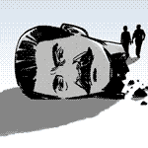
Key topic 1 – How did the Cold War develop? 1945-53 | Feature: Events of the Hungarian Revolution
During October 1956, students, workers and soldiers in Hungary attacked the AVH (the secret police) and Russian soldiers, and smashed a statue of Stalin.
July 1956, the 'Stalinist' Secretary of the Hungarian Communist Party, Rakosi, fell from power.

Slide 17
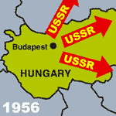
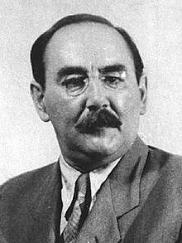
Key topic 1 – How did the Cold War develop? 1945-53 | Feature: Events of the Hungarian Revolution
July 1956, the 'Stalinist' Secretary of the Hungarian Communist Party, Rakosi, fell from power.
During October 1956, students, workers and soldiers in Hungary attacked the AVH (the secret police) and Russian soldiers, and smashed a statue of Stalin.
On 24 October 1956 Imre Nagy - a moderate and a westerniser - took over as prime minister.
Nagy asked Khrushchev to move the Russian troops out. Khrushchev agreed and on 28 October 1956, the Russian army pulled out of Budapest.

Slide 18
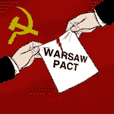
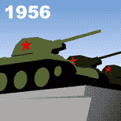
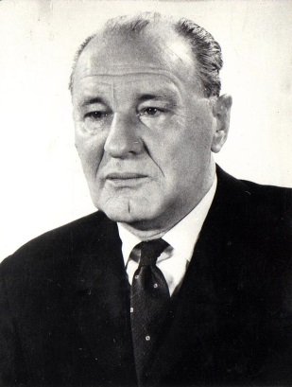
Key topic 1 – How did the Cold War develop? 1945-53 | Feature: Events of the Hungarian Revolution
For five days, there was freedom in Hungary. The new Hungarian government introduced democracy, freedom of speech, and freedom of religion.
Then, on 3 November 1956, Nagy announced that Hungary was going to leave the Warsaw Pact. Khrushchev was not going to allow this.
At dawn on 4 November 1956, 1,000 Russian tanks rolled into Budapest. They destroyed the Hungarian army and captured Hungarian Radio .
Hungarian people - even children - fought the Russian troops with machine guns. Some 4,000 Hungarians were killed.
Khrushchev put in Russian supporter, Janos Kadar, as prime minister.

Slide 19
Events of the Hungarian Revolution
July 1956, the 'Stalinist' Secretary of the Hungarian Communist Party, Rakosi, fell from power.
During October 1956, students, workers and soldiers in Hungary attacked the AVH (the secret police) and Russian soldiers, and smashed a statue of Stalin.
On 24 October 1956 Imre Nagy - a moderate and a westerniser - took over as prime minister.
Nagy asked Khrushchev to move the Russian troops out. Khrushchev agreed and on 28 October 1956, the Russian army pulled out of Budapest.
For five days, there was freedom in Hungary. The new Hungarian government introduced democracy, freedom of speech, and freedom of religion.
Then, on 3 November 1956, Nagy announced that Hungary was going to leave the Warsaw Pact. Khrushchev was not going to allow this.
At dawn on 4 November 1956, 1,000 Russian tanks rolled into Budapest. They destroyed the Hungarian army and captured Hungarian Radio .
Hungarian people - even children - fought the Russian troops with machine guns. Some 4,000 Hungarians were killed.
Khrushchev put in Russian supporter, Janos Kadar, as prime minister.

Slide 20
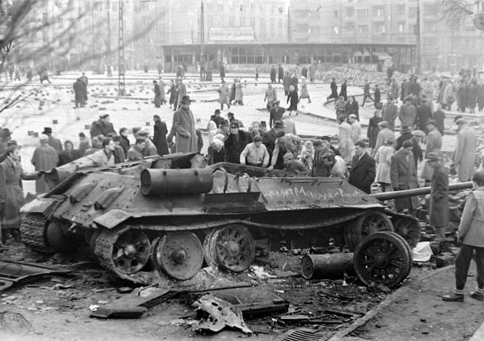
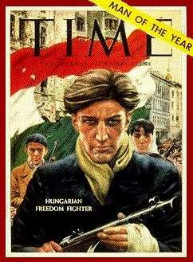
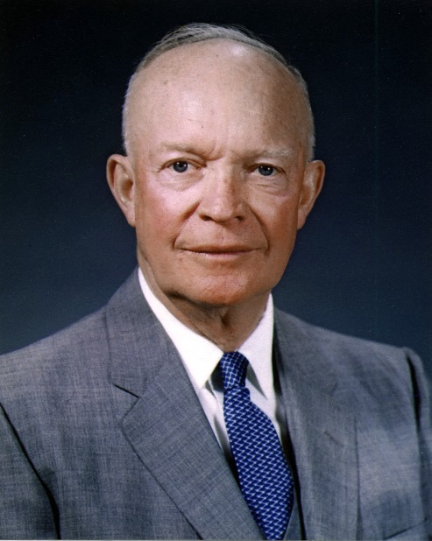
Key topic 1 – How did the Cold War develop? 1945-53 | Feature: Effects of the Hungarian Revolution
Nagy was arrested by soviet troops and accused of treason. He was hanged in June 1958.
President Eisenhower offered food and medical aid worth $20 million to the Hungarians and praised the bravery of the Hungarian people.
However the USA failed to support Hungary militarily – this discouraged many Eastern Europeans from protesting.
The UN condemned the Soviet invasion. Spain, the Netherlands and Sweden boycotted the 1956 Olympics in protest.
Many Western Communists left Communist Parties.

Slide 21
Key topic 1 – How did the Cold War develop? 1945-53 | Quiz
What is a sphere of influence”?
countries which are influenced by a larger country
What was the Grand Alliance and who was it against?
USA, USSR and UK against Nazi Germany
At the Tehran Conference in 1943 why was Stalin angry at the Allies?
USA/UK had delayed opening a second front against Nazi Germany.
Who attended the Potsdam Conference in July 1945?
Truman, Stalin and Atlee.
What did Truman keep secret from Stalin at the Potsdam Conference?
Atomic bomb
Why did Truman and Stalin disagree on what should happen to Germany?
Truman wanted Germany to be a trading partner – Stalin wanted it weakened.
Which telegram in 1946 said that “there could be no peace with the USSR while it was opposing capitalism”?
Long Telegram
Name 3 ways the USSR took over Eastern Europe 145-47.
The USSR kept control by: controlling the army, setting up a secret police force and arresting their opponents.
What was the Truman Doctrine?
America would send troops and economic resources to help governments that were threatened by communists.
What was the Marshall Plan?
help Europe recover from the war using $17 billion of American money

Slide 22
Key topic 1 – How did the Cold War develop? 1945-53 | Quiz
What did the British and Americans do to their German zones in 1947?
United them as “Bizonia”.
What was the name of the currency that the Allies introduced into their West German zones?
Deutschmark
During the Berlin airlift, how often did a plane land at Berlin's Templehof airport? Every 3 minutes.
What were the two opposing alliances during the Cold War called?
NATO and Warsaw Pact.
Who described himself as “Stalin's best pupil”?
Rakosi
Name one reason why many Hungarians were angry with the USSR?
Hungarian land was redistributed to other Eastern European countries. Hungarian coal, oil and wheat were shipped to Russia while Hungarians starved.
Communists executed popular political leaders and their supporters.
What policy did Khrushchev set out in his “secret speech” of 1956? D
De-stalinsation
Who took over as Hungarian Prime Minister after the fall of Rakosi?
Imre Nagy.
What did Nagy do that concerned Khrushchev?
Wanted to leave the Warsaw Pact.
Who was appointed Hungarian Prime Minister after the revolt was crushed?
Janos Kadar
Why were many Eastern Europeans discouraged from protesting after the Hungarian uprising?
America did not intervene militarily.

Slide 23
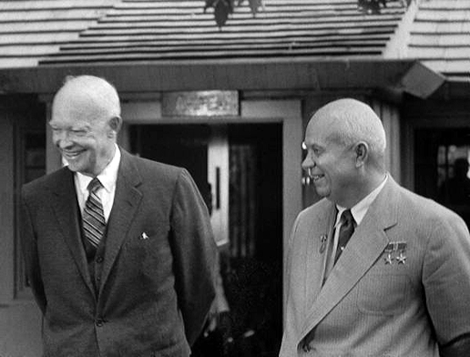
Key topic 2 – Three Cold War crises Berlin, Cuba and Czechoslovakia 1956-69 | Feature: Causes of Berlin Crisis
West Berlin caused problems as it was controlled by the Americans but deep inside the Eastern Bloc.
Many East Germans fled to West Germany. Between 1949-61, 2.7 million East German refugees, many highly skilled, escaped to the West.
This was an embarrassment to Khrushchev.
In November 1958 Khrushchev made an ultimatum giving US troops six months to withdraw from West Berlin.
President Eisenhower did not want to lose West Berlin, but neither did he want to start a war. An international meeting was set up to discuss Berlin’s future.

Slide 24
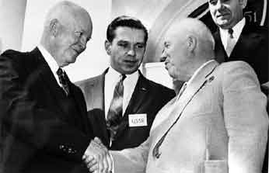
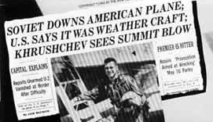
Key topic 2 – Three Cold War crises Berlin, Cuba and Czechoslovakia 1956-69 | Feature: Berlin Crisis negotiations
Summit/date | Attended | Outcome
Geneva May 1959 | Foreign representatives from USA and USSR | Agreed for Khrushchev to visit the USA and meet Eisenhower
Camp David September 1959 | Eisenhower and Khrushchev | Agreed to hold another meeting next year. Khrushchev withdrew ultimatum.
Paris Summit May 1960 | Eisenhower and Khrushchev | Nothing – USSR had shot down a US spy plane just before the summit. Khrushchev walked out when Eisenhower refused to apologize

Slide 25
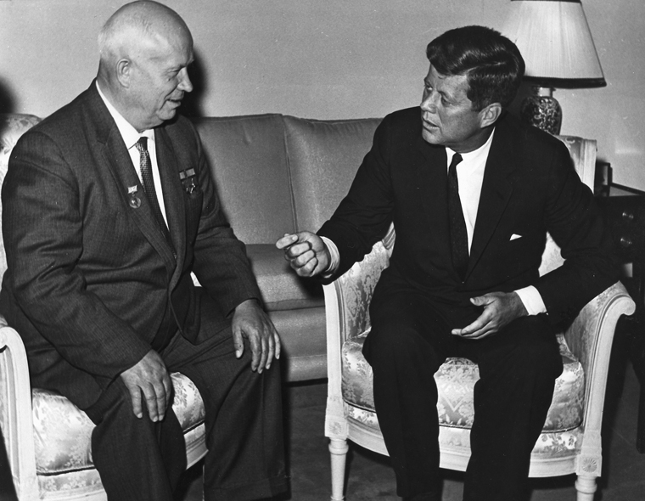
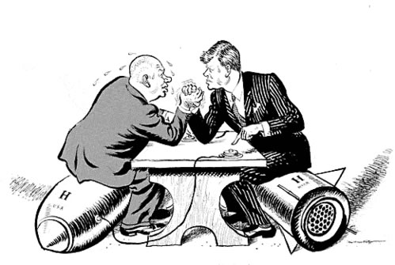
Key topic 2 – Three Cold War crises Berlin, Cuba and Czechoslovakia 1956-69 | Feature: Berlin Crisis negotiations
Summit/date | Attended | Outcome
Vienna Conference June 1961 | Kennedy and Khrushchev | Khrushchev again gave a 6 month ultimatum. He thought he could exploit Kennedy’s inexperience. Kennedy refused to back down.

Slide 26
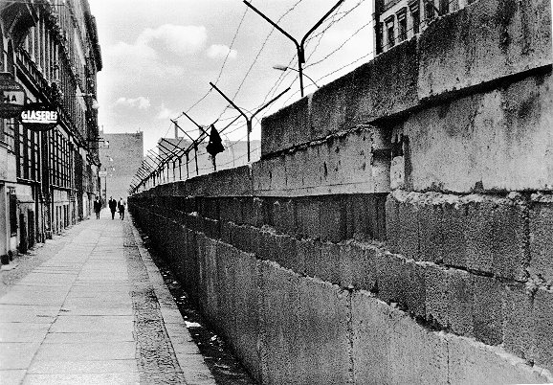
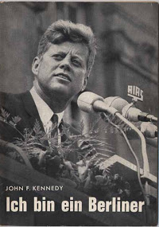
Key topic 2 – Three Cold War crises Berlin, Cuba and Czechoslovakia 1956-69 | Feature: Berlin Wall
Khrushchev knew that the USSR would not win a nuclear war as the USA had almost 20 times more nuclear weapons.
On 13 August 1961, Khrushchev closed the border between East and West Berlin and started building the Berlin Wall.
It stopped East Germans escaping to the West and therefore ended the refugee crisis.
It allowed Khrushchev to avoid war with American while still appearing strong.
At first, the Russians regarded it as a propaganda success, but as time went on, it became a propaganda disaster - a symbol of all that was bad about Soviet rule.
“All free men, wherever they live, are citizens of Berlin and therefore as a free man, I take pride in the words “Ich bin ein Berliner”.

Slide 27
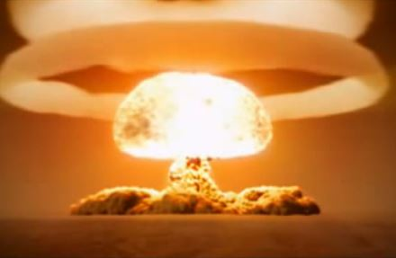
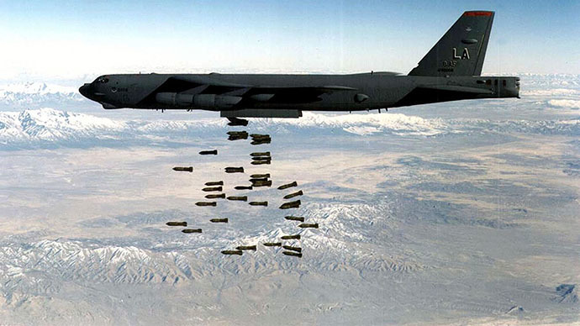
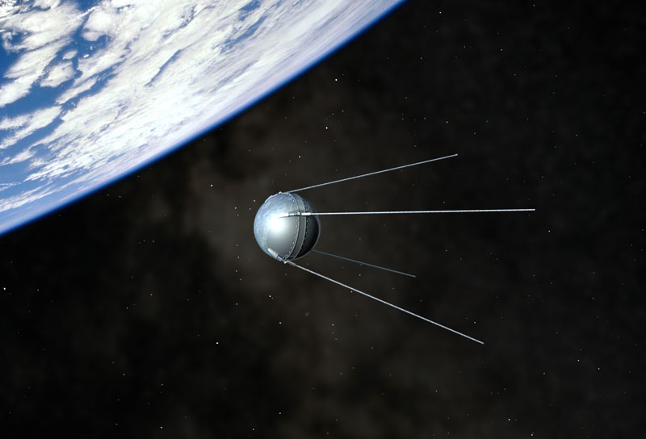
Key topic 2 – Three Cold War crises Berlin, Cuba and Czechoslovakia 1956-69 | Feature: Arms race to 1961
USA was worried that the USSR was building lots of weapons quickly. The Tsar Bomba, detonated in 1961, was the most powerful bomb ever.
USSR was worried that US had nuclear missiles in UK, Italy and Turkey.
In 1957 the Russians launched Sputnik 1 – the worlds first man made satellite. The US was worried that Russia might launch nuclear missiles from space.

Slide 28
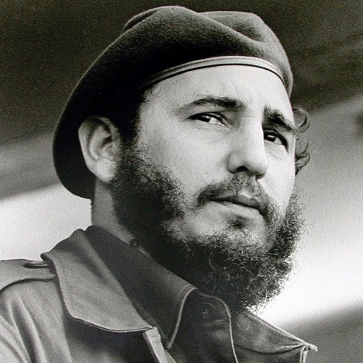
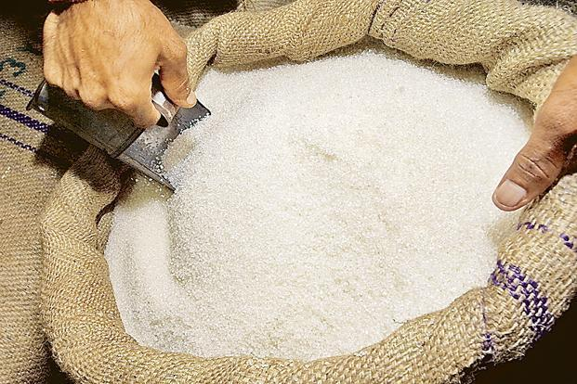
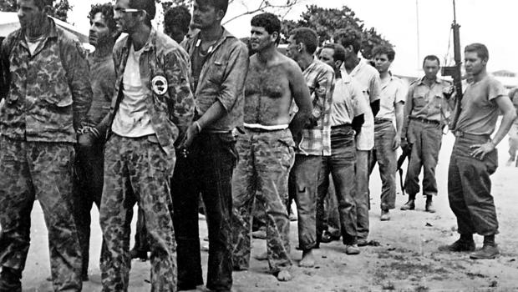
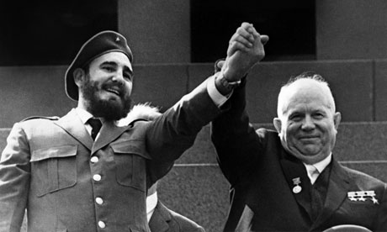
Key topic 2 – Three Cold War crises Berlin, Cuba and Czechoslovakia 1956-69 | Feature: Causes of the Cuban Missile Crisis
In 1959 1959, Fidel Castro took power in Cuba, an island just 90 miles away from Florida.
The Americans had many business interests in Cuba including railways, sugar and oil production.
When Castro came to power, however, he nationalised American companies in Cuba. In retaliation, the Americans stopped all aid to Cuba, and all imports of Cuban sugar.
Castro was forced to look to the USSR for help, and, in 1960, the USSR signed an agreement to buy 1 million tonnes of Cuban sugar every year.
In April 1961 the CIA trained 1,300 Cuban exiles to invade Cuba. They landed at the Bay of Pigs and were easily defeated. Kennedy was humiliated.
In September 1961, the USSR promised weapons to defend Cuba against America.

Slide 29
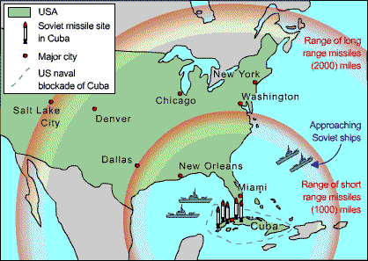
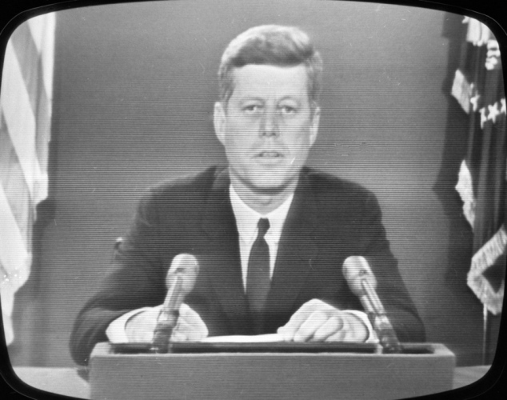
Key topic 2 – Three Cold War crises Berlin, Cuba and Czechoslovakia 1956-69 | Feature: Events of the Cuban Missile Crisis
On 14 October 1962, the Americans discovered the missile sites in Cuba.
These sites brought every town in the US within range of Soviet nuclear missiles.
President Kennedy called a meeting of the National Security Council and on 22 October went on TV to tell the American people that they were under threat.

Slide 30
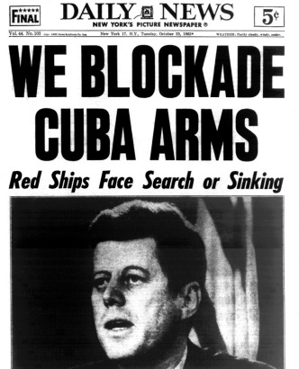
Key topic 2 – Three Cold War crises Berlin, Cuba and Czechoslovakia 1956-69 | Feature: Events of the Cuban Missile Crisis
Day | Events
Monday 22 October | Kennedy announces a naval blockade of Cuba. Kennedy warns of a full retaliatory response, if any missile is launched from Cuba.
Tuesday 23 October | Khrushchev explains that the missile sites are "solely to defend Cuba against the attack of an aggressor".
Wednesday 24 October | Twenty Russian ships head for Cuba. Khrushchev tells the captains to ignore the blockade. Khrushchev warns that Russia will have "a fitting reply to the aggressor".
Thursday 25 October | The first Russian ship reaches the naval blockade. It is an oil ship and is allowed through. The other Russian ships turn back. Secretly, the US government floats the idea of removing the missiles in Turkey in exchange for those in Cuba.
Friday 26 October | Russia is still building the missile bases. It seems that war is about to break out. But at 6pm, Kennedy gets a telegram from Khrushchev offering to dismantle the sites if Kennedy lifts the blockade and promises not to invade Cuba.

Slide 31
Key topic 2 – Three Cold War crises Berlin, Cuba and Czechoslovakia 1956-69 | Feature: Events of the Cuban Missile Crisis
Day | Events
Saturday 27 October | However, at 11am Khrushchev sends a second letter, demanding that Kennedy also dismantles American missile bases in Turkey. At noon on the same day, a U2 plane is shot down over Cuba. It looks as if a war is about to start after all. At 8.05pm, Kennedy sends a letter to Khrushchev, offering that if Khrushchev dismantles the missile bases in Cuba, America will lift the blockade and promise not to invade Cuba - and also dismantle the Turkish missile bases (as long as this is kept a secret).
Sunday 28 October | Khrushchev agrees to Kennedy's proposals. The crisis is over.
Tuesday 20 November | Russian bombers leave Cuba, and Kennedy lifts the naval blockade
Long term consequences:
USSR caught up with USA in the Arms Race.
Believed that any nuclear war would destroy both countries - Mutually Assured Destruction (MAD)
Immediate consequences:
In 1963, a telephone hotline was set up
In 1963, Limited Test Ban Treaty was signed. It banned testing of all nuclear weapons in space, in the sea and above ground.

Slide 32
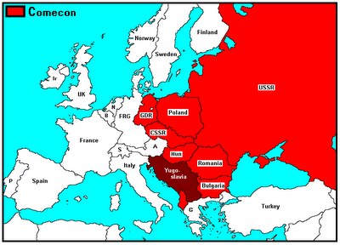
Key topic 2 – Three Cold War crises Berlin, Cuba and Czechoslovakia 1956-69 | Feature: Causes of the Prague Spring
The Czechs in the mid-1960s hated Russian control, especially:
Russian control of the economy, which had made Czechoslovakia poor.
The censorship and lack of freedom.
Secret police which crushed all opposition.
Czechoslovakia

Slide 33
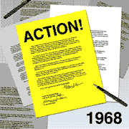
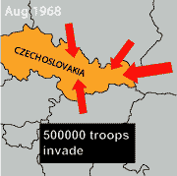
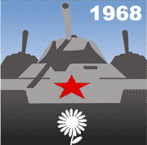
Key topic 2 – Three Cold War crises Berlin, Cuba and Czechoslovakia 1956-69 | Feature: Events of the Prague Spring
Antonin Novtony resigned and Alexander Dubcek became Communist leader on 5th January 1968.
In April 1968, Dubcek's government announced “socialism with a human face” - it removed state controls over industry and allowed freedom of speech.
For four months (the Prague Spring), there was freedom in Czechoslovakia. Censorship was relaxed and opposition was allowed.
Dubcek stressed that Czechoslovakia would stay in the Warsaw Pact. However Brezhnev was worried and announced the Brezhnev Doctrine - the USSR would not allow any Eastern European country to reject Communism.
On 20 August 1968, 500,000 Warsaw Pact troops invaded Czechoslovakia. Dubcek and three other leaders were arrested and sent to Moscow.
The Czechoslovakians did not fight the Russians. Instead, they stood in front of the tanks, and put flowers in the soldiers' hair.

Slide 34
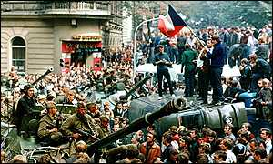
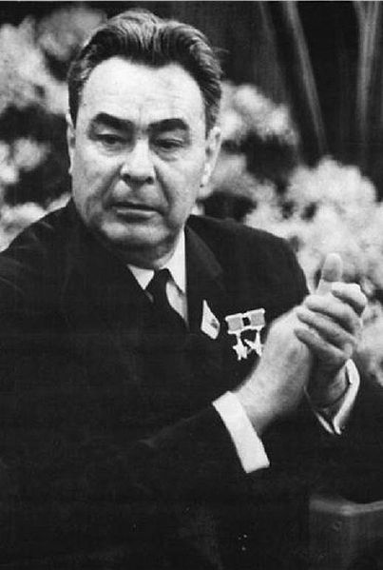
Key topic 2 – Three Cold War crises Berlin, Cuba and Czechoslovakia 1956-69 | Feature: Effects of the Prague Spring
After Dubcek’s arrest, Brezhnev put in Gustav Husak, a supporter of Russia, as leader.
It showed that America would not offer military support to a country wanting to break away from the USSR.
Russia stayed in control behind the Iron Curtain. The Brezhnev Doctrine stated that Iron Curtain countries would not be allowed to abandon communism.
People in the West were horrified and so were many communist countries, especially Romania and Yugoslavia. They formed alliances with China instead of the USSR.
Leonid Brezhnev
Leader of USSR
1964-82

Slide 35
Key topic 2 – Three Cold War crises Berlin, Cuba and Czechoslovakia 1956-69 | Quiz
Why did many East Germans escape to the West?
Higher standard of living, freedom.
How long did Khrushchev give the US to withdraw from Berlin in November 1958?
6 months
At what meeting, and with President, did Khrushchev withdraw his ultimatum?
Camp David 1959 with Eisenhower
Why did Khrushchev walk out of the 1960 Paris summit?
Eisenhower refused to apologize for spying on the Russians.
At what meeting, and with President, did Khrushchev reinstate his ultimatum?
Vienna 1961 with President Kennedy
When did Khrushchev build the Berlin Wall?
August 1961
What countries did the USA have missiles in by 1961?
UK, Italy and Turkey.
What did Russia launch in 1961?
Sputnik 1 – first man made object in space.
What did Castro do to US companies when he took over Cuba? How did the U.S retaliate?
Nationalised American companies. In retaliation, the Americans stopped all aid to Cuba, and all imports of Cuban sugar.
How was Kennedy humiliated in April 1961?
Bay of Pigs invasion.

Slide 36
Key topic 2 – Three Cold War crises Berlin, Cuba and Czechoslovakia 1956-69 | Quiz
What did Kennedy order around Cuba when missile bases were discovered?
Naval blockade
On Friday 26 October 1962, what does Khrushchev offer to do if Kennedy promises not to invade Cuba?
Khrushchev offered to dismantle the sites
However, what does Khrushchev demand in his second letter?
US to dismantle bases in Turkey.
Kennedy agrees – but only if what is kept secret?
The dismantling of US missile bases in Cuba.
Who became Communist leader of Czechoslovakia on 5th January 1968?
Alexander Dubcek.
What did Dubcek’s government announce?
“Socialism with a human face”
What was the Brezhnev “doctine”?
Stated that Iron Curtain countries would not be allowed to abandon communism.
How did the Czechoslovakians resist the Russian troops?
They stood in front of the tanks, and put flowers in the soldiers' hair.
How did Romania and Yugoslavia react to the Prague Spring?
Horrified – become closer to China as a result.

Slide 37
Key topic 3 – Why did the Cold War end? 1972-1991 | Feature: Détente (SALT 1 and SALT 2)
The Cuban Missile Crisis of 1962 brought the world to the brink of a nuclear holocaust. During the late 1960s and 1970s the two superpowers eased tension and tried to cooperate to avoid conflict in the Cold War. This policy was called détente.
SALT 1 was the first agreement between the superpowers that successfully limited the number of nuclear weapons each side had. Under the Helsinki Agreement, East and West Germany accepted each others borders for the first time.
This was called the Apollo-Soyuz Mission.

Slide 38
Key topic 3 – Why did the Cold War end? 1972-1991 | Feature: Soviet invasion of Afghanistan
In the Kabul Revolution of April 1978 a communist government under Mohammed Taraki, took power.
However the communist belief in atheism angered many Muslims and a civil war broke out between the Mujahedeen (Muslims fighting against the USSR) and the communist government.
Hafizullah Amin, the head of the army, assassinated Taraki and claimed presidency of the country.
In December 1979 the USSR invaded Afghanistan. They were concerned that:
Amin was an American spy
Afghanistan may become an Islamic state and therefore no longer communist.
Barbrak Karmal, an Afghan communist, argued he had enough popular support to form a new government but needed soviet help to defeat Amin’s military.
Results:
The USSR killed Amin and Karmal was declared President.
However the invasion lasted 10 years and 1.5 million people died, including 15,000 Russian soldiers.

Slide 39
Key topic 3 – Why did the Cold War end? 1972-1991 | Feature: The Carter Doctrine
The American President, Jimmy Carter, was appalled at the Soviet invasion of Afghanistan. He argued that the USA would not allow the USSR to gain control of territory in the oil-rich Middle East. This became known as the Carter Doctrine.
President Carter also took the following actions:
Supported the Mujahedeen (Muslims fighting against the USSR)
Stopped trade and diplomatic relations with the USSR.
Refused to ratify the SALT 2 treaty.
Increased defence spending by 5 per cent.
Organized boycott of the 1980 Moscow Olympic Games.
In retaliation, the USSR and 14 communist countries refused to take part in the 1984 Los Angeles Olympic Games.

Slide 40
Key topic 3 – Why did the Cold War end? 1972-1991 | Feature: Reagan and the ‘Second Cold War’
The “Second Cold War” was a period between 1979 and 1985 which marked a new low in superpower relations. The public was extremely concerned about the possibility of nuclear war.
In 1980, Ronald Reagan became president of the USA.
Reagan believed that détente had been a disaster for the USA.
He believed it was America’s destiny to fight for individual freedom in the Cold War.
As a strong anti-communist, he called the Soviet Union the "evil empire" that the Cold War was a fight between good and evil and that America fought with God’s blessing.
Reagans plan for winning the Cold War involved:
SDI (Strategic Defence Initiative)
An army of satellites would intercept soviet missiles in space and destroy them before they could do America any harm.
This technology was nicknamed “Star Wars”.
The USSR did not have the money or the technology to keep up with the USA in the arms race.

Slide 41
Key topic 3 – Why did the Cold War end? 1972-1991 | Feature: Reagan and Gorbachev’s changing attitudes
Mikhail Gorbachev was the last leader of the USSR, serving from 1985-1991. Gorbachev recognized that communism in Russia needed to be revived.
Perestroika (restructuring) – economic reforms designed to make the soviet economy more efficient.
Glasnost (openness) – censorship of the press was to be relaxed.
Summit between Reagan and Gorbachev | Aims | Why was it significant?
Geneva November 1985 | Reagan wanted to persuade Gorbachev that he sincerely wanted peace. Gorbachev was keen to establish a working relationship. | The two leaders were able to talk face to face and develop a personal relationship.
Reykjavik October 1985 | Reagan proposed scrapping all ballistic nuclear missiles. Gorbachev was unwilling to do this unless Reagan scrapped SDI.

Slide 42
Key topic 3 – Why did the Cold War end? 1972-1991 | Feature: Intermediate-range Nuclear Forces Treaty (INF)
What was the INF Treaty?
Following the Reykjavik meeting, American and Soviet diplomats continued to draft an arms-reduction treaty.
The Intermediate-Range Nuclear Forces (INF) Treaty was signed in Washington in December 1987.
This was the first treaty to actively reduce the number of missiles – SALT had only stopped them building more. Over the next four years both sides destroyed hundreds of missiles.
Why did Gorbachev sign the INF treaty?
Gorbachev realised the Soviet economy would never recover as long as it was spending so much money on nuclear weapons.
Gorbachev believed that disarmament would win him support in the West ad this would allow him to make profitable trade deals between the USSR and the West.

Slide 43
Key topic 3 – Why did the Cold War end? 1972-1991 | Feature: Summit conferences after Reagan
Summit | Attended by | What was agreed?
Malta 1989 | Bush and Gorbachev | Nothing – work started on CFE and START.
CFE Agreement 1990 (Conventional armed forces in Europe) | Bush and Gorbachev | Limited the size of armies NATO and the Warsaw Pact could have.
START 1 1989 (Strategic Arms Reduction Talks) | Bush and Gorbachev | Signed with pens made from scrapped nuclear missiles. Both sides agreed to destroy their nuclear missiles by a third. It also agreed that they would continue to reduce.

Slide 44
Key topic 3 – Why did the Cold War end? 1972-1991 | Feature: Fall of the Berlin Wall
East Germany had been slow to embrace perestroika and glasnost.
As soon as democratic elections were announced in Hungary there was a mass movement of East German citizens through Hungary to West Germany.
The East German government were forced to announce on 9th November 1989 that East Germans would be allowed to cross the border with West Berlin.
On hearing this news, thousands of East Berliners flooded the checkpoints in the wall. The border guards let them pass, the Berlin Wall had fallen.
The Warsaw Pact was formally dissolved in July 1991.

Slide 45
Key topic 3 – Why did the Cold War end? 1972-1991 | Feature: Collapse of the USSR
On 19 August 1991 a group of senior communists - known as the “Gang of Eight” – organized a coup which removed Gorbachev from power. They believed that perestroika and glasnost had weakened communism rather than reviving it.
The new government lasted three days. Boris Yeltsin, the future President of Russia, described the new government as “illegal” and called on the people of Moscow to resist the new regime.
Gorbachev resumed his position as leader of Russia.
His last attempt to save the USSR was by introducing a new constitution which was designed to give soviet republics, such as Latvia and the Ukraine, more freedom.
The leaders of these countries rejected this as they wanted full independence.
Gorbachev announced the dissolution of the USSR and his resignation as President on 25 December 1991.

Slide 46
Key topic 3 – Why did the Cold War end? 1972-1991 | Quiz
What did the Nuclear Non-Proliferation Treaty of 1968 agree to?
Countries with nuclear weapons would not give this technology to anyone else.
Why was the SALT 1 treaty significant?
First agreement between the superpowers that successfully limited the number of nuclear weapons each side had.
Who recognized each other for the first time after the Helsinki agreement?
East and West Germany
What was the name of the group of Muslims who fought against the USSR (and the USA funded?)
Mujahedeen
Give one reason why the USSR invaded Afghanistan in 1979.
The USSR were concerned that:
Amin was an American spy
Afghanistan may become an Islamic state and therefore no longer communist.
Barbrak Karmal, an Afghan communist, argued he had enough popular support to form a new government but needed soviet help to defeat Amin’s military.
What was the Carter Doctine?
The USA would not allow the USSR to gain control of territory in the oil-rich Middle East.
What Olympic games did the US boycott in protest?
Moscow 1980
What did Ronald Reagan believe about the Cold War and the USSR?
He called the Soviet Union the "evil empire" that the Cold War was a fight between good and evil and that America fought with God’s blessing.
How did SDI (Strategic Defence Initiative) work?
Lasers would shoot down soviet missiles in space.
Why was the Intermediate-Range Nuclear Forces (INF) Treaty signed in December 1987 significant?
First treaty to actively reduce the number of missiles – SALT had only stopped them building more.

Slide 47
Key topic 3 – Why did the Cold War end? 1972-1991 | Quiz
What did the CFE Agreement 1990 (Conventional armed forces in Europe) limit?
NATO and Warsaw Pact armies.
Why were the START 1 1989 (Strategic Arms Reduction Talks) significant?
Both sides agreed to destroy their nuclear missiles by a third. It also agreed that they would continue to reduce.
Which country did East German citizens escape through to West Germany in 1989?
Hungary
What did East Germany announce on 9th November 1989?
East Germans would be allowed to cross the border with West Berlin.
What was dissolved in July 1991?
The Warsaw Pact.
Why did a group of senior communists - known as the “Gang of Eight” – organize a coup to remove Gorbachev in August 1991?
They believed that perestroika and glasnost had weakened communism rather than reviving it.
Who lead the resistance against this coup?
Boris Yeltsin
What was Gorbachev’s last change to the Soviet constitution?
To give soviet republics such as Latvia and the Ukraine independence.
What date was the USSR dissolved?
25 December 1991

