Slide 1
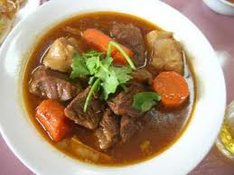
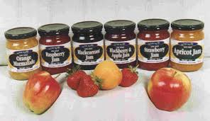
Work out the Words.
OF
St.
ES
THE
How many Historical words can you make out of the Phrase?

Slide 2
WALT: Who were the Stuarts?
WILFS:
ALL - Label the Timeline of the Stuart Monarchs. 4
MOST - Summarise the 5
SOME - Will finish all the tasks and compare! 6

Slide 3
TASKS
1 Task is to work out why James VI came to power and not a Tudor. Write a sentence in your own words.
2 Task is to complete a timeline for the Stuarts.
3 Task is to complete a FB profile for James VI
4 Task is to compare the Tudors to the Stuarts – Write down one fact.
5 Task is to Draw an image to remember facts about the Stuarts.

Slide 4
How did James VI become James I ?
On a cold, wet day in early 1603, Queen Elizabeth went out for a ten-mile horse ride. The next day, she went out for a long walk, before staying up all night dancing and talking. It was an amazing thing for a 69 year-old woman to do. By the end of the week, she was seriously ill with Pneumonia.
Despite being Queen for 45 years, Elizabeth had never married or had any children. This worried her advisors. Who would rule after she died?
Her advisors named Elizabeth’s cousin, James VI of Scotland, as her successor.
James VI, King of Scotland had also become James I of England.
Task One
Why James VI came to power and not a Tudor.
Write a sentence in your own words.
Who was he?

Slide 5
Timeline of the Stuarts
1603 March – James VI of Scotland crowned James I. | 1604 – James calls himself King of Great Britain. | 1605 Gunpowder Plot to assassinate James I discovered. | 1616 – William Shakespeare dies.
1625 – James I dies and his son Charles I crowned. | 1629 – Charles I dissolves Parliament and rules 11 years. | 1641 – Rebellion breaks out in Ireland. | 1642 – Civil War begins…
1643 – Charles I surrenders to the Scots. | 1649 – Charles I is EXECUTED. | 1649-1652 – Cromwell conquers Ireland & Scotland. | 1653 – Cromwell makes himself Lord Protector
1660 – Restoration of the Monarchy – King Charles II | 1664 – Great Plague kills 100,000 | 1666 – Great Fire of London. | 1685 – Charles II dies and James II becomes king.
1688 – Glorious Revolution. James II overthrown. | 1689 – William II becomes King. Mary II Queen. | 1694 – Bank of England is created. | 1694 – Mary dies, William rules alone. No children ☹
1701 – Act of Settlement – House of Hannover next in line. | 1707 – England and Scotland officially one country - GB | 1710 – St Pauls Cathedral completed. | 1714 – Ann dies and George I becomes King - END

Slide 6
Task Two
It doesn’t have to be perfect !!
Create a timeline of the key events of the House of Stuart – You must include at least the ones in bold.
- How long did they rule for ?
1603
1714
1625
1653
1689
1642
1649
1685
Write a sentence summarising the key events.

Slide 7
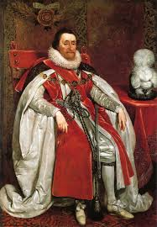
Facebook Profile of James I
King James I
TASK THREE
Come up with a QUICK facebook profile of King James I using Page 78 of the Textbook. Choose a couple of the Headings to the left.
Educations and Work
Interests
Beliefs
Intelligence
Fashion
Hygiene
Manners
Nicknames…

Slide 8
Compare the Facts
TASK FOUR
Compare at least One fact about the Tudors and the Stuarts.
How different or how similar are they…
Food –
People began to eat salad. They drank new drinks – tea from China, cocoa from Mexico, and coffee from Arabia. They would eat from porcelain dishes imported from China.
Stuarts treated the poor badly. They kept Elizabeth's Poor Laws. Anybody who refused to work was punished.
Fashion –
In Puritan households of the 17th century, clothes were very plain – black and white and made of hard-wearing cloth.
Cavaliers still dressed flamboyantly. Many women wore a false crescent-shaped beauty spot on their faces.
Entertainment –
Gentlemen went to the horse races, and played cards and board games. Smoking became popular.

Slide 9
Drawing Reminder…
Gunpowder Plot – Guy Fawkes
Civil War – England V England
No King – Cromwell – Lord Protector.
Great Plague !
Charles I executed (Head off)
TASK FIVE
Draw a quick reminder of the key events of the Stuart Period. Use Quick Symbols. Aim to get four symbols !!!
MORE RELIGION
Great Fire of London !
Union of England and Scotland

Slide 10
End…
Write down in your books Three Sentences
This week I will remember…
This week I will forget …
I want to know more about…

Slide 11
Homework
I want to know a bit about the Gunpowder Plot…
What happened?
How did it happen?
Who was involved?
Gunpowder, Treason and Plot…

