Slide 1
Title: Assessment preparation: Was King Charles to blame for the English Civil War
STARTER: Which is the odd one out. You need to write in your books which you think is the odd one out and why!
Extension: Can you link this to the topic the English Civil War

Slide 2
Title: Assessment preparation: Was King Charles to blame for the English Civil War
Learning Objectives:
I can explain the different causes of the English Civil War.
I can evaluate which cause was the most important and explain why.

Slide 3
Introduction
Your argument
Conclusion

Slide 4
MONEY
POWER
CAUSES OF THE ECW
RELIGION

Slide 5
Structure:
Introduction (Charles I was executed for his role in the events surrounding the English Civil War however, there is evidence to suggest that he was not entirely to blame. In this essay …)
Paragraph 1a: Charles I was to blame (Charles I was to blame for the English Civil War because…charge 1)
Paragraph 1b: Charles I was not to blame (However, it could also be argued that Charles I was not to blame for the English Civil war because … charge 1)
Paragraph 2a: Charles I was to blame (Furthermore, Charles I could also have been responsible for the English Civil War because…charge 2)
Paragraph 2b: Charles I was not to blame (Having said this, there is evidence to suggest that Charles I was not entirely responsible for the English Civil war because … charge 2)
Conclusion: Your verdict (In conclusion, I think that Charles I was/was not to blame for the English Civil War because …)

Slide 6
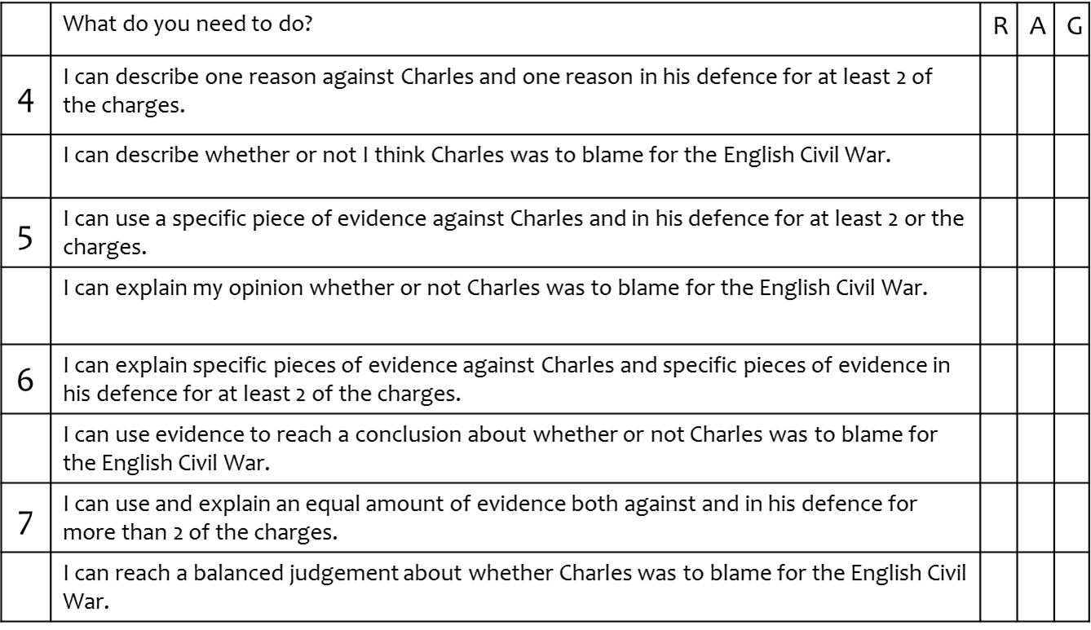
Self Assessment
Before you start…
Read your self assessment sheets and RAG yourself. Where are you going to focus your revision?

Slide 7
P.E.E
The English Civil War started for a variety of different reasons.
One of the causes of the English Civil War was power.

Slide 8
In 1625 Charles went to war with Spain and lost. | In 1629 Charles locked MP’s out of Parliament for 11 years. | In 1628, Charles went to war with the French and lost.
Many in England feared that Charles favoured the Catholics too much – after all her married one. | Charles firmly believed in the divine rights of kings to rule as he wished. | Since Henry VIII there had been many religious problems. Charles couldn’t keep everyone happy.
Charles spent a great deal of money on works of art. | In 1626 Parliament refused to raise money for Charles. | In 1640 Charles fought a war against the Scots and lots. He had to pay the Scots to leave.
Many feared that the children of Charles were being secretly brought up as Catholics. | There was a belief in the country that Parliament should have more say in how the country was run. | England had money issues. Charles shouldn’t have spent so lavishly.
Charles was arrogant and would not listen to the opinions of others. | Charles had too many favourites at court – he listened only to them. | Charles forced his way in the House of Commons BUT failed to arrest 5 MPs.
Charles decided to rule without Parliament after they would not give him the taxes. | Archbishop Laud tried to end Puritan ideas in the Church of England. | Archbishop Laud introduced a new prayer book to Scotland. They didn’t like it!
Charles used fines and ship money to raise money without Parliament’s agreement. The people were angry. | Charles called for all his loyal subject to join in a war against Parliaments supporters. | Elizabeth I had been a strong and fair ruler. Charles was not respected.

Slide 9
In 1625 Charles went to war with Spain and lost. | In 1629 Charles locked MP’s out of Parliament for 11 years. | In 1628, Charles went to war with the French and lost.
Many in England feared that Charles favoured the Catholics too much – after all her married one. | Charles firmly believed in the divine rights of kings to rule as he wished. | Since Henry VIII there had been many religious problems. Charles couldn’t keep everyone happy.
Charles spent a great deal of money on works of art. | In 1626 Parliament refused to raise money for Charles. | In 1640 Charles fought a war against the Scots and lots. He had to pay the Scots to leave.
Many feared that the children of Charles were being secretly brought up as Catholics. | There was a belief in the country that Parliament should have more say in how the country was run. | England had money issues. Charles shouldn’t have spent so lavishly.
Charles was arrogant and would not listen to the opinions of others. | Charles had too many favourites at court – he listened only to them. | Charles forced his way in the House of Commons BUT failed to arrest 5 MPs.
Charles decided to rule without Parliament after they would not give him the taxes. | Archbishop Laud tried to end Puritan ideas in the Church of England. | Archbishop Laud introduced a new prayer book to Scotland. They didn’t like it!
Charles used fines and ship money to raise money without Parliament’s agreement. The people were angry. | Charles called for all his loyal subject to join in a war against Parliaments supporters. | Elizabeth I had been a strong and fair ruler. Charles was not respected.

Slide 10
