Slide 1
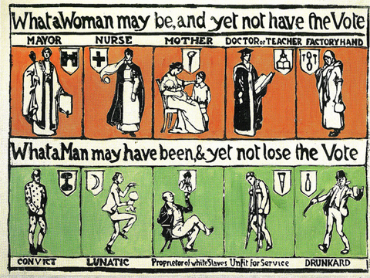
What is this source saying ? Who wrote it, why. Discuss!
WALT: What is the difference between the Suffragettes & the Suffragists

Slide 2
WALT: What is the difference between the Suffragettes & the Suffragists.
WILF:
L5 – Explain the differences between the groups methods.
L6 – Compare the suffragettes and the suffragists.
L7 – Evaluate the success of the Groups.

Slide 3
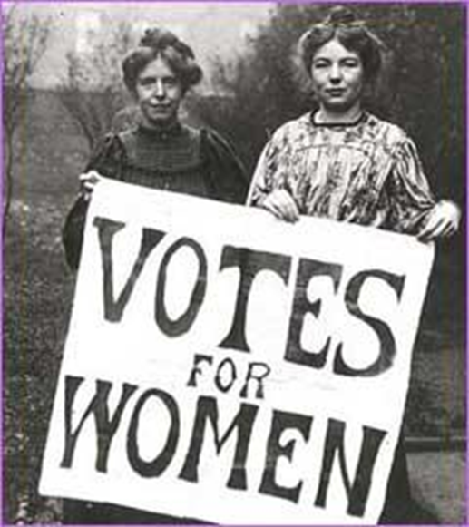
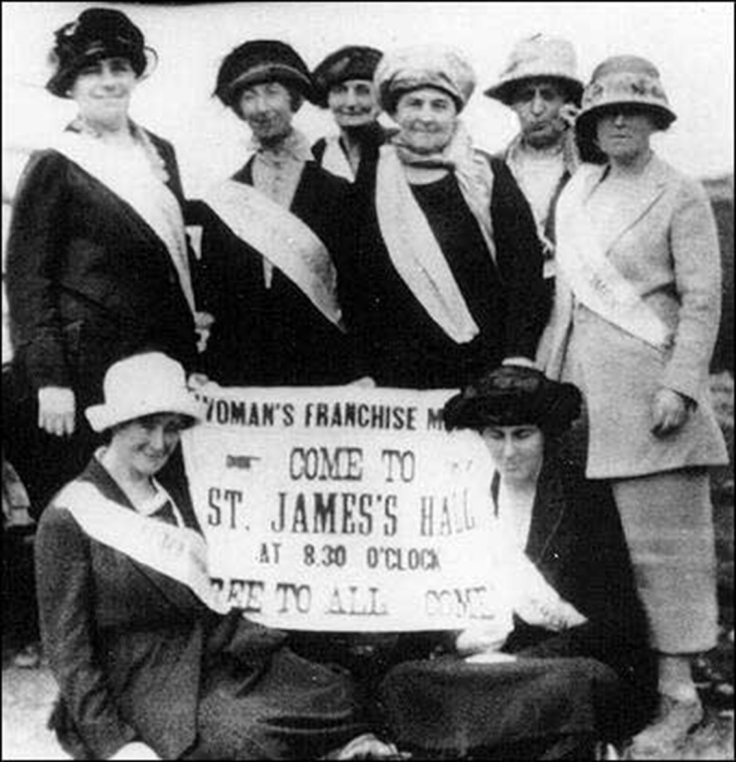
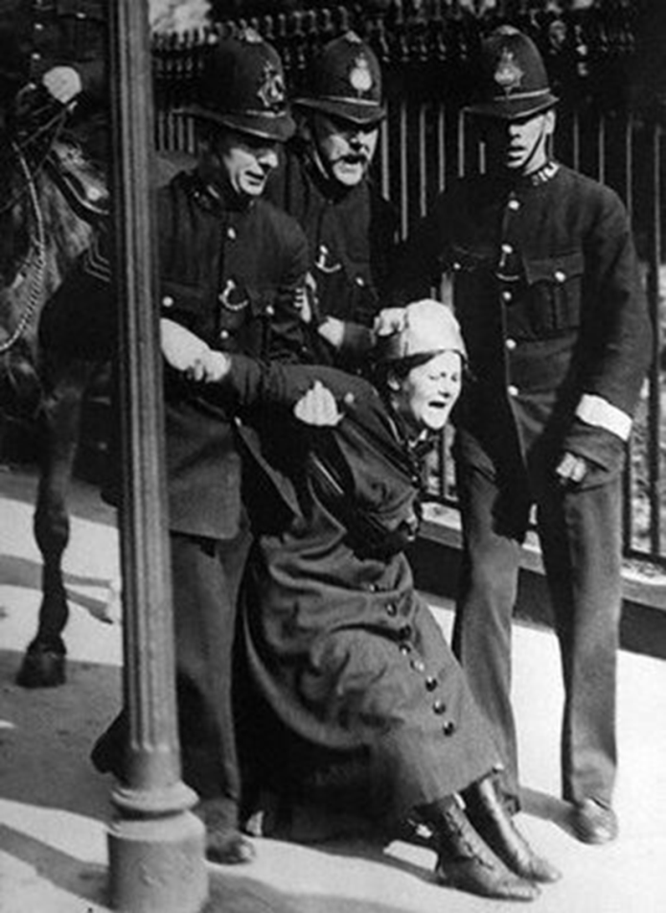
What the Difference?

Slide 4
TASK
You will now have 15 minutes to put as much information down on the Sheet of A3 as possible… WORK AS GROUP
You each have a pot of PlayDoh – You have to create something memorable from each pot to highlight a point about the Suffragettes / Suffragists.
You must place as much information around the A3 as possible to explain each creation.
You will peer assess each tables efforts.

Slide 5
SUFFRAGETTES
Example Information
Example Information
Example Information
Example Information

Slide 6
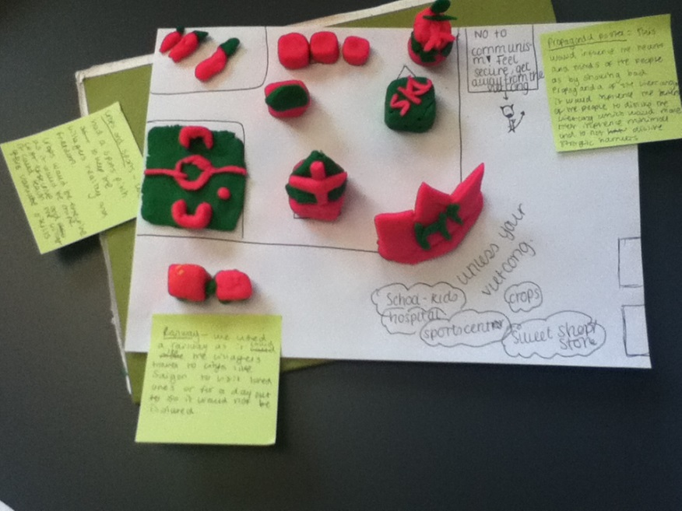
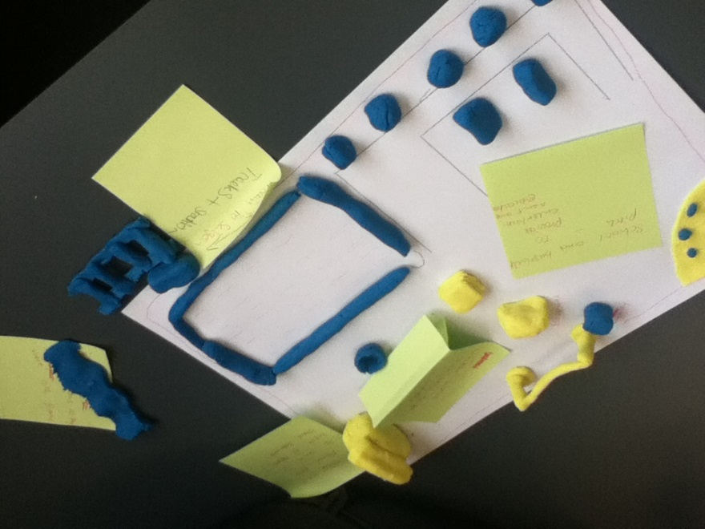
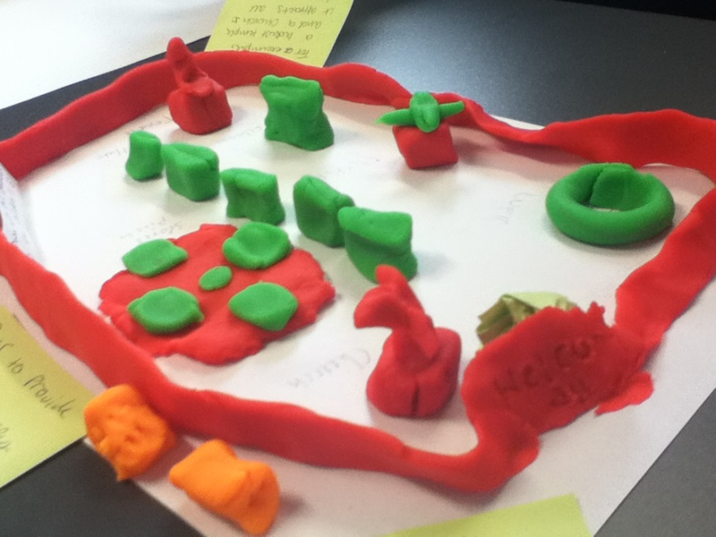
Example

Slide 7
Questions to help you
What methods did the different Groups use?
Who participated in the groups?
What years were particularly important and why?
Who were the leaders?
How effective were they?

Slide 8
On One page – Write notes about the Suffragettes – Other Suffragists.
You have One minute at each table
Take a note and move on. You need to visit each group.
Suffragettes
Suffragists

Slide 9
Written Task
Who was more effective the suffragettes or the suffragists in your opinion.
EXT: How would you react to the Suffragettes violence.
WILF:
L5 – Explain the differences between the groups methods.
L6 – Compare the suffragettes and the suffragists.
L7 – Evaluate the success of the Groups.

Slide 10
The Suffragists
In 1897, the various women’s suffrage societies joined together into the National Union of Women’s Suffrage Societies (NUWSS);
These ‘Suffragists’ continued to campaign peacefully for the vote;
They held meetings;
They went on Peaceful marches;
They wrote letters and prepared more petitions;
They had posters made;
But, although the number of pro-suffrage MPs in the House of Commons grew, the Suffragists got absolutely nowhere!
In 1866, a number of women took a petition, signed by 1,500 women to Parliament
They were asking for the vote;
Two of the very small number of pro-vote MPs presented it to Parliament
No action was taken, the women were ignored.
More and more groups of women and some men, began to get together to campaign for the vote;
They were called Suffrage societies;
They campaigned peacefully and Parliament took no notice of them.

Slide 11
The Suffragettes
The Suffragettes held mass-meetings;
They sent deputations to 10 Downing Street;
They began to interrupt debates in the House of Parliament, heckling from the Ladies Gallery;
When they were still not given the vote, they turned to violence;
They began chaining themselves to railings;
Next they started to smash windows;
Then they began a campaign of setting Post Boxes on fire;
In 1903, therefore, Emmeline Pankhurst, and her daughters Christabel and Sylvia, formed the Women’s Social and Political Union.
The ‘Suffragettes’, as they came to be called, were much more militant.
They were determined to make the government take notice;
They were led by Emmeline Pankhurst.
After 1910, when they were still not given the vote, the WSPU increased their violence;
They burned down churches and bombed Lloyd George’s house;
In 1913, Emily Davison threw herself under the king’s horse on Derby Day;
She was killed.

