Slide 1
Match your pictures.
Match the pictures of the Cavaliers and Roundheads.
These will form your groups for todays lessons.
4x5
2x4

Slide 2
WALT: Tell the difference between the Roundheads and Cavaliers?
L4: Describe some of the differences
L5: Explain why they were different
L6: Compare the Roundheads and Cavaliers methods and appearance.
L7: Evaluate the Roundheads and Cavaliers and come to a judgement.
Key Words
Roundhead Cavalier Parliamentarian Royalist Cromwell Charles

Slide 3
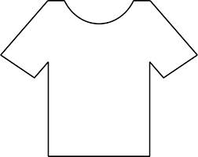
Task
You have 12 minutes to collect as much information about the Roundheads and Cavaliers as possible.
You each have a pen and as a group ONE tee-shirt.
One side is the Cavaliers, the other the Roundheads…
You will be writing a comparison / evaluation after the timers has ran out.
WALT: Tell the difference between the Roundheads and Cavaliers?

Slide 4
What I am looking for …
I want to see;
Who were the Roundheads, what did they look like?
Who were the Cavaliers, what did they look like?
Who was better equipped?
Who led the armies?
Where were they from?
Comparisons between the Roundheads and the Cavaliers.
EXAMPLE the Roundheads wore … where as the Cavaliers …

Slide 5
Peer Assessment
You will each have a couple of minutes to present to the other side. Give each other a WWW and an EBI and a level as a group based on the criteria below. BE POSITIVE.
L 4 – Description of the Roundheads and Cavaliers…
L 5 – Explained who supported who and why?
L 6c – Compared ONE difference between the R and C.
L 6b – Compared TWO differences between the R and C.
L 6a – Compared THREE or more differences…

Slide 6
Written Task
You now a choice of tasks.
You can either write a short comparison of the Roundheads and Cavaliers, explaining what they looked like, which side fought for who, who commanded them. – This will enable a Level 6.
The roundheads supported the … they were made up of … commanded by …
OR answer the following Question.
Why the Royalists more successful at the start, what changed? – You will need to make a JUDGEMENT for a level 7… What were the different factors, what was the most important and why.

Slide 7
Homework…
You will have a test on the causes of the English Civil War in the next couple of weeks.
This homework will show you how to write a good essay on the causes of the Civil War and enable the best grades. It is advisable to complete it…
WatHistory and Core – Download the attached word document and complete the Essay Plan… Stick it in your book next lesson. Could be helpful…

Slide 8
Plenary
One difference.
One similarity.
One thing interesting.

Slide 9
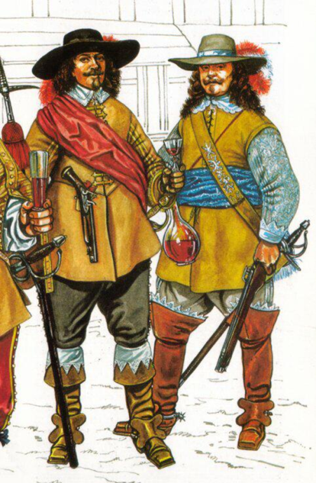
Royalists or ‘Cavaliers’
This is a Royalist soldier.
They may not looks like soldiers but at the beginning of the war they did much better.
They had better equipment and were used to guns.
They could have won the war earlier on but Charles was too cautious and would not advance on London.
Prince Rupert commanded the cavalry

Slide 10
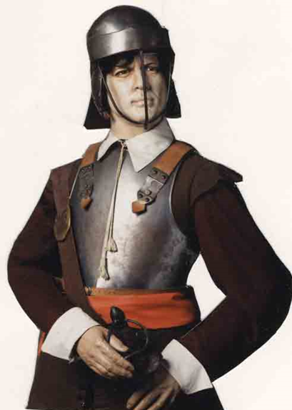
Parliamentarians or ‘Roundheads’
Parliament did not really have a proper army at the start of the war.
Oliver Cromwell and Thomas Fairfax emerged as very good leaders.
They formed and trained the New Model Army. Which was disciplined and well equipped.

Slide 11
Where were they from?
CAVALIERS - Catholics, most of the Nobles and gentry, about half of all Members of Parliament, the poorer areas of the North and West.
ROUNDHEADS - Puritans, the more militant Members of Parliament, merchants, the richer areas of the South and East.

Slide 12
Who supported who?
What you would expect. | What actually happened.
All the rich supported Charles. | In fact many of the rich opposed Charles…
Most of the MPs supported Parliament. | In fact nearly half of MPs were on the King’s side. Charles’ supporters were not just MPs from the SE but all over the UK…
Everyone took sides. | In fact, between a third and two thirds of the Rich took no active part in the war…
People Chose sides on a matter of principle. | In fact, many people did not choose which side they fought on. They tended to support whose army controlled their area…

Slide 13
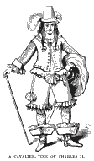
Royalists equipment.
The supporters of the King were called Cavaliers because many of them fought on horseback. The term comes from the French 'chevalier' meaning 'horse'. Cavaliers had long hair and wore fancy clothes.
Both sides used pikes and muskets (mainly matchlocks) for the 'Foot' or infantry. The 'Horse' (or cavalry) of both sides used swords and pistols.

Slide 14
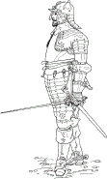
Roundheads equipment
Parliamentarians were nicknamed 'roundheads' because they cut their hair very short. They also wore very plain and simple clothes.
Both sides used pikes and muskets (mainly matchlocks) for the 'Foot' or infantry. The 'Horse' (or cavalry) of both sides used swords and pistols.

Slide 16
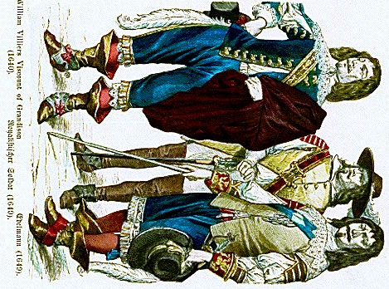

Slide 17
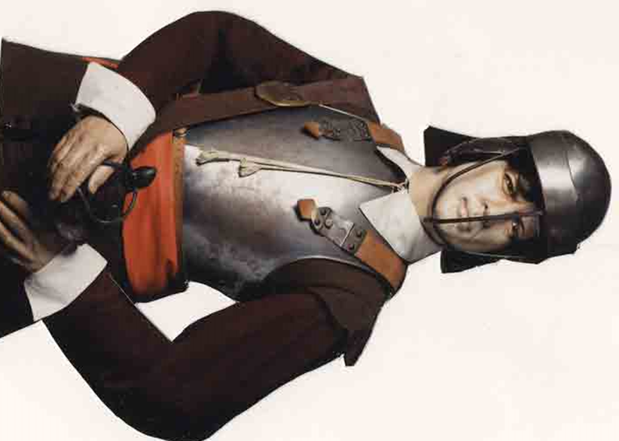

Slide 18
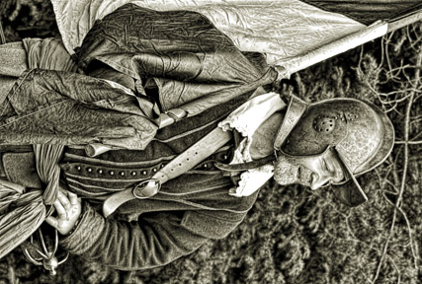

Slide 19
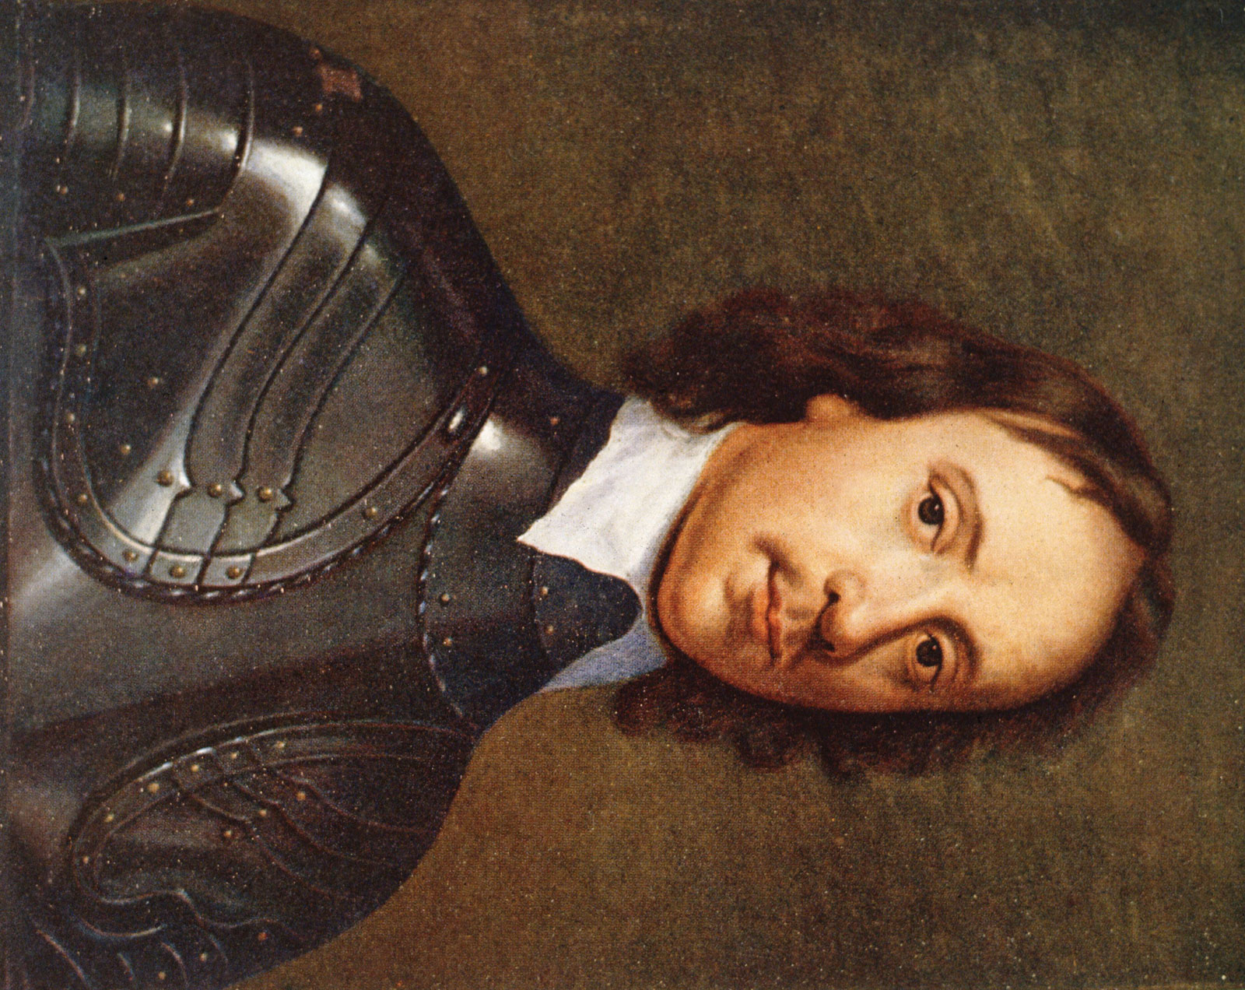

Slide 20
