Slide 1
WALT: What was life like for German workers and peasants?
WILFS
D- Understand The Motives Behind Nazi Employment Policy.
C- Compare The Experiences Of Both Groups.
B- Explain The Policies Towards The Workers And Peasants.
A- Evaluate The Success Or Otherwise Of The Nazi Policies.

Slide 2
Exam Question – June 2011
‘Nazi policies towards German workers and peasants did little to improve the lives of these groups in the years 1933 to 1939.’
Explain why you agree or disagree with this view.

Slide 3
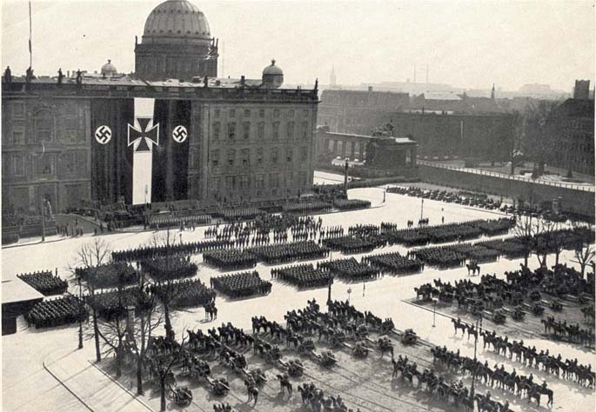
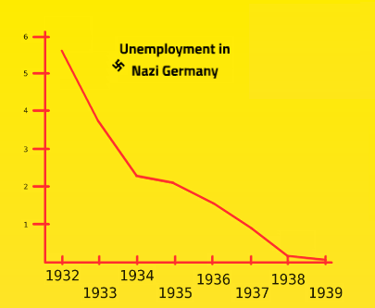
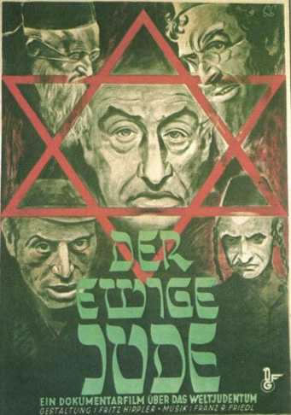
German Workers
What were the aims
of Nazi economic policy.
Link the Images – What do they represent?

Slide 4
How did the Nazis bring down unemployment.
RAD
Conscription
Sacking Others
Rearmament
Autarky

Slide 5
National Labour Service - RAD
In 1933 there were over 6 million Germans unemployed.
National Labour Service – RAD 1935
Compulsory for men aged 18-25 – 6 months in RAD
RAD workers built schools, hospitals, motorways etc.
RAD workers lived in camps
ADAPTED FROM WWW.EDUCATIONFORUM.CO.UK

Slide 6
Conscription
Conscription was introduced in 1935.
All men aged between 18-25 had to spend 2 years in one of the armed forces (army, air force, navy)
This cut around 1 million off the unemployment figures and trained Germans to be ready for war.
ADAPTED FROM WWW.EDUCATIONFORUM.CO.UK

Slide 7
Sacking Others
Jews were quickly banned from most areas of employment leaving vacancies for the unemployed
Women were increasingly encouraged to stay at home and start families – leaving vacancies for unemployed men.
ADAPTED FROM WWW.EDUCATIONFORUM.CO.UK

Slide 8
Rearmament
It was the Nazi Economic Policy to prepare for war and Germany quickly began to rearm.
New warships, tanks and guns were produced creating millions of jobs in these industries.
ADAPTED FROM WWW.EDUCATIONFORUM.CO.UK

Slide 9
Worker’s Rights
Workers had no rights in Hitler’s Germany.
The Coordination Laws of 1933 banned independent Trade Unions and it was made illegal to strike.
Trade Unions were replaced by the German Labour Front which was a Nazi controlled organisation.
ADAPTED FROM WWW.EDUCATIONFORUM.CO.UK

Slide 10
Trade Unions
Strikes – the traditional way for the working class to vent their anger over an issue – were banned. Strikes had been a thorn in the side of Weimar Germany in its final years.
Year | Day’s Lost to Strikes
1928 | 20,339,000
1930 | 4,029,000
1933 | 96,000
1934-1939 | 0
ADAPTED FROM WWW.EDUCATIONFORUM.CO.UK

Slide 11
German Labour Front
2nd May 1933 – Hitler ordered the SA to arrest Trade Union Leaders. Robert Ley was tasked with forming the DAF (Labour Front). The only Union like organization allowed in the Third Reich.
DAF set wage levels at a low level and a pay freeze was introduced.
DAF issued work books which recorded the work record of everyone – you couldn’t get work without one.
ADAPTED FROM WWW.EDUCATIONFORUM.CO.UK

Slide 12
German Labour Front (DAF)
Compulsory deductions made for Income Tax and SDA programme.
DAF had two sub groups.
KDF – Strength through Joy – Organised leisure.
SDA – Beauty of Work – Renovated workplaces and work canteens
ADAPTED FROM WWW.EDUCATIONFORUM.CO.UK

Slide 13
Strength through Joy (KDF)
The KDF aimed to encourage workers to work harder by giving them the incentive of better leisure.
The head of the KDF (Dr Ley) wanted to occupy the workforce to diver them from any opposition and make them refreshed to work harder.
The KDF organised cruises at bargain prices, skiing and walking holidays at a cheap rate, foreign tours, football and other sports events, and cultural and musical activities.
The KDF also set up special savings schemes to help them purchase a new VW beetle – The Peoples Car.
ADAPTED FROM WWW.EDUCATIONFORUM.CO.UK

Slide 14
Strength through Joy.
Ley ordered the building of two new cruise-liners that were used to take German workers on foreign holidays. In 1938 an estimated 180,000 people went on cruises.
Others were given free holidays in Germany.
Great propaganda tool for the Nazi Government. A propaganda sham perhaps?
ADAPTED FROM WWW.EDUCATIONFORUM.CO.UK

Slide 15
Conditions of Work
Beauty of Work (SDA) did much to improve working conditions however…
Wages actually fell and then were frozen.
Wages had recovered by 85% compared to 1928 levels.
Worked longer hours.
People who refused to go to work were imprisoned.
Striking was illegal.
ADAPTED FROM WWW.EDUCATIONFORUM.CO.UK

Slide 16
Nazi Agricultural Policy
Blut & Boden – Blood and Soil
Nazi ideology held traditional German peasants (small farmers) in very high regard.
Peasants were seen as racially pure being isolated from the more cosmopolitan German cities, and as more patriotic due to their attachment to their land.
Peasant were seen by Nazi ideologues as free from the moral decline and degeneration of urban Germany and therefore were central to the creation of a new purer ‘peoples community’.
ADAPTED FROM WWW.EDUCATIONFORUM.CO.UK

Slide 17
Policy Aims
Walter Darre – Minister for Food and Agriculture had 2 main aims:
1. To halt the population drift from countryside to the towns
2. To protect the peasants from debt and takeover by larger farms or retail outlets.
To do this the whole food industry was coordinated by a massive and bureaucratic organisation known as the Reich Food Estate.
ADAPTED FROM WWW.EDUCATIONFORUM.CO.UK

Slide 18
Reich Food Estate
Based on the Fuhrerprincip throughout.
Darre aimed to control both agricultural production and retail through a vast command structure.
The Reich Food Estate fixed prices and wage rates, set production quotas and dictated farming practices.
Such state direction and protection inevitably led to a recovery in the agricultural economy.
ADAPTED FROM WWW.EDUCATIONFORUM.CO.UK

Slide 19
Other Policies
The Reich Entailed Farm Law 1933 protected thousands of small farms from completion. Any farm over 30 acres was classified as an ‘Hereditary Farm’. An Hereditary Farm could not be divided up on the death of its owner – it had to be passed onto the eldest son intact.
Peasants were also given considerable financial inducement to stay on the land – For instance agricultural workers were exempt from National Insurance and Health Insurance.
ADAPTED FROM WWW.EDUCATIONFORUM.CO.UK

Slide 20
Evaluation – Success or Failure?
Half a million farms protected by Hereditary status.
Farmers income increased 41% between 1933-1936.
‘Command’ structure reduced farmers ability to innovate and invest – resented by many older peasants.
Agricultural wages remained significantly lower than industrial wages and with the return of full employment in 1936 the rural urban population drift re-emerged.
From 1936 onwards the Nazis were forced to merge smaller farms with larger farms to reap the economies of scale and increase food production – directly in opposition to ‘blood and soil’ ideology.
ADAPTED FROM WWW.EDUCATIONFORUM.CO.UK

Slide 21
Why did Agricultural Policy fail?
By 1939 Darre’s policy had largely been abandoned and Darre himself marginalised within the regime…Why?
1. Economic objectives of autarky and rearmament ALWAYS took precedence over social objectives of a ‘people’s community’.
2. With rearmament more and more land was needed for air bases, training camps etc.
3. Darre’s policies divided the peasants – older generation resented the interference – younger generation more enthusiastic about seizing opportunities offered by the Nazis.
ADAPTED FROM WWW.EDUCATIONFORUM.CO.UK

Slide 22
TASK
Come up with your own Worker’s Scheme to rectify the problems that workers now faced.
Ie. - Living wage scheme – Given workers had a relative fall in wage, my scheme pay’s workers what they deserve, so they can afford holidays etc…
Yours should be more detail – THINK about the failings of the the DAF/KDF/SDA

