Slide 1
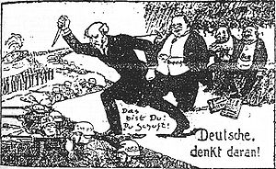
Title: Why was the Weimar Republic so unstable in its early days?
Starter: write down three questions you have about this picture.

Slide 2
Title: Why was the Weimar Republic so unstable in its early days?
L.O 1: To identify the problems Germany faced in November 1918
L.O2: To understand how the Weimar Republic was set up
L.O3: To assess the strengths and weaknesses of the new Weimar Republic

Slide 3
“Germans, think about it!”, postcard (1923). The man with the dagger is Philipp Scheidemann who was a member of the Weimar government. He is raising it behind the backs of German soldiers. He is receiving the approval of wealthy Jews in the background.

Slide 4
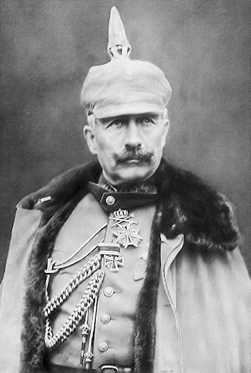
What was the Weimar Republic and why was it set up?
L.O2: To understand how the Weimar Republic was set up
In 1918, Germany was defeated in WW1 by the Allies (Britain, France, USA).
Its King (Kaiser) Wilhelm II was forced to abdicate (resign) and flee. A new republic (without a King) was set up to rule Germany.
However, it was too dangerous for this new republic to meet in Berlin. Instead, it met in the quiet town of Weimar.
Task
Read the timeline of events and create a summary in your books.
Copy and complete the sentences at the bottom of the sheet in your book.
Challenge: write down 4 quiz questions we could use to test someone's knowledge about Germany at the end of WW1.

Slide 5
What problems did the Weimar government face from 1919-23?
What was the Weimar Republic?
L.O3: To assess the strengths and weaknesses of the new Weimar Republic
Notes:
https://www.youtube.com/watch?v=_CMch8mHyXQ

Slide 6
Title: Why was the Weimar Republic so unstable in its early days?
STARTER
Can you link these images to the course so far? Write a sentence explaining their link…
L.O 1: To identify the problems Germany faced in November 1918
L.O2: To understand how the Weimar Republic was set up
L.O3: To assess the strengths and weaknesses of the new Weimar Republic

Slide 8
Weimar Constitution
The perfect democracy?
These features of the Republic served to ensure that it was the perfect democracy:
A Bill of Rights guaranteed every German citizen freedom of speech and religion, and equality under the law.
All men and women over the age of 20 were given the vote. This was even better than Britain where only women over 30 could vote.
There was an elected president and an elected Reichstag (parliament).
The Reichstag made the laws and appointed the government, which had to do what the Reichstag wanted.

Slide 9
However …
Proportional representation - instead of voting for an MP, like we do in Britain, Weimar Germans voted for a party. Each party was then allocated seats in the Reichstag exactly reflecting (proportional' to) the number of people who had voted for it. This sounds fair, but in practice it was a disaster it resulted in dozens of tiny parties, with no party strong enough to get a majority, and, therefore, no government to get its laws passed in the Reichstag. This was a major weakness of the Republic.
Article 48 - this said that, in an emergency, the president did not need the agreement of the Reichstag, but could issue decrees [Decrees: Laws passed by one minister in a parliament, which have not been approved by the majority parliament. ]. The problem with this was that it did not say what an emergency was, and in the end, it turned out to be a back door that Hitler used to take power legally.

Slide 10
L.O2: To understand how the Weimar Republic was set up
Plenary: Can you match the Weimar Republic positions with their responsibilities?
The Prime Minister, proposes new laws
Veto laws passed by the Reichstag
All men and women over 20 have the right to
vote for the Reichstag, President, and local
government
D. By which the country is governed
E. The head of state
F. Vote on new laws and on the budget
President
Reichstag
Voters
Reichsrat
Chancellor
The Laws

Slide 11
Homework
Imagine you are a journalist from a small German village. You have been sent to Weimar in January 1919 to report back on the new government.
Create a newspaper report on your findings.

Slide 12
Roaming Review
i) What was the impact of the defeat in the war on Germany? ii) How fairly was Germany treated in the Versailles Treaty? iii) Why was the Weimar government so unpopular? iv) What were the main features of the Weimar constitution? v) What was the Spartacist revolt and why was it important? vI) What was the Kapp putsch revolt and why was it important? vii) What was the Munich putsch and why was it important? viii) Was the Weimar government doomed from the start? Explain your answer

Slide 13
Find Someone Who…
Can describe how Germany was treated by the Treaty of Versailles
Can give 3 reasons why the Weimar government was unpopular from the start
Can describe the Weimar Constitution
Can explain what the Spartacists Revolt was and why it was important
Can explain what the Kapp Putsch was and why it was important
Can explain what the Munich Putsch was and why it was important
Can explain why France wanted to punish Germany after the First World War
Can explain why France invaded the Ruhr in 1924
Can explain what hyperinflation was and how it affected people
Can explain why the period 1919-24 was a period of crisis for Germany

Slide 14
i) What was the impact of the defeat in the war on Germany?

Slide 15
ii) How fairly was Germany treated in the Versailles Treaty?

Slide 16
iii) Why was the Weimar government so unpopular?

Slide 17
iv) What were the main features of the Weimar constitution?

Slide 18
v) What was the Spartacist revolt and why was it important?

Slide 19
vI) What was the Kapp putsch revolt and why was it important?

Slide 20
vii) What was the Munich putsch and why was it important?

Slide 21
viii) Was the Weimar government doomed from the start? Explain your answer

