Slide 2
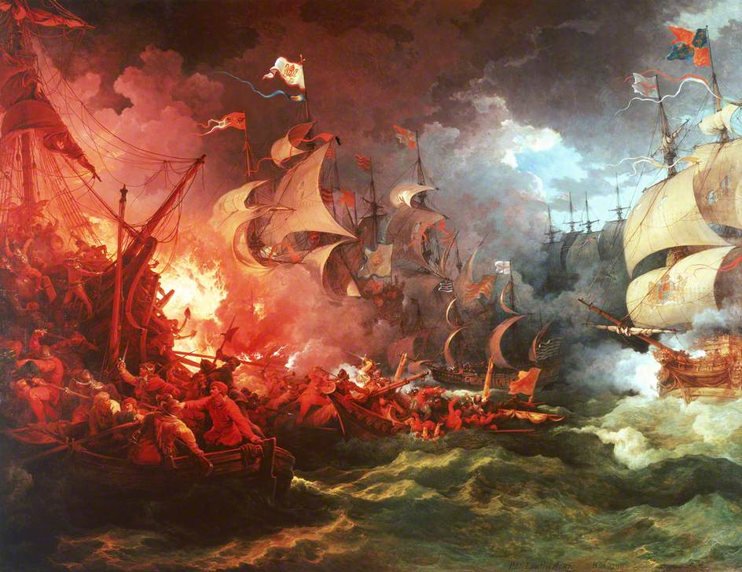

What are we studying today. Write down as many words this scene makes you think of…

Slide 3

WALT: How was the Spanish Armada defeated
5 – Explain why the Spanish invaded – What reasons?
6 – Compare the Plans - Who was more effective?
7 – Evaluate the plans - Why was it successful? – Use Sources in your answers.

Slide 4
Causes of the Invasion…
England increases the size of her navy
England seizes Spanish treasure
Elizabeth makes England Protestant
Private Trade
England harasses Spanish ships
Elizabeth supports the Dutch
Execution of Mary Queen of Scots
In Groups of TWO.
Sort the information cards into order of most significant.
The most important cause should be at the top.
The least important cause should be at the bottom.
L5 - In your opinion which is the most significant. Why have you chosen this..
L6 – What is the least important cause…
Compare your two…

Slide 5

The Plans
The English defence plan
Order traders and fishermen to bring over 150 ships to join Elizabeth’s navy of 28 warships at Plymouth
Order noble men called Lords Lieutenant, to train small bands of men to defend the coast in each county
Gather an army of about 5,000 men to defend London
Depend on the famous skill of England’s sailors
Pray for God’s help
Spanish plans of attack
Build 130 warships
Gather an army of 35,000 men in the Netherlands, just across the English Channel
Sail the Armada (fleet of ships) from Spain to the Netherlands and carry the soldiers from the Netherlands to England.
Depend on the famous power of Spain’s land forces
Pray for God’s help.
What strength did Spain depend on?
What strength did England depend on?
Which plan was better and why?

Slide 6
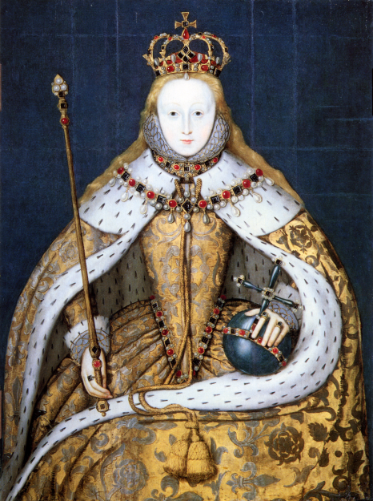
Queen Elizabeth First
"I know I have the body of a weak and feeble woman, but I have the heart and stomach of a King, and of a King of England too, and think foul scorn that Parma of Spain, or any Prince of Europe should dare to invade the borders of my realm. I myself will be your general, judge and rewarder of every one of your virtues in the field.“
Think-Pair-Share - What does Liz mean?

Slide 7
Peer Assessment.
Swap Sheets with the person sitting next you.
In your opinion what grade they have achieved. Have they met their EBI comment from Mr Watkins?
WWW –
EBI –
LIT –
5 – Explain why the Spanish invaded – What reasons?
6 – Compare the Plans - Who was more effective? Have they made a judgement.
7 – Evaluate the plans - Why was it successful? – Use Sources in your answers.

Slide 8
Homework - Events
King Philip II of Spain decided to attack Elizabeth. He was upset that England was becoming a Protestant country.
In April 1588 the Armada set sail but was blown of course. The Armada suffered a lot of damage and returned to port.
In July 1588 the Armada set sail again.
On July 19th the English spotted the Armada.
After the English spotted the Armada in July there was a running fight and the English chased the Armada up the English Channel.
On 27th July the Armada dropped anchor near Calais.
The English sent fire ships to attack the Spanish fleet. The Spanish panicked and sailed away.
The English attacked again on 28th July as the Spanish ships were trying to get away. The Spanish Armada was defeated and wanted to sail for home.
The Armada wanted to get home but could not get through the Channel and so they decided to sail north around Scotland. It was dangerous and many of the ships were damaged or destroyed on their way home.
Only 67 ships got back to Spain. A sad end for a great fleet.

Slide 9
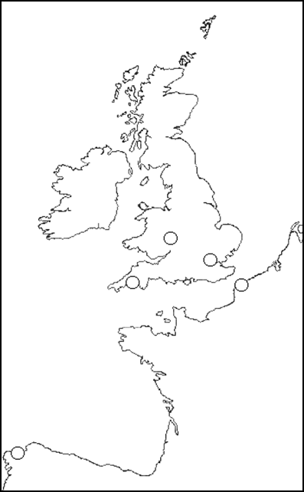
Homework
Website & CORE
Using the events of the Armada
Draw the route the Armada took.
Put a number along the route for
where each event took place.

