Slide 1
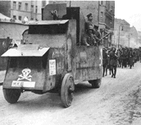
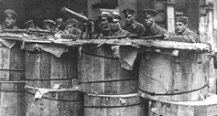
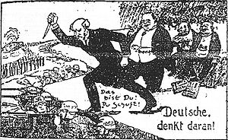
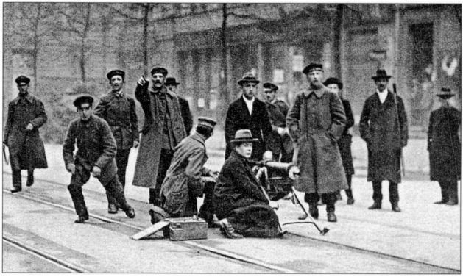
Starter: Look at the images below. They show groups of people who wanted to destroy the Weimar Republic.
Why might they want to do this? Make a list of your ideas.

Slide 2
Why was there opposition to the Weimar Republic 1918-23?
Keywords:
-Communist
-Spartacist
-Freikorps
-Kapp Putsch
Learning objectives:
I can describe the two different types of opposition to the Weimar Republic.
I can evaluate which threat was the most serious and why.

Slide 3
What threats were there towards the Weimar Republic?
The characters on your sheet show the threat to the Weimar Republic and how Ebert (the President) tried to deal with these threats.
Task 1
Match up the statements with who might have said them.
Task 2
Use the matched up statements to complete the sentences in your book.
Extension: Write a speech for one of the characters explaining why they’re opposed to Weimar.

Slide 4
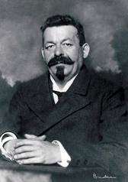
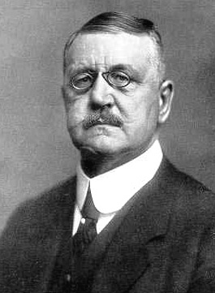
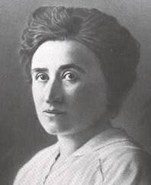
Who was the biggest threat to the Weimar Republic 1918-23?
You are going to be looking at the two main threats to Weimar 1918-23.
The Spartacists (Communists)
The Freikorps
Task
In your groups carousel around the 4 resource sheets. Use the information from the sheets to complete your fact file about the two different groups.
Spartacists
Ebert
Freikorps

Slide 5
What was the most serious opposition to the Weimar Republic 1918-23?
Copy and complete:
There were two groups who opposed the Weimar government. These were…
I think the most serious opposition to the Weimar Republic was the Spartacists/ Freikorps.
I think this because… (explain own opinion)
Spartacists
Ebert
Freikorps

Slide 6
What was the most serious opposition to the Weimar Republic 1918-23?
Spartacists
Freikorps

Slide 7
Little Big History
Whilst you watch the video, think about what you’ve learnt today and pick what decisions the character is going to make.
Spartacists
Freikorps

Slide 8
Plenary: Keyword bingo
Write down six of the keywords below into your book.
When I call out the definition of one of them, cross it off your list.
First to full a row wins!
Communist | Ebert | Freikorps | Kaiser | Kapp | KPD
Liebknicht | Luxembourg | Swastika | Putsch | Spartacist | Strike

