Slide 1
Can ‘PMT’ be a contributory factor in murder?
YES
NO

Slide 2
R v Smith (1979)
A murder charge was successfully reduced to manslaughter when PMT was taken as a contributory factor behind the killing…
What conclusions can be drawn from this?
What IDAs could this case link to?
Free will/Determinism
Nature/Nurture
Discuss with SP… Prepare to share.

Slide 3
WALT: What are the biological explanations of aggression?
WILFS:
Describe how biological and physiological processes affect aggressive behaviour.
Explain how biological explanations are split into hormonal and physiological explanations.
Evaluate these explanations (including research for and against).

Slide 4
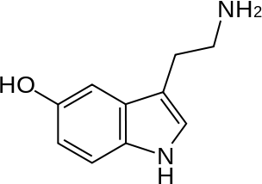
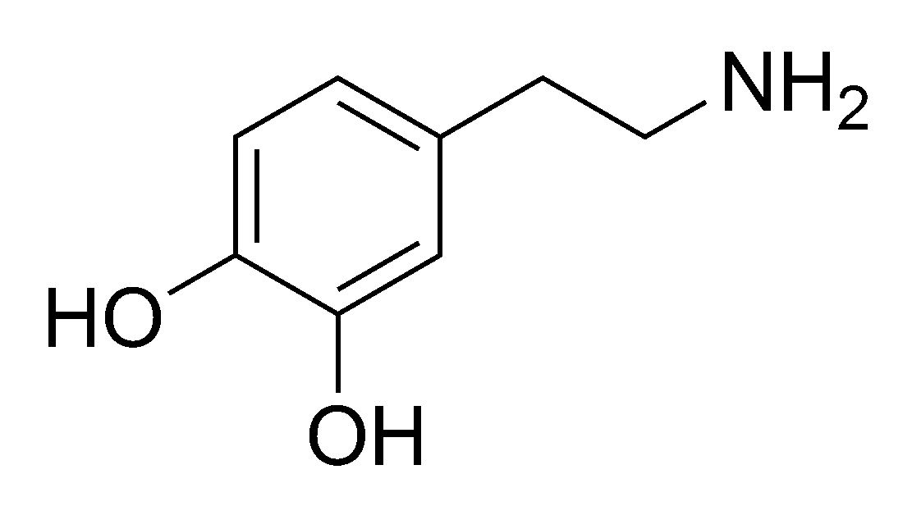
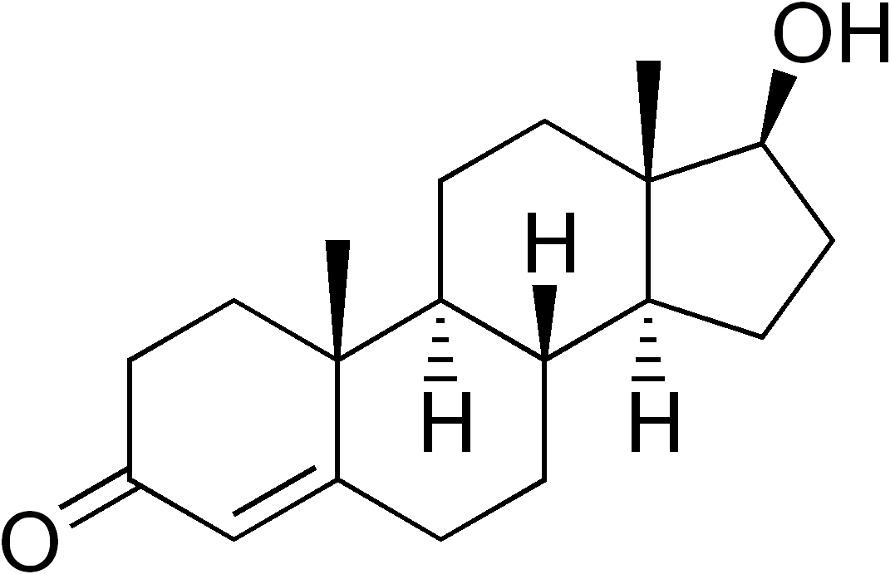
S, D, T.

Slide 5
Exam Questions.
Discuss the role of neural and/or hormonal mechanisms in aggression - (9 marks + 16 marks)
There are various neural and hormonal mechanisms linked to aggression, including:…This essay will examine [use 3].
Their role in aggression is complex and research has highlighted the different consequences of increased/decreased levels of these neurotransmitters and hormones and their varied affects on aggression.
For example, serotonin does…supporting research shows…however, [apply two IDA] to this…

Slide 6
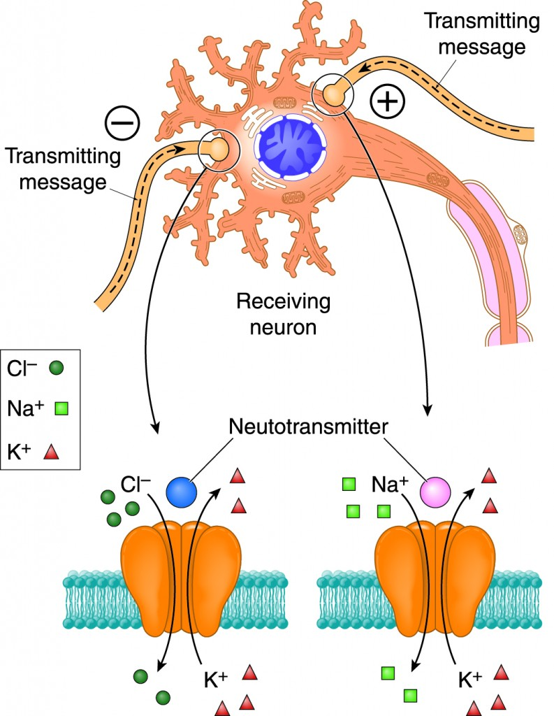
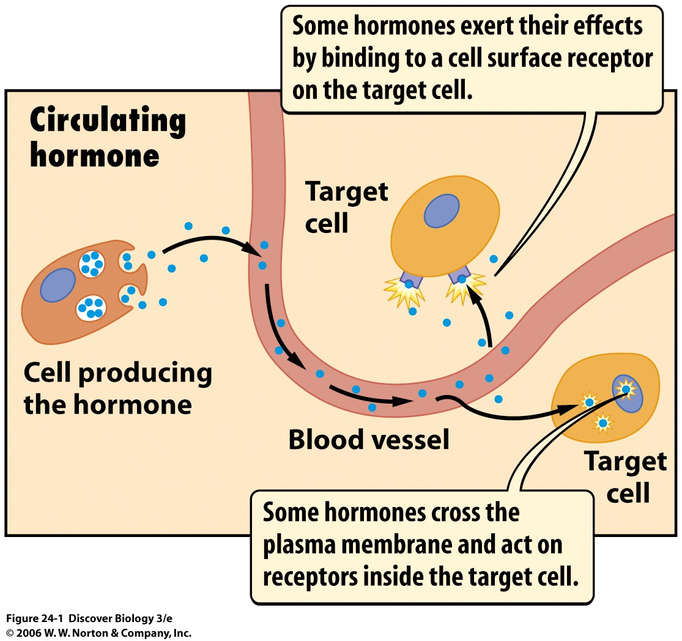
Definitions.
Neurotransmitter - a electro chemical produced and released by nerve cells to send signals to other nerve cells across a synapse.
Hormone - Secreted by specialized glands called endocrine glands into the bloodstream. They are essential for every activity of daily living, including the processes of digestion, metabolism, growth, reproduction, and even mood control.

Slide 7
Groups of Three…
Split into Groups of THREE and number yourselves 1-3.
1s get together, 2s etc.
You will research and complete your table for your assigned topic.
You will then have time to teach the others in your group.

Slide 8
Questions.
What is it? (Keep this short, it’s complex…)
How does it apply to aggression? (How does it cause aggressive behaviour?)
Arguments that support its application to aggression? (What research is there to support it?)
Arguments that challenge the hypothesis?
Cultural Bias?
Gender Bias?
Real world application?
Reductionist?
Deterministic/Free will?
Animal Testing?
Ethics?
Correlation?

Slide 9
Serotonin
The neurotransmitter serotonin has also been linked with increased aggression.
For example, people with a history of criminal behaviour have been found to have low levels of serotonin (Virkkunen et al., 1987).
Over the last 50 years there have been numerous investigations into the effect of serotonin on aggression. Davidson et al (2000) suggested that serotonin may provide an inhibitory function so that when comparing violent criminals to non violent criminals, the levels of serotonin were markedly lower. Certainly research on animals supports this conclusion – since when rats have low levels of serotonin an increase in aggressive behaviour is seen. Tame domestic pets have much higher levels of serotonin.
Serotonin has an influence, but it is not the only influence on behaviour. Neurotransmitters on their own, out of the context of the wider physiology of the brain, ignore the influence that brain structure has on demonstrating aggressive behaviour.
Evidence to support this alternative explanation has mainly come from post-mortem studies of the brains of people who have committed suicide. Arora and Meltzer (1989) found that people who had killed themselves using a very violent method had more serotonin receptor sites in the pre-frontal cortex than a control group who had not used violent methods.
Mann et al. (1990), Raleigh et al. (1991)
Real world applications – Antidepressants (as well as MDMD/LSD).
Issues include:
Nature/Nurture

Slide 10
Dopamine
Dopamine is a neurotransmitter that helps control the brain's reward and pleasure centers. Dopamine also helps regulate movement and emotional responses, and it enables us not only to see rewards, but to take action to move toward them. Dopamine deficiency results in Parkinson's Disease, and people with low dopamine activity may be more prone to addiction. The presence of a certain kind of dopamine receptor is also associated with sensation-seeking.
There is some evidence that there is a link between elevated levels of dopamine and dopamine activity in the brain and an increase in aggressive behaviour.
Dopamine agonists that reduce dopamine activity in the brain have been administered to reduce aggressive behaviour. One explanation for the effect of dopamine on aggressive behaviour is linked to the effect of dopamine on reward systems in the brain.
Aggressive behaviour may activate the release of dopamine and generate rewarding feelings. This reinforces aggressive behaviour: some people may seek out aggressive situations because it makes them feel good.
Ferrari et al (2003) conducted an experiment that forced rats to fight at exactly the same time every day for 10 days. On the 11th day the rats were not allowed to fight and the level of serotonin and dopamine was measured in their brain. Ferrari found that the rat’s serotonin levels had decreased and their levels of dopamine had increased. This shows that consistent aggressive behaviour had changed the rats brain chemistry
Issues include:
Correlation – Does dopamine lead to aggressive behaviour or does it lead to other behaviours such as addiction which has a link to aggression.
Supporting research – animal research?

Slide 11
Testosterone
One way to explain why men are generally more aggressive than women is in terms of the male hormone testosterone. Testosterone is produced by males in the testes. Women produce testosterone in the adrenal glands. Testosterone produces male characteristics.
Kalat (1998) reports that men aged 15 to 25, who have the highest levels of testosterone, also show the highest levels of violence as measured by crime statistics. Further evidence can be gleaned from the fact that in non-human animals, those males who have been castrated (and thus produce no male hormones) fight least.
Female aggression has also been linked to hormones. For example, Floody (1968) reviewed research on pre-menstrual syndrome and found evidence to support the view that during this time of hormonal fluctuation women increase in irritability and hostility, and also are more likely to commit a crime.
Research on the link between testosterone and aggression has mainly involved studies using correlational analysis or the measurement of levels of testosterone between aggressive and non-aggressive people.
Research suggests that higher levels of testosterone is associated with dominance behaviour rather than aggression. Some types of dominance behaviour may involve aggression but most do not. Evaluation Research has not found a consistent link between testosterone and aggression. A few studies have found a strong positive correlation between high levels of testosterone and high levels of aggression.
Issues include:
Freewill determinism

Slide 12
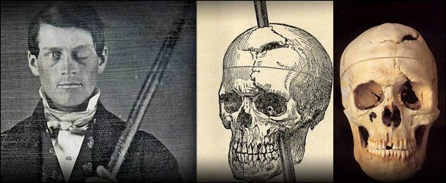
Brain Make-up (Neural)
A third way of explaining aggression in physiological terms is with reference to brain anatomy Raine, Buchsbaum, and LaCasse (1997) found significant differences in the brain structure of murderers and normal individuals, such as reduced activity in both sides of the prefrontal cortex and in the amygdala. One major difficulty with physiological explanations of aggression is that it is difficult to know whether physiological correlates are causes or effects of aggressiveness.

Slide 13
Question
You have low levels of serotonin.
You have high levels of dopamine.
You have high levels of testosterone.
What behavior would you expect from this person?
How else can you explain the behavior?

Slide 14
Should all males be castrated at birth?
YES
NO

Slide 15
Exam Questions.
Discuss the role of neural and/or hormonal mechanisms in aggression - (9 marks + 16 marks)
There are various neural and hormonal mechanisms linked to aggression, including:…This essay will examine [use 3].
Their role in aggression is complex and research has highlighted the different consequences of increased/decreased levels of these neurotransmitters and hormones and their varied affects on aggression.
For example, serotonin does…supporting research shows…however, [apply two IDA] to this…

Slide 16
Post-It
Outline either a Neural or a Hormonal explanation of aggression on your Post-It.
What is it?
How does it apply?
Supporting studies?
Evaluation point?
Stick it to the door an examine what others have come up with.

