Slide 1
Title: Ideological function of religion
Task: Can you link all of these images to our studies

Slide 2
Title: Ideological function of religion
Answer the exam question

Slide 3
Item A
In today’s Western societies such as Britain, there are clear gender & ethnic differences in religiosity in the UK. These difference can be found among all age groups, and in both non-Christian religions and almost every Christian denomination. Sociologists have suggested that socialisation and culture play a part in gender and ethnic divides of religiosity.
Q1. Applying material from Item A, analyse two reasons for differences in religiosity between gender & ethnic groups (10 marks)

Slide 4
Q1. Applying material from Item A, analyse two reasons for differences in religiosity between gender & ethnic groups (10 marks)
Marks | Level descriptors
8–10 | Answers in this band will show very good knowledge and understanding of religiosity between gender & ethnic groups. There will be two applications of relevant material, eg socialisation of women, closer to birth and death and Cultural defence . There will be appropriate analysis.
4–7 | Answers in this band will show a reasonable to good knowledge and understanding of religiosity between gender & ethnic group. There will be one or two applications of relevant material. There will be some basic analysis.
1–3 | Answers in this band will show limited knowledge and understanding of the question or the material. There will be limited focus on the question, eg there may be some drift into accounts of socialisation in general. There will be limited or no analysis.

Slide 5
Item B
Since the 1960’s there has been an explosion in the number of new religions and organisations, such as Krishna consciousness, scientology etc. There are estimated to be over 800 NRMs and over half a million individuals belonging to these and other non-mainstream Christian churches in the UK. Sociologists have offered three main explanations for this trend: marginality, relative deprivation and social change. Furthermore, there has been a growth of the ‘New Age’ since the 1980’s such as Yoga and meditation. Together, NRM’s and the ‘New Age’ have contributed to the decline of traditional religious organisations.
Q2. Applying material from Item B, evaluate sociological explanations for decline of traditional religious organisations in favour of New Religious Movements & the New Age (20 marks)

Slide 6
Applying material from Item A and your knowledge, evaluate the claim that religion performs an ideological function in the interests of powerful groups.
Marks | Descriptors
17-20 | AO1: Conceptually detailed knowledge of a range of material. AO2: Appropriate material applied accurately and with sensitivity to the issues. AO3: Analysis will be explicit and relevant. Developed through debate between perspectives. Analysis will be clearly explained. Conclusions drawn.
13-16 | AO1: Accurate, broad but incomplete knowledge of a number of aspects. AO2: Application is largely explicit and relevant though some may be less so. AO3: Limited explicit evaluation. And/or some appropriate analysis.
9-12 | AO1: Largely accurate knowledge but limited range and depth. Superficial understanding of material. AO2: Application is general with limited relevance or applied narrowly. AO3: Evaluation will be limited, tending towards description.
5-8 | AO1: Limited and undeveloped knowledge. Simplistic understanding of the material. AO2: Limited application of suitable material or irrelevant to the demands of questions. AO3: Very limited or no evaluation. Attempts at analysis are poor.

Slide 7
Applying material from Item A and your knowledge, evaluate the claim that religion performs an ideological function in the interests of powerful groups.
- Explain what is meant by ideology.
- Focus on explaining the Feminist and Marxist perspectives on religion.
- Identify the powerful interest groups.
- Explain how religions function is in their interest
Patriarchy, subordination, legitimation, capitalism, revolution, alienation, division of labour, false class consciousness, spiritual gin, opium of the people, exploitation.
Evaluate the strength of the views in comparison to the functionalist view or where submissive groups demonstrate religion does not perform an ideological function

Slide 8
Q2. Applying material from Item B, evaluate sociological explanations for decline of traditional religious organisations in favour of New Religious Movements & the New Age (20 marks)
Mark | Knowledge AO1 | Application AO2 | Evaluation AO3
17-20 | AO1: Conceptually detailed knowledge of a range of material. | AO2: Appropriate material applied accurately and with sensitivity to the issues. | AO3: Analysis will be explicit and relevant. Developed through debate between perspectives. Analysis will be clearly explained. Conclusions drawn.
13-16 | AO1: Accurate, broad but incomplete knowledge of a number of aspects. | AO2: Application is largely explicit and relevant though some may be less so. | AO3: Limited explicit evaluation. And/or some appropriate analysis.
9-12 | Ao1: Largely accurate knowledge but limited range and depth. Superficial understanding of material. | AO2: Application is general with limited relevance or applied narrowly. | AO3: Evaluation will be limited, tending towards description.
WWW
EBI
Response

Slide 9
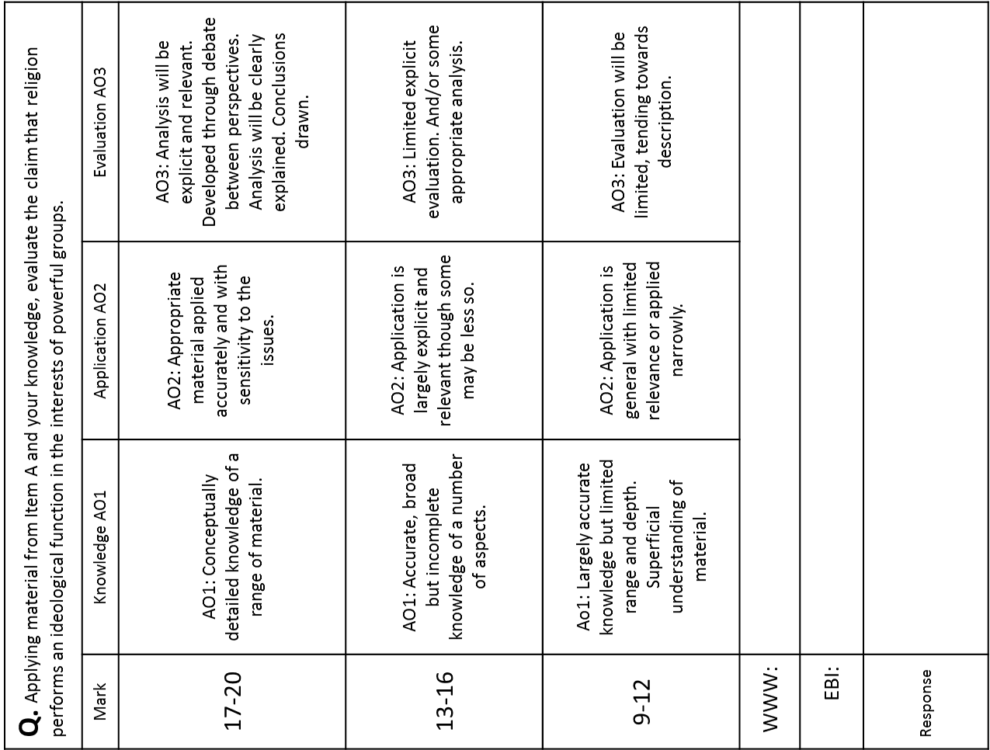

Slide 10
Q1. Applying material from Item A, analyse two reasons for differences in religiosity between gender & ethnic groups (10 marks)
Marks | Level descriptors
8–10 | Answers in this band will show very good knowledge and understanding of religiosity between gender & ethnic groups. There will be two applications of relevant material, eg socialisation of women, closer to birth and death and Cultural defence . There will be appropriate analysis.
4–7 | Answers in this band will show a reasonable to good knowledge and understanding of religiosity between gender & ethnic group. There will be one or two applications of relevant material. There will be some basic analysis.
1–3 | Answers in this band will show limited knowledge and understanding of the question or the material. There will be limited focus on the question, eg there may be some drift into accounts of socialisation in general. There will be limited or no analysis.
Time must be spent equally on each reason.
It is essential that you take two points from the Item and show through a chain of reasoning how each explains a difference in religiosity between social groups.
Socialisation - validates Women’s Traditional role this lead to a higher attendance.
Immigrant groups may use their ‘home’ religion as a means of cultural defence this leads to higher attendance

Slide 11
Q2. Applying material from Item B, evaluate sociological explanations for decline of traditional religious organisations in favour of New Religious Movements & the New Age (20 marks)
Marks | Level descriptors
17-20 | Answers in this band will show sound, conceptually detailed knowledge of a range of relevant material on the role of religion. Sophisticated understanding of the question and of the presented material will be shown. Appropriate material will be applied accurately and with sensitivity to the issues raised by the question. Analysis and evaluation will be explicit and relevant. Evaluation may be developed for example through a debate between different perspectives. Analysis will show clear explanation. Appropriate conclusions will be drawn.
13-16 | Answers in this band will show accurate, broad and/or deep but incomplete knowledge. Understands a number of significant aspects of the question; good understanding of the presented material. Application of material is largely explicitly relevant to the question, though some material may be inadequately focused. Some limited explicit evaluation and/or some appropriate analysis, eg clear explanations of some of the presented material.
9-12 | Answers in this band will show largely accurate knowledge but limited range and depth. Understands some limited but significant aspects of the question; superficial understanding of the presented material. Applying listed material from the general topic area but with limited regard for its relevance to the issues raised by the question, or applying a narrow range of more relevant material. Evaluation will take the form of a juxtaposition of competing positions or one to two isolated stated points. Analysis will be limited, with answers tending towards the descriptive.

