Slide 1
Title: To what extent does religion perform an ideological function?

Slide 2
Title: To what extent does religion perform an ideological function?
Describe the Marxist & Feminist perspective of religious functions
Explain these perspectives.
Evaluate the theories.

Slide 3
Title: To what extent does religion perform an ideological function?
Task: To what extent does religion perform an ideological function?
According to Marxists, in all non-communist societies, a ruling class own the means of production and from their wealth derive power, which allows them to control the superstructure of society.
The superstructure is the non-economic parts if society – e.g religion

Slide 4
Title: To what extent does religion perform an ideological function?
Task: How do you think Marxists may explain religion ?

Slide 5
Title: To what extent does religion perform an ideological function?
Task: How do you think Marxists may explain religion ?
From this point of view, religion is used to promote the interests of the ruling class by being used to support ruling-class ideology.
Ruling class ideology keeps the ruling class in power by discouraging subject classes from realising they are being exploited and then trying to overthrow ruling class power.

Slide 6
Title: To what extent does religion perform an ideological function?
Task: How do you think Marxists may explain religion ?
Marx (1842) famously described religion as the ‘opium of the masses’.
By this he meant that he saw religion as being like a drug that distorts reality and helps individuals deal with pain.

Slide 7
Examples of how religion does this…
Promises a paradise of eternal bliss in life after death, making life bearable by giving people something to look forward to.

Slide 8
Examples of how religion does this…
2. Make a virtue out of the suffering produced by oppression. In particular those who suffer poverty with dignity and humility, will be rewarded in the afterlife. Religion this makes poverty more tolerable.

Slide 9
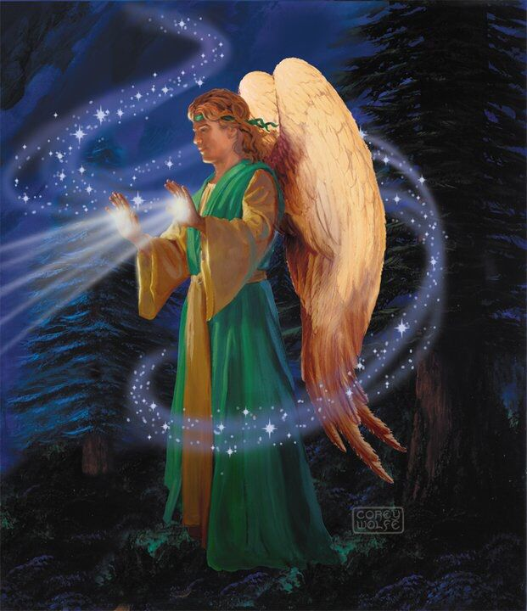
Examples of how religion does this…
3. Offer the hope of supernatural solutions to problems in earthly life. Anticipation of this future can make the present more acceptable.

Slide 10
Examples of how religion does this…
4. Often justify the social order and a person’s position within it. In this way social arrangements appear inevitable, and those at the bottom can accept and come to terms with their situation. In the same way, poverty and misfortune can be seen as a punishment for sin.

Slide 11
Gospel of St. Matthew 5:3-10 : Beatitudes
Title: To what extent does religion perform an ideological function?
Task: Does this piece of scripture demonstrate Marx’s point ?
Blessed are the meek, for they shall inherit the earth. Blessed are they who hunger and thirst for righteousness, for they shall be satisfied. Blessed are the merciful, for they shall obtain mercy. Blessed are the pure of heart, for they shall see God.

Slide 12
Therefore…
Religion justifies and legitimates the existing social order.
For example, in Medieval Europe, kings and queens ruled by divine right; they got their legitimacy from God.
Individuals were persuaded to accept their situation as it was divinely ordained and therefore something they should not challenge.

Slide 13
Religion and Alienation
Marx saw religion as a form of alienation.
As we give up our power and belief in a higher being, God, which in turn means we are giving up our true humanity by denying us the right to make our own decisions.

Slide 14
Religion and Social Control
Marx saw religion as a mechanism of social control.
It creates a false class consciousness – mistaken beliefs about the true nature of social life, which justify the position of the ruling class.
The ruling class (bourgeoisie) also adopt religious beliefs to justify their dominance, to themselves and others.

Slide 15
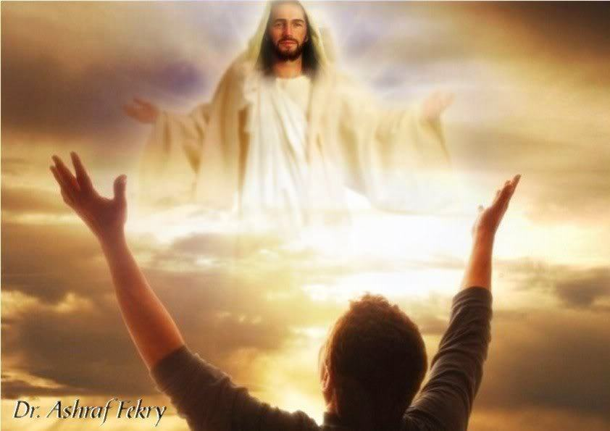
Religion and Social Control
This prevents the working class (Proletariat) developing class consciousness, in which they become aware that they are exploited, and unite to overthrow the capitalist system that exploits them.

Slide 16
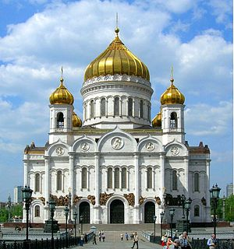
Essential to Note
In the Soviet Union under communist leadership from 1917 to 1990 the state consistently opposed the existence of religious beliefs and destroyed man Russian Orthodox Churches, as well as mosques and synagogues.
(Approx 150,000,000 Russian Orthodox now …)

Slide 17
Religion and Social Control
Marx believed on the advent of communism religion would no longer be necessary.
Since the means of production would be shared communally, and no one would own the means of production meaning there would be no social class.

Slide 18
Religion and Social Control
Without classes there would be no need for religion, as its sole purpose was to legitimate ruling class power.
Religion would therefore disappear.
However, communists countries such as Cuba now accept that religion will coexist with communism and they will no longer attempt to suppress it.

Slide 19
Task
Task: Complete the table.
Think about how they would support the Marxist view point.
Example | Description | How it supports the Marxist view
Slavery
The Hindu Caste System
The New Christian Right
Evangelical Christianity in Latin America.

Slide 20
Example | Description | How it supports the Marxist view
Slavery | In slave societies, slave masters tried to convert African Slaves to European religions
The Hindu Caste System | Traditional caste system which provided a clear hierarchy in society. Ranging from the Brahmins (priests) at the top to the Untouchables at the bottom.
The New Christian Right | Very religious Christians in the USA which highly conservative and pro-capitalist views.
Evangelical Christianity in Latin America. | NCR encouraged the spread of protestant beliefs in Catholic counties specifically Latin America.

Slide 21
Example | Description | How it supports the Marxist view
Slavery | In slave societies, slave masters tried to convert African Slaves to European religions | Slave masters saw religion as a way of controlling their slaves – preventing rebellions.
The Hindu Caste System | Traditional caste system which provided a clear hierarchy in society. Ranging from the Brahmins (priests) at the top to the Untouchables at the bottom. | No movement was permitted between the classes – therefore the ruling classes power was maintained.
The New Christian Right | Very religious Christians in the USA which highly conservative and pro-capitalist views. | Supports interests of the r/c in religious terms.
Evangelical Christianity in Latin America. | NCR encouraged the spread of protestant beliefs in Catholic counties specifically Latin America. | Protestant beliefs encourage religious discipline and hope for salvation in the afterlife. Discouraging Catholic liberation theology.

Slide 22
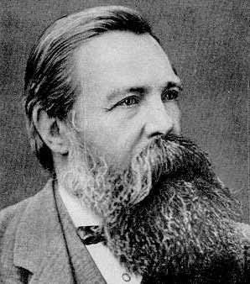
Engels (1957)
Recognise that religion didn’t always act as a conservative force supporting the interest of the ruling class.
He argues that religion started off amongst the oppressed groups in society as a way of coping with their oppression. In addition Engels believed that religion could be used as a force for change by uniting the oppressed group and giving them a common set of beliefs.

Slide 23
Criticisms
Functionalist – Marxism ignores the positive benefits of religion to society, such as the way it creates stability and shared values, which are necessary for society to function effectively. Religion benefits everyone, not just the ruling class.

Slide 24
Criticisms
Religion under communism – Attempts to destroy religion in communist countries were not successful. Religion survived in the USSR and Catholicism thrived in communist Poland.
Secularisation – Religion seems to have declined in many Western societies, suggesting it is no longer needed to maintain ruling class power.

Slide 25
Criticisms
The narrow focus of Marxism – By concentrating on just one possible role of religion in society it ignores the much broader range of effects religions might have.
Feminist Criticisms – Religion acts to preserve male, patriarchal power, not ruling class power. Marxists ignore gender and inequality.

Slide 26
Criticisms
Religion as a radical force - religion does not always support the status quo and the preservation of ruling class power. Some radical religions such as liberation theology challenge ruling class power.
Liberation theology was a radical movement that grew up in South America. It said the church should act to bring about social change, and should ally itself with the working class to do so. The late Pope John Paul II opposed the movement.

Slide 27
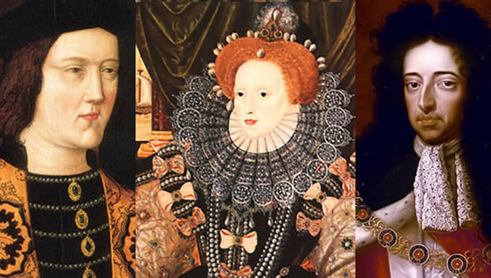
Evidence to Support Marxism
There are many examples from history where ruling groups have used religion to justify their dominance.
The caste system in traditional India was justified by Hindu religious beliefs; whilst in medieval Europe, Kings and queens ruled by ‘Divine Right’.

Slide 28
Bruce (1988)
Points out that conservative Protestants in the USA – the New Christian Right – consistently support right wing political candidates.
Although they had a limited influence on American politics, they have tended to defend the interests of the rich and powerful at the expense of other groups in the population.

Slide 29
Bruce (1988)
George W Bush (President from 2001-2009) consistently supported right-wing views, for example low taxes for the rich, and was a supporter of the New Christian Right.

Slide 30
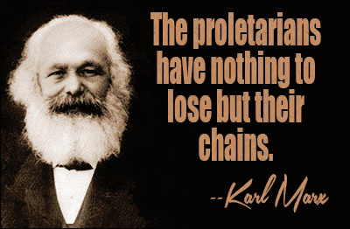
Summary
Marxism is a conflict perspective that highlights the ideological function of religion.
Marxists see religion as dulling the pain of class exploitation and as fostering false consciousness.
They see religion as a form of ideology and as a response to alienation.
For Marxists religion therefore legitimates social inequalities, disguises the true nature of exploitation and keeps the works passive and resigned to their fate.

Slide 31
Examining religion & social change
Task: Answer the following.
Identify three examples of ways in which religions may have been patriarchal
Give one example of how religion may be empowering for women?

Slide 32
Examining religion & social change
Task: Applying the material from Item A and your own knowledge, evaluate the claim that religion performs an ideological function in the interests of powerful groups. (page 11)
Introduction: Outline

Slide 33
Example | Description | How it supports the Marxist view
Slavery | In slave societies, slave masters tried to convert African Slaves to European religions | Slave masters saw religion as a way of controlling their slaves – preventing rebellions.
The Hindu Caste System | Traditional caste system which provided a clear hierarchy in society. Ranging from the Brahmins (priests) at the top to the Untouchables at the bottom. | No movement was permitted between the classes – therefore the ruling classes power was maintained.
The New Christian Right | Very religious Christians in the USA which highly conservative and pro-capitalist views. | Supports interests of the r/c in religious terms.
Evangelical Christianity in Latin America. | NCR encouraged the spread of protestant beliefs in Catholic counties specifically Latin America. | Protestant beliefs encourage religious discipline and hope for salvation in the afterlife. Discouraging Catholic liberation theology.

Slide 34
Feminism

Slide 35
What can you recall…
What can you remember about Feminism when covering it last year ?
Any particular key terms that you think may come back into use in this topic?

Slide 36
Objectives
To evaluate the role religion plays in the oppression of women.
To discuss modern examples of the relationship between women and religion.

Slide 37
Feminism
Like Marxists, Feminists believe that religion does not serve the interests of society as a whole but rather serves the interest of particular social groups.
Most feminists agree with Marxist that religion tends to be a force preventing change and maintaining the power of the most powerful group in society, but they see this group as being men rather than the ruling class.
They view religion as patriarchal, male-dominated, and serving the interests of men.

Slide 38
Feminism
According to Kirby et al, feminists are interested in the way that religion is used as a source of ‘social opium’ to control women.
The church service also illustrates how deep-rooted the masculine nature of the church is, using male pronouns and commands for women to take a subservient role.
Power holders in religious organisations tend to be male – women play a subsidiary role.

Slide 39
Historical Analysis of Religion
Historically, Anderson & Gordon (1979) showed how witch-hunting had an ideological basis which reflected the low status of women. Witches were invariably identified as being feminine, evil and anti-Christ.
Power (1975) states that “the view of women as an instrument of the devil, a thing at once inferior and evil, took shape in the earliest period of Church history and was indeed originated by the church”.

Slide 40
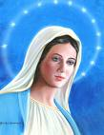
Historical Analysis of Religion
Female deities are found in all religions throughout the world. In some, they take on a motherly caring role (e.g. Mary, the mother of God).
Feminists argue that the Catholic Church has allowed Mary to epitomise women’s roles, leading a life of submission to God and an unhelpful role model to young girls.

Slide 41
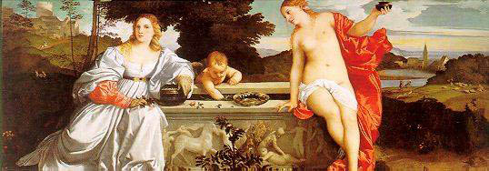
Historical Analysis of Religion
Erickson (1992) gives a critical reading of the work of Durkheim and Weber on religion. A central aspect of her work is an investigation of the sacred-profane dualism, in which the sacred is gendered masculine and the profane is gendered feminine.
Such notions are at the heart of the sexist bias in the sociology of religion and its implicit support of male dominance.

Slide 42
Karen Armstrong (1993)
Argues that religion has not always been patriarchal.
She claims that in early history women were considered central to spirituality and archaeologists have found numerous symbols of the Great Mother Goddess.
In comparison there were few portrayals of male gods.

Slide 43
Examples
1750 BC in Babylon the importance of the Goddess declined as the male god Marduk replaced the female goddess Tiamat as the dominant figure in religion.

Slide 44
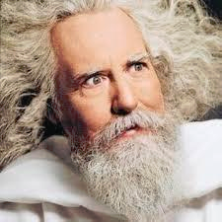
Examples
With the advent of Judaism, Christianity and Islam, monotheistic religions ( one God) largely replaced polytheistic religions ( many gods).
In all these cases the God was portrayed as Male.

Slide 45
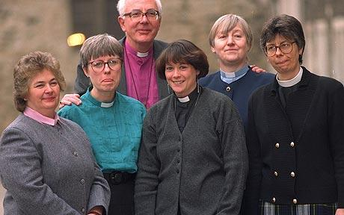
Gender Inequality in major religions
Women continue to be excluded from key roles in many religions (Although in the Church of England women are allowed to become ordained priests in 1992)
This is despite the fact that women often participate more than men in organised religion.

Slide 46
Jean Holm (1994)
Argues that in the public sphere of religion, where important positions are held and public pronouncements are made, men almost always dominate.
However, in the private sphere, for example the socialisation of children into religion within families is dominantly done by women as well as doing a large chunk of the religious work in the household.

Slide 47
Inequalities identified by Holm in major religions….
Religion | Nature and extent of Inequality
Christianity/ Roman Catholicism | God is portrayed as male and as a father figure. Jesus and all his disciples were male and the Bible is entirely written by men. Only men can become priests and the Pope is therefore male. In the bible, Eve is portrayed as being created out of Adam’s rib.
Islam | The Prophet Muhammad was male. Men make all the legal judgements and are religious leaders.
Hinduism | Only men become Brahmin priests. Women cannot approach family shrines when pregnant or menstruating.
Chinese folk religions | Women are associated with Yin and men with Yang spirits, but Yang spirits are more important and powerful.
Orthodox Judaism | Only men can play a full part in religious ceremonies and become Rabbis
Sikhism | The most equal of the major religions since all positions are equally open to men and women. However, in practice, most senior positions are still held by men.

Slide 48
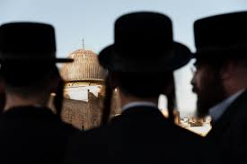
Holm (1994)
Notes that women’s second class status is often related to female biology and sexuality.
For example, Islamic women cannot touch the Qur'an when menstruating.

Slide 49
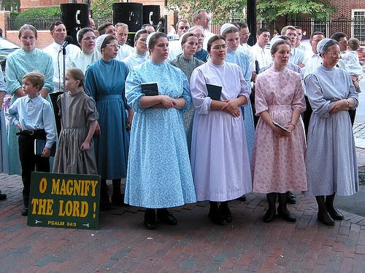
Changes?
Have there been any recent changes in the role of women in religion ?

Slide 50
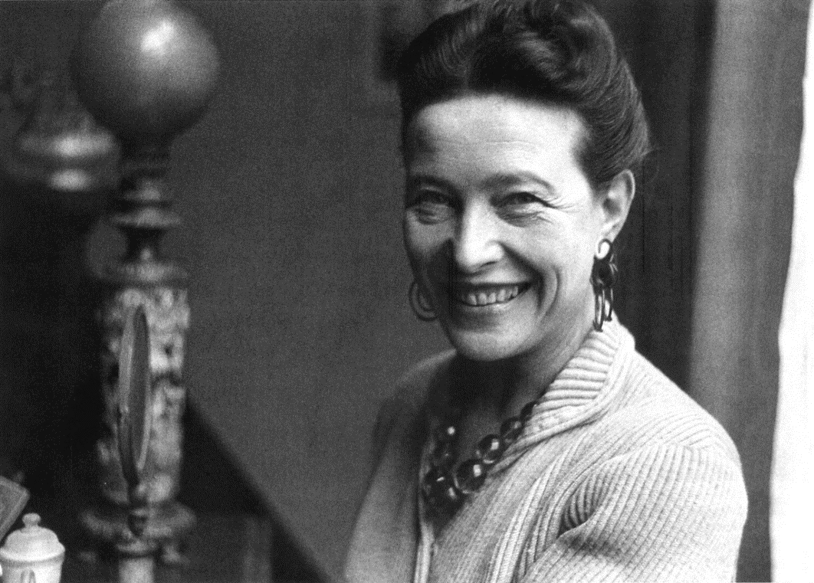
Simone de Beauvoir (1949)
Sees religion as an instrument of male domination.
Please Note: De Beauvoir is usually considered to be a radical feminist. Her views have similarities with Marxism.

Slide 51
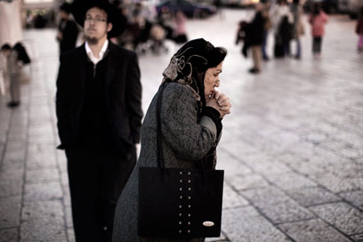
Simone de Beauvoir (1949)
Men usually control religious organisations and claim that their authority comes from God; for example, Kings rules by ‘Divine Right’.
Religion gives women a false belief that their suffering will be rewarded in heaven.
It deceives women into thinking they are equal to men whilst in reality they are disadvantages as the second sex

Slide 52
Simone de Beauvoir (1949)
Some religions portray women as being closer to God, but only if they are passive and do not question male authority.
Religion therefore gives women a form of False consciousness which keeps them in their place.

Slide 53
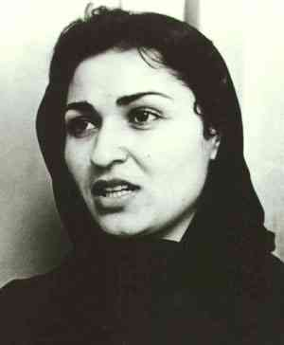
Nawal El Saadawi (1980)
Read El Saadawi’s criticism of De Beauvoir .. Make notes about this.

Slide 54
Women and resistance to religious oppression
Sociologists have come to acknowledge that women cannot always be seen as passive victims of religious oppression, and that religious practices are open to interpretation.
Badawi (1994) notes that aspects of Islam are positive for women. For example, Islamic women keep their own family name when they get married.

Slide 55
Women and resistance to religious oppression
Watson (1994) examined the veiling of Islamic women.
This practice is seen by many non-Muslim writers as a form of social control.
However, Watson argues that veiling can have advantages for women in that it can reduce, or allow them to cope with male oppression.
For example: it reduces the possibility of sexual harassment and allows Muslim women to be judged for who they are rather than what they look like.

Slide 56
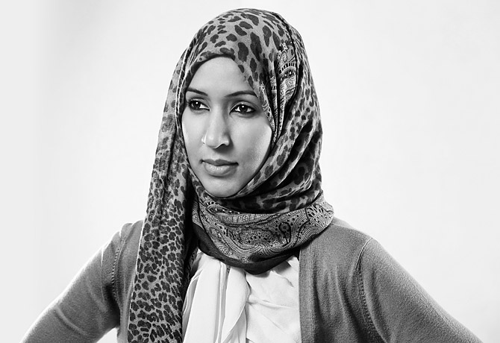
However…
Despite having some power in the religion .. In some countries religion is used as an oppressive force.. Be good to take notes about her story as a modern source…
Notes:
https://www.ted.com/talks/manal_al_sharif_a_saudi_woman_who_dared_to_drive/transcript?language=en
Till about 6 minutes

Slide 57
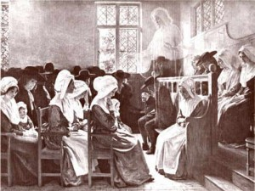
Women and resistance to religious oppression
Holm (1994)- notes that Quakerism is one religion that always had relative equality between men and women.
Holm also argues that women are starting to resist patriarchal religion and gain some rights, so religion is not as male-dominated as it once was.
Wright (1994) notes that Reform Judaism allows women to become Rabbis.

Slide 58
Evaluation
Functionalists argue that religion is a force creating value consensus which is beneficial to society rather than being used to oppress women.
Some feminists (Such as De Beauvoir) generalise about religion and ignore the differences between religions.
Feminists focus on one aspect of religion at the expense of all others.

Slide 59
Task
Create a resource about Feminism and its views on religion.
Research any recent information or stories about women and religion and oppression or freedom.

