Slide 1
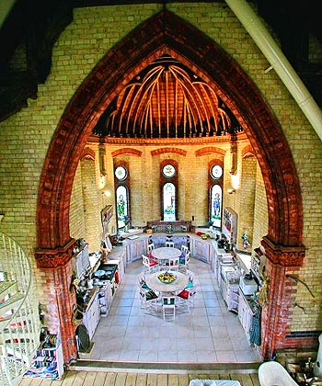
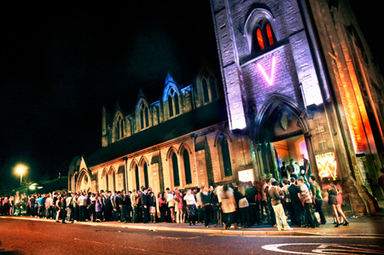
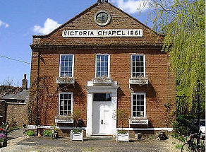
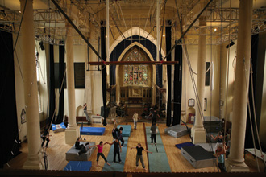
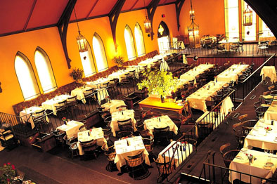
Title: How secularised is society today?
Task: Define Secularisation

Slide 2
Title: How secularised is society today?
Task: Define Secularisation
Long term process whereby religious institutions, beliefs and practices lose social significance

Slide 3
Title: How secularised is society today?
Describe the process of secularisation
Explain how society is secularised
Evaluate the theory of secularisation

Slide 4
What is secularisation?
Task: Define Secularisation
Long term process whereby religious institutions, beliefs and practices lose social significance.
The word secular means not sacred, not spiritual, not religious.
The claim that religion is declining in importance is known as the secularisation thesis.
However, defining secularisation is not as simple as this. Sociologists cannot agree on a definition of religion!
As a result, sociologists cannot agree on how to define – and measure secularisation.

Slide 5
Secularisation in Britain
Task: Define Secularisation
Wilson (1966) 40% mid 1800’s, by 1960 10-15%, 6.3% 2005
"the process whereby religious thinking, practice and institutions lose social significance"
English Church Census (2006) church attendance and membership of large organisations had declined whereas they had stayed constant or increased for small organisation
Church of England:
45,000 clergymen in 1900 and only 34,000 in 2000 means reduced influence on society (law, media and education)
disengagement
The church is seen as being outdated (attitudes, values, beliefs and views)

Slide 6
Explanations
Task: Define Secularisation
Weber (1905): before Protestant Reformation ‘magical garden’
After the reformation, God = transcendent.
Rationality was needed to understand workings of natural forces.
No longer need for religious explanations
Reformation had began the ‘disenchantment’
Bruce: technological worldview. People now view the world in terms of science and technology rather than looking for religious explanations. Only when they fail does religion come forth.

Slide 7
Structural Differentiation, social, cultural and religious diversity
Task: If you were answering an essay question about secularisation in an exam.
What 5 key words/names/phrases would you make sure you were to use in your paragraph about Rationalisation as a explanation of secularisation.

Slide 8
Structural Differentiation, social, cultural and religious diversity
Task: Define Secularisation
Before rationalisation, it was thought that human beings could change things by magic, prayer etc.
Through the reformation (from Catholicism to Protestantism), there was a change in a world view (from God intervening to God transcending - God stood back and began to watch from above – he made the world, but now nature would take over).
Weber saw modernity as the ‘age of reason’, in that is was driven by the process of rationalisation
The ‘age of reason’ was seen to be driven by enlightenment ideals; the progress made by science in eradicating magic and superstition, and replacing these types of belief with ones based upon science and reason.
For example, through scientific discovery our understanding of natural phenomena such as lightning floods and droughts, has changed.
Our understanding of illness, disease and other ‘essential mysteries’ has also changed
Weber referred to this process as disenchantment.
What evidence is there of disenchantment in today’s society?

Slide 9
Structural Differentiation, social, cultural and religious diversity
Task: Can you think of any criticisms?
Non-rational activities still practised:
- Palm reading;
- Tea Leaves
- Tarot Cards
- Feng Shui
Religious beliefs still guide many. For example the NCR.
Doesn’t explain secularisation, only applies to Europe and Christianity.

Slide 10
Criticisms of the secularisation theory
Task: Use your hand out to complete information on one of the following:
Structural differentiation
Social and cultural diversity
Religious diversity
Cultural defence and transition
A spiritual revolution.
Your will then feedback this information to the rest of the class.
Make sure you understand your explanation first!

Slide 11
Structural Differentiation, social, cultural and religious diversity
Task: Define Secularisation
Parsons (1951) : structural differentiation is the process of specialisation that occurs with the development of an industrial society leads to disengagement
Wilson: close knit pre industrial communities had shared values expressed through rituals that regulated and integrated. Loss of basis of religion in communities led to loss of vitality and hold. Diversity of occupations, lifestyles and cultures undermines religion
Individualism causes religion to decline as it depends on an existing practising community.
Aldridge: religion is a source of identity on a global scale. E.g. Hindu communities
Some are ‘imagined communities’ who interact via media
Berger (1969) Catholic Church held absolute monopoly and had no competition. After Protestant Reformation, churches and sects broke away and grew.

Slide 12
Cultural Defence and Transition
Task: Define Secularisation
Cultural Defence: religion provides a focal point for the defence of national, ethic, local identity against an external hostile foreign power force.
Cultural Transition: religion provides support and a sense of community for migrants in a different country and culture
Berger (1999) diversity and choice stimulate interest and participation in religion
Beckford (2003) religious diversity leads people to questioning their beliefs but opposing views can actually strengthen a group’s commitment

Slide 13
Spiritual Revolution
Task: Define Secularisation
Traditional Christianity is giving way to New Age beliefs and practices.
Heelas and Woodhead identify two groups: congregational domain (traditional and evangelical Christianity) and holistic milieu (spirituality and New Age beliefs)
2000: 7.9% attend church, 1.6% participate in holistic milieu activities.
1) due to subjective turn in society. Should no longer obey external authority but explore ones inner self.
2) therefore traditional religions that demand obedience are declining
3) evangelical are more successful than traditional because despite demanding obedience they also emphasise healing and personal growth
A spiritual revolution hasn’t occurred as the milieu’s growth hasn’t compensated for the decline of traditional churches
Therefore Britain is undergoing secularisation.

Slide 14
Secularisation in America
Task: Secularisation in America
Wilson (1962) ‘American way of life rather than deeply held religious beliefs’. Religion has become superficial.
Bruce (2002):
Declining church attendance
Hadaway et al (1993): Level of attendance was 83% higher than the church’s own estimates. May be due to church going being socially desirable.
1972 attendance had been exaggerated by 42% and had risen to 101% by 1996.
This has masked a decline in actual church attendance
Secularisation from within: emphasis on traditional Christian beliefs has declined and religion has turned into a form of therapy thus allowing it to fit into a secular society.
Purpose of religion changed from other-worldly salvation to this-wordly personal improvement
Religious diversity: trend towards practical relativism – accepting the view that others are entitled to hold their own beliefs even if they are different to our own but also undermines plausibility

Slide 15
Criticisms of the secularisation theory
Task: Secularisation in America
Religion isn’t declining, simply changing form (privatised, individualised)
It only focuses on the decline of traditional churches and ignores religious revivals and new religions
Church attendance statistics disregard people who believe but don’t necessarily belong (Davie)
Secularisation isn’t universal
Religious diversity increases participation as it offers choice

Slide 16
Social and cultural diversity
Explanation Number 3:
The move from pre-industrial society brings about the decline of community and this contributes to the decline of religion.
Wilson argues that in pre-industrial communities, shared values were expressed through religious rituals that brought individuals together and regulated behaviour.

Slide 17
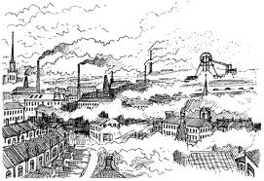
Bruce sees industrialisation as undermining the consensus of religious beliefs that old small rural communities together.
Social and geographical mobility not only breaks up communities but brings people together from many different backgrounds, creating more diversity.
Diversity of occupations, cultures and lifestyles undermines religion.
Bruce argues that the ‘believability’ of beliefs is undermined by alternatives.

Slide 18
Criticisms
How might this view be criticised?
Can you think of any examples where religion is still in unison?
The Orthodox Church and the powerful religious right in America.
An apparent “desecularization,” or at least a “resacralization,” has occurred across the world.
Globalization actually engages Islam rather than denying its relevance.
Within the new public spaces created by globalization, religious identities interact with modern ideas and technologies - Glocalization
Globalisation has allowed people to turn their religious beliefs into actions.
Religious texts are now more easily accessible.

Slide 19
So the criticisms are…
Religion can be a source of identity on a worldwide scale.
Some religious communities are imagined communities (interact through global media).
Pentecostal (Christian) and other religion groups often flourish in ‘impersonal’ urban areas.
+ the criticisms mentioned previously:
The Orthodox Church and the powerful religious right in America.
An apparent “desecularization,” or at least a “resacralization,” has occurred across the world.
Globalization actually engages Islam rather than denying its relevance.
Within the new public spaces created by globalization, religious identities interact with modern ideas and technologies - Glocalization
Globalisation has allowed people to turn their religious beliefs into actions.
Religious texts are now more easily accessible.

Slide 20
Religious diversity
Explanation Number 4:
According to Berger (1969), another cause of secularisation is the trend towards religious diversity.
Instead of there being only one religious organisation and only one interpretation of the faith, there are many.
In the middle ages, the Catholic Church held an absolute monopoly with no competition.
As a result a set of beliefs were shared by all.
Giving beliefs greater plausibility because they had no challengers and the Church’s version of the truth was unquestioned.

Slide 21
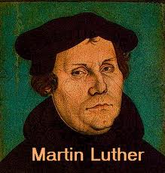
What happened?
The protestant reformation
Since the protestant reformation, the number and variety of religious organisations has continued to grow.
With the arrival of this religious diversity, no church can now claim an unchallenged monopoly of the truth.
Therefore society is no longer unified under the single sacred canopy provided by one church.
Religious diversity creates a pluralistic of life world –where people’s views vary.
Berger argues that this creates a crisis of credibility for religion.
When there are alternative versions of religion to choose between, people are likely to question all of them.
Religion becomes relative rather than absolute.
What is true or false becomes simply a personal point of view.

Slide 22
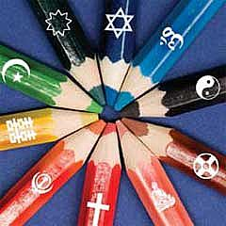
Discuss
“The increase in different religions within Britain have meant people have begun to ‘believe’ less”
To what extent do you think this is true?

Slide 23
Cultural defence and transition
Explanation Number 5:
Bruce identifies two counter-trends that go against secularisation theory.
Cultural defence
Religion provides a focal point for the defence of national, ethnic, local or group identity,
For example the popularity of Catholicism in Poland before the fall of communism.
Cultural transition
Religion provides support and a sense of community for ethnic groups such as migrants to a different country or culture.

Slide 24
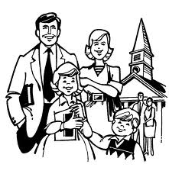
However…
Bruce argues that religion survives in such situations only because it is a focus for group identity.
Secularisation does still exist as religion is most likely to survive when it performs functions other than relating individual to the supernatural.
This is supported by the fact that church going declined in Poland after the fall of communism.

Slide 25
Religion and identity
These notions of cultural defence and cultural transition – show that religion and identity are linked.
People may identify with a religious tradition as a symbol of their culture or ethnic identity but they may not hold strong religious beliefs.
Question
Can you think of three types of support that a religious community might be likely to give to recent immigrants?

Slide 26
Criticisms
Berger (1999) has changed his views and now argues that diversity and choice actually stimulate interest and participation in religion.
As proved earlier (and see reading).
Beckford (2003) agrees with the idea that religious diversity will lead some to question or abandon their religious beliefs, but this is not inevitable.
Opposing view can instead strengthen a religious group’s commitment to exist beliefs.

Slide 27
A spiritual revolution?
Explanation Number 6:
Some sociologists argue that ‘spiritual revolution’ is taking place today.
Traditional Christianity and formal organised religion is giving way to ‘holistic spirituality’ or New Age beliefs.
People are becoming more spiritual – with self-help books, visits to Indian gurus and yoga.

Slide 28
Kendal - Cumbria study 2000
Heelas and Woodhead investigated whether traditional religion has decline and if so, how far the growth of spirituality compensating for this.
They distinguish between two groups:
The congregational domain (Traditional Christianity and evangelical)
The holistic milieu (Spirituality and the New Age)

Slide 29
Results
In a typical week:
7.9% of the population attended church
With this traditional churches were losing support whilst evangelical churches were holding their own.
1.6% took part in the activities of the holistic milieu (and growing).

Slide 30
Explanations
1) Growth in spirituality comes from a massive subjective turn in today’s culture.
Shift from duty and obedience to explore your inner self.
2) As a result, traditional religions, which demand this duty and obedience are declining.
3) Evangelical churches are more successful than traditional churches because although they both demand discipline – evangelicals emphasise spiritual healing and personal growth.

Slide 31
Criticisms of the secularisation theory
Task: How do we define secularisation?
What are the problems in defining secularisation?
What problems does this then create for us when we are weighing up the arguments for and against secularisation?
Create a comprehensive and detailed table of evidence for and against secularisation, including relevant theories, concepts, studies, statistics and any other evidence.
You could even bring in evidence from your personal experiences and current affairs issues that you are aware of.

Slide 32
Criticisms of the secularisation theory
Task: Group 1 will argue that secularisation is taking place today in Britain and America.
Group 2 will argue that secularisation is not taking place in Britain and America.
You will need to:
Look at all the arguments that support your claim.
Decide counter-arguments for arguments that do not support your claim.

