Slide 1
Immanuela
Sashmika
Zoe
Eloghosa
Bailey
Jadesola
Victor
Dalu
James
Kirthana
Jade
Albert
Nikki
Louis
Maddie
Daniel
Erica
Natalia
Emily
Harry
Kayla
Olivia
Shieullie
Haaris
Clarice
Amber
Karen
Lucas
Sharleen
Mr Watkins
Board

Slide 2
No Hogs
No
Logs

Slide 3
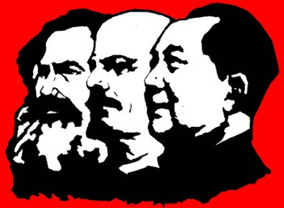
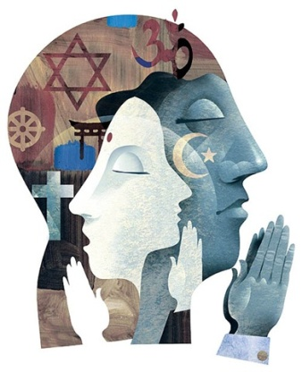
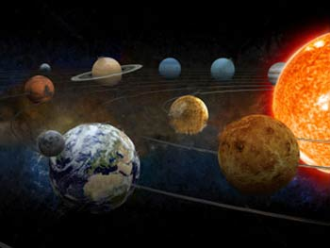
Title: Science as a belief system
Task: Why do we need belief systems (sets of ideas that claim to have knowledge about reality). Using your own knowledge and the images below, brainstorm the importance of belief systems…
Challenge – Are belief systems positive or negative?

Slide 4
Title: Science as a belief system
Evaluate whether science has lived up to its principles.
Explain how science is views as a belief system.
Describe the difference between science and religion.

Slide 5
Title: Science as a belief system
Task: Can you sort them out into a table to show the key differences.
Although religion claims to explain what the world is like or ought to be like, they are not the only belief systems to do this. Similarly, science claims to tell us about how the world is. All belief systems, according to Berger and Luckmann, are socially constructed to give people a sense of meaning to their lives and make sense of the world. Below are common features of both science and religion.
An open system (allows retesting and criticism).
Answers basic questions such as the meaning of life, but without evidence.
A closed system (rejecting change and criticism).
Rational & logical thinking.
Is very subjective.
Remains objective at all times.
Based on superstition and opinion.
Knowledge is based on empirical evidence.
Challenge – Are belief systems positive or negative?

Slide 6
Title: Science as a belief system
Task: Can you sort them out into a table to show the key differences.
Although religion claims to explain what the world is like or ought to be like, they are not the only belief systems to do this. Similarly, science claims to tell us about how the world is. All belief systems, according to Berger and Luckmann, are socially constructed to give people a sense of meaning to their lives and make sense of the world. Below are common features of both science and religion.
An open system (allows retesting and criticism).
A closed system (rejecting change and criticism).
Rational & logical thinking.
Answers basic questions such as the meaning of life, but without evidence.
Remains objective at all times.
Is very subjective.
Knowledge is based on empirical evidence.
Based on superstition and opinion.
Challenge – Are belief systems positive or negative?

Slide 7
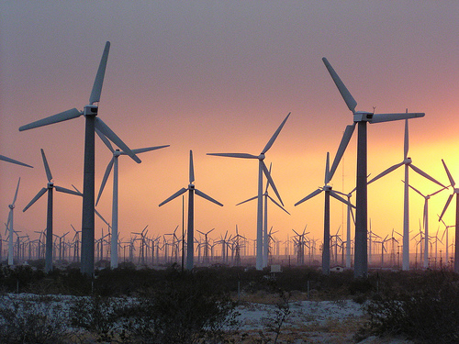
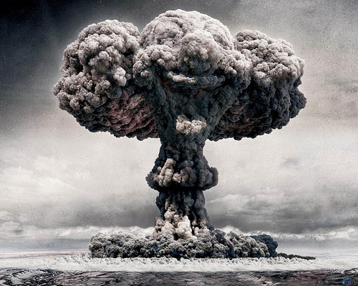
Title: Science as a belief system
Task: What do the picture above represent? Despite the positive and negative affects of science, it’s clear that it can explain, predict and control the world. Religion can’t do this!
Science has had an enormous impact on society over the last few centuries. Its achievements in medicine have eradicated many once fatal diseases. Many basic features of daily life today – transport, communication, work and leisure's – would unrecognisable to our recent ancestors due to scientific and technological development. More recently faith and religion has been some what dimmed by a recognition that science has brought to our society, however some people are beginning to see problems with science today.

Slide 8
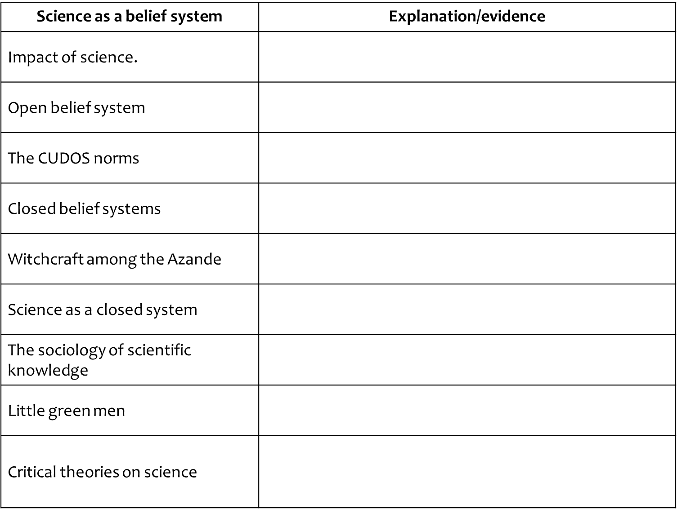
Title: Science as a belief system
Task: Using the relevant pages in the textbook, design a summary for the key evidence for science being a belief system and how it differs from other belief systems.
Using the relevant pages in the textbook, design a summary for the key evidence for science being a belief system and how it differs from other belief systems.
Challenge – using the evidence in your completed summary answer the following questions …
Has science benefited humanity?
Is science an objective belief system?
Has science replaced religion as the dominant belief system today?

Slide 9
Title: Science as a belief system
Task: Do they provide accurate explanations?
In the 18th century – Enlightenment found 2 new principles 1) that belief can provide an understanding to the world 2) belief can improve human lives. Challenges occurred to religious belief. Scientific experiment happened and scientist attained high status’. Traditionally, in modern society, science was seen to be based on objective observation and measurement.
Do they provide accurate explanations?
Berger and Luckmann argue that beliefs are socially constructed. Science can be seen as a social construction.
Popper states that if theories withstand tests they gain acceptance which is good, as it is open and critical.
Knorr-Centina also believes scientific facts are not objective but fabricated social constructs of scientists;
Kuhn believed that science is directed by paradigms (a framework stating which theories should be developed and the methods and data which can be used). Scientists look for data which supports it, therefore paradigms are socially constructed;
Giddens, in late modernity, questions the objectivity and value of science there are now with dangers like nuclear power stations;
According to Beck late modernity is characterised by risk and uncertainty, science contributes to this;
Lyotard , in Postmodernity, sees science as a metanarrative and no longer directs action and failed to live up the promise of enlightenment.

Slide 10
Do they provide accurate explanations?
Berger and Luckmann argue that beliefs are socially constructed. Science can be seen as a social construction.
Popper states that if theories withstand tests they gain acceptance which is good, as it is open and critical.
Knorr-Centina also believes scientific facts are not objective but fabricated social constructs of scientists;
Kuhn believed that science is directed by paradigms (a framework stating which theories should be developed and the methods and data which can be used). Scientists look for data which supports it, therefore paradigms are socially constructed;
Giddens, in late modernity, questions the objectivity and value of science there are now with dangers like nuclear power stations;
According to Beck late modernity is characterised by risk and uncertainty, science contributes to this;
Lyotard , in Postmodernity, sees science as a metanarrative and no longer directs action and failed to live up the promise of enlightenment.

Slide 11
Title: Science as a belief system
Task: Read Item A below and answer the question that follows.
Item A
Both science and religion are belief systems that involve sets of knowledge-claims: that is, statements that claim to offer explanations of why things are as they are. For example, science uses concepts such as germs to explain why people fall ill from infectious diseases, while some religions use ideas such as the will of God to explain human illness and suffering.
Applying material from Item A, analyse two differences between science and religion as belief systems. [10 marks]
One difference between religion and science is …
This means …
Evidence to support this comes from …
A second difference between religion and science is …
This means …
Evidence to support this comes from …

Slide 12
Title: Science as a belief system
Task: Read Item A below and answer the question that follows.
Marks | Explanation
8-10 (A) | It is easy to read. And flows. Has two clear points developed. They’re explained using key words/sociologists and examples which are relevant and linked to key ideas With criticisms and strengths.
4-7 (C-B) | One or two but they might be vague and lack sociological evidence or one relevant and one not/ None or some evaluation for one or both but lacks evaluation or none (4)
1-3 (D-E) | Is to general with no clear examples or examples with no clear sociological explanation. No criticism of the ideas Poor SPAG
0 Marks (U) | Nothing is relevant

Slide 13
One difference between religion and science is
This means
Evidence to support this comes from
A second difference between religion and science is
This means
Evidence to support this comes from

Slide 14
Science as a belief system | Explanation/evidence
Impact of science.
Open belief system
The CUDOS norms
Closed belief systems
Witchcraft among the Azande
Science as a closed system
The sociology of scientific knowledge
Little green men
Critical theories on science

Slide 15
Title: Ideology
Task: Can you link these to past topics or current topics?
=

Slide 16
Title: Ideology
Task: What is an ideology?

Slide 17
Title: Ideology
Task: Can you give examples for each definition
Ideology is a worldview or a set of ideas and values – in other words a belief system. However, in sociology it has taken on a number of related meanings.
Definition | Example
Distorted, false or mistaken ideas of the world. | Christianity has Jesus as son of god.
Partial, one-sided or biased view of reality | Ruling class as overlords
Conceal the interests of a particular group | Men behind the scenes controlling people
Legitimate their privileges | CEO’s and workers – poor are dumb
Ideas that prevent change by misleading people about the reality | Catholic 16th C
Self sustaining belief system that is irrational and closed. | Sikhism

Slide 19
Title: Ideology
Task: What role does Nationalism play as a belief system?
Nationalism is an important political ideology that has had a major impact on the world over the last 200 years.
Nations are real, distinctive communities each is unique.
Every nation should be self-governing
National loyalty and identity should come before all others.
Benedict 2006 – ‘imagined community’
Marxism
Functionalism
Modernity

Slide 20
Title: Ideology
Task: What role does Nationalism play as a belief system?
Nationalism is an important political ideology that has had a major impact on the world over the last 200 years.
Nations are real, distinctive communities each is unique.
Every nation should be self-governing
National loyalty and identity should come before all others.
Benedict 2006 – ‘imagined community’
Marxism | Nationalism is a form of false class consciousness that helps to prevent the other throw of capitalism by dividing international workers.
Functionalism | Nationalism is secular civil religion. Integrates members by making them feel part of something regardless of religion or class.
Modernity | Nationalism provides modern states post industrial something to impose a single standard, language and culture on society.

Slide 21
Title: Ideology
Task: Mannheim: Ideology and Utopia.
Karl Mannheim’s – 1929-39 – critical of ideologies.
All belief systems as partial or one sided.
Ideological: Justifies status quo for benefit of privileged groups
Utopian: Justifies social change. Reflects interest of underprivileged.
Creation of intellectuals > attach to particular group > represent these groups not society > partial trust = conflict.

Slide 22
Title: Ideology
Task: Mannheim: Ideology and Utopia.
Free-Floating intelligentsia
Solution is to detach the intellectuals from the social group they represent = arrive at a total worldview that represented the interests of society.

Slide 23
Title: Ideology
Task: Feminism
Gender inequality as fundamental division in society and patriarchal ideology as play a key role in legitimating it.
Gender Difference in all Society = ideologies that justify it
Marks: Science excludes women in history
Religion and Beliefs = Women inferior
Before monotheistic – religions were matriarchal

