Slide 1
Title: Religion, Renewal and Choice
Task: Can you define these words.
Individualism
Believing nor belonging
Vicarious Religion
Hervieu-Leger
Privatised Religion
Converts and Pilgrims
Consumption versus Obligation
Secularisation
Voas and Crockett
Congregational domain
New Age
Davie
Televangelism
Institutional religion
Bruce
Holistic Mileu
Postmodernism
Multiple Moderninity

Slide 2
Title: Religion, Renewal and Choice
Apply your knowledge to Questions.
Evaluate your success and improve.

Slide 3
Apply your knowledge to Questions.
Task: Answer the following Question.
Outline & explain two reasons why figures on attendance at mainstream churches overstate the degree of secularisation in Britain today. (10 marks)
P – Vicarious Religion: Spiritual Health
E – Davie, Diana, Anders Brevic
E – Tip of an iceberg, evidence of believing without belonging.
L – Shows that Secularisation is not occurring, attendance is falling.
P – Spiritual shopping
E –
E –
L –

Slide 4
Title: Religion, Renewal and Choice
Task: Can you define these words.
Vicarious Religion | Privatised Religion | Individualism | Consumption versus Obligation | Converts and Pilgrims
Believing nor belonging | Davie | Secularisation | Congregational domain | Holistic Mileu
Hervieu-Leger | Bruce | Voas and Crockett | Televangelism | New Age
Postmodernism | Multiple Modernitites | Institutional religion | Day | Woodhead

Slide 5
Apply your knowledge to Questions.
Task: Answer the following Question.
Applying material from Item A and your own knowledge, evaluate the impact of postmodernity on religious and spiritual beliefs and practices. (20 marks)
17-20 | Answers in this band will show sound, conceptually detailed knowledge of a range of relevant material on postmodernity impact. Sophisticated understanding of the question and of the presented material will be shown. Appropriate material will be applied accurately and with sensitivity to the issues raised by the question. Analysis and evaluation will be explicit and relevant. Evaluation may be developed for example through a debate
13-16 | Answers in this band will show accurate, broad and/or deep but incomplete knowledge. Understands a number of significant aspects of the question; good understanding of the presented material. Application of material is largely explicitly relevant to the question, though some material may be inadequately focused. Some limited explicit evaluation.

Slide 6
Apply your knowledge to Questions.
Task: Answer the following Question.
Applying material from Item A and your own knowledge, evaluate the impact of postmodernity on religious and spiritual beliefs and practices. (20 marks)
Some sociologists claim that society has entered a new era, that of postmodernity, in which religion and spirituality take on new forms. In postmodern society, tradition loses its influence over people. Consumption and choice become more important, and people are free to choose their identity and their beliefs. Postmodern society is increasingly globalised, and the media and information technology become much more important, for example moving religious ideas and images out of their tradition physical home in churches and making them available around the globe.
However, other sociologists are that these trends merely promote secularisation.

Slide 7
Apply your knowledge to Questions.
Task: Answer the following Question.
Applying material from Item A and your own knowledge, evaluate the impact of postmodernity on religious and spiritual beliefs and practices. (20 marks)
Some sociologists claim that society has entered a new era, that of postmodernity, in which religion and spirituality take on new forms. In postmodern society, tradition loses its influence over people. Consumption and choice become more important, and people are free to choose their identity and their beliefs. Postmodern society is increasingly globalised, and the media and information technology become much more important, for example moving religious ideas and images out of their tradition physical home in churches and making them available around the globe.
However, other sociologists are that these trends merely promote secularisation.

Slide 8
Apply your knowledge to Questions.
Task: Answer the following Question.
Introduce: Introduce your point. (AO1)
Describe: Offer substantial developed description (AO1)
Evidence: Provide evidence to support your information. (AO3)
Explain: Develop your answer further. Link to the Question. (AO2)
Analyse: Providence evaluation that supports or criticises. (Ao3)
Link: Link back to your question. (AO2)

Slide 9
Apply your knowledge to Questions.
Task: Applying material from Item A and your own knowledge, evaluate the impact of postmodernity on religious and spiritual beliefs and practices. (20 marks)
Item A suggests that “postmodern society is increasingly globalised” and that “religion is taking on new forms”.
There is evidence to support this theory from the postmodern perspective, the expansion of the ‘electronic church’ and televangelism. These new practices only possible in a postmodern society, remove ‘believers’ from a physical church, allowing them to express their faith without attending church.
This has led to religion becoming de-institutionalised meaning it is detached from religious institutions, clearly showing the impact of postmodernity on religious and spiritual beliefs and practices.
The theory is supported by Hellend (2000) which distinguished between two kinds of internet activity, which he calls religion online and online religion. This sees online religion as a radical new alternative that may be replacing religion.
However, evidence from Hoover would argue against this theory that online religion supplements their church based activities.
The electronic church would suggest that postmodernity has had some impact on religious and spiritual beliefs and practices.

Slide 10
Apply your knowledge to Questions.
Task: Applying material from Item A and your own knowledge, evaluate the impact of postmodernity on religious and spiritual beliefs and practices. (20 marks)
I
Item A suggests that “postmodern society is increasingly globalised” and that “religion is taking on new forms”.
There is evidence to support this theory from the postmodern perspective, the expansion of the ‘electronic church’ and televangelism. These new practices only possible in a postmodern society, remove ‘believers’ from a physical church, allowing them to express their faith without attending church.
This has led to religion becoming de-institutionalised meaning it is detached from religious institutions, clearly showing the impact of postmodernity on religious and spiritual beliefs and practices.
The theory is supported by Hellend (2000) which distinguished between two kinds of internet activity, which he calls religion online and online religion. This sees online religion as a radical new alternative that may be replacing religion.
However, evidence from Hoover would argue against this theory that online religion supplements their church based activities.
The electronic church would suggest that postmodernity has had some impact on religious and spiritual beliefs and practices.
Ao2
D
Ao1
E
Ao2
A
Ao3
Ao3
L
Ao2

Slide 11
Apply your knowledge to Questions.
Task: Applying material from Item A and your own knowledge, evaluate the impact of postmodernity on religious and spiritual beliefs and practices. (20 marks)

Slide 12
Apply your knowledge to Questions.
Task: Applying material from Item A and your own knowledge, evaluate the impact of postmodernity on religious and spiritual beliefs and practices. (20 marks)
Clearly there is evidence to suggest that postmodernity has had an impact on religious and spiritual beliefs and practices. Through the concepts of neither believing nor belonging, obligation and institutional religion show that there is an impact. We have religious beliefs that are in fluctuation, evolving with an ever changing world. However, there is evidence that show that these developments mean religion and spirituality are thriving as well as evidence that show that they are symptoms of secularisation. Ultimately, either way, there is an impact.

Slide 13
Apply your knowledge to Questions.
Task: Applying material from Item A and your own knowledge, evaluate the impact of postmodernity on religious and spiritual beliefs and practices. (20 marks)
Clearly there is evidence to suggest that postmodernity has had an impact on religious and spiritual beliefs and practices. Through the concepts of neither believing nor belonging, obligation and institutional religion show that there is an impact. We have religious beliefs that are in fluctuation, evolving with an ever changing world. However, there is evidence that show that these developments mean religion and spirituality are thriving as well as evidence that show that they are symptoms of secularisation. Ultimately, either way, there is an impact.

Slide 14
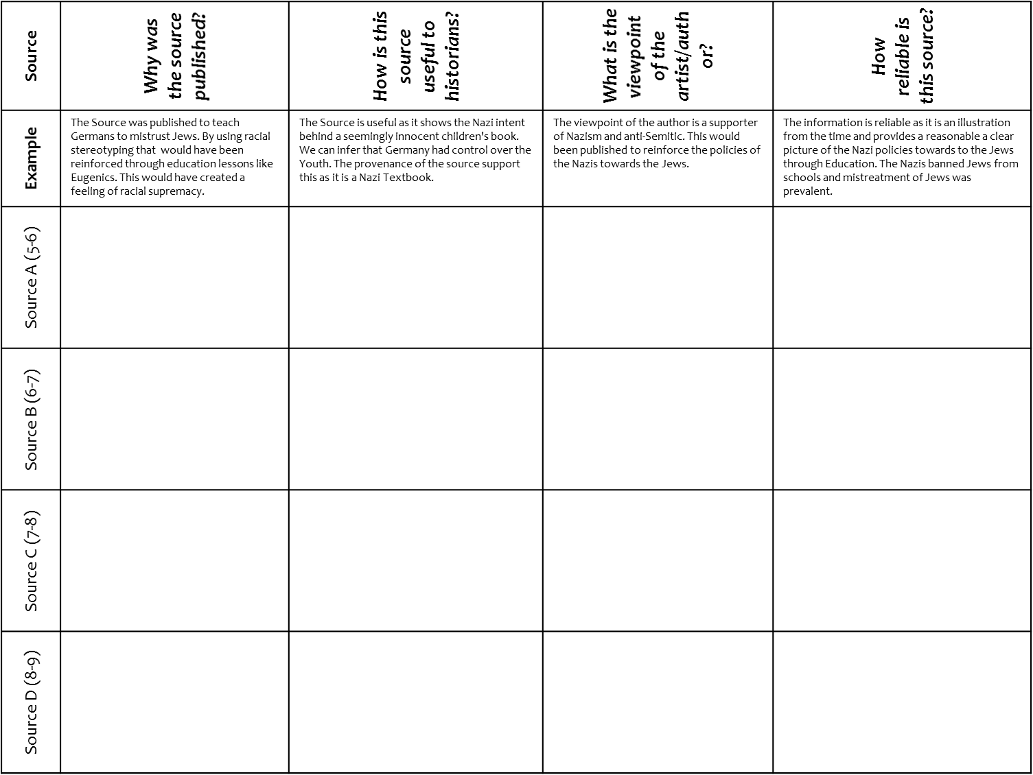
Describe information and apply it to a question.
Task: Working with the person next to you – Complete the relevant section of the sheet – aim to complete the section appropriate to your level .
More challenge
More challenge
CHALLENGE: Answer down to the Question “Democratisation and denazification were more successful in the East. How far do you agree?” Use evidence from the sources to support or challenge this opinion.

Slide 15
Q. Applying material from Item A and your own knowledge, evaluate the impact of postmodernity on religious and spiritual beliefs and practices. (20 marks)
Mark | Knowledge AO1 | Application AO2 | Evaluation AO3
17-20 | AO1: Conceptually detailed knowledge of a range of material. | AO2: Appropriate material applied accurately and with sensitivity to the issues. | AO3: Analysis will be explicit and relevant. Developed through debate between perspectives. Analysis will be clearly explained. Conclusions drawn.
13-16 | AO1: Accurate, broad but incomplete knowledge of a number of aspects. | AO2: Application is largely explicit and relevant though some may be less so. | AO3: Limited explicit evaluation. And/or some appropriate analysis.
9-12 | Ao1: Largely accurate knowledge but limited range and depth. Superficial understanding of material. | AO2: Application is general with limited relevance or applied narrowly. | AO3: Evaluation will be limited, tending towards description.
WWW:
EBI:
Response

Slide 16
