Slide 1
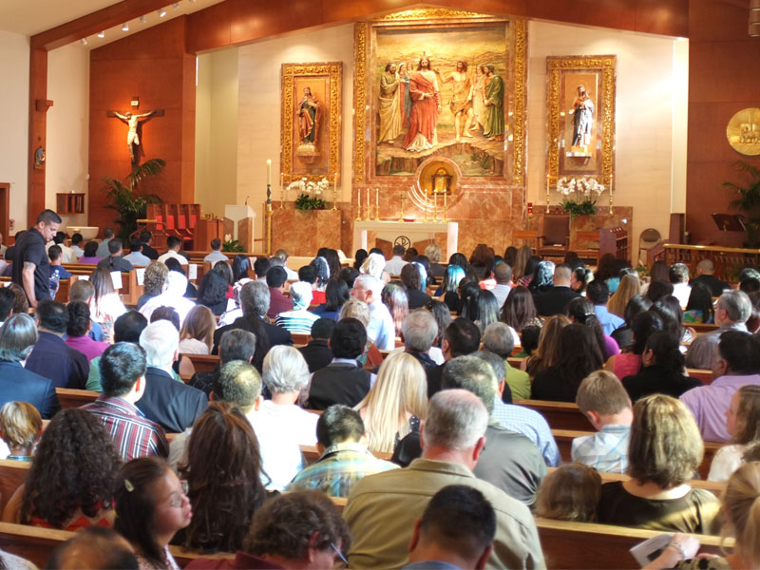
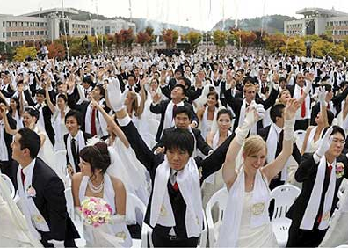
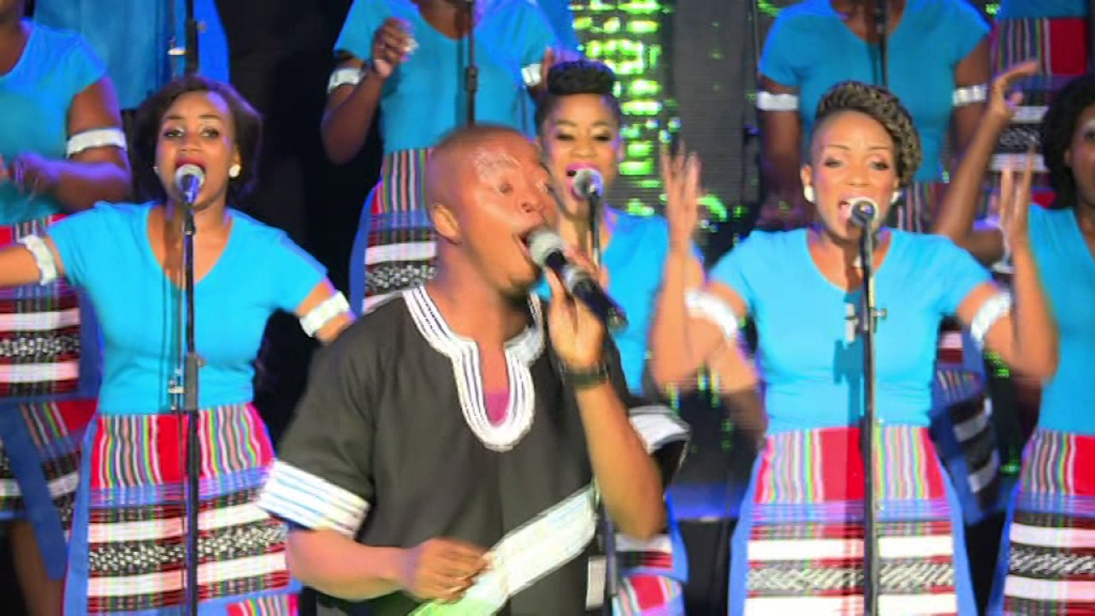
Title: Organisations, movements and members
Task: Spot the difference

Slide 2
Title: Organisations, movements and members
Describe who came and why.
Explain their experience and actions.
Evaluate their impact.

Slide 3
Title: Organisations, movements and members
Task: With the people can you come up with a criteria for defining churches
Shared beliefs
Churches
Organised

Slide 4
Title: Organisations, movements and members
Task: Use page 47 to define the following.
Churches
Denominations
Sects
Cults
Challenge: How similar or different are they?

Slide 5
Title: Denominations
Title: Churches
Claim universality, include all members of the society within their ranks, and have a strong tendency to equate "citizenship" with "membership"
Exercise religious monopoly and try to eliminate religious competition
Are very closely allied with the state and secular powers; frequently there is overlapping of responsibilities and much mutual reinforcement
Are extensively organized as a hierarchical bureaucratic institution with a complex division of labor
Employ professional, full-time clergy who possess the appropriate credentials of education and formal ordination
Primarily gain new members through natural reproduction and the socialization of children into the ranks
Allow for diversity by creating different groups within the church (e.g., orders of nuns or monks) rather than through the formation of new religions
similar to churches, but unlike sects, in being on relatively good terms with the state and secular powers and may even attempt to influence government at times
maintain at least tolerant and usually fairly friendly relationships with other denominations in a context of religious pluralism
rely primarily on birth for membership increase, though it will also accept converts; some actively pursue evangelization
accept the principle of at least modestly changing doctrine and practice and tolerate some theological diversity and dispute
follow a fairly routinized ritual and worship service that explicitly discourages spontaneous emotional expression
train and employ professional clergy who must meet formal requirements for certification
accept less extensive involvement from members than do sects, but more involvement than churches
often draw disproportionately from the middle and upper classes of society

Slide 6
Title: Churches
Claim universality, include all members of the society within their ranks, and have a strong tendency to equate "citizenship" with "membership"
Exercise religious monopoly and try to eliminate religious competition
Are very closely allied with the state and secular powers; frequently there is overlapping of responsibilities and much mutual reinforcement
Are extensively organized as a hierarchical bureaucratic institution with a complex division of labor
Employ professional, full-time clergy who possess the appropriate credentials of education and formal ordination
Primarily gain new members through natural reproduction and the socialization of children into the ranks
Allow for diversity by creating different groups within the church (e.g., orders of nuns or monks) rather than through the formation of new religions

Slide 7
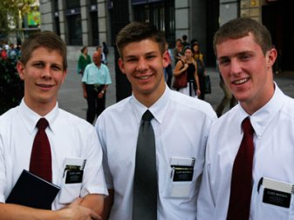
Title: Organisations, movements and members
Task:
Churches
Denominations
Sects
Cults
Mormons

Slide 8
Title: Organisations, movements and members
Task:
Churches
Denominations
Sects
Cults
Transcendental Meditation

Slide 9
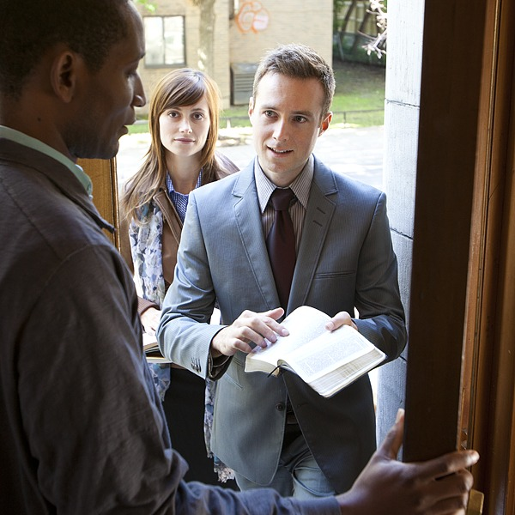
Title: Organisations, movements and members
Task:
Churches
Denominations
Sects
Cults
Jehovah’s Witnesses

Slide 10
Title: Organisations, movements and members
Task:
Churches
Denominations
Sects
Cults
Scientology

Slide 11
Name: International Society for Krishna Consciousness (Hare Krishna)
Scale: SKCON as of 2009 is a worldwide confederation of more than 650 temples and centres, including 60 farm communities, some aiming for self-sufficiency, 50 schools, and 90 restaurants.
Practices: A form of Hinduism; where Krishna is described as the source of all the avatars of God. Thus ISKCON devotees worship Krishna as God. It is monotheistic.
Purpose: 7 aims: To spread spiritual knowledge and education, To spread belief of Krishna, To bring society together, To teach their religious beliefs, To erect religious building, To bring a simpler way, To publish information.
Principles: Vegetarian, No illicit sex, No gambling, No drugs
Organisation: Bhaktivedanta Swami spent much of the last decade of his life setting up the institution of ISKCON. As a charismatic leader. The Governing Body Commission (or GBC) was created by Bhaktivedanta Swami in 1970. GBC has since grown in size to include 48 senior members from the movement who make decisions based on consensus of opinion rather than any one person having ultimate authority.

Slide 12
Name: Church of Scientology
Scale: Worldwide estimates of Scientology's core practicing membership ranges between 100,000 and 200,000
Practices: Scientology is a religion that offers a precise path leading to a complete and certain understanding of one’s true spiritual nature and one’s relationship to self, family, groups, Mankind, all life forms, the material universe, the spiritual universe and the Supreme Being
Purpose: Seek only evolution to higher states of being for the individual and for society.
Principles: The fundamental principles are threefold: Man is an immortal spiritual being. His experience extends well beyond a single lifetime. His capabilities are unlimited, even if not presently realised.

Slide 13
Name: Unification Church (Moonies)
Scale: Unificationism has attracted hundreds of thousands of members worldwide.
Practices: Members hand over their choice of life partner to Reverend Moon, a self proclaimed messiah who believes Jesus Christ has called upon him to carry out unfinished work.
Purpose: My wish is to completely tear down barriers and to create a world in which everyone becomes one.
Notes:
https://www.youtube.com/watch?v=jroufYZOfFE

Slide 14
Title: Organisations, movements and members
Task: Use AQA book pg 48
Roy Wallis (1985) – New Religious Movements
World Rejecting NRM
World Accommodating NRM
World Affirming NRM
Use AQA book pg 48

Slide 15
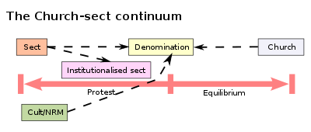
Title: Organisations, movements and members
Task: Use AQA book pg 48

Slide 16
Title: Organisations, movements and members
Task: What are New Religion Movements – World Rejecting
HAVE MOST IN COMMON WITH SECTS
To achieve salvation members are expected to make a sharp break from conventional life when they join the movement. The organisation acts as a TOTAL INSTITUTION, which control every aspect of the life's of their members.
Members must be highly disciplined and devote themselves to their religion rather than personal pleasures.
They have a reputation for brainwashing. Family and friends are cut off and are often unable to understand the reasons for joining the movement.
Most world-rejecting movements base their lives around commune.
E.g. People’s Temple, Branch Davidians, Children of God
Notes:
https://www.youtube.com/watch?v=6S_d1eVv0E8

Slide 17
Title: Organisations, movements and members
Task: What are New Religion Movements – World Affirming
HAVE MOST IN COMMON WITH CULTS
Often lack the typical characteristics of a religion, e.g. The may not involve a belief on God.
Rather than turning against the world these are often positive about the world, but agree that individuals are often lacking something spiritually and this is preventing them from achieving fulfilment and success.
They offer their followers access to supernatural or spiritual powers that will enhance their ability to lead fulfilling and successful lives.
Followers are unlikely to live in a commune or give up other aspects of their lives. However, there are sometimes hardcore followers who do give up their normal lives to follow the movement.
E.g. Transcendental Meditation (TM), Scientology

Slide 18
Title: Organisations, movements and members
Task: What are New Religion Movements – World Accommodating
THEY ARE OFTEN OFFSHOOTS OF AN EXISTING MAJOR CHURCH OR DENOMINATION
Typically they neither accept not reject the world as it is, they simply live with it.
They are concerned more with religious than worldly questions
The often seek to restore religious purity to a religion that they believe has lost its commitment to it’s core values
E.g. Neo-Pentecostalism
Notes:
https://www.youtube.com/watch?v=v_YsnoXaphk

Slide 19
Title: Organisations, movements and members
Task: STARK & BAINBRIDGE (1985)
Audience Cult – These require little commitment from their followers and often act as little more than a form of entertainment, e.g. Astrology
Client Cult – These offer services to their followers, who are seen as customers. They offer a way of enhancing life rather than an alternative lifestyle, e.g. Scientology
Cult Movements – Members may expect to give up aspects of their life by living in a commune. They offer members a complete spiritual package including answers to core questions e.g. What happens when you die, e.g. Heaven’s Gate Cult.
Their Typology can also be criticised. It’s unclear how much involvement members need to have. Their typology is just as inadequate as Wallis

Slide 20
Title: Organisations, movements and members
Task: STARK & BAINBRIDGE (1985)
Audience Cult – These require little commitment from their followers and often act as little more than a form of entertainment, e.g. Astrology
Client Cult – These offer services to their followers, who are seen as customers. They offer a way of enhancing life rather than an alternative lifestyle, e.g. Scientology
Cult Movements – Members may expect to give up aspects of their life by living in a commune. They offer members a complete spiritual package including answers to core questions e.g. What happens when you die, e.g. Heaven’s Gate Cult.
Their Typology can also be criticised. It’s unclear how much involvement members need to have. Their typology is just as inadequate as Wallis

Slide 21
Title: Organisations, movements and members
Task: STARK & BAINBRIDGE (1985)
Even Wallis accepts that not all organisations fit neatly into his typology – e.g. Members might live in communes but still hold conventional jobs – e.g. Divine Light Mission, Holy Organisation (3HO)

Slide 22
Title: Organisations, movements and members
Task: GROWTH OF SECTS AND CULTS WHO MIGHT JOIN AND WHY?
DATE | MEMBERS | NO. OF NEW GROUPS
1995 | 14,350 | No figs available
2000 | 29,503 | 775
2005 | 37,412 | 829
Figures suggest that many groups have grown in numbers – e.g. Moonies have trebled to 1,200. Scientology has also increased, however anyone who has completed a course is a member.
Many of these figures are open to question.
Reasons why people might join cults and sects...

Slide 23
Reason | Definition | Reason | Who said it
MARGINALITY | Marginalised people (those outside of mainstream social life) tend to be attracted to sects |  | Roy Wallis Max Weber
RELATIVE DEPRIVATION | People who experience a sense of deprivation (lacking in something) even if they are not poor |  | Roy Wallis
SOCIAL CHANGE | Period of rapid social change when traditional norms are disrupted and social relationships come to lack consistent meaning. |  | Brian Wilson Steve Bruce

Slide 24
Title: Organisations, movements and members
Task: Why might sects be short lived?
H.R. NIEBUHR (1929) – Sects can’t survive more than a single generation without changing or disappearing
Sect membership is based on voluntary adult commitment where people choose to follow the beliefs of religion. Once members start to have children, the children themselves cannot give the same commitment because they are not old enough to understand the teachings of the sect. They will not have the same fervour as the 1st generation, the organisation will become less extreme and turn into a denomination.
Sects that depend upon a charismatic leader will tend to disappear when that leader dies. Alternatively, following the death, the organisation might develop into a bureaucratic structure rather than being held together by the charisma of an individual. It will therefore tend to become a denomination.
The ideology of the sect may contain the seeds of its own destruction. Sects often encourage members to work hard and save money. As a result the members will be upwardly socially mobile and will no longer want to belong to an organisation that caters for marginal members of society. The sect may change to accommodate this by becoming a denomination or disappearing once it’s members have left.
A good example of Niebuhr’s ideas are the Methodists. They were once a radical group opposed to conventional religion with marginalised members. As it’s membership grew it’s rejection of society was watered down.

Slide 25
Title: Organisations, movements and members
Task: Sect Life Cycle
Not all agree with Niebuhr
Brian Wilson (1966) – Some sects survive for long periods of time, especially ‘Adventist Sects’ which believe that God will return to judge the people and only sect members will go to heaven – e.g. JWs, Seventh Day Adventists
Brian Wilson – also suggests some sects are better at recruiting children of followers and integrating them into the sect, e.g. Quakers
However rising education standards, new media and increased opportunities all threaten sects as do the death of Charismatic leaders (Davidians), mass death of members!! (People’s Temple)

Slide 26
Title: Organisations, movements and members
Task: Sect Life Cycle
Roy Wallis (1984)
World Rejecting Sects often change as time passes, e.g. Groups might soften their hostility to society. Groups often break up when a Charismatic leader dies, but new groups develop. These groups are often unstable and few survive long term.
2. Affirming Movements (cult like) often sell their services commercially (like a business). Competition in the market place can see the disappearance of some groups or remodel themselves. These groups are very flexible and can evolve as circumstances change.
3. World Accommodating groups tend to be the most stable, continuing for long periods without major change.

Slide 27
Title: Organisations, movements and members
Task: N.B: New Age Movements
Became popular from the 1980s. Associated with spiritualism not traditional religion, e.gs
Clairvoyance
Paganism/witchcraft & magic
Feng Shui
Alternative medicine (e.g. Herbal remedies, aromatherapy, reflexology)
New Age movements often see as part of Modernity and an emphasis on individualism and achieving your human potential (self improvement & perfection). New Age Movements are part of a Spiritual Revolution – a shift towards discovering your spirituality and moving away from traditional religion.

Slide 28
Title: Organisations, movements and members
Task: STARK & BAINBRIDGE (1985)
H.R. NIEBUHR (1929) – Sects can’t survive more than a single generation without changing or disappearing
Sect membership is based on voluntary adult commitment where people choose to follow the beliefs of religion. Once members start to have children, the children themselves cannot give the same commitment because they are not old enough to understand the teachings of the sect. They will not have the same fervour as the 1st generation, the organisation will become less extreme and turn into a denomination.
Sects that depend upon a charismatic leader will tend to disappear when that leader dies. Alternatively, following the death, the organisation might develop into a bureaucratic structure rather than being held together by the charisma of an individual. It will therefore tend to become a denomination.
The ideology of the sect may contain the seeds of its own destruction. Sects often encourage members to work hard and save money. As a result the members will be upwardly socially mobile and will no longer want to belong to an organisation that caters for marginal members of society. The sect may change to accommodate this by becoming a denomination or disappearing once it’s members have left.
A good example of Niebuhr’s ideas are the Methodists. They were once a radical group opposed to conventional religion with marginalised members. As it’s membership grew it’s rejection of society was watered down.

Slide 29
TYPES OF EXAM QUESTIONS

Slide 30
9 MARK QUESTION
JUNE 2010
A. Identify and briefly explain three reasons why membership of sects may be short-lived.

Slide 31
18 MARK QUESTION
JUNE 2010
Using material from Item A and elsewhere, examine the view that cults and sects have taken the place of established churches as the most important religious and spiritual movements in society today.

Slide 32
33 MARK QUESTION
SPECIMEN
Assess the view that cults, sects and New Age movements are fringe organisations that are inevitably short-lived and of little influence in contemporary society. (33 marks)
JAN 2012
A. ‘The Growth of New Age and similar movements is evidence of a spiritual revolution in society today.’ To what extent do sociological arguments and evidence support this view? (33 marks)
JUNE 2012
B. Critically examine sociological views of sects in society today. (33 marks)

Slide 33
Assess the view that cults, sects and New Age movements are fringe organisations that are inevitably short-lived and of little influence in contemporary society.
Planning....

