Slide 1
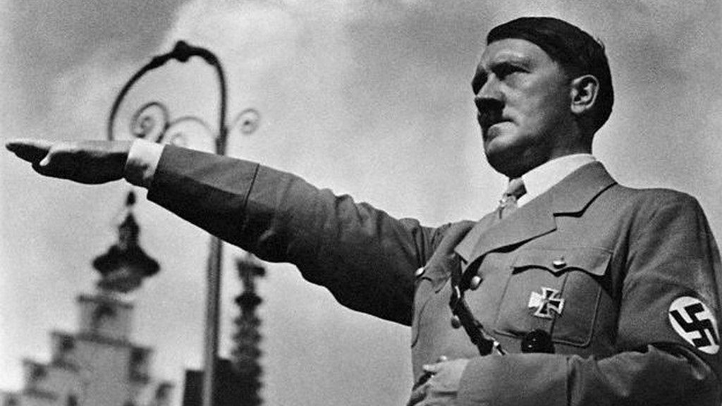
Nazi Germany 1918-1939

Slide 2
Key Topic 1
Weimar Republic
1918-1929

Slide 3
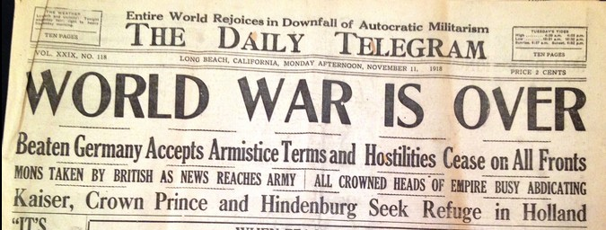
November 1918
Germany loses WW1
Kaiser abdicates
Armistice signed (agreement to stop fighting)

Slide 4
June 1919
Treaty of Versailles
GUILT Germany had to accept all responsibility for the war
ARMY Army reduced to 100,000
REPARATIONS Reparations £6600 million
GERMANY LOSE LAND 13% of European territory, 15% of its iron and 15% of its coal reserves, 11 German colonies in Africa and the Far East were also lost
LEAGUE OF NATIONS
DOLCHSTOSS NOVEMBER CRIMINALS

Slide 5
1919
The Weimar Republic- Democracy
Proportional representation (number or Reichstag seats depended on the percentage of the vote)
Weak:
1. PR: lots of parties- difficult to agree on anything
2. Article 48

Slide 6
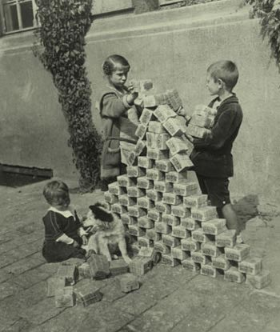
Economic problems 1918-23
Who was blamed?
WEIMAR REPUBLIC
Bankruptcy- war and reparations (£6600 million)
Occupation of the Ruhr
Hyperinflation: Shortages, everyone found it difficult to buy what they needed (wheelbarrows filled with money).
Benefitted | Suffered
Big business in debt Foreign visitors | Savings Fixed wages Older people Middle class

Slide 7
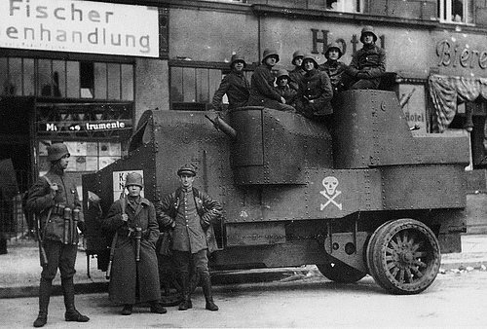
Political problems 1918-23
The Freikorps
Demobilised soldiers who refused to give back their arms
Anti- communist
Worked with regular army
March 1919- 250,000
376 left wing and moderate political assassinations : Hugo Haase, Matthias Erberger and Walther Rathenau- not a single right- wing murderer was convicted

Slide 8
Spartacists (left-wing movement)
Communists
Rosa Luxemburg and Karl Liebknecht
6 Jan 1919, 100,000 demonstrated in Berlin, took over key buildings
Set up local councils for workers and soldier soviets
Uprising crushed early 1919 by Freikorps and Reichswehr (regular army)
Leaders arrested and shot Jan. 1919
The Kapp Putsch (right-wing revolt)
Dr Wolfgang Kapp
Outraged by ToV
1920-5000 marched on Berlin to overthrow Weimar Republic and bring back the Kaiser
Army refused to move against Kapp
Government ordered a strike instead- services halted
Kapp fled to Sweden
Kapp arrested and died in prison 1922

Slide 9
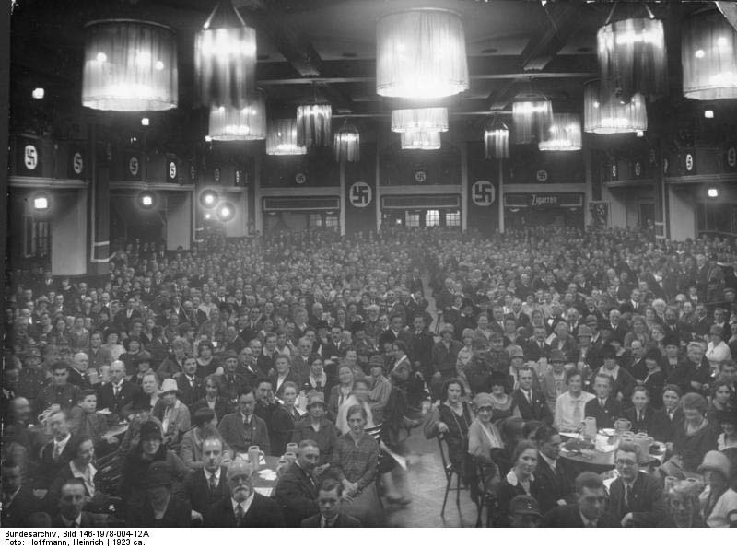
The Munich Putsch 1923
NSDAP- 55,000 members (mostly from Munich) and private army (SA) only 200 rifles
Von Kahr, von Seisser and von Lossow forced to offer support then withdrew the next day
9 November 1923, Hitler and his Nazis went into Munich on what they thought would be a triumphal march to take power
Kahr had called in police and army reinforcements.
Police killed 16 Nazis
Hitler fled, but was arrested two days later
Sentenced to 5 years (only served 9 months)- Landsberg Castle for treason- NSDAP banned
Lenient punishment- posed no real threat to Berlin

Slide 10
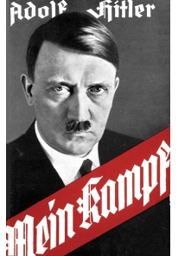
Impact of Munich Putsch
Trial used to get publicity
1924 re- launches NSDAP with new focus- power through the Reichstag
Mein Kampf (My Struggle)
May 1924 32 seats- NSDAP win first seats in the Reichstag

Slide 11
Weimar recovery 1924-29 Stresemann
STRESEMANN:
Reduced reparations
Improved relations with France, the US and world community
Regained support of moderate parties and public opinion
August 1923 Gustav Stresemann became chancellor and foreign secretary (forced to resign as chancellor Nov 1923)
Retenmark (real value)
The Dawes Plan 1924 (US loans and reduction of reparations)
The Locarno (Rhineland) Pact, 1925 (Germany agreed to keep new 1919 with France and Belgium)
The Young Plan, 1929 (reduced reparations from £6.6 billion to £2 billion)
The League of Nations (Germany accepted 1926)
Kellogg-Briand Pact (August 1928 61 countries agreed war would not be used to achieve foreign policy aims)

Slide 12
Key topic 1 quiz
When did WW1 finish?
Name at least 3 features of the ToV
What is proportional representation?
What was Article 48 used for?
How much were the reparations?
Name the two leaders of the Spartacist Uprising.
Who led the Kapp Putsch?
When was the Munich Putsch?
What does Mein Kampf stand for?
What did Stresemann do to stabilise the economy?

Slide 13
Key topic 1 quiz
When did WW1 finish? Nov. 1918
Name at least 3 features of the ToV. G/A/R/G/L
What is proportional representation? Percentage of the vote determines number of seats in the Reichstag
What was Article 48 used for? Emergency decree
How much were the reparations? £6600 million
Name the two leaders of the Spartacist Uprising. Rosa Luxemburg and Karl Liebknecht
Who led the Kapp Putsch? Dr Wolfgang Kapp
When was the Munich Putsch? Nov. 1923
What does Mein Kampf stand for? My Struggle
What did Stresemann do to stabilise the economy? Reduced reparations/Improved relations with France, the US and world community/ Regained support of moderate parties and public opinion

Slide 14
Key Topic 2
Hitler and the Rise of the Nazis
1919-33

Slide 15
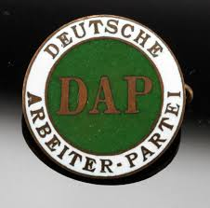
The birth of the Nazi party 1919-1923
Jan 1919- German Workers’ Party (DAP)- Anton Drexler
23 members by Sept 1919
Against:
-communists and socialists
-November Criminals
-Democracy
-Jews
HITLER AGREED AND JOINED
25-Point Programme- Feb. 1920:
-scrap ToV
-expand German borders- lebensraum
-deprive Jews of German citizenship

Slide 16
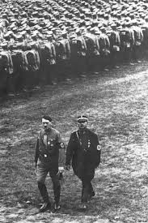
August 1920- DAP becomes NSDAP
Mid-1921- Hitler became party Führer (leader)
Created his party with strong leaders:
-Ernst Rohm, Hermann Goering, Rudolf Hess and Julius Streicher
The Sturmabteilung (SA, storm troopers, brownshirts) Hitler’s private army
-provided security
-broke up opposition meetings
THUGS!
(Shock Troop made up of trusted member of the SA)

Slide 17
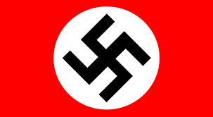
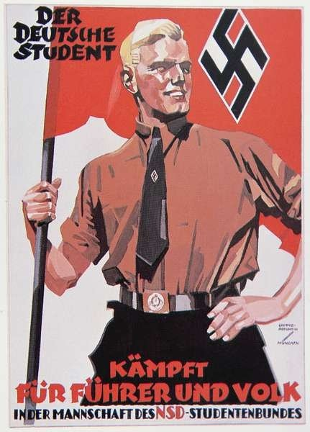
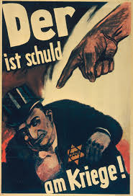
What did the Nazis stand for?
Nationalism
Socialism
Totalitarianism
Traditional German Values
Survival of the fittest
Racial Purity

Slide 18
Nazi Party organisation 1924-28
27th Feb. 25 re-launch of the Nazi Party- Burgerbrau Keller
Gaue (regions) run by a Gauleiters answerable only to Hitler
SA- 400,000 members by 1930
1925- Schutzstaffel (SS) set up as the SA were out of control (Leader- Himmler)
Goebbels- propaganda:
-Jews, communists, moderate Weimar leaders blamed for Germany’s problems
-Hitler promoted as the voice of the Nazis
-Up to date technology (films, radios, gramophone records)
-Image of strength for the party

Slide 19
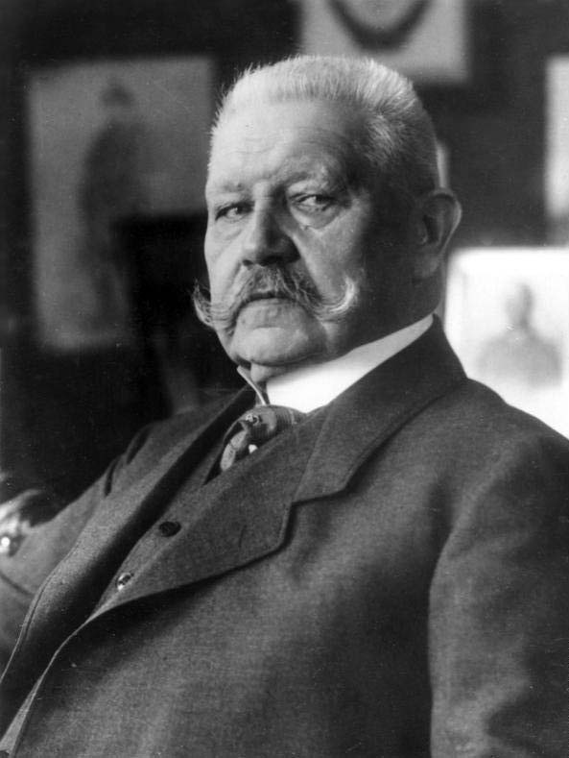
The Lean Years 1924-29
1928- Nazis had 100,000 members
Inflation eased
Employment increased
Germany back on the world stage
1925- Hindenburg had become President- more people supported Weimar
Voters supported moderate parties (extreme parties lost out)
May 1928- Nazis only won 12 seats

Slide 20
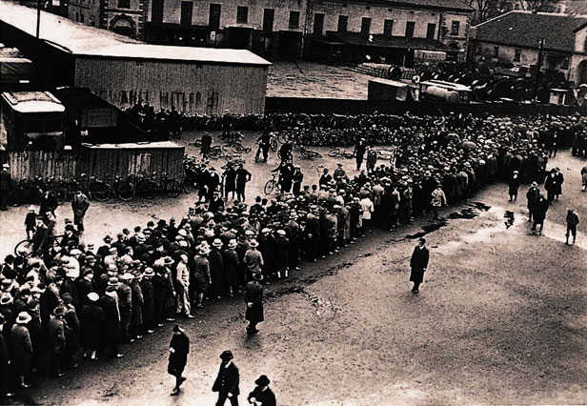
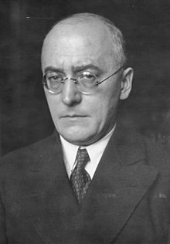
1929-32 the Great Depression
October 1929- Wall Street Crash
US banks recalled German loans
German industrial output fell
Unemployment rose
Middle classes lost savings, their companies
or their homes
Brüning (The Hunger Chancellor):
-raise taxes to pay for unemployment benefit
-reduce unemployment benefit to make payments more affordable
UNPOPULAR- had to rule by Decree!
Brüning lost control of the Reichstag and resigned in 1932.

Slide 21
Nazi Support Grows 1929-32
Great Depression helped the Nazis- voters turned to extreme parties to solve their problems
July 1932- Nazis won 230 seats
Support grew because:
-Hitler
-Strength of the SA
-Propaganda
-Flexibility
-Industrialist funding
-Weakness of opposition
Who supported the Nazis?
-Working Class support (‘Work and Bread’)
-Middle Class support (savings, land and business)
-Farmers (private land only confiscated if owned by Jews)
-Big business (protection against communists)
-Young people and women (best party for families)

Slide 22
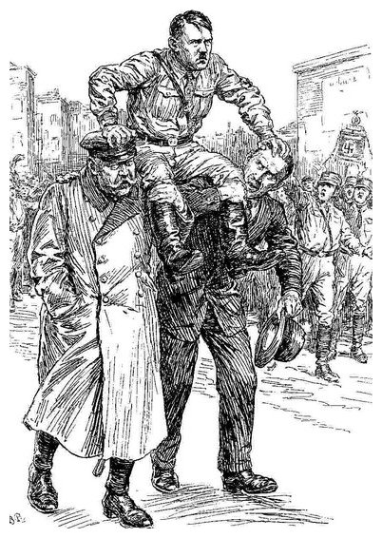
The Nazis win power 1932-33
Presidential elections 1932- communist votes fell to 4 million and Hitler’s vote grew to 13 million- Hitler was now a major political figure
Von Schleicher controls government from behind the scenes (gets rid of Brüning)
Von Papen becomes chancellor May 1932 with a coalition that included the Nazis
Von Papen’s government was weak and the Nazis became largest party in the Reichstag so Hitler demands that he becomes chancellor- Hindenburg refuses.
Von Papen resigns and von Schleicher appointed as chancellor but quickly loses support in the Reichstag
Von Papen is convince that he can control Hitler is he is made Hitler’s vice chancellor
30th Jan 1933 Hitler is legally and democratically appointed chancellor!

Slide 23
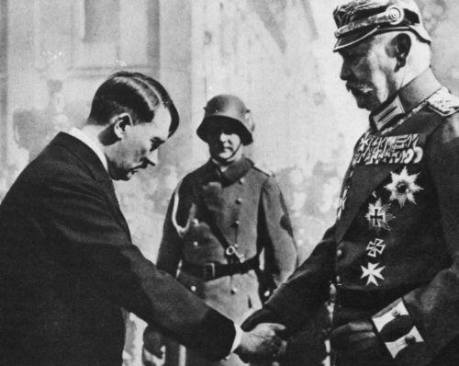
30th Jan 1933 Hitler is legally and democratically appointed chancellor!

Slide 24
Key topic 2 quiz
What does DAP stand for?
Who was the original leader of the DAP?
When did the DAP become the NSDAP?
What were the SA?
Why did Hitler set up the SS?
Who was put in charge of propaganda?
Why were he years 1924-1929 called the ‘lean years’?
What was the Wall Street Crash?
What was Brüning known as?
When did Hitler become chancellor?

Slide 25
Key topic 2 quiz
What does DAP stand for? German Workers’ Party
Who was the original leader of the DAP? Anton Drexler
When did the DAP become the NSDAP? Aug. 1920
What were the SA? Hitler’s private army
Why did Hitler set up the SS? The SA were difficult to control
Who was put in charge of propaganda? Josef Goebbels
Why were he years 1924-1929 called the ‘lean years’? Voters started to support moderate parties again because of the economic recovery
What was the Wall Street Crash? Oct 1929
What was Brüning known as? The Hunger Chancellor
When did Hitler become chancellor? Jan 1933

Slide 26
Key Topic 3
The Nazi Dictatorship
1933-39
https://www.youtube.com/watch?v=9CFWH4Fhkak
From 4.30 mins
https://www.youtube.com/watch?v=hJ8ewZySQls
From 0.30 mins

Slide 27
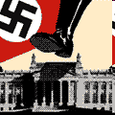
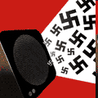
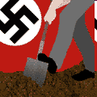
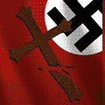
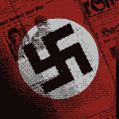
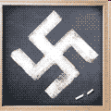
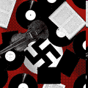
7 structures brought under control by the Nazis
Work
Government
Propaganda
Religion
Terror
Culture
Education and Youth

Slide 28
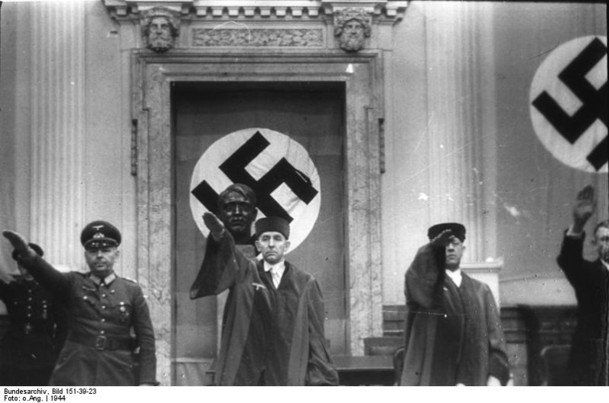
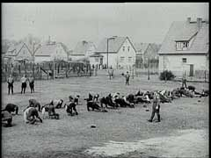
How did the Nazis control Germany?
Gestapo
SS
Concentration camps
The legal system

Slide 29
Key topic 3 quiz
What was the Reichstag fire?
Who was responsible for the Reichstag Fire?
What did Hitler ban in May 1933?
Name two if the structures brought under Nazi control.
What was the Gestapo?
Which group ran the concentration camps?
Who was removed on the Night of the Long Knives?
What powers did the Enabling Act give Hitler and the Nazis?
When did Hindenburg die?
Who title did Hitler give himself?

Slide 30
Key topic 3 quiz
What was the Reichstag fire? 27th Feb 1933
Who was responsible for the Reichstag Fire? Communists
What did Hitler ban in May 1933? Trade Unions
Name two if the structures brought under Nazi control. Government, work, culture, education and youth, propaganda, religion, terror
What was the Gestapo? Secret police
Which group ran the concentration camps? SS
Who was removed on the Night of the Long Knives? SA and other political opponents
What powers did the Enabling Act give Hitler and the Nazis? 4 years to pass any laws
When did Hindenburg die? Aug 1934
Who title did Hitler give himself? Führer

Slide 31
Key Topic 4
Nazi Domestic Policies
1933-39

Slide 32
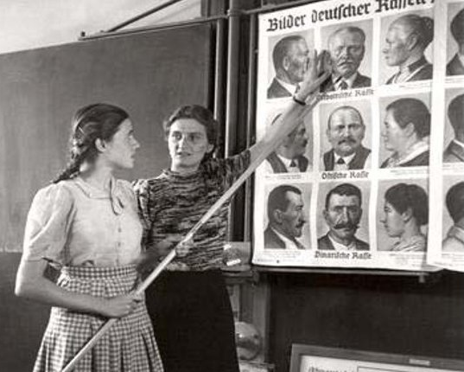
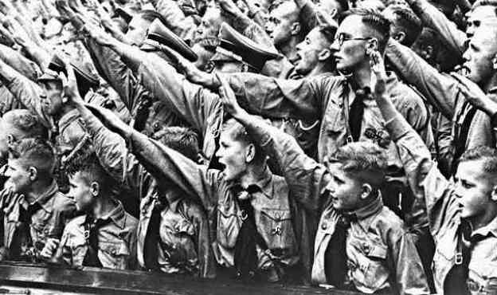
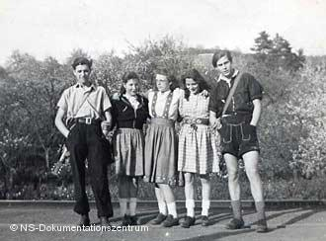
Youth and education
Boys and girls went to separate schools
New subjects (racial studies)
Mein Kampf- compulsory school text
PE 1/6 school time- to keep the young healthy
Domestic science was compulsory for girls
Youth organisations:
-Hitler Youth- boys age 14+ military training
-League of German Maidens- girls- focused on health and motherhood
Rebellion- Edelweiss Pirates- 2000 members by 1939

Slide 33
Women in Nazi Germany 1933-39
1920s
Women over 20 could vote
20 females members of the Reichstag
Women worked (100,00- female teachers 1933)
Women enjoyed social activities outside the family
Liberated dress
1930s
Focus on good mothers
Learn how to look after a family
Marry
Have children
Stay at home
No make-up or trousers
German Women’s Enterprise (taught good motherhood)
Kinder, küche, kirche (children, kitchen and church)
Professionals forced to leave their jobs (reduced unemployment)

Slide 34
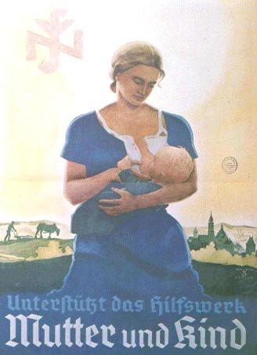
Policies for women
1933- Law for the Encouragement of Marriage- loans 100 marks
Mother’s Cross- award given for the number of children a women had (bronze: 4-5, silver: 6-7 and gold: 8>)
1935 > Lebensborn (‘fountain of life’)

Slide 35
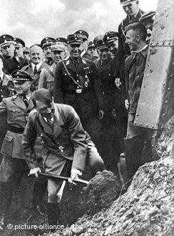
Work and employment 1933-39
1933
Banned trade unions
DAF (German Labour Front)- ensure workers served the Nazi regime
By 1939 Germany had 7000 km of autobahns
TRADE UNIONS

Slide 36
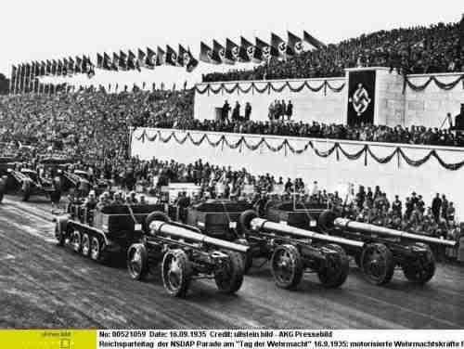
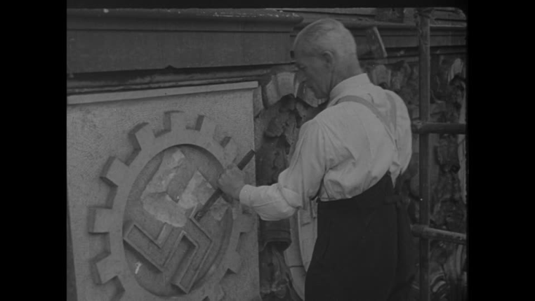
How did the Nazis get rid of unemployment?
RAD (National Labour Front)- provided manual work for the unemployed- from 1935 compulsory
Job creation schemes- subsidised private firms
Invisible employment- Jews, unmarried men, women and opponents of the Nazi regime
Rearmament- conscription from 1935- army grew from 100,000 in 1933 to 1.4 mil by 1939

Slide 37
Were people better off under the Nazis?
YES
Strength through Joy (KdF)- leisure activities for hard workers
Beauty of Work- improved working conditions
Volkswagen scheme 1938- scheme to fund new car
Wages rose from 86 marks in 1932 to 109 marks in 1938
NO
Lack of freedom
Strength through Joy- expensive
Volkswagen scheme- didn’t work- no cars delivered- money not refunded
Cost of living increased
Longer working hours- 42.9 hrs per week in 1933 to 47 hrs per week in 1939

Slide 38
Persecution of minorities 1933-39
JEWS
Anti-Semitism- scapegoats
Mein Kampf
April 1933- boycott
Sept 1935 Nuremberg Laws
Nov 1938 Kristallnacht
OTHERS
Slavs
Gypsies
Disabled
Homosexuals
Prostitutes
Jehovah’s Witnesses
Alcoholics
Pacifists
Homeless

Slide 39
How did the Nazis control Germany?
Gestapo
SS
Concentration camps
The legal system

Slide 40
Key topic 4 quiz
What was the Hitler Youth?
Name one group that protested against Nazi policies towards the young.
What was a women’s role in Nazi Germany?
What was the Mother’s Cross awarded for?
How many kilometres of autobahn had been built by 1939?
Name 2 measures that the Nazis put in place to reduce unemployment.
What was KdF?
How successful was the Volkswagen scheme?
What was introduced in Sept 1935?
Name 3 groups that the Nazis persecuted.

Slide 41
Key topic 4 quiz
What was the Hitler Youth? Nazi boys youth organisation for 14years+
Name one group that protested against Nazi policies towards the young. Edelweiss Pirates
What was a women’s role in Nazi Germany? Mother and wife, stay at home, healthy
What was the Mother’s Cross awarded for? Having 4 or more children
How many kilometres of autobahn ha been built by 1939? 7000km
Name 2 measures that the Nazis put in place to reduce unemployment. RAD, job creation schemes, rearmament, invisible employment
What was KdF? Strength through Joy- leisure activities
How successful was the Volkswagen scheme? Not successful- no cars delivered- money not refunded
What was introduced in Sept 1935? Nuremberg Laws
Name 3 groups that the Nazis persecuted.
Jews
Slavs
Gypsies
Disabled
Homosexuals
Prostitutes
Jehovah’s Witnesses
Alcoholics
Pacifists
Homeless

