Slide 1
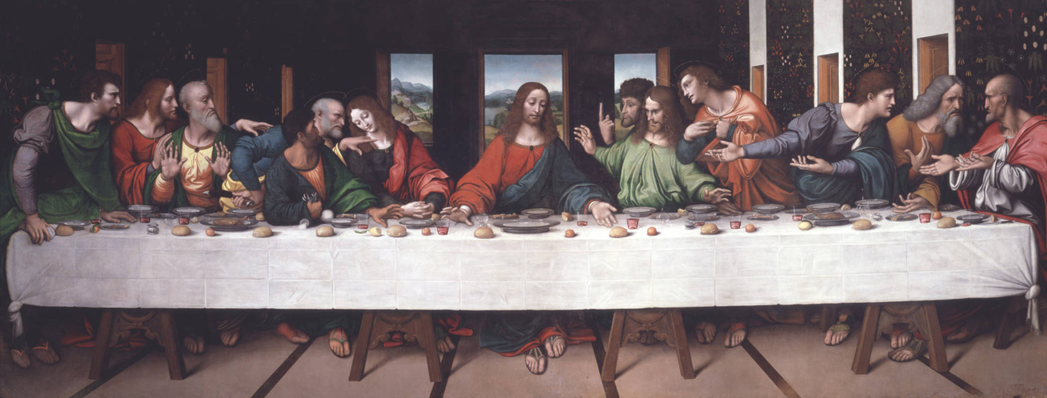
As a Table – Come up with a story to go along with this image.
It is called the ‘Last Supper’
What Questions would you like answered about this image?

Slide 2
WALT: What happened on Maundy Thursday?
L3: List the events of Maundy Thursday.
L4: Describe the events.
L5: Explain the importance to Christians.

Slide 3
What happens and Why?
http://request.org.uk/festivals/holy-week/2014/02/15/holy-thursday/

Slide 4
Story Board
Jesus ate his last meal with his disciples. | Jesus washed the feet of his disciples. Normally done by a humble servant.
‘As I have loved you so you must love one another’. | How is Maundy Thursday celebrated today.

Slide 5
Story Board
Meal | Wash
Speech | Today

Slide 6
Now we know the story of Maundy Thursday – Lets look at its importance.
“As I have loved you so you must love one another”
(John 13.34)
What do you think that Jesus was trying to teach his disciples by acting out this parable in front of them?
Jesus called this a new commandment. The Latin word for commandment is mandatum.

Slide 7
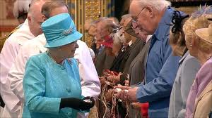
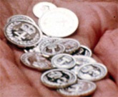
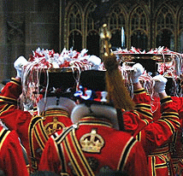
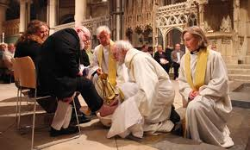
Think

Slide 8
TASK
Now write from the point of view of a Christian celebrating in the United Kingdom.
Write a diary entry, after the event.
Dear Diary I have just celebrated Maundy Thursday, I saw the Queen … She does this because … In the past … Today bishops and priests … They do this because …
4: Describe.
5: Explain.
6: Compare.

Slide 9
Bump and Share
You now have three minutes to bump into as many people as you can and tell them about Maundy Thursday.
What is it?
How is it celebrated?
Why do Christians celebrate it?

