Slide 1
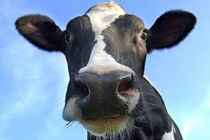
What has a cow got to do with immunology?

Slide 2
WALT: Just how important was Edward Jenner to the History of Medicine?
WILFs:
(C) Can describe the story of Edward Jenner and the first vaccination. (B) Can explain which factors were important in Edward Jenner's discovery. (A) Evaluate the importance of Jenner's contribution to the history of medicine.

Slide 3
Find-Someone-Who
Find Someone Who … For the following Questions.
What is the difference between inoculation & vaccination?
Give 3 reasons why Jenner faced so much opposition?
What factors helped in the discovery of a vaccine for smallpox?

Slide 4
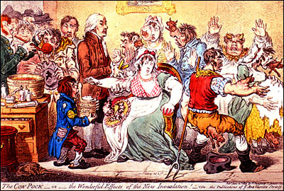
Opposition

Slide 5
BLOG TASK
Click the Button on WatHistory
Open up a Word Document and answer the following Question. "How important was Jenner to the History of medicine?" You will have 10 minutes with your Study Buddy to create the perfect answer. Post your answers to this Blog when instructed (Copy & Paste from Word). CLICK ADD COMMENT >> TYPE NAMES >> POST

Slide 6
Find the Fiction
Create a Find the Fiction for Edward Jenner with your SB
2 Correct and 1 incorrect Statement.
You could write a Question about;
Factors?
Opposition?
Immunology?
TASK – Play with at least 3 Groups.

Slide 7
Why was it feared?
Symptoms: fever, headaches, pus-filled blisters
Scarring
Treatments, e.g. bleeding, quack remedies
Killed more children than any other disease
No known cure
Affected rich & poor (Elizabeth I)

Slide 8
Problems with Inoculation
Costly – some doctors exploited this!
Some died from inoculation or became carriers
People refused treatments

Slide 9
Factors affecting Jenner
Education – studied under surgeon, John Hunter
Enquiry & attitude – noted down his observations, e.g. milkmaids didn’t develop smallpox; carried out 23 tests; undeterred by criticism
Technology – published his ideas (1798); by 1803 USA using vaccination & in 1805 Napoleon vaccinated Fr army
Government - £30,000 grant; 1852 compulsory vaccination introduced

Slide 10
Opposition
Ungodly – using animals to cure humans
Inoculators would lose their jobs
Royal Society – vaccination was too revolutionary!
Government should not interfere with health
Vaccinations were costly
People hadn’t heard of Jenner

Slide 11
Limitations
Jenner’s vaccination only dealt with one disease. Many other diseases like cholera and typhoid were killing thousands in epidemics.
Pasteur didn’t publish his germ theory until 1859, so Jenner didn’t exactly know how his vaccine worked.
At first governments were unsure whether they wished to force people to vaccinate their children.
Many people opposed vaccination. An anti-vaccine league was formed in 1866.

