Slide 1
Title: Gender and Religious Participation
Task: Evidence for Gender Difference in Religiosity
Opinion poll evidence also suggests that women are more religious than men.
A poll conducted in 1990 found that 84% of women believed in a God, compared to 64% of men.

Slide 2
Title: Gender and Religious Participation
Describe who came and why.
Explain their experience and actions.
Evaluate their impact.

Slide 3
Title: Gender and Religious Participation
Task: Evidence for Gender Difference in Religiosity
There is evidence to support that women tend to be more likely to participate in religion than men.
The church census records participation in churches and denominations in England and Wales shows that between 1979 to 2005 women were consistently more likely to attend.

Slide 4
Title: Gender and Religious Participation
Task: Evidence for Gender Difference in Religiosity
Paul Heelas (2005) states that members of New age beliefs were more likely to be women ( As well as middle aged)
Modood (1997) found in the Fourth National Survey of Ethic Minorities that Muslim women were more likely too say religion was important to them than men.
However, men would be more likely to attend the mosque – this could be due to some Mosques not welcoming women into them.

Slide 5
Title: Gender and Religious Participation
Task: How might the following two explanations explain such gender differences in religion/religious commitment?
Miller and Hoffman 1995
Differential socialisation: females are taught to be more submissive, obedient and nurturing. These traits are compatible with religiosity.
Differential roles: females have lower rates of participation in paid work which leads to more time and a greater need for religion.

Slide 6
Differential Socialisation
According to traditional views women taught to be more submissive and obedient than men, as the religion requires it.
Research from the USA suggests that the less passive and obedient men, are less likely to be involved in a religion.

Slide 7
Structural Location
This view explains why women are more likely to be involved in religion than men.
Women who are in a “house wife” role( or work part-time), need religion to help provide a sense of personal identity.
Whilst men are traditionally full time male breadwinners do not need this, as the work provides them with their identity.

Slide 8
Title: Gender and Religious Participation
Task: Attitude to risk
Miller and Hoffman suggest that even when these two factors are taken into account it does not fully explain why women are more religious than men.
They argue that the third factor is important as well: attitude to risk.
Research suggests men are more willing to take risks than women.

Slide 9
Title: Gender and Religious Participation
Task: Attitude to risk
Not being religious is seen as risky behaviour as it means you may not gain access too……..?
Miller and Hoffman’s research shows that both men and women who are risk averse have high levels of religiosity.

Slide 10
Title: Gender and Religious Participation
Task: Bruce: Gender, religion and secularisation
Religion has an affinity with many aspects of femininity , such as women are less goal-orientated, more cooperative and less domineering.
The attributes fit with traditional religions and new age beliefs as well.
Women are attracted to healing and channelling…
Why?

Slide 11
Title: Gender and Religious Participation
Task: Bruce: Gender, religion and secularisation
Bruce believes in the modern world there is a sharp divide between the public and private sphere.
He supports the idea that religion isn't declining but rather is retreating into the private sphere.
Women are more likely to be involved in traditional religions because…. (what do they do for the next generation?)

Slide 12
Title: Gender and Religious Participation
Task: Bruce: Gender, religion and secularisation
Bruce believes that there are differences in the type of religion continues to appeal to women according to their social class.
Working Class – Women tend too continue to support religion – Believe in an all powerful God and are quite passive.
Middle Class – Have more experience of controlling their lives – therefore attracted to New Age religions ( as individuals can develop their own spirituality)

Slide 13
Title: Gender and Religious Participation
Task: Bruce: Gender, religion and secularisation
Like Bruce, Woodhead believes that secularisation reduced the involvement of men in traditional religion as they become increasingly involved in the rationalised modern world.
As a result churches become increasingly feminised.
This is explains why there is a rapid reduction in the attendance figures.

Slide 14
Title: Gender and Religious Participation
Task: Why else does religion appeal to women?
Women and the New Age
Women, compensators and sects
Pentecostal gender paradox

Slide 15
Title: Gender and Religious Participation
Task: Why else does religion appeal to women?
Women are still more likely to participate there has been a decline.
Movement to paid work
Rejection of traditional roles

Slide 16
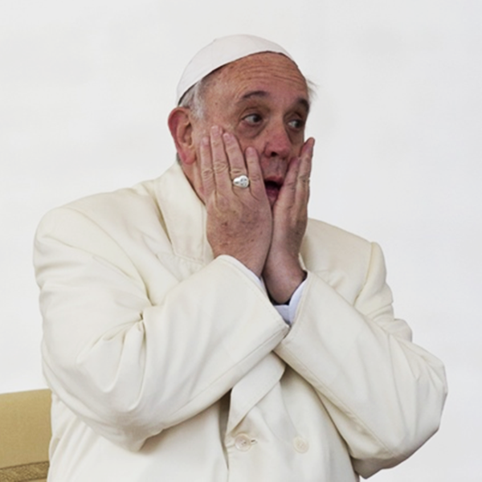
Title: Gender and Religious Participation
Task: What will I choose and why?
.

Slide 17
Title: Gender and Religious Participation
Task: Women as more religious than men
Greerley 1992 > Argues that before women get married and have children their religiosity is not dissimilar to men.
However ………
Davie argues that women feel closer to God because they are involved in the creation of life through pregnancy and giving birth.
Callister and Khalaf (2009) found that mothers claimed ‘contact with God’ intensified during childbirth.
- women opportunities for religious reflection

Slide 18
Title: Gender and Religious Participation
Task: Conclusions
Women are seen to be more religious across all religions.
Male domination within religions is responsible for the patriarchal nature of religion.
BUT……It cannot be generalised that all religions are patriarchal as many have good benefits for women.
Female church attendance has declined due to life commitments like employment and diversity.
Gender: socialisation and roles are responsible for the differences in religiosity between genders.

Slide 19
Title: Gender and Religious Participation
Task: Example Exam Questions
Outline and explain two ways in which women may be disadvantaged by religion today. (10 marks)

Slide 20
Title: Gender and Religious Participation
Task: Example Exam Questions
religious organisational hierarchies are still male dominated
religious texts reinforce patriarchy
some religions have segregation of men and women at worship
some religions do not allow women to become priests
women are seen as polluted.
e.g. religious organisational hierarchies are still male dominated putting women at a disadvantage. For example, the Pope is always a male and God is always portrayed as a ‘he’, therefore showing male dominance in power due to the significance of men in religious hierarchies. This would be clear evidence for Feminists that the nature and root of religion is patriarchal. However, it could been seen that there has been moves towards more equality in some religious hierarchies, e.g. the Church of England allowing women to become Bishops, a move seen by liberal feminists as a change to equality within the church. Nevertheless, as the majority of religious hierarchies are male dominated, this implies there is still a significant glass ceiling within religion and therefore women are disadvantaged by religion due to lack of representation in the power and status of religious figures.

Slide 21
Title: Ethnicity and Age and Religious Participation
Task: Evidence for Ethnic in Religiosity
 | % important | % attend
White Anglican | 11 | 9
White Catholic | 32 | 29
Hindus | 43 | 43
African Caribbean Protestants | 81 | 57
Muslims | 74 | 62
Brierley 2013 found that Black people are twice as likely to attend church than White.
Decline in importance of religion for all ethnic groups and that fewer were observant, especially among the second generation.

Slide 22
Title: Gender and Religious Participation
Task: Statistics on Ethnicity and religion
Modood et al (1997) – survey found that African Caribbean's has high rates of participating in the 20th century sects such as seventh day.
There were differences each ethnicity attached to religion – 11% CofE members saw religion as important – 71% of Caribbean members of Protestantism
Minority ethnic groups, with the exception of the Chinese, were all more likely to attend places of worship than whites.

Slide 23
Title: Gender and Religious Participation
Task: Statistics on Ethnicity and religion
Bird identifies 5 important reasons why minority ethic groups are more likely to be religious than the majority of white populations in Britain.
Many of the minority ethic groups originate from societies that have high religiosity.
Belonging to a minority group could increase the religiosity of the individual – as it provides a sense of community and identity.
Minority groups see religion as a way of maintaining the cultural identity in terms of tradition.
Socialisation increases the pressure of children to maintain religious commitment.
Religious beliefs also provide a way of dealing with oppression. (Pentecostalism – helps African Caribbean community in Bristol to cope with low pay and racial discrimination).

Slide 24
Title: Gender and Religious Participation
Task: Statistics on Ethnicity and religion
Bruce argues that ethnic minorities are more religious than Whites in Britain because it is more about community solidarity than deep religious commitment. He argues this stems from:
Cultural defence – Use religion to protect identity in a hostile environment
Cultural Transition – Religion is used to cope with the upheaval of migration.
Bruce argues that secular Britain will stat to erode the importance of religion for these ethic minorities.

Slide 25
Title: Gender and Religious Participation
Task: George Chryssides (1994)
Identifies three possible paths for immigrants in terms of religion:
Apostasy – Beliefs are abandoned in a hostile environment
Accommodation – Religious beliefs are adapted to take account of the changed situation.
Renewed Vigour – Religion is reasserted more strongly than ever as a response to actual or perceived hostility.
Argues that the general pattern in the UK has been accommodation and renewed vigour.
For example: Accommodation such as Muslim women dressing modestly but still fashionably, or increased vigour , for example finding new converts.

Slide 26
Title: Gender and Religious Participation
Task: Gilles Kepel (1994)
Argues that there has been a general religious revival in he world for both minority and majority religions.
He argues that Muslims have retained and strengthened their faith in response to an upsurge of Islamic Beliefs throughout the world.

Slide 27
Title: Gender and Religious Participation
Task: Policy Studies Institute Survey
PSSS provides evaluation for these competing claims.
Younger Chinese, White and African-Caribbean people were less likely than older members of these groups to see religion as important.
The survey found evidence to show that religion is declining from generation to generation – but this differs from group to group. Some areas in the population religion remained strong – (Muslims)

Slide 28
Title: Gender and Religious Participation
Task: In your own words – Religion is in decline for all ethnicities. How far do you agree?
In your own words – Religion is in decline for all ethnicities. How far do you agree?
Religious attendance
Cultural difference
Immigrants and minorities.

Slide 29
Title: Gender and Religious Participation
Task: In your own words – Religion is in decline for all ethnicities. How far do you agree?
Older a person is the more likely they are to attend religious services
Age | 1980 | 2015 | 2025
<15 | 1,165 | 493 | 338
15-19 | 394 | 126 | 63
20-29 | 492 | 170 | 114
30-44 | 718 | 432 | 328
45-64 | 897 | 751 | 614
65> | 810 | 957 | 1,070
Brierley 2015 15-19 will be less than 2.5% of all churchgoers

Slide 30
Title: Gender and Religious Participation
Task: In your own words – Religion is in decline for all ethnicities. How far do you agree?
Ageing Affect – Heelas more interested in spirituality as they approach death.
Period or cohort affect – People born during particular periods are likely to attend church i.e. war.
Secularisation – As religion declines in importance next generations become less religious.

Slide 31
Title: Gender and Religious Participation
Task: In your own words – Religion is in decline for all ethnicities. How far do you agree?
Arweck and Beckford 2013 describes the virtual collapse of religious socialisation in 1960s. Sunday schools have all but disappeared.
Voas 2003 – 50/50 if both are same religion. One in Four if different.

Slide 32
Title: Gender and Religious Participation
Task: Create your own Topic summary – Paragraph or Mind map
You must include;
Churches
Sects
Denominations
Cults
New Religious Movements
World Rejecting
World Affirming
World Accommodating
Secularisation
Deprivation
Religious Participation
Gender
Class
Age
Ethnicity

Slide 34
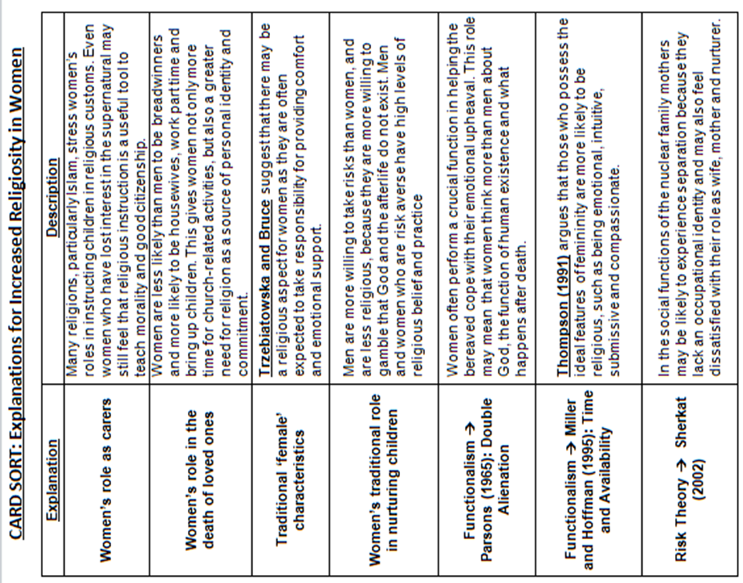

Slide 35
Example of patriarchy in religion | Example of patriarchy in religion | Example of changing views on women in Religion | Example of changing views on women in Religion
Example of patriarchy in religion | Example of patriarchy in religion | Example of non-patriarchal religions | Example of non-patriarchal religions

