Slide 1
Blockbuster: Explain the event and link to the next. Write down your links.
POTSDAM
AIRLIFT
SALT 1
YALTA
BERLIN
TRUMAN DOCTRINE
DETENTE
CHURCHILL
NATO
START
HIROSHIMA
MARSHALL PLAN
ARMS RACE
AFGHANISTAN
VE DAY
WARSAW PACT
GLASTNOST
TEHRAN
COMINFORM
SPACE RACE
FALL OF BERLIN WALL
UNITED NATIONS
HUNGARIAN REVOLUTION
YALTA

Slide 2
Revision: Timelines
Learning Outcomes
D: Simple descriptive timeline of the events.
B: Explain the key events.
A: Expand, Link the different events together.

Slide 3
Timeliner: Create at least 2 timelines for the Cold War and Germany.
You will see three different examples of timelines.
Choose one that suits your style and make your own version. You must have two completed timelines by the end of the lesson.

Slide 4
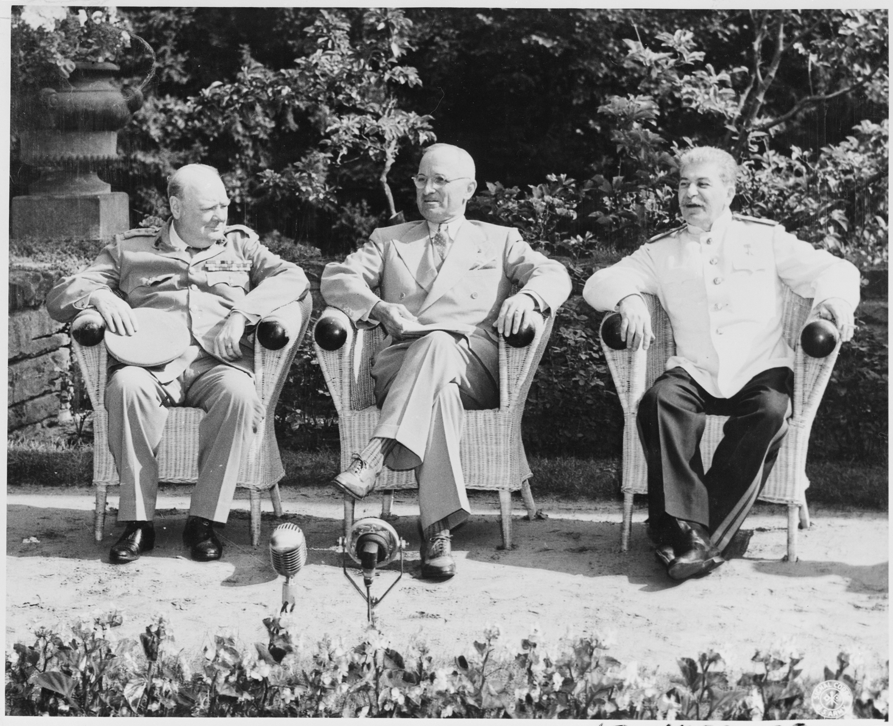
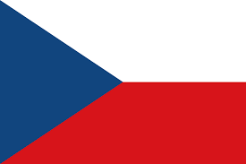
Challenge Level – D+
1945 – Yalta
1955 - The Warsaw Pact
1984 - Russia and 13 allied countries boycotted the summer Olympics
1955
1975
1945
1965
1985
1945 - The Potsdam Conference
1968 - Czecholslovakia

Slide 5
1945 – Yalta
Meeting between Churchill, Roosevelt and Stalin to decide what would happen at the end of the war. Topics discussed included -
Partitioning of Germany
Fate of Poland
The United Nations
German reparations
Challenge Level – C+
1955 - The Warsaw Pact was formed with member states East Germany, Czechoslovakia, Poland, Hungary, Romania, Albania, Bulgaria, and the Soviet Union.
1984 - Russia and 13 allied countries boycotted the summer Olympics held in Los Angeles in retaliation for the US boycott of 1980.
1955
1975
1945
1965
1985
1945 - The Potsdam Conference formally divided Germany and Austria into four zones. It was also agreed that the German capital Berlin would be divided into four zones. The Russian Polish border was determined and Korea was to be divided into Soviet and American zones.
1968 - Warsaw Pact forces entered Czechoslovakia in a bid to stop the reforms known as 'Prague Spring' instigated by Alexander Dubcek. When he refused to halt his programme of reforms Dubcek was arrested.

Slide 6
Challenge Level – B+
1945 – Yalta conference. The big 3 met to discuss the future of Germany, UN and the end of WW2
1955 - The Warsaw Pact had a negative effect, Threatened the European countries that did not follow communism. Presented a threat to the USA
1985 – Gorbachev is new leader of USSR. Favours better relations with US. Glasnost and Perestroika
1962 – Cuban Missile Crisis. Affected international relations in a number of way … led to the detente
1945
1955
1965
1975
1985

Slide 7
1945 – Yalta
Meeting between Churchill, Roosevelt and Stalin this led to the Potsdam Conference. Had a significant effect on international relations. It is called the strange relationship because …
Challenge Level – A+
1955 - The Warsaw Pact was formed with member states East Germany, Czechoslovakia, Poland, Hungary, Romania, Albania, Bulgaria, and the Soviet Union.
1984 - Russia and 13 allied countries boycotted the summer Olympics held in Los Angeles in retaliation for the US boycott of 1980.
1955
1975
1945
1965
1985
1945 - The Potsdam Conference formally divided Germany and Austria into four zones. This would ensure that Berlin would be an area of contention for the future…
1968 - Warsaw Pact forces entered Czechoslovakia in a bid to stop the reforms known as 'Prague Spring' instigated by Alexander Dubcek. When he refused to halt his programme of reforms Dubcek was arrested.

Slide 8
Blockbuster: Explain the event and link to the next. Write down your links.
WEIMAR REPUBLIC
RUHR VALLEY
COMMUNISTS
VERSAILLES
LUXEMBERG
ENABLING ACT
K,K,K
ARMY
RENTENMARK
SA, SS, GESTAPO
FORMATION OF DAP
STRESEMANN
REICHSTAG FIRE
CONCENTRATIONCAMPS
KAPP PUTSCH
MUNICH PUTSCH
FUHRER
DREXLER
LEAGUE OF NATIONS
CONCORDAT
WORLD WAR TWO
HYPER-INFLATION
MEIN KAMPF
HITLER YOUTH

Slide 9
1945 Feb.Yalta Conference - Meeting between big 3 to decide what would happen at the end of the war. Topics discussed included - Germany 4 zones, Poland, The UN, reparations. | 1945 Jul. The Potsdam Conference - formally divided Germany and Austria into four zones. It was also agreed that the German capital Berlin would be divided into four zones. | 1946 – Long and Novikov telegram. Both US and USSR intercepted communication reports about the other. Start of the Cold War | 1947 Mar. Truman Doctrine - President Truman promised to help any country facing a Communist takeover | 1947 Jun. Marshall Plan Money from US to any country. The plan was rejected by Stalin & any Eastern Bloc country was punished. Only given to Western Countries.
1947 Sept. Cominform - The USSR set up Cominform in response to the Marshall Plan | 1947-1949 – Creation of Satellite States. USSR turned most countries in Eastern Europe into satellite states. | 1948 Jun. – Formation of West Germany. The French, USA and UK partitions of Germany were merged to form West Germany | 1948 Jun. – Berlin Blockade. Russia's was to cut all links to that sector. Food was brought to Western Berliners by US and UK Airlift. | 1949 Apr. NATO formed. An agreement between 13 different allied countries
1953 Mar – Death of Stalin – Khrushchev takes over. | 1955 May. Warsaw Pact – USSR and Easter European countries in retaliation to NATO. | 1956 Oct – Hungarian Revolution. Nagy took over and promised reform. USSR responded with tanks entering capital. US condemned actions. | 1959 – Fidel Castro takes charge of Cuba. 1961 – Bay of Pigs. CIA failed invasion of Cuba. | 1961 Aug. Berlin Wall - Berlin wall built and borders sealed between East and West Germany.
1962 Oct – Cuban Missile Crisis. Nukes spotted in Cuba. Naval Blockade. 13 days. Agreed to remove threats from Turkey & Cuba. | 1964 Jul – Kruschev removed replaced by Brezhnev | 1968 Aug. Invasion of Czechosolvakia. Warsaw Pact countries enter Czech to stop Prague Spring by Dubcek | 1972 SALT1 – Strategic Arms Limitation Treaty signed. 1975 Jul – Apollo-Soyuz Mission | 1977 Jan - Jimmy Carter become president
1979 Dec – Soviet invasion of Afghanistan 1980 Jul – Olympic Boycott by USA | 1980 – Reagan become US president. Calls the USSR the Evil Empire. 2nd Cold War. Announce SDI (Star Wars) | 1982 – START proposed. 1984 – Olympic Boycott by Russia. | 1985 Gorbachev becomes leader of USSR. 1987 policy of Glasnost and Perestroika. 1987 – INF TREATY | 1989 – Fall of Berlin Wall 1991 – Warsaw Pact end. 1991 – Gang of Eight 1991 – End of USSR.

Slide 10
1919 – Signing of the Treaty of Versailles. Creation of the Weimar Republic. | 1919 Jan – Spartacist uprising in Berlin and other cities. Crushed by Freikorp | 1919 March – German Workers Party (DAP) founded. Hitler joins. | 1920 March – Kapp leads Freikorps to take over Berlin. General strike is ordered. | 1920 July – DAP changes to the NSDAP. Called the Nazis. 25 Point program adopted and Hitler takes over.
1923 Jan – Aug 1925 – invasion of the Ruhr valley. Leads to hyperinflation. | 1923 Nov – Beer Hall Putsch aka the Munich Putsch. Hitler arrested and sent to prison for 9 months. | 1924 Sept – Dawes Plan implemented. 1928 – Nazis win 12 seats. 1929 – Young Plan implemented. | 1929 Oct – Wall St crash | 1932 Dec – Von Schleicher becomes Chancellor. 1932 – Nazi’s win 230 seats.
1933 Jan – Hitler becomes Chancellor in a political manoeuvre | 1933 Feb – Reichstag fire. Communists are banned from Reichstag. | 1933 March – Election called. Nazis poll 44% with a small coalition they have a majority. | 1933 March – Enabling Act. Hitler can rule without Reichstag. He changes constitution. Hitler bans socialist. | 1933 May – Banning of all trade unions.
1933 July – Bans all new political parties. All other parties dissolve ‘voluntarily’. | 1933 July – Formation of Reich Labour Service. 1933 Apr – Boycott of Jewish shops. | 1933 July – Lebensborn policy. Fountain of Life. Mothers cross award. | 1934 June – Night of the Long Knives. The SA were out of hand. Hitler removes a potential obstacle to power. | 1934 Aug – Hindenburg dies. Hitler assumes Presidency. Hitler prefers to known as Fuhrer.
1935 – RAD – National Labour Front. Rearmament and Conscription. 1935 Sept – Nuremberg Laws. | 1936 – Goering announces Four Year plan in speech to the Reichstag. Preparation for War. Autobahns. Autarky. | 1938 – KdF – Strength through Joy program. | 1939 Nov – Kristallnacht | 1939 Sept – Invasion of Poland

