Slide 1
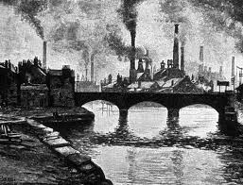
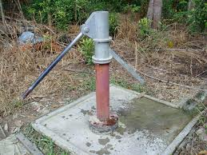
Starter – Why are you unhappy in 1800…
Think back to Peterloo and The Vote in 1800 & the Industrial Revolution.
You are Working Class.
Why are you unhappy in 1800… ?
How can you get things to improve?

Slide 2
WALT: Who were the chartists. What did they want?
L4 – Who were the Chartists? (Describe)
L5 – Why did the Chartists want change? (Explain)
L6 – Why would it annoy the Landowners? (Evaluate)

Slide 3
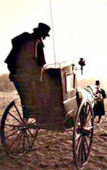
Who were they?
The Chartists collected signatures for a petition that would be presented to Parliament. Their Third petition in 1848 was enormous! It had to be carried in carriages like this one. The Chartists claimed it had six million signatures, but the Government said there were only 1.9 million.

Slide 4
Copy the table & complete
Chartist Demand | Reason for it!
A vote for every man 21 years of age.
The ballot should be secret.
No property qualification – rich or poor should be able to be MPs.
MPs should be paid so anyone can afford to be an MP.
Equal constituencies – each MP should represent the same number of voters.
There should be annual elections.
EXT: Which do you think will upset the Landowners the most & why?

Slide 5
Who were the chartists…
1. A vote for every man 21 years of age.
2. The ballot should be secret.
3. No property qualification – rich or poor should be able to be MPs.
4. MPs should be paid so anyone can afford to be an MP.
5. Equal constituencies – each MP should represent the same number of voters.
6. There should be annual elections.

Slide 6
Who do Chartists want to achieve? What are their aims?
Who are the leaders?
What methods do they use?
Is it legal?
Who else has joined?
How many have joined?
What's in it for me/us?
What will it cost us?
What is the governments reaction to
Chartism?
Can women join?

Slide 7
Individually you need to WRITE a speech in your books that a Chartist might give to justify (back up) why they want to make the changes in the charter.
We will pick random pupils to read theirs aloud at the end to be peer assessed – so make sure yours is impressive and ready to go!
Ladies and Gentleman!
We Chartists feel the conditions of the working people of this country are….
Not only that but they have very few rights! For example…
We Chartists suggest we change all this. We have written a charter that says…[insert demand] …The current law is unfair because … I know you the landowners will be annoyed as you feel there is no need for reform but…
We think these changes are necessary because….
Ext: Pick up an information sheet on the Chartists to hit L6.

Slide 8
Peer assessment
Needs to include:
Some of the six key Chartists demands
Reasons why they are important
Information about the conditions of the working classes (think back to two lessons)
Information about the rights of working people as they were then (think back to last week!)
L4 – Who were the Chartists? (Describe)
L5 – Why did the Chartists want change? (Explain)
L6 – Why would it annoy the Landowners? (Evaluate)
WWW:
EBI:

Slide 9
Plenary
Write one Change that the Chartist’s demanded…
Swap around the table and write WHY they wanted the change.
Stick it to the wall when you are finished.
Take a Seat and Wait to be dismissed.
Tidy Books
Tidy Table

