Slide 1
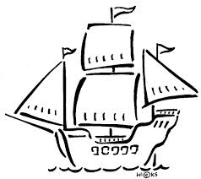
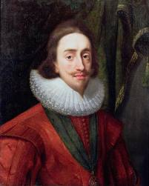
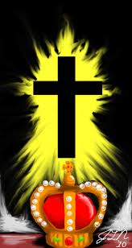
WALT: What Best explains why the English Civil War started?

Slide 2
WALT: What Best explains why the English Civil War started?

Slide 3
Causes
n 1625, Charles went to war with Spain and lost | In 1629, Charles locked MP's out of Parliament for 11 years | Charles was arrogant and conceited and would not listen to the opinions of others
Many in England feared that Charles favoured the Catholics too much - after all, he was married to a Catholic | Charles firmly believed in the divine rights of kings and that it was his right to run the country as he wished | Since Henry VIII there had been problems over religion and Charles could not hope to keep everybody happy
Charles spent a great deal of money on works of art by Rubens and Van Dyck | There was a general belief in the country that Parliament should have more say in how the country was run | In 1640, Charles fought a war against the Scots and lost. He had to pay the Scots to leave England
In 1626, Parliament refused to raise money for Charles | Many feared that the children of Charles were being secretly brought up as Roman Catholics | England had general money problems in the 1620's to 1640's. Charles should have set a better example to his people with regards to spending
In 1628, Charles went to war with the French and lost | Charles had too many favourites at court - he listened only to their advice | In 1634, Charles extended Ship Money throughout the country

Slide 4
Assessment Mark Scheme
4 | Remembered and Described the reasons why the English Civil War started. Described some of the main events of the English Civil War.
5 | Started to explain the reasons why the English Civil War started. Explained the chain of events in the story of the English Civil War. Explained in your conclusion why one cause was in your opinion more important than the others.
6 | Explained in depth the reasons for the start of the English Civil War Started to analyse the events in the story of the English Civil War.. Reached a supported conclusion explaining your choice of the most important causes using some revised knowledge and understanding.
7 | Explained the reasons for the outbreak of the English Civil War evaluating consistently. Fully analysed the events of the English Civil War and linked this analysis to your argument and conclusion. Reached an evaluated and supported conclusion to the question supported by clear and consistent argument, analysis and evidence.

Slide 5
Writing Frame
In my opinion, the most important reason why the English Civil war started was
This was a very important reason because
Another reason why the English Civil War started was
This was also very important because
There were several other reasons why the English Civil War started including;
Probably the least important reason why was
This is less important because
In conclusion the English Civil war is best explained by……. I believe this because..........

