Slide 1
starter
What is the purpose of a castle – Who do you imagine lived in one during Norman times?

Slide 2
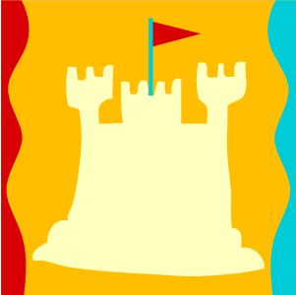
WALT: Who lived in a Castle and what was life like?
WILF:
L3 – a simple model of life in a castle, sheet a little information about life.
L4 – A good model of life in a castle and your sheet has lots of description about life in a castle.
L5 – An imaginative model, you’ve used symbols to represent and explained what they mean.

Slide 3
Who lived in a castle
Remember the Feudal System, who do you think lived in Castles. There were hundreds built by the Normans. They didn’t all house the King…
Norman Lords! The vast majority of Norman Castles were built by William’s lords and were guarded by the Lords’ personal armies.
Can you imagine what the defeated English felt about the Castles.
It was to the Castle that a peasant went to pay taxes, to seek justice and to offer services.

Slide 4
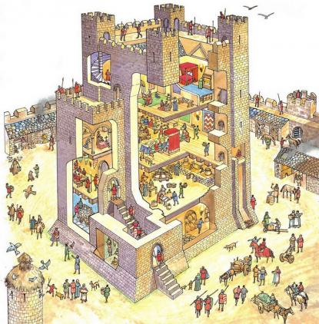
What was life like
What can you see happening in this castle.

Slide 5
Task – Homework
This is a class project. We will present information about Castles two weeks after half term (07/03/14). This requires research over half term.
For the first lesson back (28/02/14) I need you to have researched the following about Norman Castles; ideally your research will involve visiting one of the many Norman Castles in Kent.

Slide 6
task
You will now have time as a Group to create a worksheet of information for Year 6’s that have never seen a castle before.
You will need to include lots of information about Daily life in a Castle.
You will need to create some models for them using the PlayDoh – You need to put information around the model explaining what it is you have made and what it represents.
L3 – a simple model of life in a castle, sheet a little information about life.
L4 – A good model of life in a castle and your sheet has lots of description about life in a castle.
L5 – An imaginative model, you’ve used symbols to represent and explained what they mean.

Slide 7
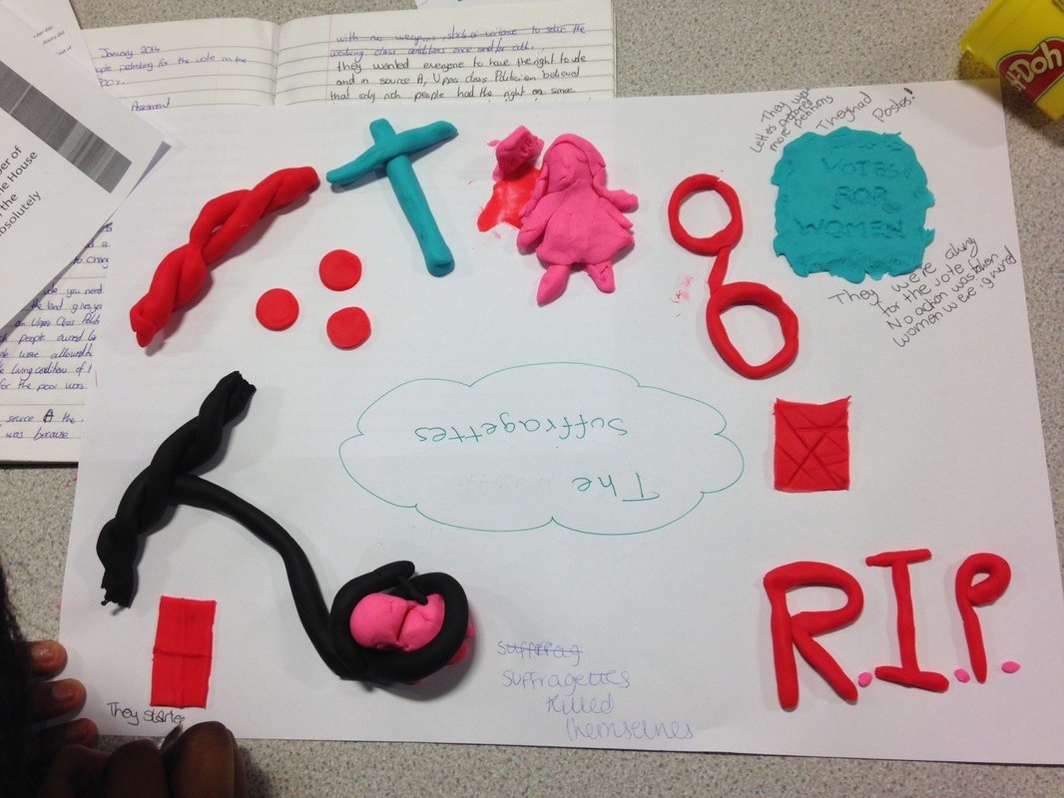
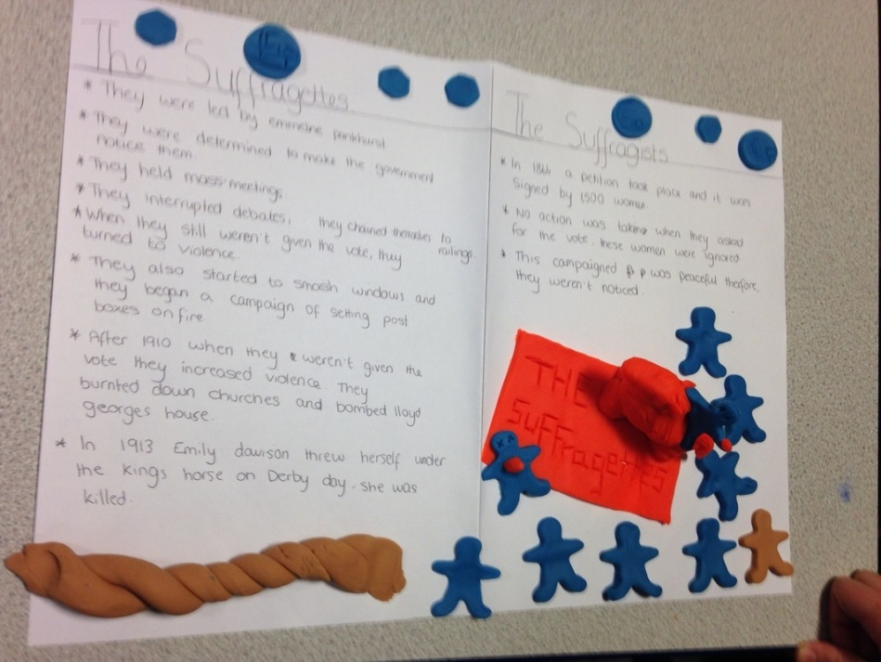
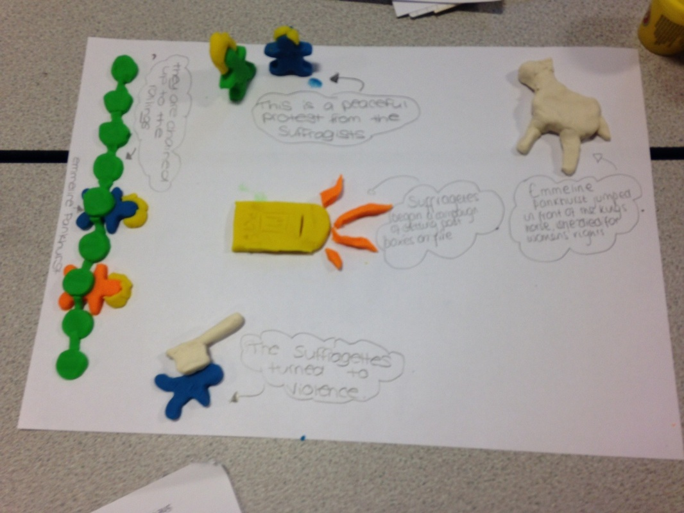
Who lives in a castle?
How many?
Who does what in a castle?
Soldiers?
Lords?
Servants?
How could you represent this?

Slide 8
Often, the lord was granted possession of more than one lordship or earldom so had to divide his time among all of his properties. His powers were political, judicial, fiscal, and also included the policing of his territory. Like his king, he could mete out punishment, collect rent from his subjects, and even mint his own coins.
When the lord had obligations that took him away from the castle, as was frequently the case, his main representative was the steward, also called the seneschal. The steward actually had substantial power of his own, because he had to know virtually everything that went on at the castle and in the surrounding estates. So, he had to be skilled at accounting and legal matters, as well as personnel management.
Other key members of the household staff included the chamberlain (in charge of the great chamber/hall), the chaplain, the keeper of the wardrobe, the butler (also known as the bottler, he ensured there was enough drink stored in the buttery), the cook, the chandler (who made candles), and the marshal (who was in charge of the stables). Each of these individuals had their own staff to manage.
The lady of the castle was served by ladies-in-waiting and chambermaids. She spent much of the day overseeing their work, as well as supervising the activities in the kitchen staff. The lady also kept an eye on her large group of spinners, weavers, and embroiderers who had the enormous responsibility of keeping everyone clothed, and offering the lady companionship. In addition, the ladies were responsible for educating the young pages who, at the age of 7, came to the castle to learn religion, music, dance, hunting, reading, and writing before moving into knight's service as squires.
At 14, young boys became squires, and the lord placed them under the guidance of a knowledgeable knight who would teach them about chivalry as well as how to wield a sword or ride a horse into battle. A youth's ultimate goal was knighthood, which could be attained at the age of 21 when the boys officially became men. Many knights became highly skilled warriors and spent peacetime traveling to tournaments to pitch themselves into individual combat with other aspiring knights. The tournaments were good training grounds for real warfare.
When a group of soldiers was stationed at a castle, they comprised its garrison. Individual members included the knights, squires, a porter (to tend the main door), guards, watchmen, and men-at-arms. All were prepared to defend their lord and his household in an instant. Each soldier had his own place in an attack and his own skill to rely upon. Some were crossbowmen, archers, lancers, or wielded swords. Medieval warfare was definitely a highly complex process, despite the simplicity of the weapons.
Castles must have been noisy - and smelly - places. Livestock roamed inside the stables, blacksmiths clanged out ironwork in the forges, the soldiers practiced their skills, and children played when lessons were completed. Various craftsmen worked diligently in the inner ward, including cobblers (making shoes), armorers, coopers (who made casks), hoopers (who helped the coopers build the barrels), billers (making axes), and spencers (who dispensed).
The interior walls were used to support timber structures, like the workshops and the stables, and, sometimes, stone buildings also leaned against the walls. Fires burned. The well and cisterns offered water. Servants were constantly bustling, taking care of the personal needs of the household, but also finding time for gossip and flirtation.
At mid-morning, dinner was served. This was the main meal of the day, and often featured three or four courses, as well as entertainment. After dinner, the day's activities would resume, or the lord might lead his guests on a hunt through the grounds of his nearby deer park. Recreation was never ignored!
The evening meal, supper, was generally eaten late in the day, sometimes just before bedtime. While not as formidable as dinner, this meal ensured residents would never be hungry when they settled down to sleep off the day's labors.
We can only imagine that, though the people worked hard during the Middle Ages, they also compensated by playing hard. Holidays were times for letting loose of inhibitions and forgetting the stresses of life. The peasants as well as the castle's household found time for pleasure, and made up for their struggles as best they could. In this modern age of technological convenience, we must admire their perseverance.

Slide 9
Plenary
Now tell someone else in the room as many facts about Daily Life in a Castle as you can.
Let them add to your list. Can you remember everything you have learnt between you?

