Slide 1
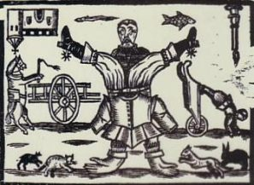
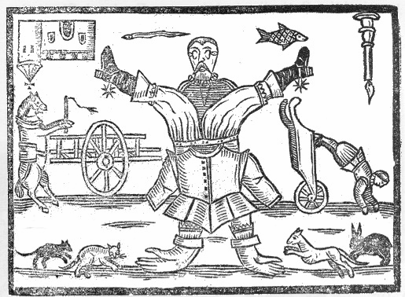
How many odd things can you spot in this picture? Make a list in your book (There are at least 8!)
What title would you give this picture?
What message do you think the cartoonist is trying to send?

Slide 2
Title: What caused the English Civil War?
Term Focus: What caused a country to divide itself in two?
Learning Objectives
4 – Describe what caused the English Civil war.
5 – Explain why one causes is more important than another.
6 – Compare multiple causes of the English Civil War.
6A – Compare and give links between different causes of the English Civil War

Slide 3
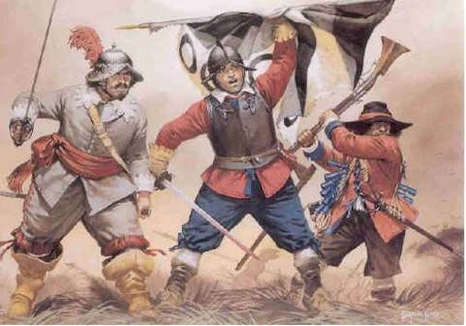
The English Civil War
On 22 August 1642, thousands of Englishmen went to war. They were not fighting the French, the Spanish, or any other foreign country. They were fighting each other – England was at war with itself!

Slide 4
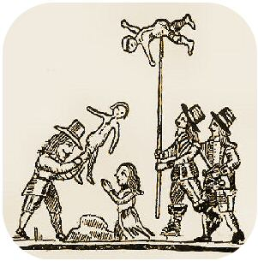
Why would Englishmen fight each other?
An estimated 250,000 people were killed during the English Civil War.
How had a situation arisen in which men were prepared to kill each other, their friends, and even members of their own families?

Slide 5
Causes of the
Civil War
Religion
Power
Draw a Venn diagram like this in your books – use two pages!
Charles spent a great deal of money on works of art.
Money

Slide 6
Causes of the English Civil War
1. Read each cause box and decide which of the following categories it fits into:
Religion - Power - Money
2. Copy the information from the cause box onto the correct part of your Venn diagram. Use the overlaps for reasons which might fit into more than one category.

Slide 7
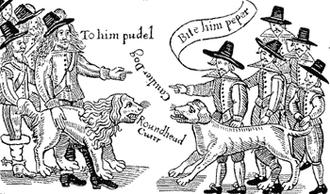
What caused a country to divide itself in two?
Make a decision – which reason was most important in causing the civil war?
Write a short statement explaining your decision. You might want to start like this:
I think the most important cause of the civil war was …………………………
because ……………………………………………………………………………
……………………………………………………………………………………………………………………………………………………………………………

Slide 8
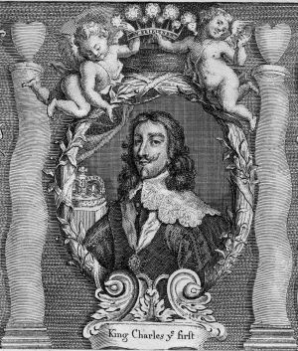
What would you have done?
Put yourself in Charles’ shoes!

Slide 9
L4 - Cover your ven diagram. Can you describe in your own words, what caused the English Civil War. Write a statement from the King’s supporters, why would they be annoyed. Then write a statement from the Parliamentarians. Why would they be annoyed?
L4 - Cover your ven diagram. Can you describe in your own words, what caused the English Civil War. Write a statement from the King’s supporters, why would they be annoyed. Then write a statement from the Parliamentarians. Why would they be annoyed?
L4 - Cover your ven diagram. Can you describe in your own words, what caused the English Civil War. Write a statement from the King’s supporters, why would they be annoyed. Then write a statement from the Parliamentarians. Why would they be annoyed?
L4 - Cover your ven diagram. Can you describe in your own words, what caused the English Civil War. Write a statement from the King’s supporters, why would they be annoyed. Then write a statement from the Parliamentarians. Why would they be annoyed?
L4 - Cover your ven diagram. Can you describe in your own words, what caused the English Civil War. Write a statement from the King’s supporters, why would they be annoyed. Then write a statement from the Parliamentarians. Why would they be annoyed?
L4 - Cover your ven diagram. Can you describe in your own words, what caused the English Civil War. Write a statement from the King’s supporters, why would they be annoyed. Then write a statement from the Parliamentarians. Why would they be annoyed?

Slide 10
L5 - Cover your ven diagram. Can you explain in your own words. Why was religion, power and money causes of the English Civil War. Write a paragraph explaining your answers.
L5 - Cover your ven diagram. Can you explain in your own words. Why was religion, power and money causes of the English Civil War. Write a paragraph explaining your answers.
L5 - Cover your ven diagram. Can you explain in your own words. Why was religion, power and money causes of the English Civil War. Write a paragraph explaining your answers.
L5 - Cover your ven diagram. Can you explain in your own words. Why was religion, power and money causes of the English Civil War. Write a paragraph explaining your answers.
L5 - Cover your ven diagram. Can you explain in your own words. Why was religion, power and money causes of the English Civil War. Write a paragraph explaining your answers.
L5 - Cover your ven diagram. Can you explain in your own words. Why was religion, power and money causes of the English Civil War. Write a paragraph explaining your answers.

Slide 11
L6 - Cover your ven diagram. Can you compare different causes of the English Civil War. Why was one cause MORE important than another? Can you show the links between each causes with examples?
L6 - Cover your ven diagram. Can you compare different causes of the English Civil War. Why was one cause MORE important than another? Can you show the links between each causes with examples?
L6 - Cover your ven diagram. Can you compare different causes of the English Civil War. Why was one cause MORE important than another? Can you show the links between each causes with examples?
L6 - Cover your ven diagram. Can you compare different causes of the English Civil War. Why was one cause MORE important than another? Can you show the links between each causes with examples?
L6 - Cover your ven diagram. Can you compare different causes of the English Civil War. Why was one cause MORE important than another? Can you show the links between each causes with examples?
L6 - Cover your ven diagram. Can you compare different causes of the English Civil War. Why was one cause MORE important than another? Can you show the links between each causes with examples?

Slide 12
Causes of the
Civil War
Religion
Power
Money

Slide 13
In 1625 Charles went to war with Spain and lost. | In 1629 Charles locked MP’s out of Parliament for 11 years. | In 1628, Charles went to war with the French and lost.
Many in England feared that Charles favoured the Catholics too much – after all her married one. | Charles firmly believed in the divine rights of kings to rule as he wished. | Since Henry VIII there had been many religious problems. Charles couldn’t keep everyone happy.
Charles spent a great deal of money on works of art. | In 1626 Parliament refused to raise money for Charles. | In 1640 Charles fought a war against the Scots and lots. He had to pay the Scots to leave.
Many feared that the children of Charles were being secretly brought up as Catholics. | There was a belief in the country that Parliament should have more say in how the country was run. | England had money issues. Charles shouldn’t have spent so lavishly.
Charles was arrogant and would not listen to the opinions of others. | Charles had too many favourites at court – he listened only to them. | Charles forced his way in the House of Commons BUT failed to arrest 5 MPs.
Charles decided to rule without Parliament after they would not give him the taxes. | Archbishop Laud tried to end Puritan ideas in the Church of England. | Archbishop Laud introduced a new prayer book to Scotland. They didn’t like it!
Charles used fines and ship money to raise money without Parliament’s agreement. The people were angry. | Charles called for all his loyal subject to join in a war against Parliaments supporters. | Elizabeth I had been a strong and fair ruler. Charles was not respected.

