Slide 1
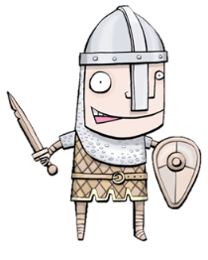
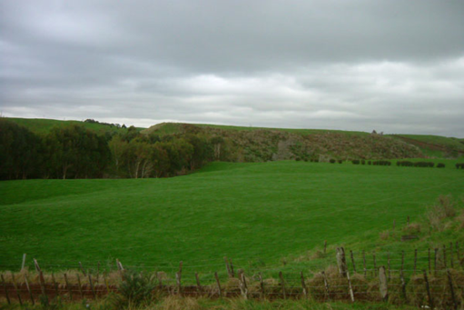
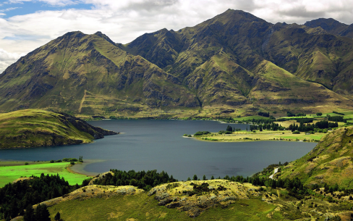
Rally table
On one sheet of paper in front of you. WRITE ONE THING DOWN AND PASS IT AROUND.
What can you remember from last week about Settlements…
EXTENSION - What makes a good place for a Settlement?
WALT: How are Settlements planned?

Slide 2
WALT: How are Settlements planned?
L4 – Describe the different Settlement Shapes
L5 – Explain why they were built in these shapes.

Slide 3
Settlement recap
Water
Not too much water…
Flat land
Sheltered
Materials
Stone and wood
Protection

Slide 4
Settlement shapes
Linear Settlement – Buildings are along a road or another feature
Nucleated Settlement – Buildings are grouped together around a focus point. IE Bridge or Crossroads.
Dispersed Settlement - where few buildings are spread over a large area

Slide 5
White boards

Slide 6
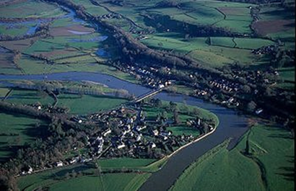
White boards

Slide 7
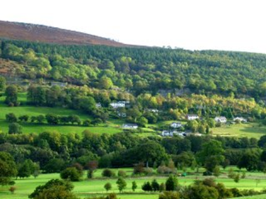
White boards

Slide 8
Around the room
Around the room are several pictures and images – Write on the sheet what type of settlement you think it is.
N – For Nucleated
L – For Linear
D – For Dispersed

Slide 9
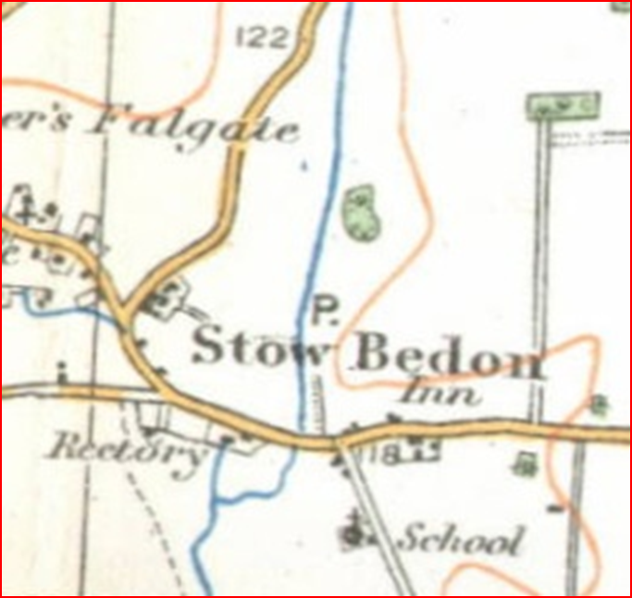
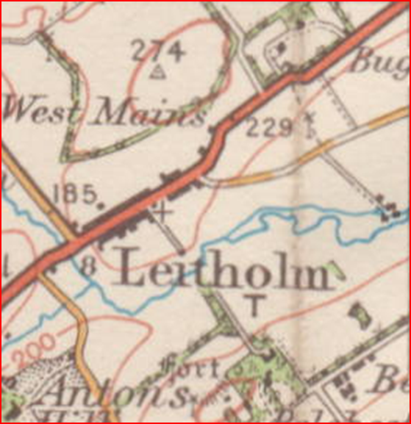

Slide 10
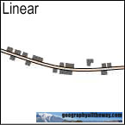
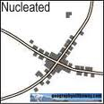

Slide 11
Now create your own
EXT: Describe in your own words why your layout is Linear, why your layout is Nucleated!
Draw your own version of a Linear
& Nucleated Town You must include
the following;
At least;
A Road, River & Bridge
Church
A Visitor & Parking Site
P
V
3 Dwellings

Slide 12
QQT
QQT KEY WORDS!

