Slide 1
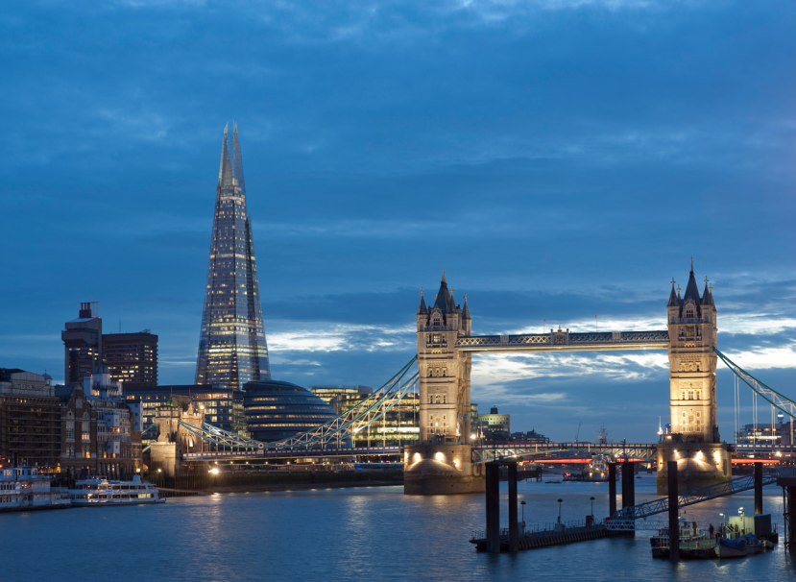
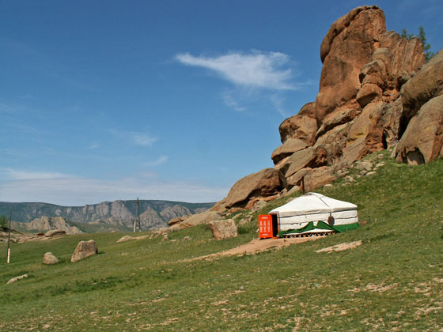
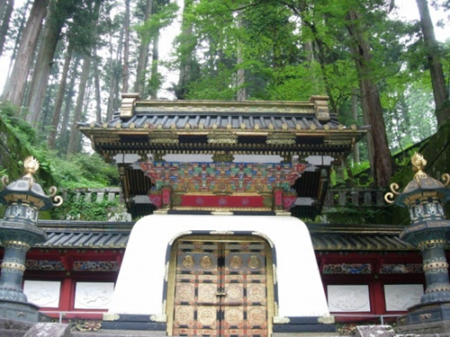
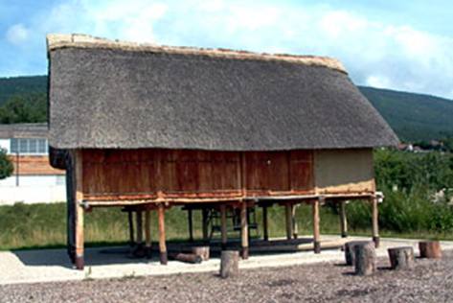
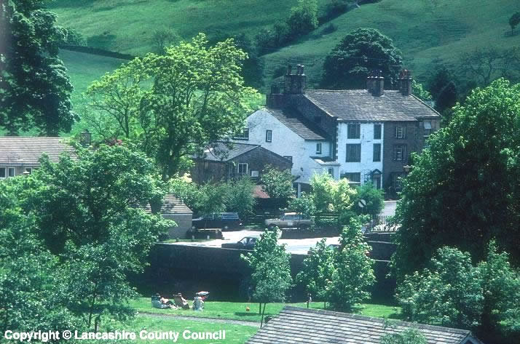
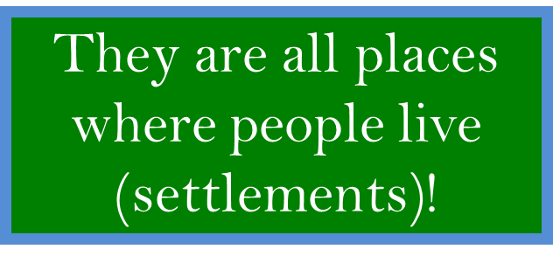
What do all of these have in common?

Slide 2
WALT: What makes a good place to live?
L4: Describe the location of a settlement
L5: Explain what makes a good location for a settlement

Slide 3
Key Words
Settlement – a place where people live (town, village or city)
Site – the land a settlement is built on
Dwelling – a building to live in (like a house or flat)

Slide 4



You are a Norman settler before the times of nice homes with running water and heating.
What natural (NOT MAN MADE) factors would influence where you would build your settlement?
Think!
There is no running water, bricks, internet, electricity etc.
Where are you going to get water from?
Where are you going to get heat for cooking and keeping warm?
Where are you going to get building materials?
What does the land need to be like to build on?
How are you going to get food?
Natural factors influencing settlement site.

Slide 5
PROTECTION: Good views from a hill top give you warning if you are about to be attacked.
WATER: Needed for drinking, cooking and washing. Water might come from a river, spring or well. NOT TOO MUCH – Sites must not floor or be marshy
WOOD: Needed for fires for warmth and to cook on
Natural factors influencing settlement site.
RIVERS : Easy to cross either on foot at a ford or by a bridge.
MATERIALS: Needed wood or stone. Useful to be near a wood or a rocky hillside.
SHELTER: A South facing slope will have more sun and will be protected from the cold north wind
FLAT: Easier to build on, for growing crops and travelling to other towns.

Slide 6

TASK
Imagine you are an Early Norman Settler and are looking for a place to live.
1. Look at the images and write down the natural advantages (good site factors and disadvantages (bad site factors). (level 4)
2. As a group decide and explain which site you would choose. (level 5+)

Slide 7
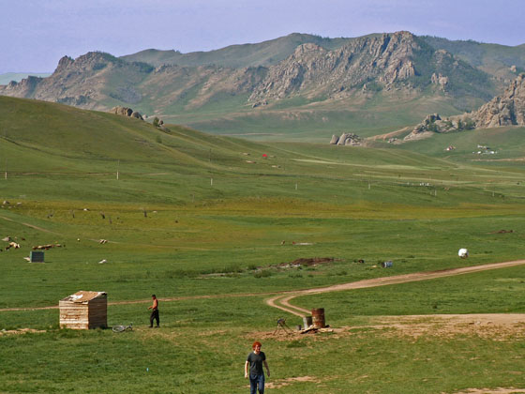
Most of the land here is flat with the hills behind. A small river runs through the land. The land is great for grazing cattle but the soil is not very fertile.
A
Rocky hillside
River runs through hills
Hard ground
Some flat land

Slide 8
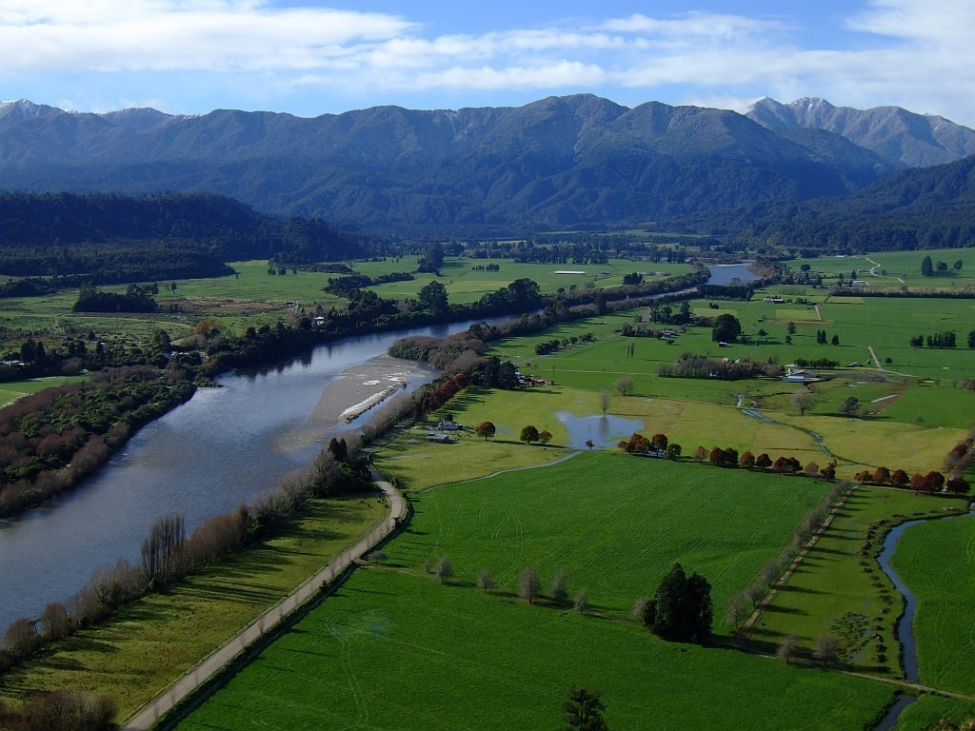
The land is very flat. There is a river next to the land. The land has very good soil. There are hills not too far away.
B
Hilltop (not south facing)
River
Flat land
Rich soil
Notes:
Ask- How could the flooding problem be overcome.

Slide 9
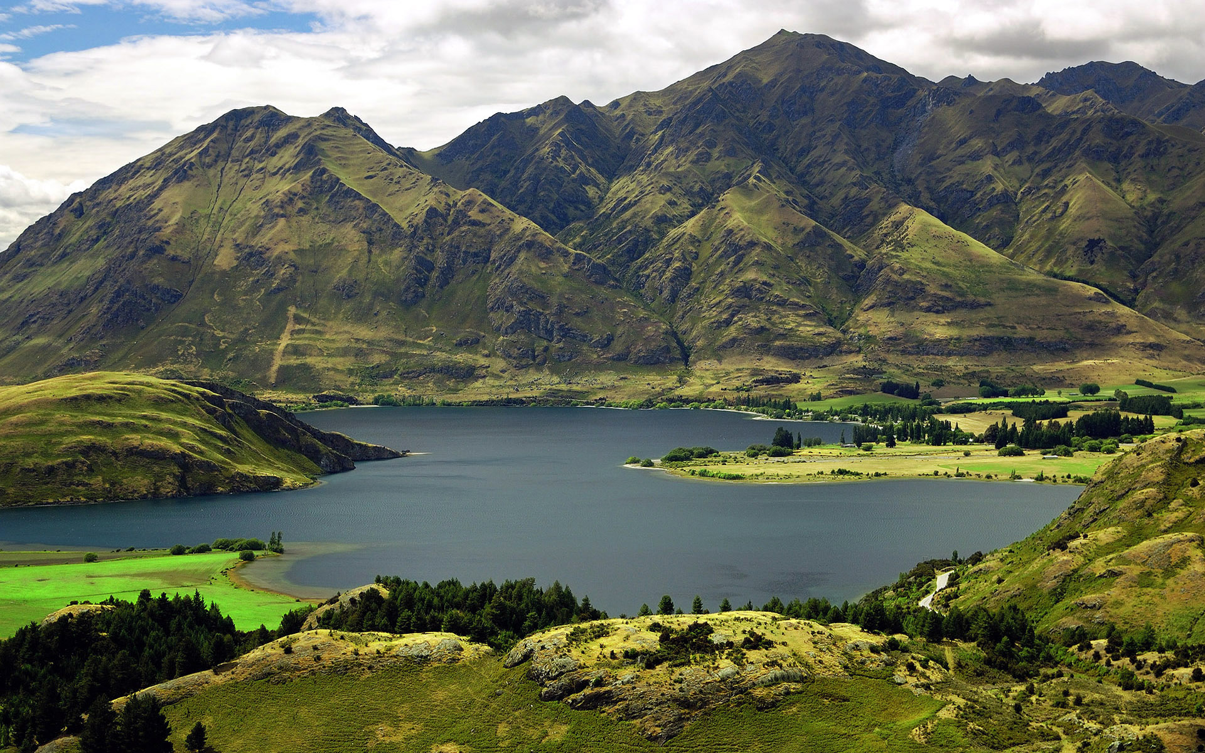
The land is here is very hilly and the ground is hard. There are lots of areas of trees and a large lake which receives fresh water from the mountains.
C
South facing
Mountains
Areas of forest
Lake
Poor soil

Slide 10
The land is very flat. The area is very open and there is only a small area of forest.
D
Area of forest
Good fertile soil
Flat land

Slide 11
Key Words QQT
STAND UP and MOVE AROUND, ask someone the Question on your card and wait for them to answer. Try and help them if they don’t know.
They ask you their Question.
Swap Cards and move on, find someone else!

Slide 12
Homework!
Think of your hometown.
Describe why it would have originally been built.
Is it near a river, is it flat, is it hilly etc?

