Slide 1
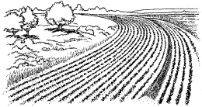
STARTER
URBAN
RURAL
Trees
Fields
Skyscraper
Parks
Cities
Forest

Slide 2
WALT- What is the difference between Rural & Urban?
L3 - List the difference between Rural & Urban
L4 - Describe the differences between them.
L5 - Explain why they are different!

Slide 3
Key Words
Urban – A developed area
Rural – Countryside.
National Park – A rural area of natural beauty protected by law.
Flora – Plant Life
Fauna – Animal Life

Slide 4
National Parks
There are currently 15 National Parks in England, Scotland and Wales.
They are areas of outstanding natural beauty with protected landscapes and breath taking scenery.
Rich with historical and geographical features each park has a unique character, diverse flora and fauna (Plants and Animals) & plentiful facilities for visitors and tourists.

Slide 5
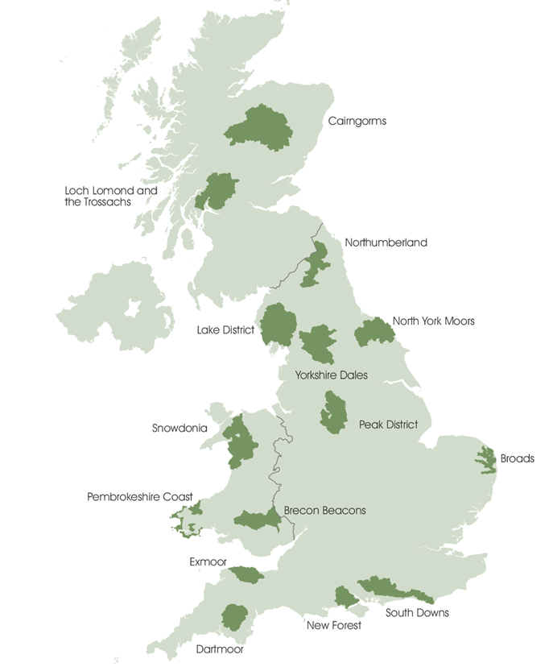

Slide 6
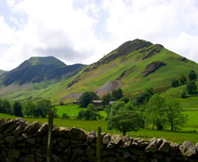
The Lake District
The Largest of the National Parks.
England's Highest Peak.

Slide 8
Diary Task.

