Slide 1
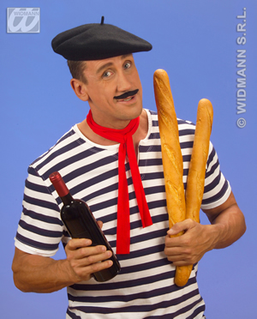
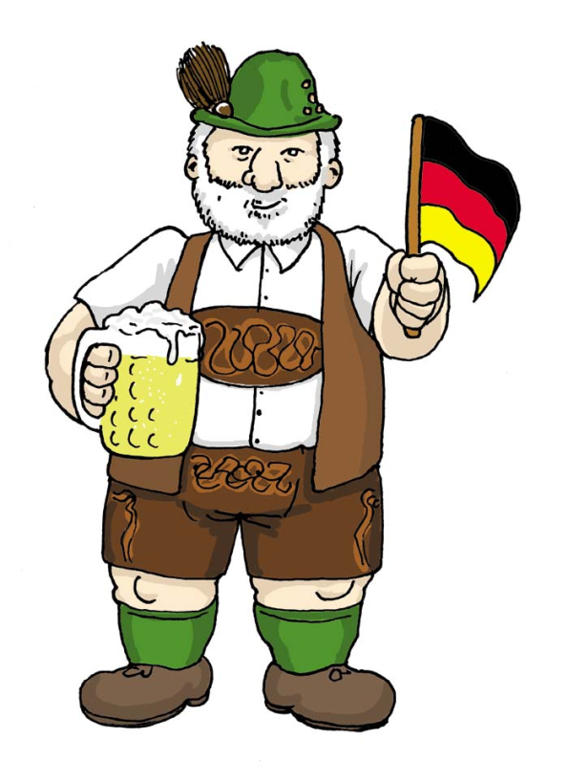
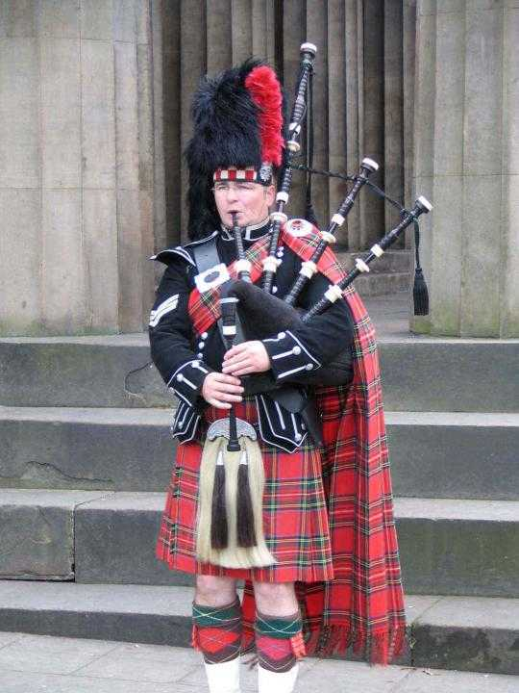
Where are the Stereotypes from ?
1
3
2
4

Slide 2
? ? ? ?
PARIS IMAGE

Slide 3
? ? ? ?
NY IMAGE

Slide 4
? ? ? ?
LONDON IMAGE

Slide 5
WALT: What can I do to sell a city to a tourist.
WILFS: Create a brochure advertising a city in the UK.

Slide 6
Brochure
Your Task is to create a brochure to advertise a city of your choice to a tourist visiting the United Kingdom?
What do you think it needs to include?
You will be planning a guided tour of the City.
You need to research what sites of interest are available in your chosen City.
What can the visitor do while they are visiting?

Slide 7
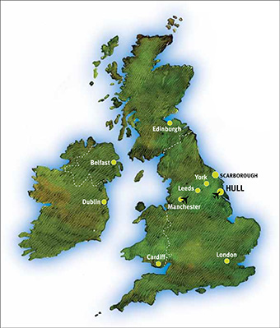
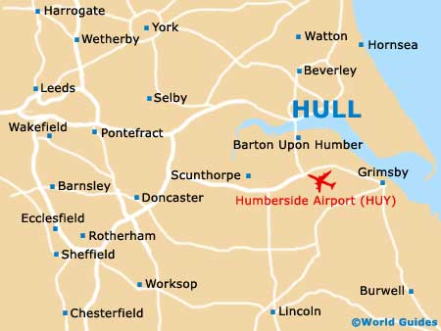
HULL
A MAP

Slide 8
Some information about Hull
Hull has been named the UK’s next City of Culture from 2017.
Hull was founded in the 12 Century, it gained City status in 1897
Hull is about 215 miles from London and will take about 3 hours to drive.

Slide 9
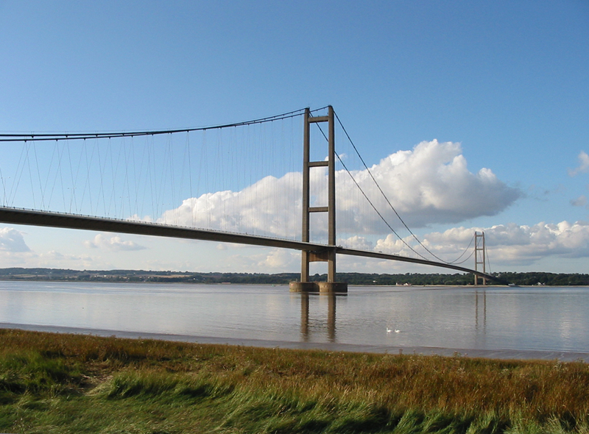
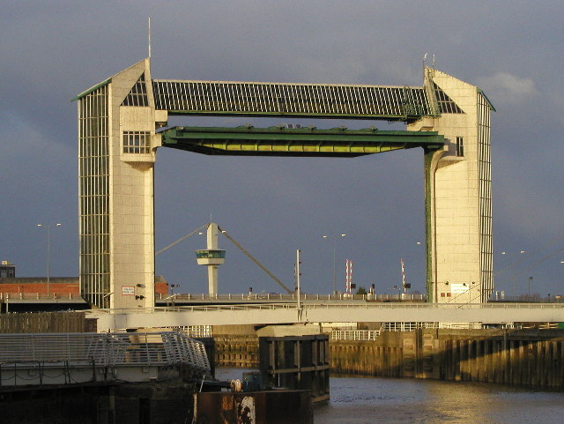
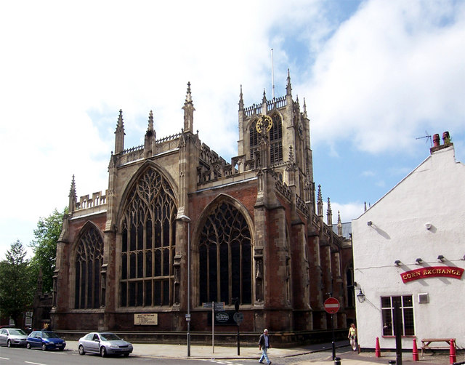
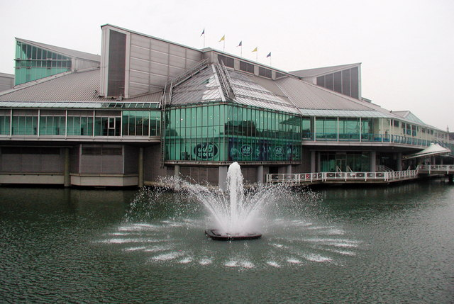
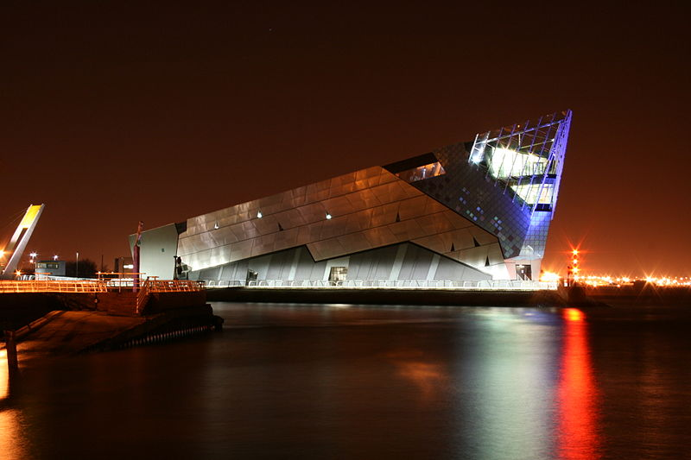
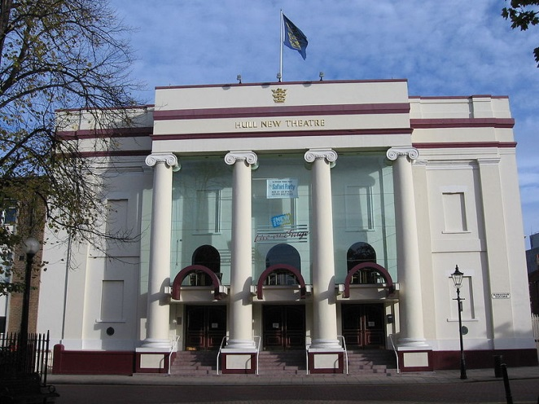
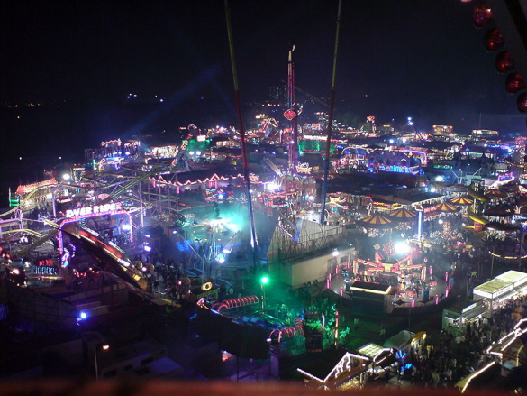
Why would you visit?
Holy Trinity Church // River Hull tidal barrier // Prince’s Quay Shopping Centre // The Deep // The Hull New Theatre // The Hull Fair // Humber Bridge

Slide 10
What do I need to include.
Some History.
Location.
Where can I stay.
What can I do.
What can I eat!
How is your City identified?

