Slide 1
TITLE: What effect did World War One have on Germany?
L.O 1: I can identify the conditions Germany faced in 1918.
L.O 2: To evaluate the options Germany had for her long term recovery
Starter: On your white board draw a picture to summarise the effects of WW1 on Germany.
Be prepared to explain!

Slide 2
25%, 1h15m, 6Q 50 m + 4 SPaG
The Weimar Republic 1918–29
Hitler and the rise of the Nazi Party 1919–33
The Nazi dictatorship 1933–39
Nazi domestic policies 1933–39

Slide 3
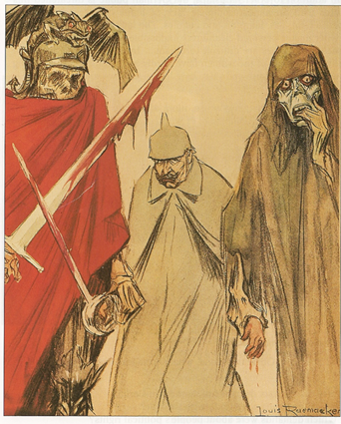
The Kaiser ?
1. Who was the Kaiser?
2. What qualities would be needed for a good leader?
3. How do you think the Kaiser behaved and was viewed in Germany according to the sources?
B
A
“There is only one person who is master
in this Empire and I am not going to
tolerate any other.”
Kaiser Wilhelm II, 1891

Slide 4
L.O 1: I can identify the conditions Germany faced in 1918.
What were conditions like in 1918 and why did Kaiser Wilhelm II abdicate in November?
Be prepared to explain!
Challenge: Make a prediction! What do you think would happen to Germany at the end of the war? Why?

Slide 5
L.O 2: To evaluate the options Germany had for her long term recovery
After conditions worsen in Germany the Kaiser flees to Holland on 9th November 1918. You are to be given source material that identifies the options available to Germany in 1918.
Set up a new constitution defining political power
End the war by signing an armistice
Accept help to rebuild Germany
Task:
Underline and annotate your sources, highlighting the key points.
You are to use these points to argue your case that your option is the most important for the recovery of Germany.
Clearly write your option on your show me board. Circulate the room to present your case and listen to others argument. Has your mind been changed? Mark this on your show me board.

Slide 6
L.O 2: To evaluate the options Germany had for her long term recovery
In your new groups create your argument for debate.
What are the weaknesses of the other groups?
Why is your argument the strongest?

Slide 7
L.O 2: To evaluate the options Germany had for her long term recovery
Q. What should Germany do for her long term recovery? Explain in detail with reference to at least one source what Germany should do for recovery.

Slide 8
Plenary
Write down three questions (easy, medium, hard) from the lesson today.
i.e. what was the name of the Kaiser during WW1?

Slide 9
Independent Study.
Write a reply to Deutsche Zeitung explaining why Chancellor Ebert had to sign the Treaty of Versailles.

Slide 10
Q. What was the Treaty of Versailles?
Read page 7.
Answer the following Questions in full sentences.
What was the Diktat?
Who were the leaders that signed the Diktat?
What were reparations?
Why did Germany have to accept the Treaty?
How did the public react to the Treaty?

