Slide 1
WALT: Define What is Culture and Identity?
WILFs
E - Describe, explain and summarise types of culture/perspectives on culture
C - Assess types of culture/perspectives on culture
A - Evaluate types of culture/perspectives on culture

Slide 2
Remember these?
Norms mores values
Roles achieved and ascribed status
culture rules/laws
deviance sanctions
Write down as many definitions as you can

Slide 3
What is culture?
READING IMAGES
You are about to see a short clip of images linked to culture...in your teams...write down as many as you can!
Hint: there are four on each slide....

Slide 4
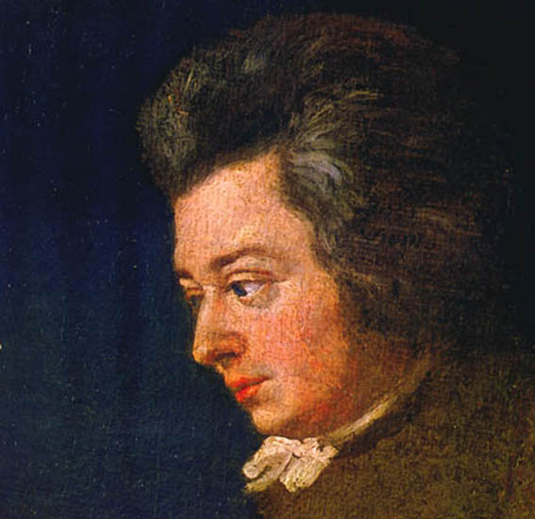
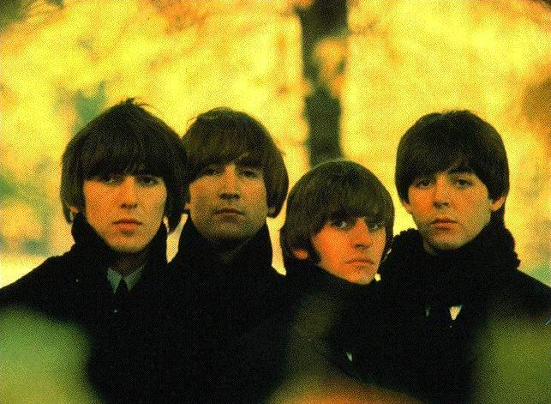
1
3
4
2

Slide 5
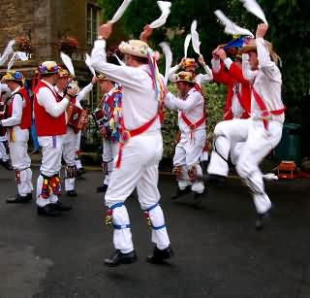
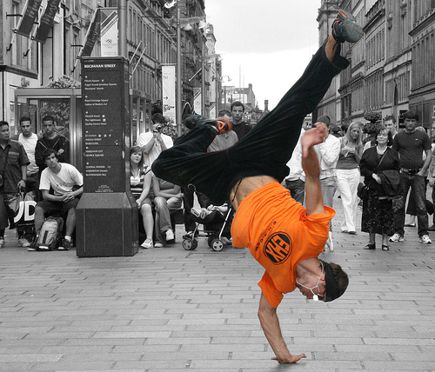
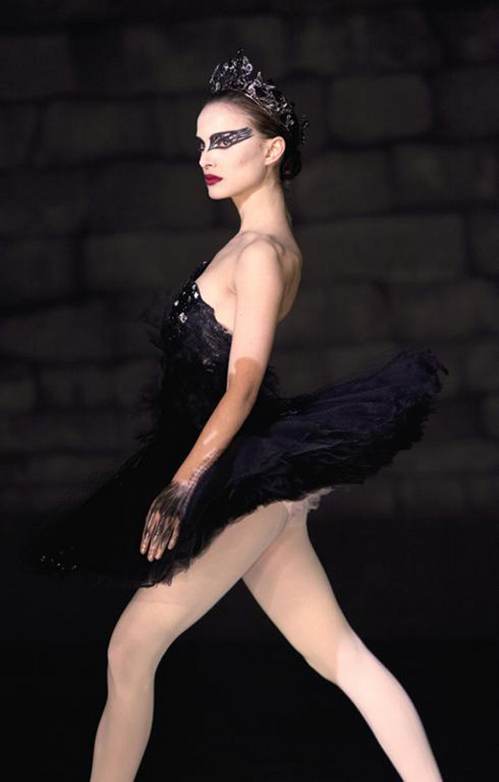
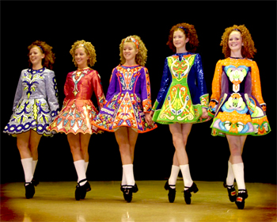
5
7
6
8

Slide 6
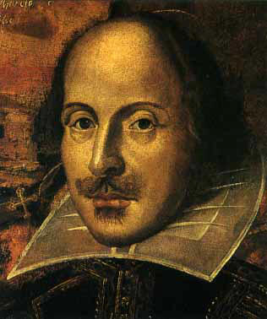
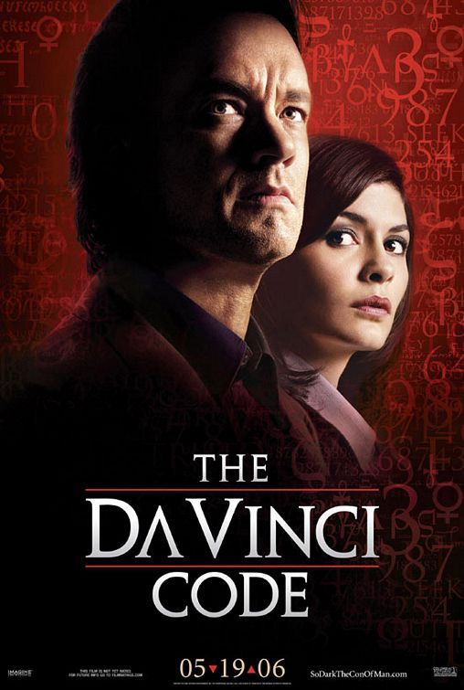
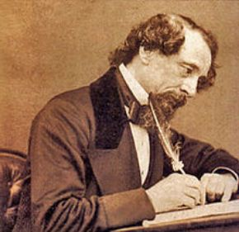
9
11
9
10
12

Slide 7
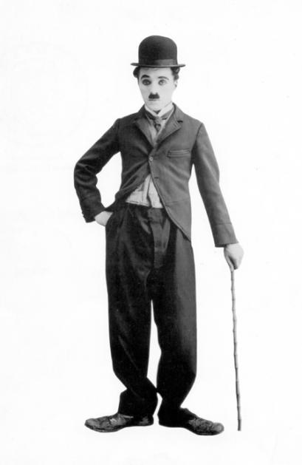
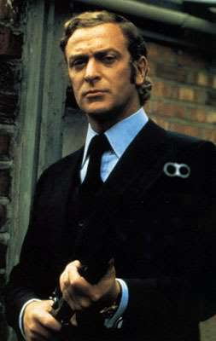
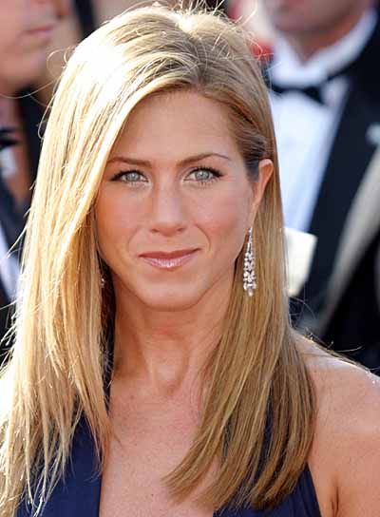
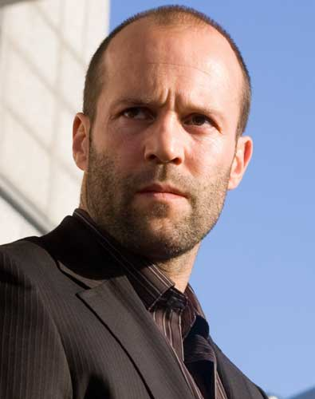
13
15
14
14
16

Slide 8
Did you get them all?
Mozart
Lady GaGa
The Beatles
Tiny Tempah
Morris Dancing
Irish Dancing
Street Dance
Natalie Portman/Black Swan
8. William Shakespeare
Harry Potter
Dan Brown/da Vinci code
Charles Dickens
Charlie Chaplin
Jason Statham
Michael Caine
Jennifer Aniston

Slide 9
Sociological definitions 1
Kidd (2002)
The features of culture (language, symbols, history, norms and values) influence the way members of society live their lives
Abbott (1998)
Language is the most obvious set of symbols through which members of society share meanings
Page 32-33

Slide 10
Sociological definitions 2
Marshall (1998)
Culture is all that in human society which is socially rather than biologically transmitted.
Giddens (1997)
‘No cultures could exist without societies. But equally, no societies could exist without culture. Without culture, no one could be human at all’

Slide 11
Sociological definitions 3
Jencks: 4 main ways
A state of mind – a ‘quality’ possessed by individuals
Civilization – some cultures are seen as more civilized than others
‘Collective body of arts and intellectual work within any society’
‘Whole way of life of a people’

Slide 12
Evaluating definitions
Read through all the definitions
Do you agree with them?
WWW/EBI?

Slide 13
How do we learn our culture?
Identify as many as you can think of
Agents and Agencies
?
?
?
?
?

