Slide 1
WALT: Revise Inequality & Stratification.
E – Define Inequality and Stratification.
C – Describe some of the effects of them
A – Evaluate solutions.

Slide 2
What do they represent…

Slide 3
Social Inequality.
Social inequality refers to the uneven distribution of;
Resources – Such as money and power.
Opportunities related to, for example education, employment and health (‘life chances’.)

Slide 4
Differentiation
Refers to the ways in which we draw sociologically significant distinctions between groups.
Sociology gives a great deal of focus to these inequalities .
In particular, sociologists aim to …
DESCRIBE
EXPLAIN
ADDRESS
SOCIAL THEORY
SOCIAL POLICY
Notes:
Ie Gender, Class inequality etc. Sociologists aim to describe these problems then explain and address them …

Slide 5
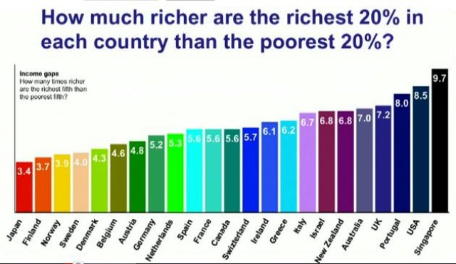
What does this mean?

Slide 6
Stratification.
Refers to the division of society into a pattern of layers made up of a hierarchy of unequal groups.
CLOSED
SOCIAL MOBILITY
OPEN
Research using the websites given on this PPT for your type of differentiations.
Tomorrow you will need to …
You need to research the types of inequalities experienced by the people within the group.
Create a A3 Poster and PlayDoh models to explain what impact your research has had.

Slide 7
Websites…
Sexuality: https://www.stonewall.org.uk/
www.outrage.org.uk
Nationality: www.equalityhumanrights.co
www.ons.org.uk
http://www.ons.gov.uk/ons/rel/migration1/migration-statistics-quarterly-report/august-2012/population-by-country-of-birth-and-nationality.html
Ethnicity: www.ethnicity.ac.uk

