Slide 1
WALT: defend our choice of Sociology.
E – Describe what sociology is.
D – Explain what the benefits of studying sociology are.
B – Evaluate the benefits of studying sociology.

Slide 2
Think-Pair-Share
30 Seconds – Think about what Sociology means to you.
02 Minutes – Pair and Share your ideas.
Q. “What is Sociology about?”

Slide 3
Over to you.
You will be given one set of images. In a small group think about what the images say about society, its relationships and interactions.
Then complete the sentence below on a ‘splat’ card;
“Sociology involves the study of ....”

Slide 4
What is Sociology?
Sociology is the study of people in society.
This means that we look at how people behave as part of a large cultural group.
In order to do this we must understand features of the social group itself.
What Sociology is NOT…
Sociology is not looking at an individual’s behaviour.
Sociology is not a subject that has one answer for any of the questions that it asks.
Sociology is not an easy option.

Slide 5
Who will enjoy Sociology?
You are most likely to enjoy sociology if you have ever thought any of the following things:-
Its not fair that some people are rich and some are poor
Its not fair that some jobs seem easy but pay well while other really hard jobs are poorly paid
Perhaps the world would be much happier if there was only one religion
Will anything ever really change.
Regardless of the answers you came up with regard to these issues you will probably enjoy sociology if you have ever even considered them.

Slide 6
Good & Bad points of Soc.
You are expected to learn new terminology alongside new theories and key research studies.
You are expected to consider things with a great deal of sensitivity and maturity.
You will greatly enhance your communication skills, (both written and verbal)
You will gain a far wider understanding of the world and the country in which you live, this should enable you to appreciate far more about information that you read or see on TV.
You will gain a political awareness that you have probably not yet covered in your education to date.

Slide 7
TASK: What is British Society
Rally Table – What words and values do you associate with British society.
Individually – Summarise British Society in #140 characters or less.
Q. What is British Society like in 100 words or less. How does it differ from Utopia?

Slide 8
TASK: Utopia
Now think and design your perfect utopia.
Think about;
Families
Schooling
Culture
Mass Media
Religion
Legal system
Political system

Slide 9
Question: Are we born Human or do we learn it?
BORN
LEARNT
TASK: Read the Blue Box on P2 of the AS Textbooks and answer Questions 1-5.
BORN
LEARNT

Slide 10
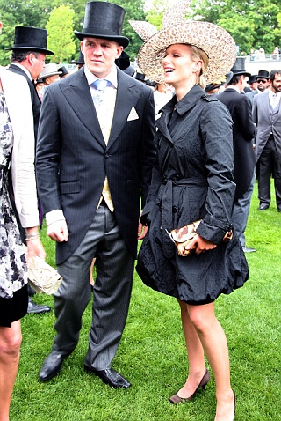
Sociology is the study of society. Sociologists are concerned about many issues and problems in society. Some of the issues and problems we investigate are shown below.
Task
Think about what the images on this page say about society, its relationships and interactions. Then complete the sentence below on a ‘splat’ card.
“Sociology involves the study of ...... “

Slide 11
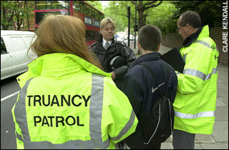
Sociology is the study of society. Sociologists are concerned about many issues and problems in society. Some of the issues and problems we investigate are shown below.
Task
Think about what the images on this page say about society, its relationships and interactions. Then complete the sentence below on a ‘splat’ card.
“Sociology involves the study of ...... “

Slide 12
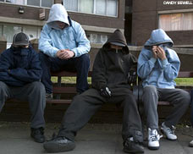
Sociology is the study of society. Sociologists are concerned about many issues and problems in society. Some of the issues and problems we investigate are shown below.
Task
Think about what the images on this page say about society, its relationships and interactions. Then complete the sentence below on a ‘splat’ card.
“Sociology involves the study of ...... “

Slide 13
Sociology is the study of society. Sociologists are concerned about many issues and problems in society. Some of the issues and problems we investigate are shown below.
Task
Think about what the images on this page say about society, its relationships and interactions. Then complete the sentence below on a ‘splat’ card.
“Sociology involves the study of ...... “

