Slide 1
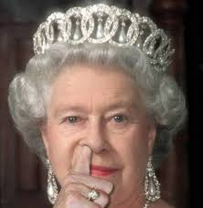
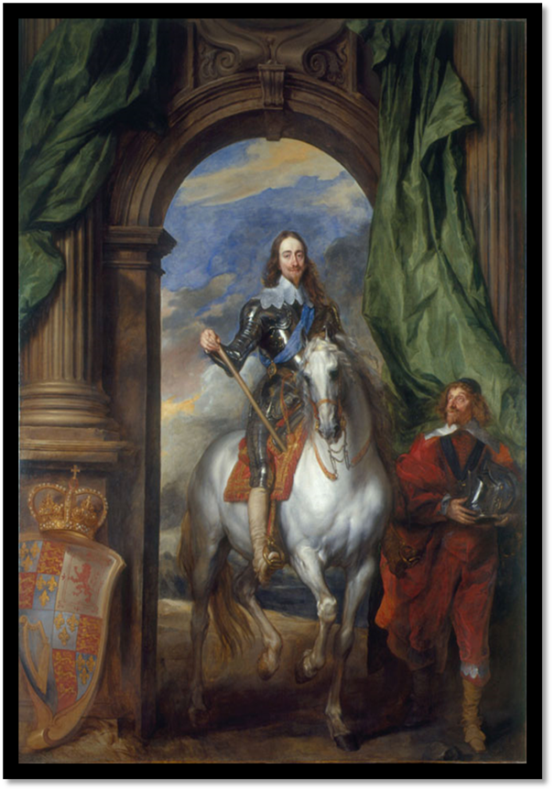
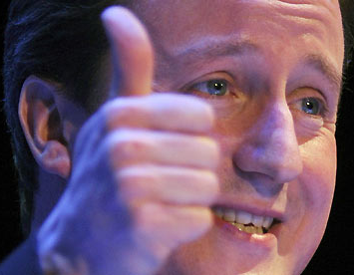
WALT: What was the English Civil War?
Who Governs the United Kingdom today? Write down who you think does what…

Slide 2
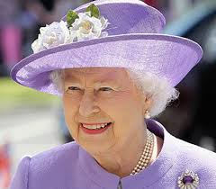
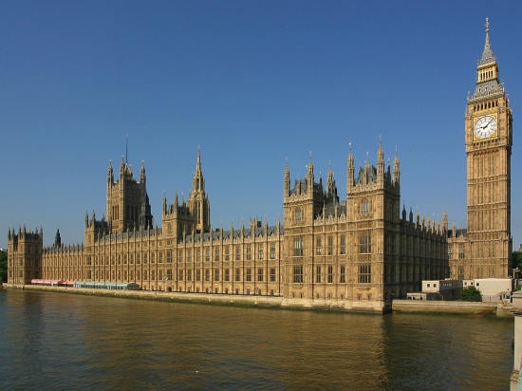
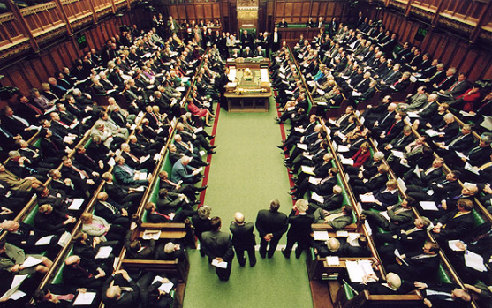
Why is it important…
It is the Reason why the Queen does not govern us today.
It is the reason why we have a Government that we elect to create laws and rule over us.
It resolved the problems between the King and Parliament.
It lead to England EXECUTING a King.

Slide 3
WALT-What was the English Civil War?
WILFS
L4 – Describe who Parliament and the King were.
L5 - Explain whether King Charles was a good or bad King.
L6 – Use Sources and COMPARE evidence on King Charles.

Slide 4
WALT-What was the English Civil War
Parliament – Responsible for making Laws and deciding taxes.
Civil War – A war between organized groups within the same country.
Divine Right – The belief that the King/Queen has the right to rule directly from God.
Parliamentarian – Supporter of the Parliamentary Cause (Roundhead)
Royalist – Supporter of the Monarch (Kings) Cause (Cavalier)

Slide 5
Civil War – Intro… Q. What was it?

Slide 6
In your own words…
Write a description of the situation in the 1600’s – What was the Civil War and who was involved.
The English Civil War (1642-1651) was a series of battles between those loyal to King Charles I (known as Royalists or Cavaliers) and those loyal to Parliament (known as the Parliamentarians or Roundheads). It had many short term and long term causes…
It was not a long continuous war (like WW1 or WW2) but a series of major battles.
It ended with the Public Execution of Charles I and the establishment of a republic…

Slide 7
Source Analysis
Draw this table in your exercise books.
Source | Author + Year | Word’s I don’t understand. | Evidence he was a good King | Evidence he was a bad King
1 | Thomas Macauley 1848 | Domestic | Intelligent / Well Educated | N/A
2 | James Oliphant 1920
3 | Andrey Langley 1993
4 | Educational Website 2005

Slide 8
What you should have had…
Source | Author + Year | Word’s I don’t understand. | Evidence he was a good King | Evidence he was a bad King
1 | Thomas Macauley 1848 | Domestic | Intelligent / Well Educated | N/A
2 | James Oliphant 1920 |  | Handsome / Popular | Stupid and Cold Hearted / Unfit for King
3 | Andrey Langley 1993 |  | Married Sis of France for Peace - Religion | Shy but serious – Got off to bad star
4 | Educational Website 2005 |  | N/A | Unpopular / Arrogant / Conceited.

Slide 9
Sources
Source 1:
Charles I was an intelligent and well educated gentleman. His taste in literature and art was excellent, his manner dignified. His domestic life was without blemish.
“The history of England” by Thomas Macauley — written in 1848 (199 years after Charles I died).
Source 2:
Charles I was a handsome man with cultivated tastes, but he was unfit for the position of king. He was too stupid and cold-hearted to understand or sympathise with the feelings of his people, and events were to prove that he was hopelessly obstinate, self-centred and untrustworthy.
“A history of England” by James Oliphant — written in 1920 (320 years after Charles I was born).
Source 4:
Charles had a very different personality compared to James (his father). Charles was arrogant and conceited. He found it difficult to believe that a king could be wrong. This belief was known as the ‘Divine Right of Kings’, and it made him unpopular.
From an educational website, written in 2005 (more than 400 years after Charles I was born).
Source 3:
The new king was shy, serious and deeply religious. Charles’ reign got off to a bad start. Needing a queen he married Henrietta Maria, the sister of the king of France. She was a Catholic, and Parliament was alarmed that she might make Charles and their children Catholic too.
“The Stuarts” by Andrew Langley. A children’s history book. It was written in 1993.

Slide 10
Sources
1) Which sources tell you that Charles I was a good king?
Source ‘X’ tells me that Charles I was a good king. It says ___
This means that he is a good king because ___
2) Which sources tell you that Charles I was a bad king?
Source ‘X’ tells me that Charles I was a bad king. It says ___
This means that he is a bad king because ___
Extension: Which of his weaknesses might get Charles into trouble with the people of England? Explain why.

Slide 11
Peer Assessment.
Level 4c: If they used only 1 source to describe Charles I as a good or a bad king.
Level 4b: If they used 2 sources to show Charles as a good or a bad king.
Level 4a: If they mentioned 2 or more sources to describe Charles I as a good and a bad king.
Level 5c: If they explained what 1 source means.
Level 5b: If they explained what 2 sources mean.
Level 5a: If they explained what 3 or more sources mean.

Slide 12
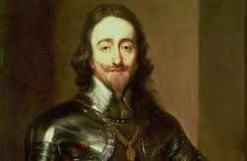
Post It – Was King Charles a Good King or a Bad King – 1 Thing
GOOD Stick in on the Board BAD

