Slide 1
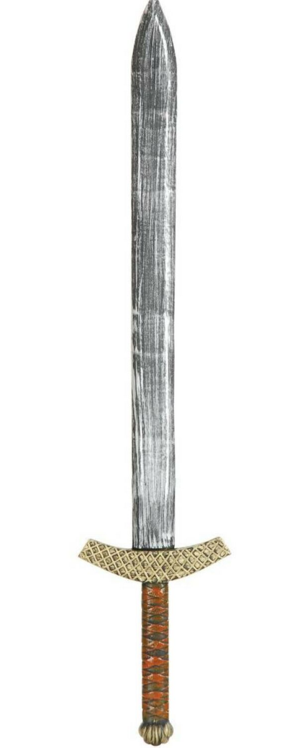
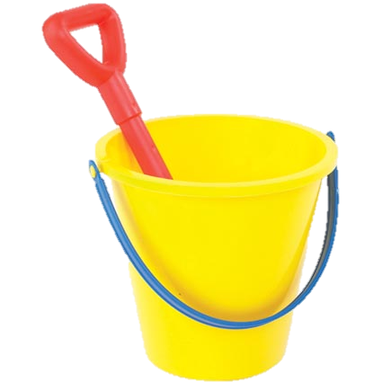
How did William protect himself?
What do the images have to do with control ? Discuss with your table.

Slide 2
WALT: How William used castles to control.
WILFS
L3 – A list of the purposes of a castle
L4 – A description of a Norman Castle
L5 – Explain some of the features of a Castle

Slide 3
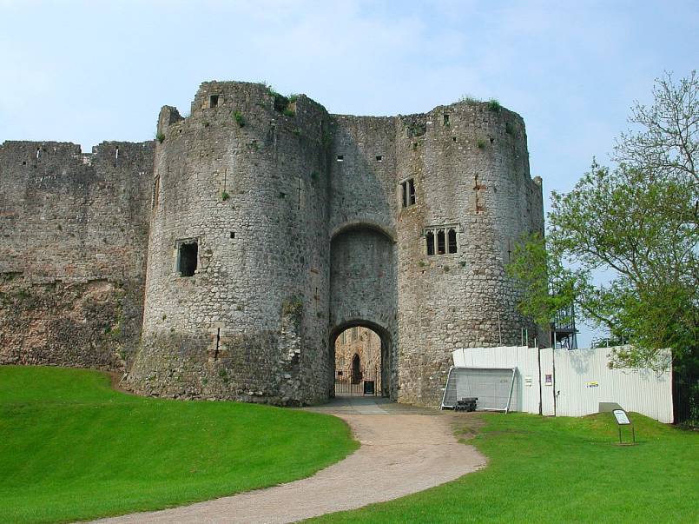
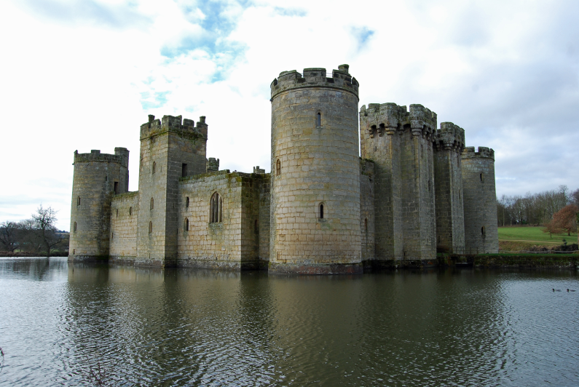
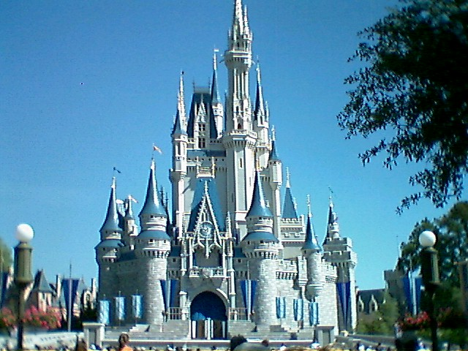
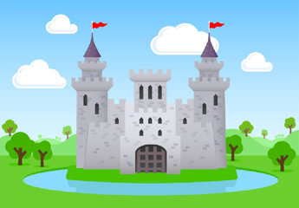
CASTLES

Slide 4
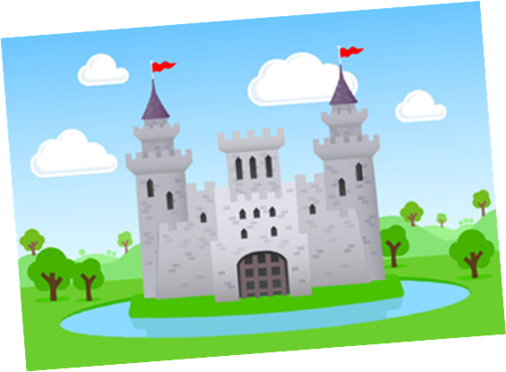
TABLES
Design your own Castle.
You must put arrows around your castle and tell me why you have drawn it that way.
Flags are fun
How else do we get in
Water to drink

Slide 5
SWAP
Swap Pictures with another table.
You’re now invaders… Tell me how you would attack their castle.

Slide 6
Spot-the-Difference
Match the feature of a Norman Castle to the Description.
Come up with some differences between your castle and an early Norman castle.

Slide 7
I’ll forget…
Write down one thing that you will REMEMBER for next week.
Write down one thing that you will FORGET next week.

