Slide 1
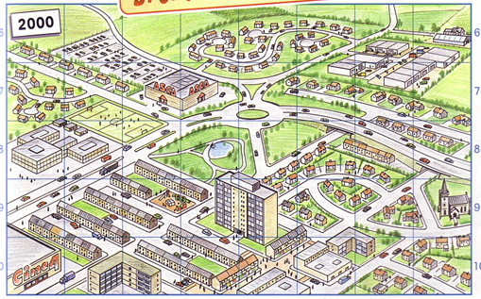
WALT: What are the benefits and problems of settlement growth?
STARTER:
What are the effects of Settlement Growth do you think?

Slide 2
WALT: What are the benefits and problems of settlement growth?.
WILFS:
L4 – Describe the changes that take place.
L5 – Explain why the benefits and problems.
L6 – Compare the benefits and problems.

Slide 3
Complete the Table
List the three things which you think are best about living in cities, and the three things that you think are the worst.

Slide 4
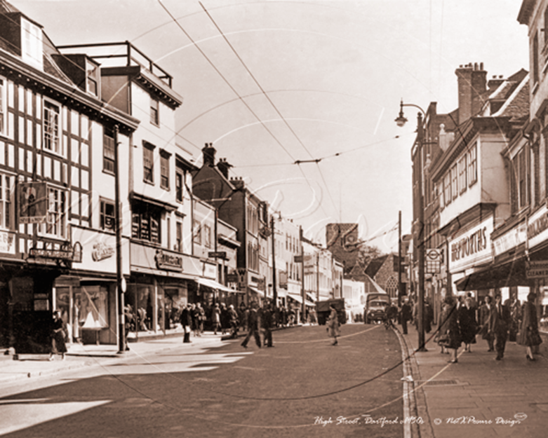
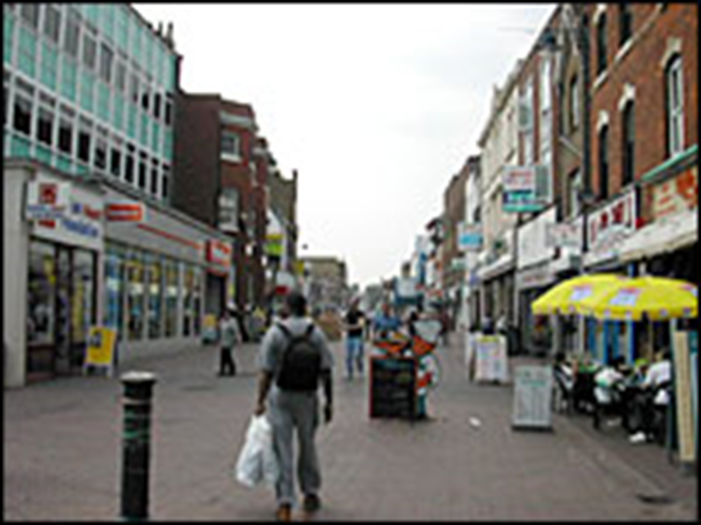
Dartford – Settlement Change.
http://news.bbc.co.uk/local/kent/hi/people_and_places/history/newsid_9137000/9137047.stm

Slide 5
Design a poster to
(a) promote urban living
(b) to highlight problems
Pg 48/49
Think of the following:
Jobs
Technology
People
Shopping

Slide 6
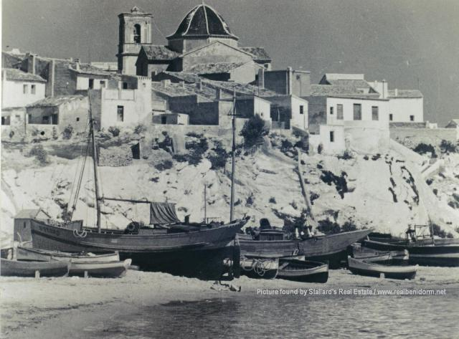
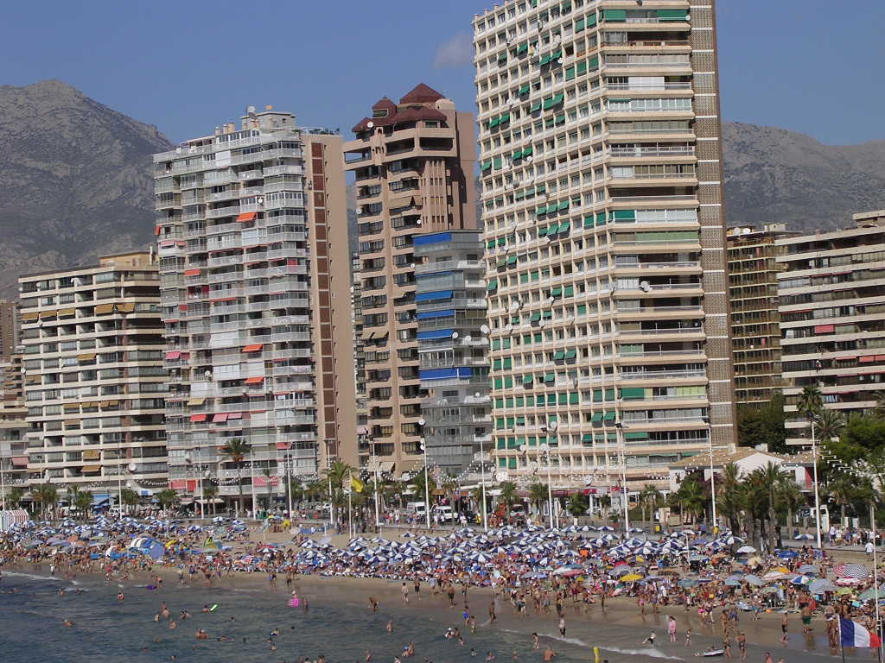
Benidorm – Settlement function.
1930’s
1980’s

